Slide 1
PACIFIC PLANT PROTECTION ORGANISATION (PPPO) UPDATE ON IMPLEMENTED ACTIVITIES
34th TC-RPPO Meeting
From the PPPO Executive Secretary – 22nd September 2022
ABBEY ROOM, UK London

Slide 2
OUTLINE
Introduction
PPPO Implemented Activities
Partnerships/Collaboration
Challenges
Way forward

Slide 3
PPPO Regional ePhyto Programme
Collaboration with Development Partners
Australia & New Zealand Government
Engaged and recruited the ephyto coordinator
Identified countries for the phase 1 roll out plan
Identified countries for the phase 2 roll out plan
Capacity building training – ongoing virtual and face to face
Test run on ephyto certificates between phase 1 countries
Upcoming regional e-Phyto workshop for relevant stakeholders in October 2022

Slide 4
PPPO FAW TWG
Regional Emerging Risks, Preparedness and Response Presentation
Fall Armyworm (regional and international technical working groups)
Panama Disease-Tropical Race 4 (regional technical working group)
Coconut Rhinoceros Beetle - Guam Biotype (regional technical working group/coordination)
Khapra Beetle (regional technical working group)
DISCUSSION – propose the establishment of PPPO regional ‘priority pests’ technical working group
Country: | Region
Australia | DAFF
New Zealand | MPI
Solomon Is | Melanesia
Fiji | Melanesia
Cook Islands | Polynesia
Samoa | Polynesia
Tuvalu | Polynesia
Guam | Micronesia
SPC LRD | Plant Health & Biosecurity

Slide 5
Sea Container and Cargo Cleanliness – PPPO Regional Workshop/ Meeting August 30th 2022
The workshop/ meeting included short presentations on various aspects of the issue, including the work undertaken by the CPM’s SCTF and the next steps. Presentations were provided by representatives from:
Australian Department of Agriculture, Fisheries and Forestry
New Zealand Ministry for Primary Industries
United States Department of Agriculture
Canadian Food Inspection Agency

Slide 6
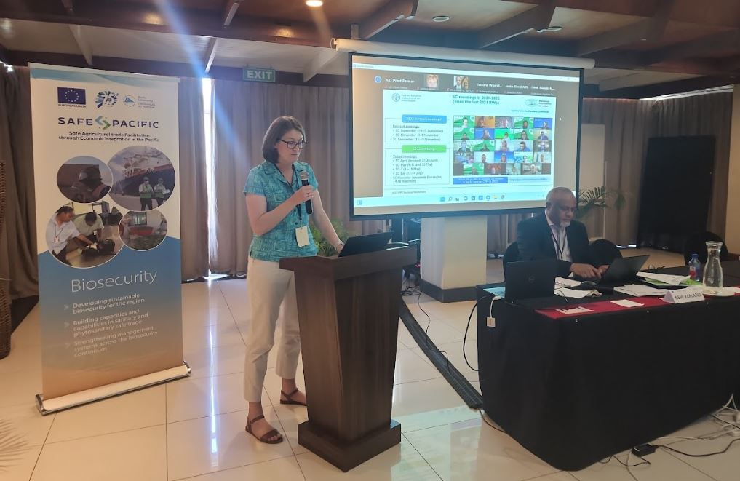
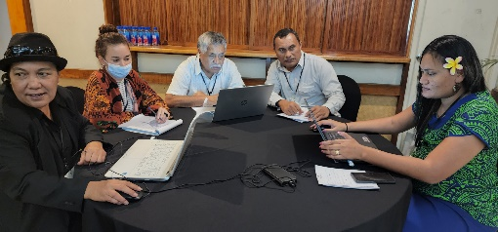
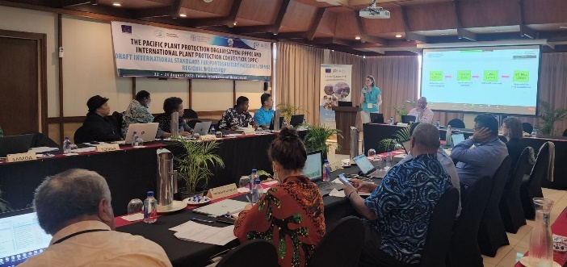
PPPO/IPPC Draft ISPM Regional Workshop and PPPO Executive Committee Meeting 22nd – 26th August 2022
Acknowledge and Thank the following:
IPPC Secretariat Team – Ms. Janka Kiss
FAO Team – Samoa Sub-regional Office – bringing some participants to the PPPO regional workshop and also for Mr. Hermant Nitturkar participation
The PPPO Family for attending

Slide 7
Ongoing PPPO Talanoa Session
An opportunity to continue to stay connected with the PPPO Members in the region.
Capture the Issues and Challenges, Success Stories, Lessons Learned and Way forward.
THEME: CONNECTED, INFORMED & PREPARED (CIP)
A PPPO family where no member is left behind

Slide 8
Partnership and Collaborations
European Union (EDF 11)
Biosecurity & SPS – Ongoing
Value Chains – Ongoing
Australia - Department of Agriculture Fisheries and Forestry (DAFF)
General biosecurity engagement and support
Pacific Export Plan (PEP) - Ongoing
Pacific Pest List Database Upgrade – Ongoing and Company Consultant has been engaged
ePhyto - Ongoing
Green Climate Fund
Transboundary Pests/ invasive species exacerbated by effects of Climate change – Submitted for the 2nd round of consultations
New Zealand Ministry of Primary industries (MPI)
Output 1 - Establishment of a holistic system to facilitate the development, management, monitoring, and evaluation of export systems including export plans – Team leader engaged and coordinator is in the process of being recruited.
Output 2 - Review of the Phytosanitary Certification System (PCS) and Phytosanitary Capacity Evaluation (PCE) – Consultant has been identified and engaged for this work.
Output 3 - Establishment of a robust e-operational and GIS information database system for export facilitation - Request For Quotation (RFQ) has been put up. Looking and finalising the consultant company soon.
Output 4 - Rollout of ePhyto in line with the Pacific Community, Pacific Plant Protection Organisation, Regional ePhyto Implementation Plan, 2020-2022. Ongoing with the regional ephyto coordinator in place.
Output 5 - MPI contribution to the implementation of PPPO Workplan and core functions – Request For Quotation (RFQ) has been put up for short term consultants to be engaged. Looking and finalising the consultant company soon.

Slide 9
Updates
Submission of Safe Food Aid – Support from RPPOs and NPPOs for the Focus Group.
Face-to-face meeting Feb 2023
Australia/PPPO secretariat factsheets for safe aid post Tongan Volcano eruption
PPPO Full Board meeting
November 2022
Pacific Week of Agriculture (PWA)
March 2023.

Slide 10
Challenges
&
COVID 19 situation
Travel restrictions
Procurement and Logistics
Virtual Meeting & Different Time Zones
Deadlines and Responses
Way Forward
Boarders Opening
Managing expectations (meetings and projects)
Procurement and Logistics
Deadlines and Responses

Slide 11
THANK YOU

