Slide 1


ORGANISMO INTERNACIONAL REGIONAL DE SANIDAD AGROPECUARIA
34TH TECHNICAL CONSULTATION AMONG RPPOS
OIRSA Regional Challenges
September 21, London

Slide 2

Technical and capacity development achievements

Slide 3
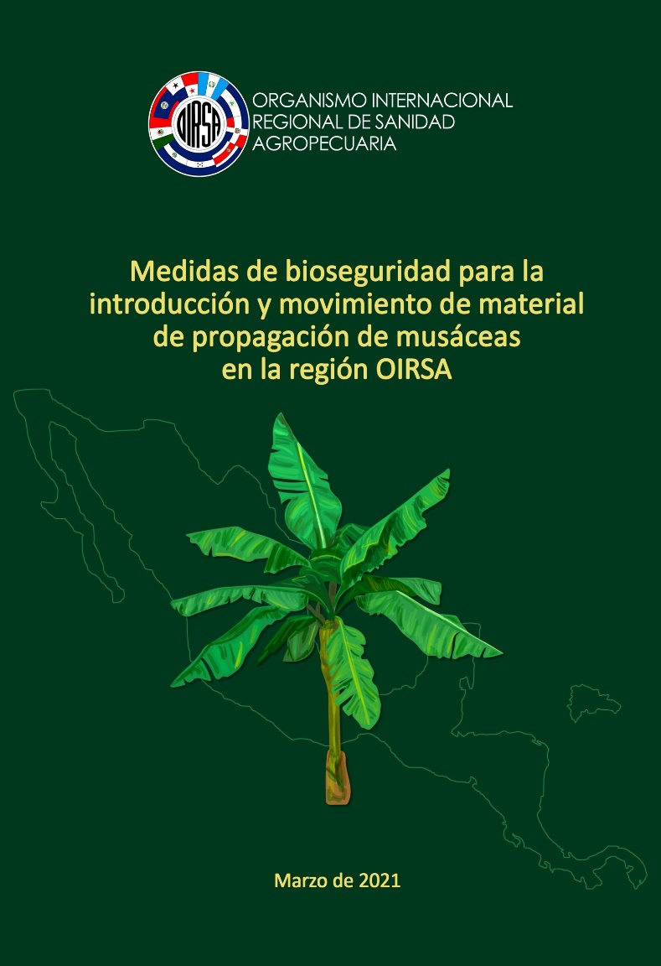
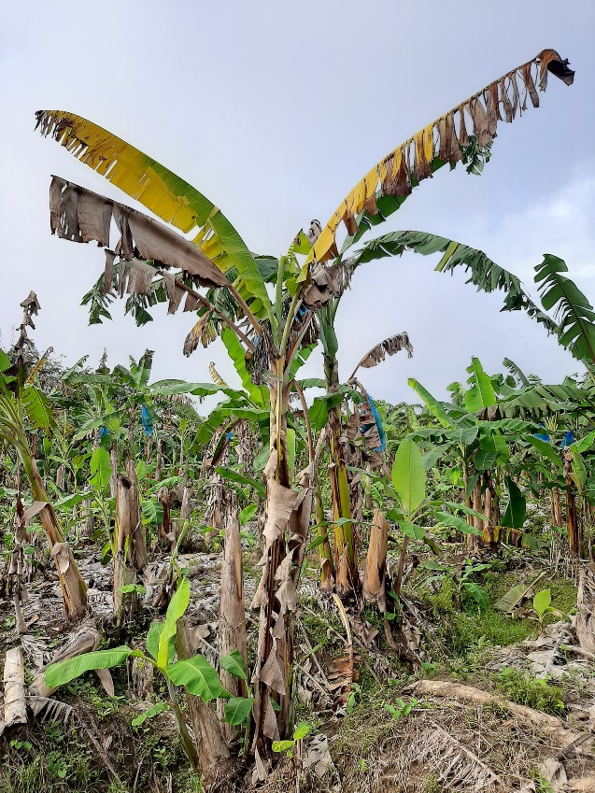
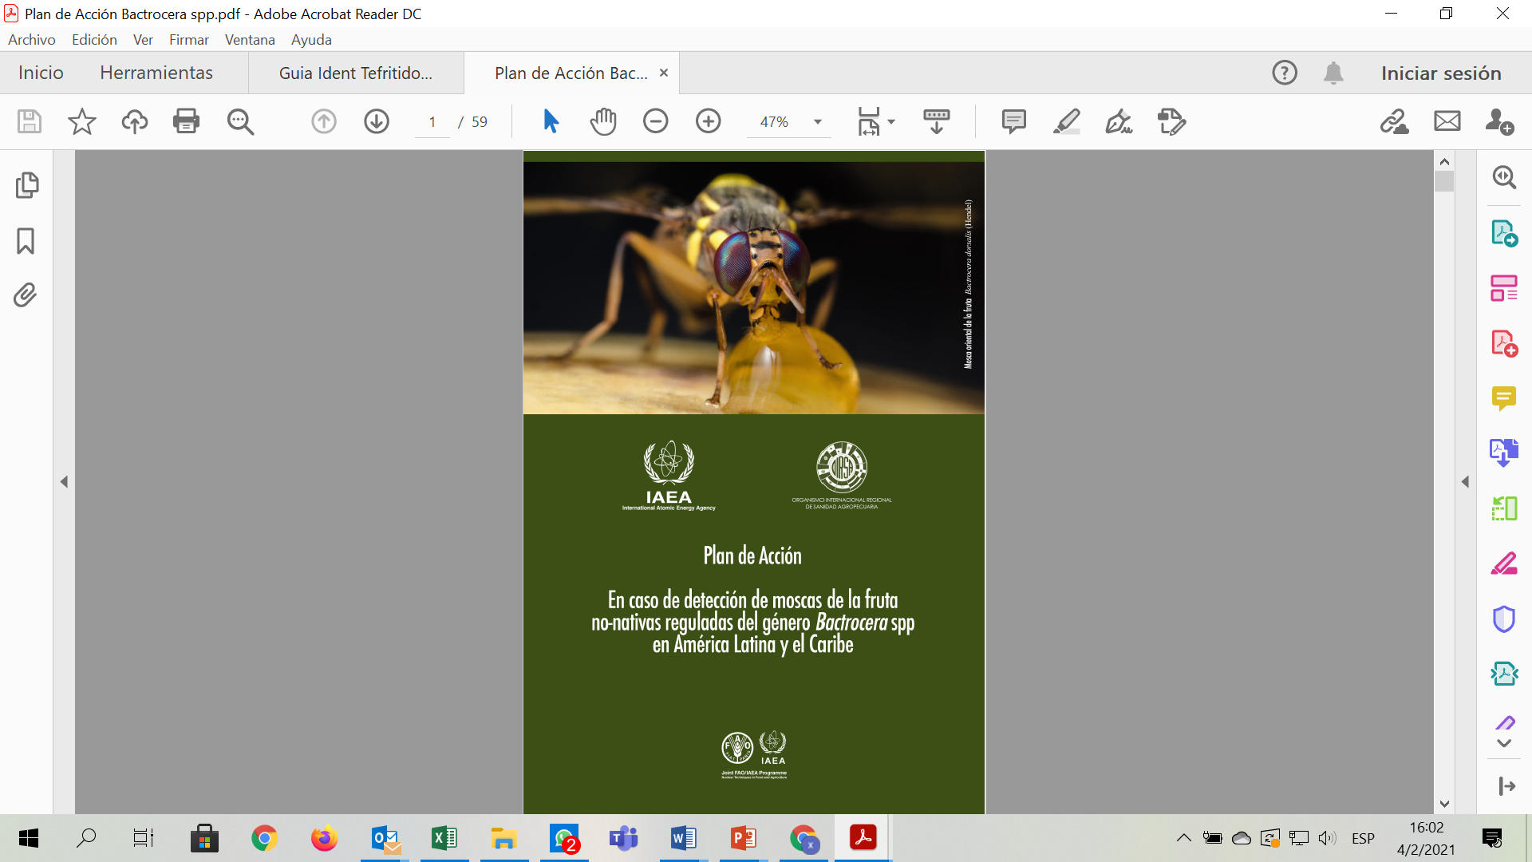
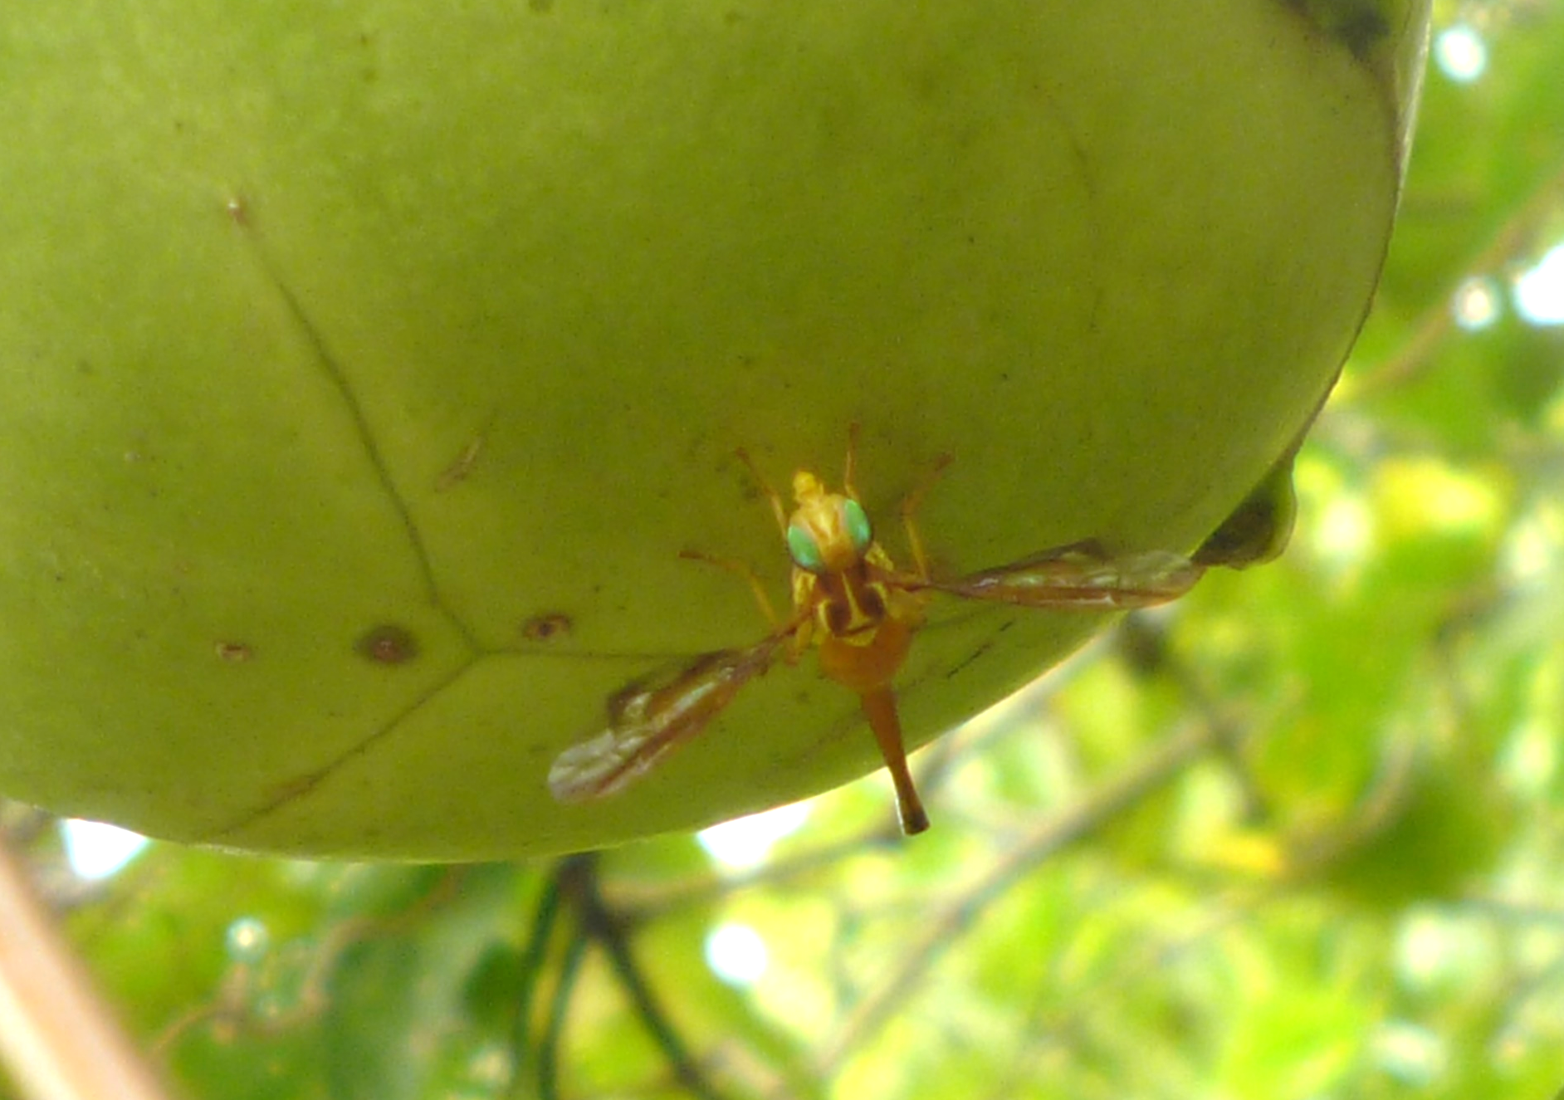
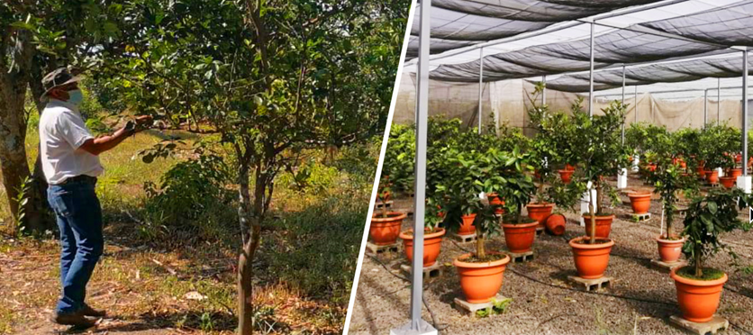
Fruit-growing Programs
Musaceae (Foc TR4)
Strengthening of Diagnostic Capabilities.
Protocol for the mobilization of musaceae materials.
Simulations of actions in case of outbreaks.
The PRA of Foc TR4 was completed.
Healthy citrus plants production and greenhouse renovations.
Fruit Flies
Production of IAEA & OIRSA scientific documents
Implementation of the Fruit Flies Virtual Training

Slide 4
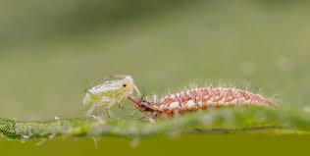
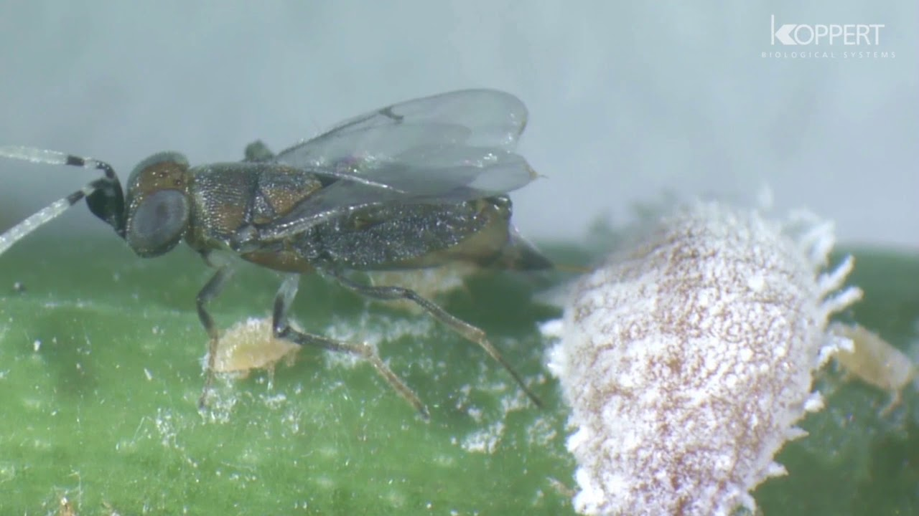
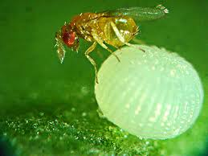
PROGRAM ON HORTICULTURAL CROPS
IPM in Solanaceae, cucurbitaceae and family agriculture
Biological Controllers Project in Belize
Chrysoperla carnea
Anagyrus kamali
Trichogramma pretiosum

Slide 5
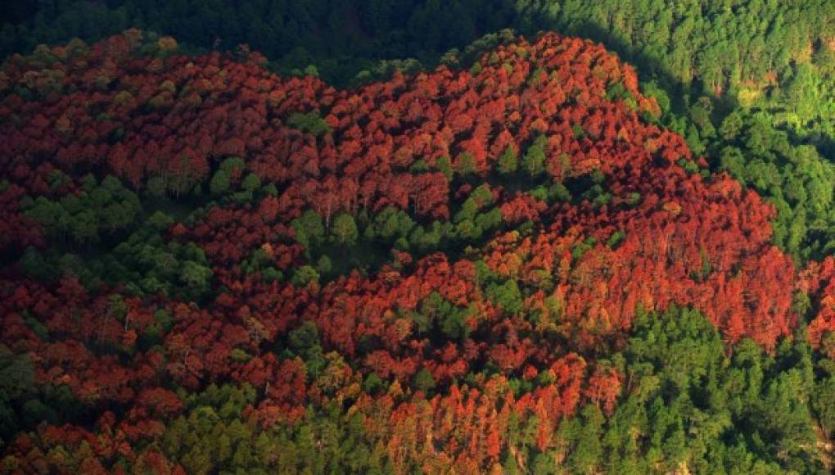
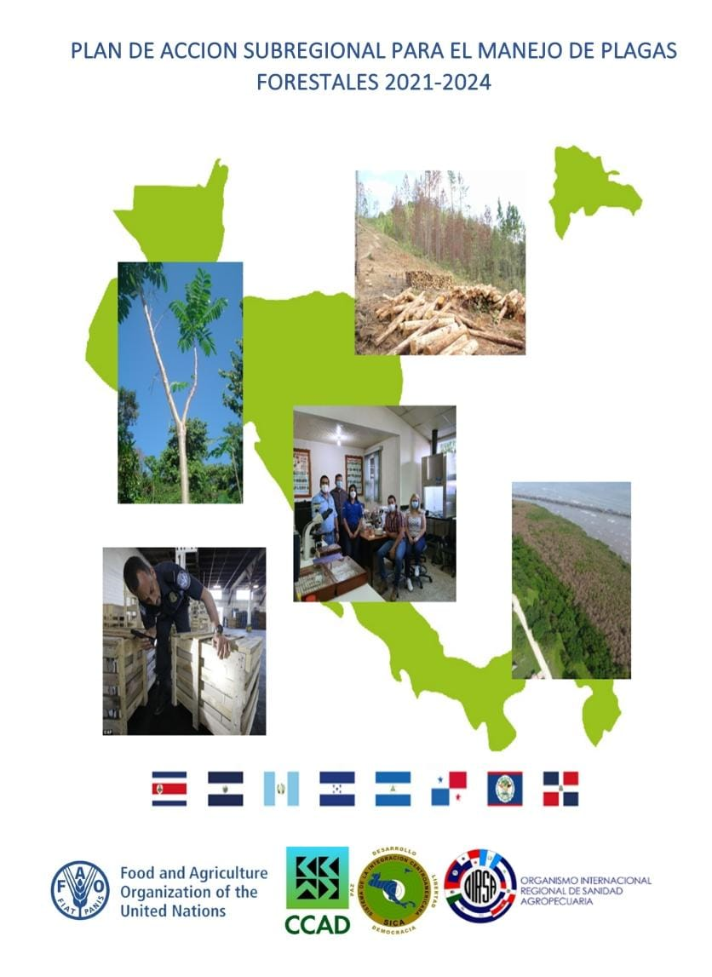
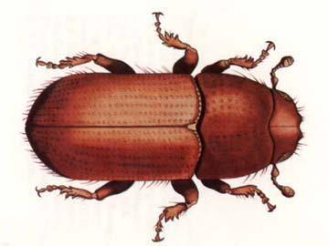
IPM PROGRAM IN FORESTRY
Action plan for the management of Dendroctonus frontalis (Southern pine beetle) (OIRSA and FAO)

Slide 6

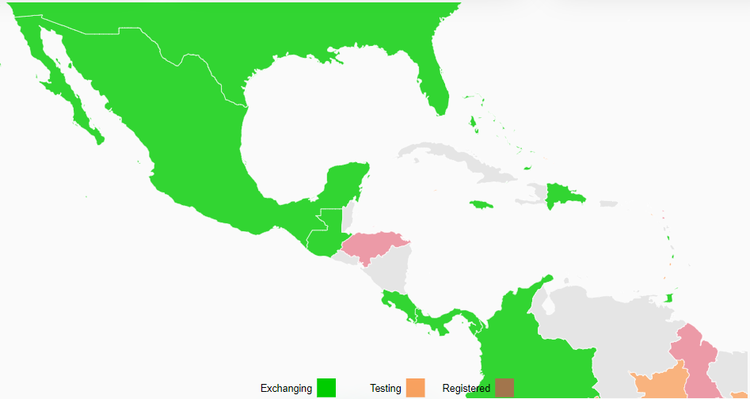
Implementation in the OIRSA region
Central server (Hub):
México (operating since 2019)
Costa Rica (operating since 2020)
GeNS System
Dominican Republic(operating since 2020)
Guatemala (operating since 2021)
Panamá (operating since 2021)
Honduras (registered)
Belize (Registered)
El Salvador (Not registered)
Nicaragua (Not registered)

Slide 7
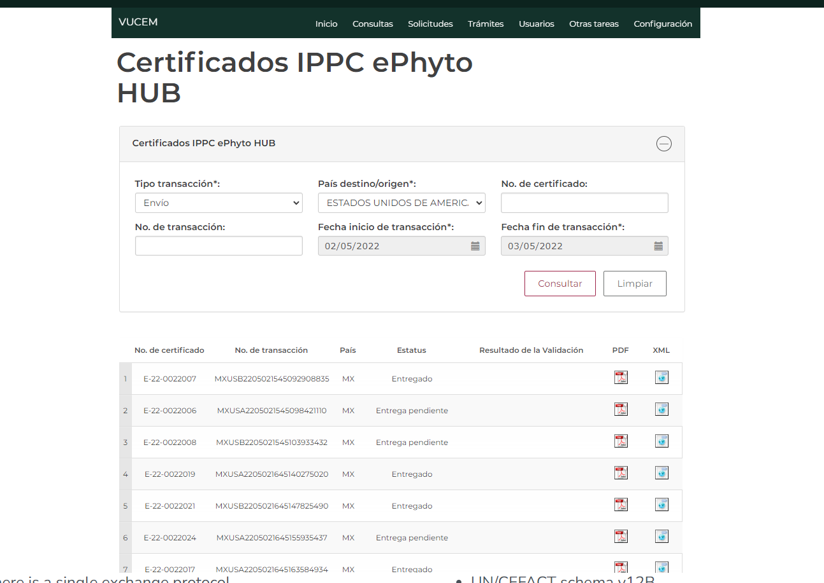
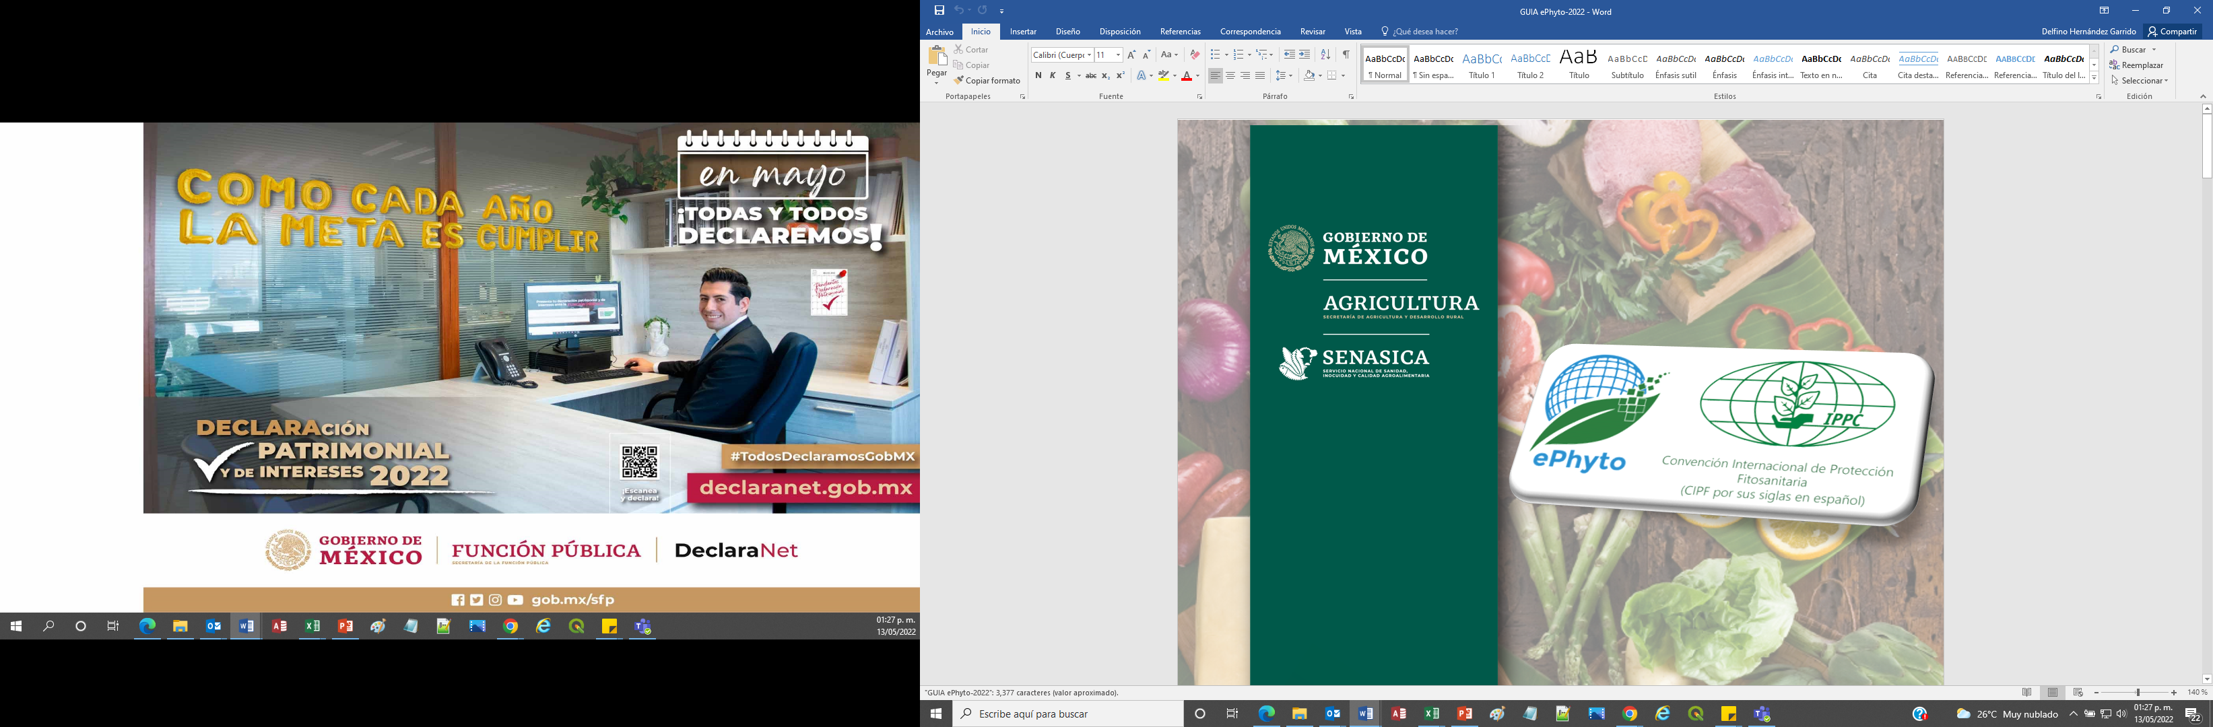
EPHYTO MEXICO
2022 began Exchange with Guatemala. Integration with Unión Europea, Costa Rica, Argentina, in process
2021 began official Exchange with USA, import and export
Antecedentes y estatus

Slide 8
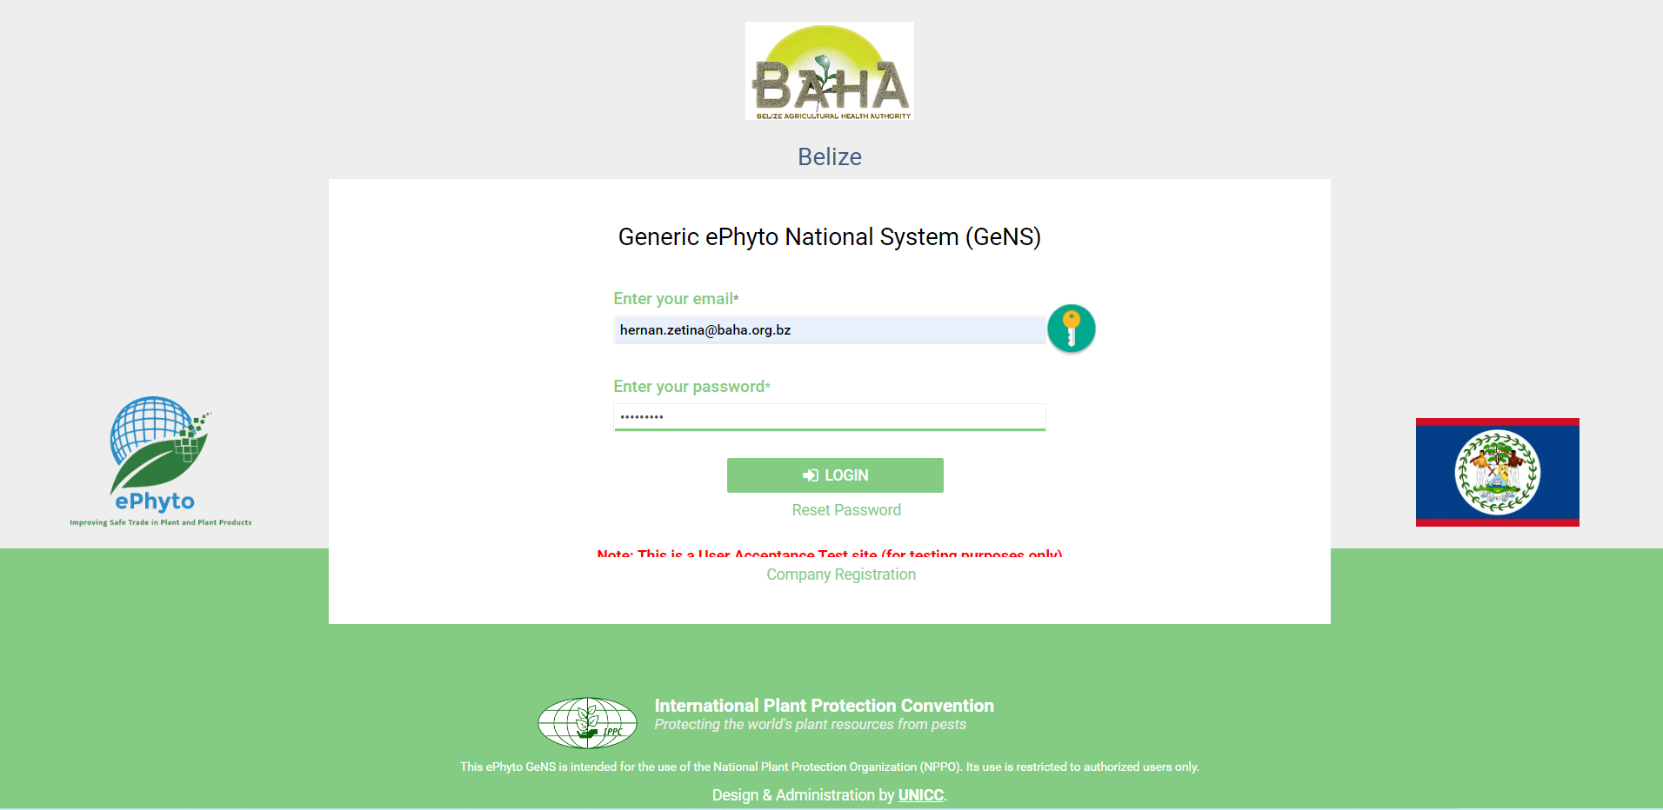
Ephyto situation Belize
APHIS and BAHA (Plant Health) began working on establishing an ephyto platform using the Gens system in February of 2022
User Acceptance & Training (UAT) site up and running
Once the system is up and running, BAHA will run a pilot project and begin exchanging ephytos with a country that is willing to participate.
Challenges- internet needs to be upgraded and equipment need to be procured.

Slide 9
Ephyto situation Guatemala
GeNs Systems
User manual finished
Training program running
Currently exchanging with 33 countries
MÉXICO LUXEMBURGO CHIPRE
PANAMÁ PAÍSES BAJOS ESLOVENIA
ESTADOS UNIDOS SUECIA FINLANDIA
ALEMANIA BULGARIA HUNGRÍA
BÉLGICA ESLOVAQUIA ITALIA
CROACIA ESTONIA LITUANIA
DINAMARCA GRECIA PORTUGAL
ESPAÑA MALTA RUMANÍA
FRANCIA POLONIA SUIZA
IRLANDA REPÚBLICA CHECA COSTA RICA
LETONIA AUSTRIA

Slide 10

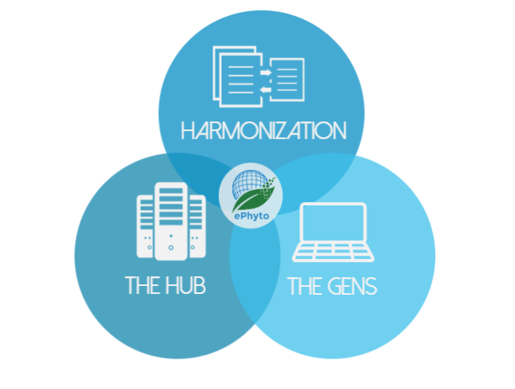
Ephyto situation Costa Rica
2020: began pilot plan with USA
Currently exchanging with: USA, Europe, Argentina, Martinica, Islas Guadalupe, Panamá, Guatemala.

Slide 11
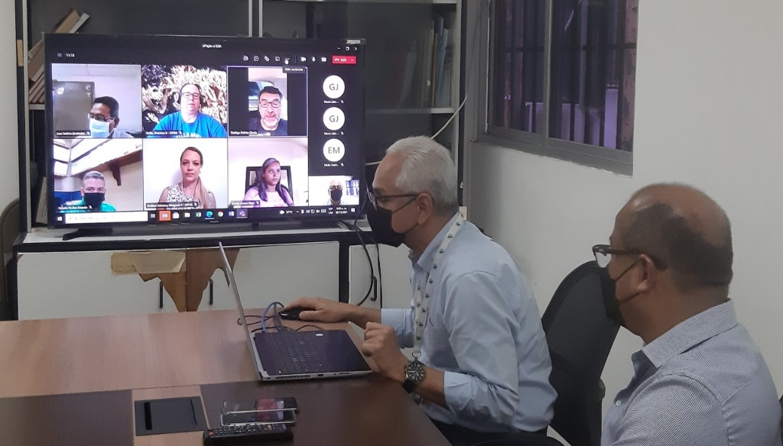
Ephyto situation Panamá
2021, began Exchange with USA
Currently electronic exchange by two ways (export-import) with USA, Chile, Costa Rica y Guatemala.

Slide 12
Ephyto situation Dominican Republic
2021, establish and Exchange agreement with APHIS/USDA and Chile
Currently exchanging with USA and Chile.

Slide 13
Emerging Pests and Issues

Slide 14
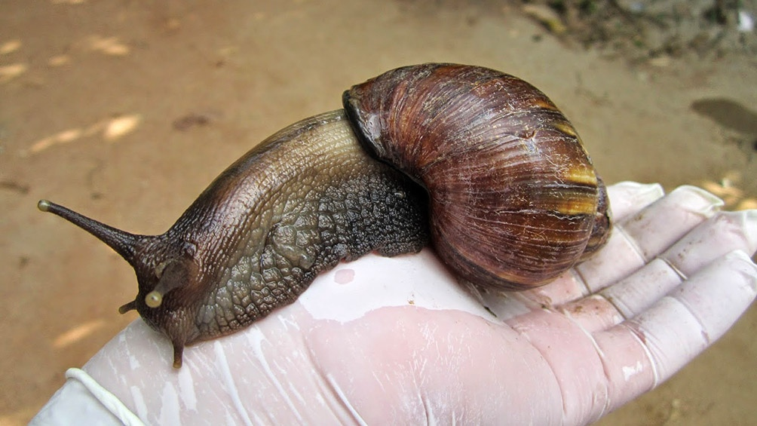
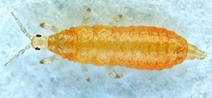
Emerging Pests and Issues
Giant African Snail (Achatina fulica)
  Costa Rica, october 2019
  Dominican Republic, november 2016
Bean flower thrips (Megalurothrips usitatus (Thysanoptera: Thripidae))

Slide 15
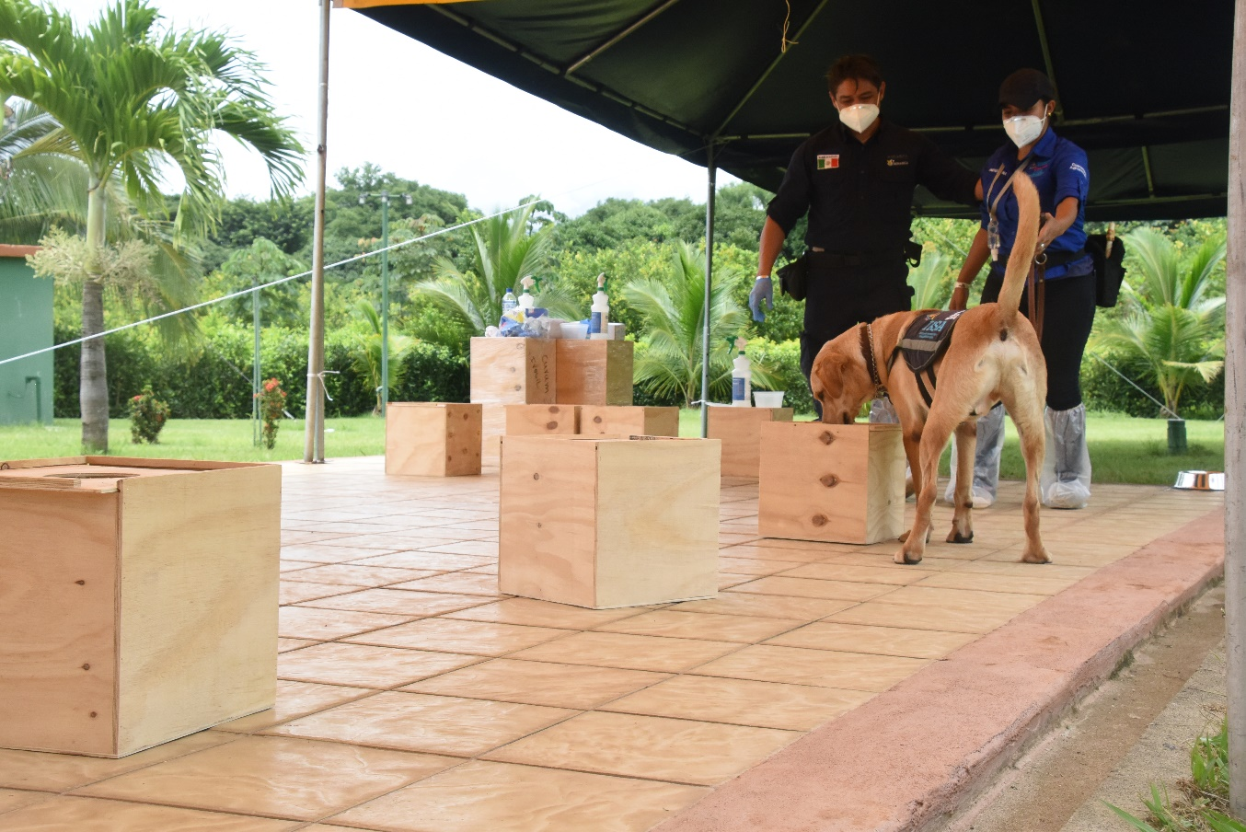
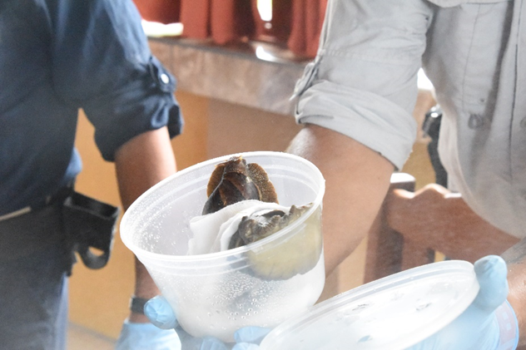
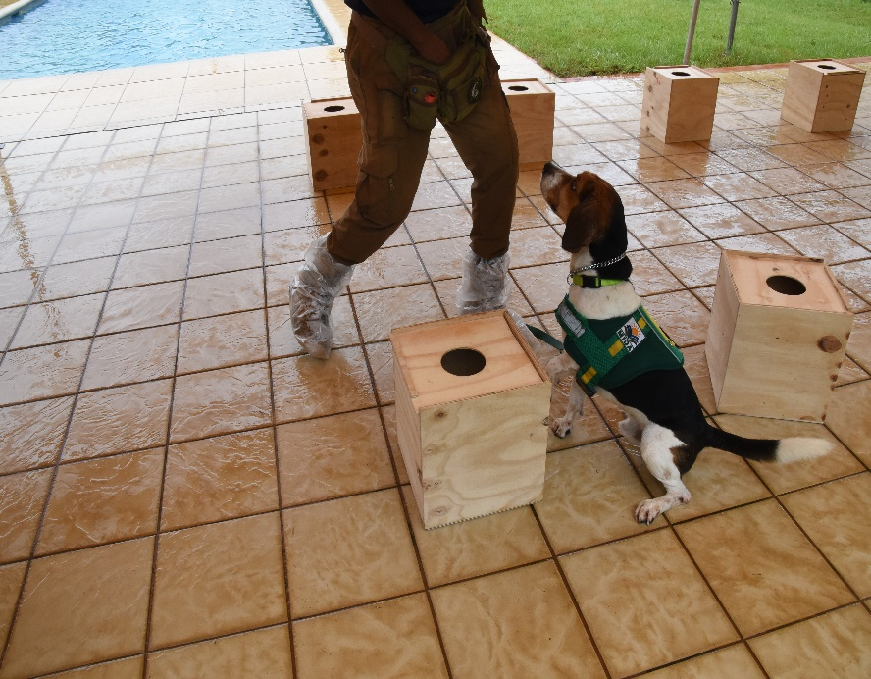
Emerging Pests and Issues
Giant African Snail (Achatina fulica) (Costa Rica and Dominican Republic)
  Surveillance
  Communication programs
  Outbreak eradication activities (chemical control)
  Dog brigades training, detecting snails in the fields and airports

Slide 16
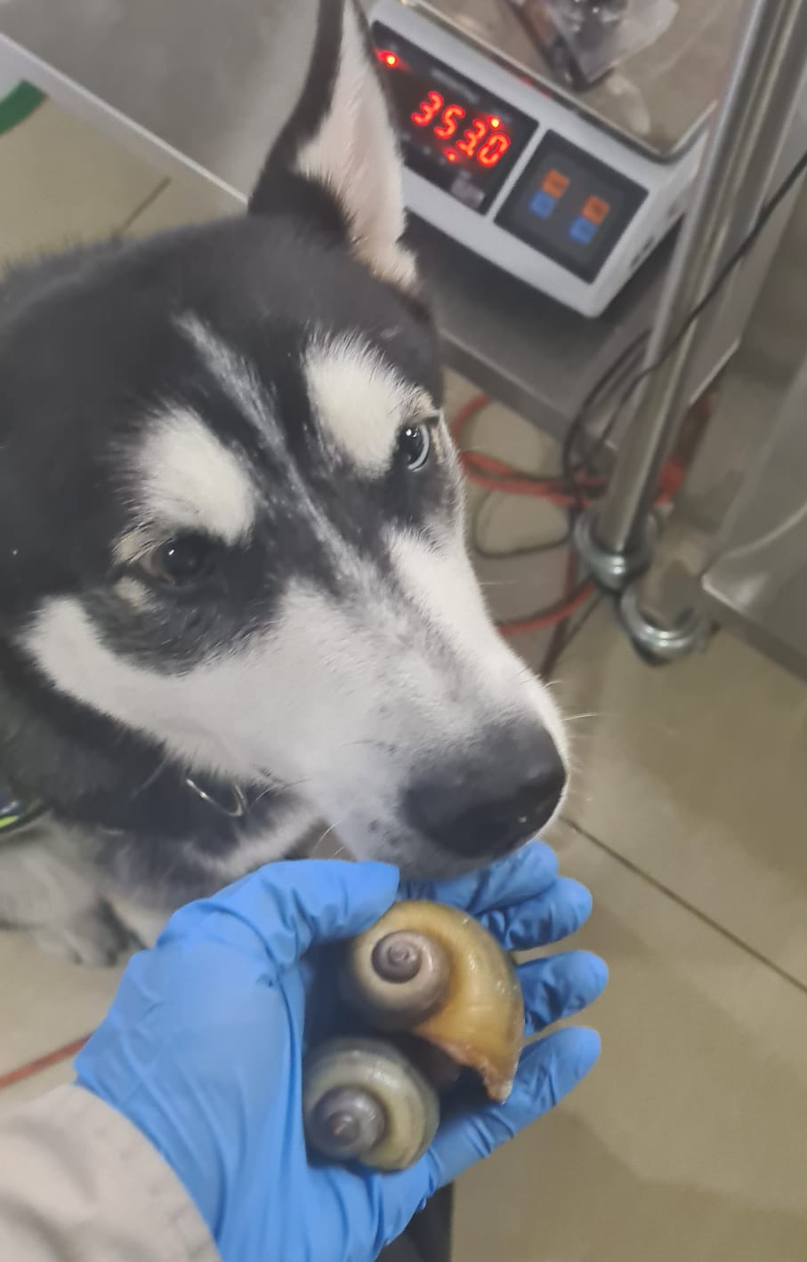
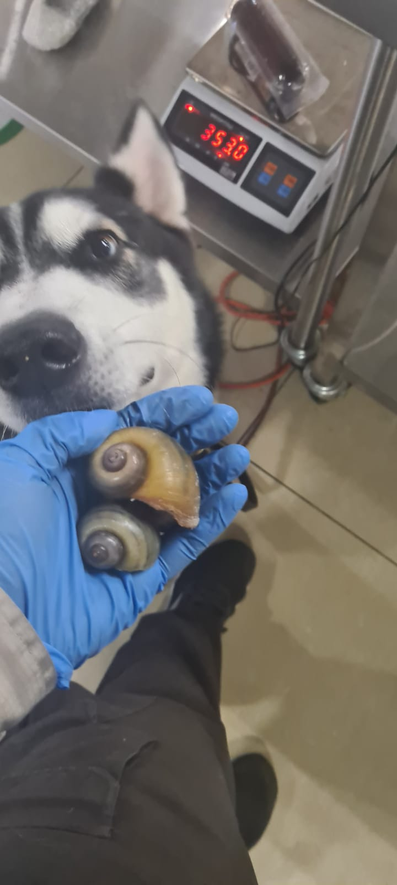
What happened after the training?

Slide 17
Surveillance Projects and Activities

Slide 18
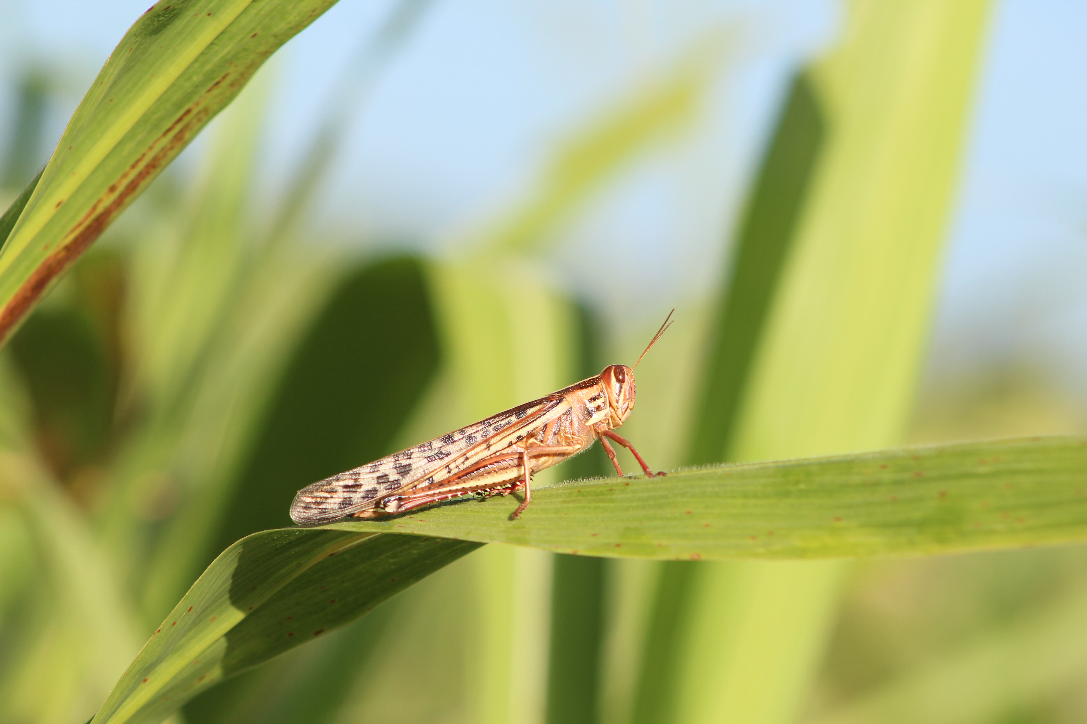
PHYTOSANITARY SURVEILLANCE
IPM on Bean, Corn, Rice, Potato & Sorghum
Implementation of a pest alert for central american locus.
Technology platform and APP for Phytosanitary surveillance in the countries of the región
Climate variable platform for damage impact forecast.
General Surveillance: Yellow Sorghum Aphid, Zebra chip or purple tip on potato, asphalt stain on corn, panicle rice mite.
Pilot projects: traceability in healthy plant production and digital surveillance.

Slide 19
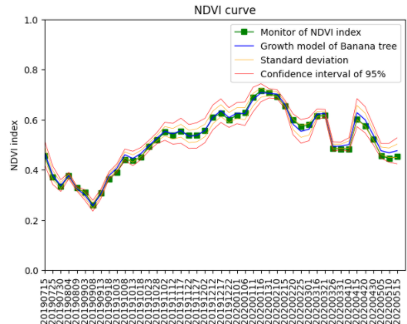


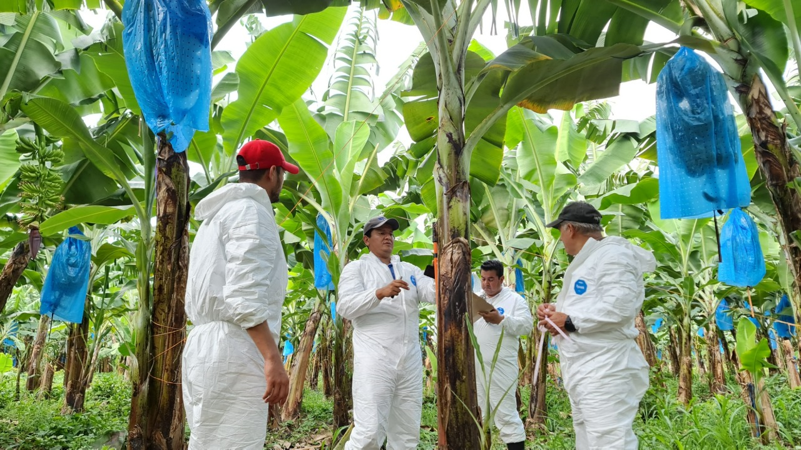
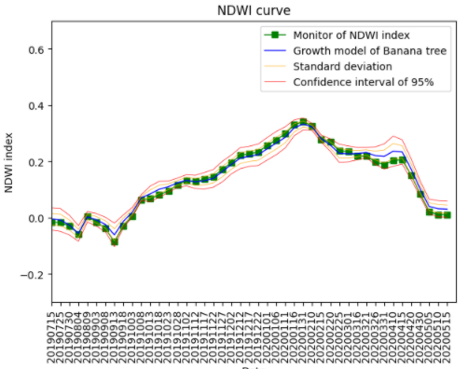
Sentinel farm for satellital monitoring of Foc TR4
Healthy Plantation Model
Measurement
Shooting & flowering
Vegetative growth stage
seedling
North district
South district
Guard row
Shooting & flowering
Vegetative growth stage
seedling

Slide 20
Proposals for further collaboration/cooperation

Slide 21
Proposals for further collaboration/cooperation
 | Acciones | Proceso
1 | Intelligent Platform: VIGIMUSA | Starts 2022 with the support of IDB/ Phytosanitary Surveillance
2 | Satellite monitoring | Established sentinel farms/ Taiwan Space Agency
3 | Technological Platform Trazar - Agro | Ongoing project
4 | Risk maps with climatic and genetic variables | In process of updating
5 | Tolerant or resistant varieties | In process with the support of Taiwan ICDF
6 | Canine Brigades | Ongoing project
7 | Capacity evaluations (including simulations) | Ongoing project

Slide 22









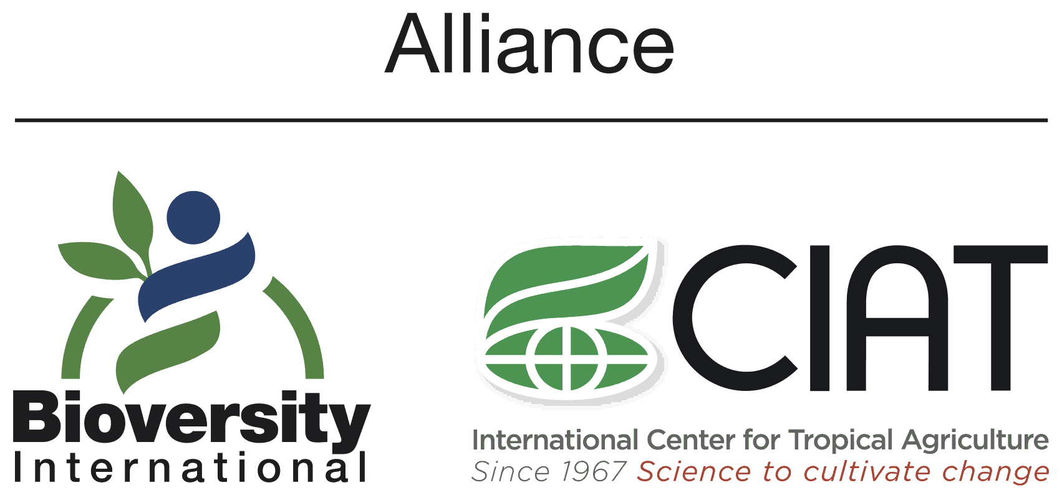

COORDINATION WITH INTERNATIONAL ORGANIZATIONS
Results
Strengthened relationship:
FAO (coordination, financial support, advice)
Taiwan - ICDF (financing and advice Foc TR4)
AIEA (document editing)
BID (project financing VIGIMUSA)
Bioversity CIAT (Foc TR4, initiative OneCGIAR)
CIPF – ORPF (NIMFs y technical groups)
AGROCALIDAD (sharing of experiences)
CAN (sharing of experiences)
ICA Colombia (containment support)
SELA (containment support)
AFAS (quarantine treatment certification)
USDA (training and financial support)

Slide 23
¡Thank you!
Raúl Rodas rrodas@oirsa.org
ORGANISMO INTERNACIONAL REGIONAL DE SANIDAD AGROPECUARIA

