Slide 1
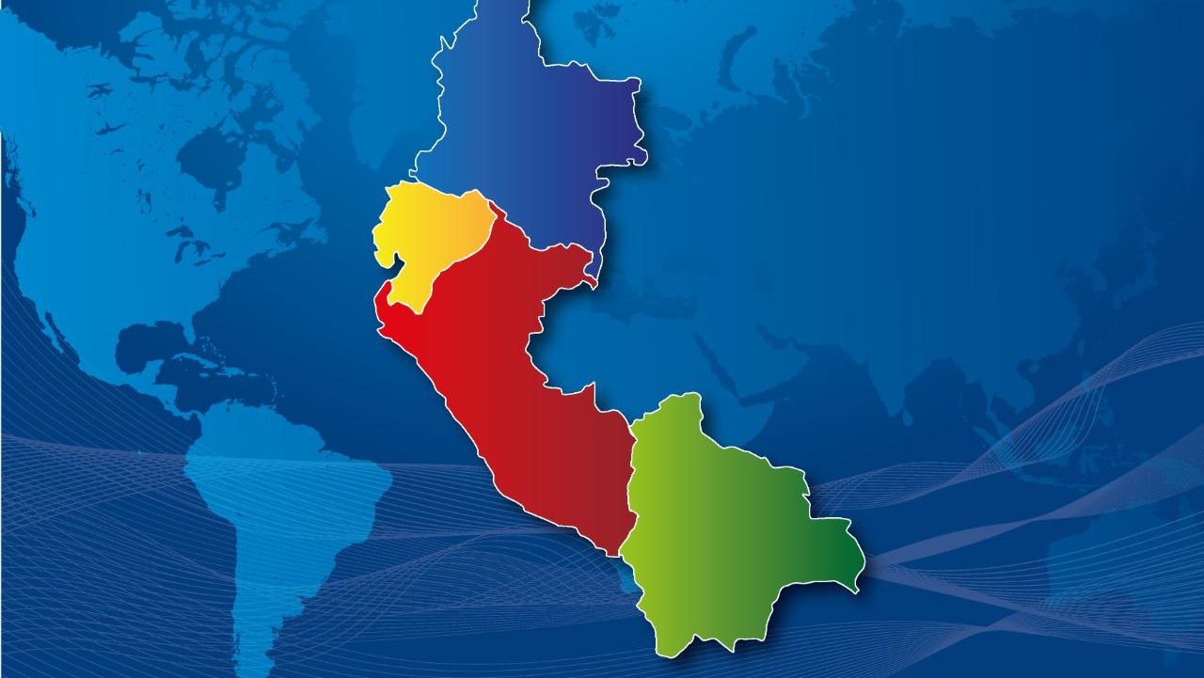
REGIONAL CHALLENGES
ANDEAN COMMUNITY CAN
BOLIVIA COLOMBIA ECUADOR PERÚ

Slide 2
REGULATORY FRAMEWORK
The Andean Community is made up of Bolivia, Colombia, Ecuador and Peru. It is governed by the Cartagena Agreement and has the following objectives:
Promote the balanced and harmonious development of the Member Countries in conditions of equity, through integration and economic and social cooperation;
Accelerate their growth and the generation of employment;
To facilitate their participation in the regional integration process, with a view to the gradual formation of a Latin American common market.

Slide 3
REGULATORY FRAMEWORK
DECISION 515
Plant health falls within the scope of the Andean Agricultural Health System (SASA), which is responsible for:
Harmonization of sanitary and phytosanitary standards;
Protection and improvement of animal and plant health;
Facilitating trade in plants, plant products, regulated articles, and animals and their products; and,
Ensuring compliance with the sanitary and phytosanitary standards of the Andean legal system.

Slide 4
1. TECHNICAL AND CAPACITY BUILDING ACHIEVEMENTS
Within the framework of the Work Plan of the Andean Technical Committee on Agricultural Health COTASA - Plant Health, the updating or issuance of :
Regional List of Quarantine Pests Absent in the Andean Community and repeal of JUNAC 419.
Update of SGCAN Resolution 1475 Replacement of Resolution 1008: "Adoption of Phytosanitary Risk Categories for Intra-Subregional and Third Country Trade in Plants, Plant Products and Other Regulated Articles".
Regional Harmonized Protocol for the Management and Control of the Giant African Snail of the Andean Community.
Phytosanitary Emergency Response Plan.
"Regional Methodology (standard/harmonized) for Ceratitis capitata (Mediterranean fruit fly) control in urban areas".
"Potato psyllid Bactericera cockerelli management strategy".

Slide 5
1. TECHNICAL AND CAPACITY BUILDING ACHIEVEMENTS
An exploratory visit was made to SENASICA in Mexico for the Plant Health Representatives of the Member Countries to learn about SENASICA's experiences in the design and implementation of the Plant Health Intelligence Unit.
Within the framework of COTASA, internal workshops have been held to learn about the phytosanitary status of Foc R4T, African snail, ceratitis capitata, flying locust, HLB, phytosanitary emergency, Bactericera cockerelly, among others.
An exploratory visit to El Salvador is planned for October to learn about OIRSA's experience in the implementation of its Monitoring Center, the implementation of a Phytosanitary Command and the use of canine units.
With GIZ, a regional workshop is planned for October to conduct a cabinet simulation in Foc R4T.
With the FAS Project (USDA-APHIS), the Biopesticide Registration Standard is being developed.

Slide 6
2. PESTS AND EMERGING PROBLEMS
Pests of regional concern include:
Fusarium oxysporum f. Sp cubense TROPICAL RACE 4.
FRUIT FLY (Mosca del mediterraneo)
CITRUS HUANGLONGBING (HLB)
LOCUSTS (Orthopthera)
POTATO ZEBRA CHIP
In this framework, actions have been prioritised to develop regional regulations to share information and propose projects for funding.

Slide 7
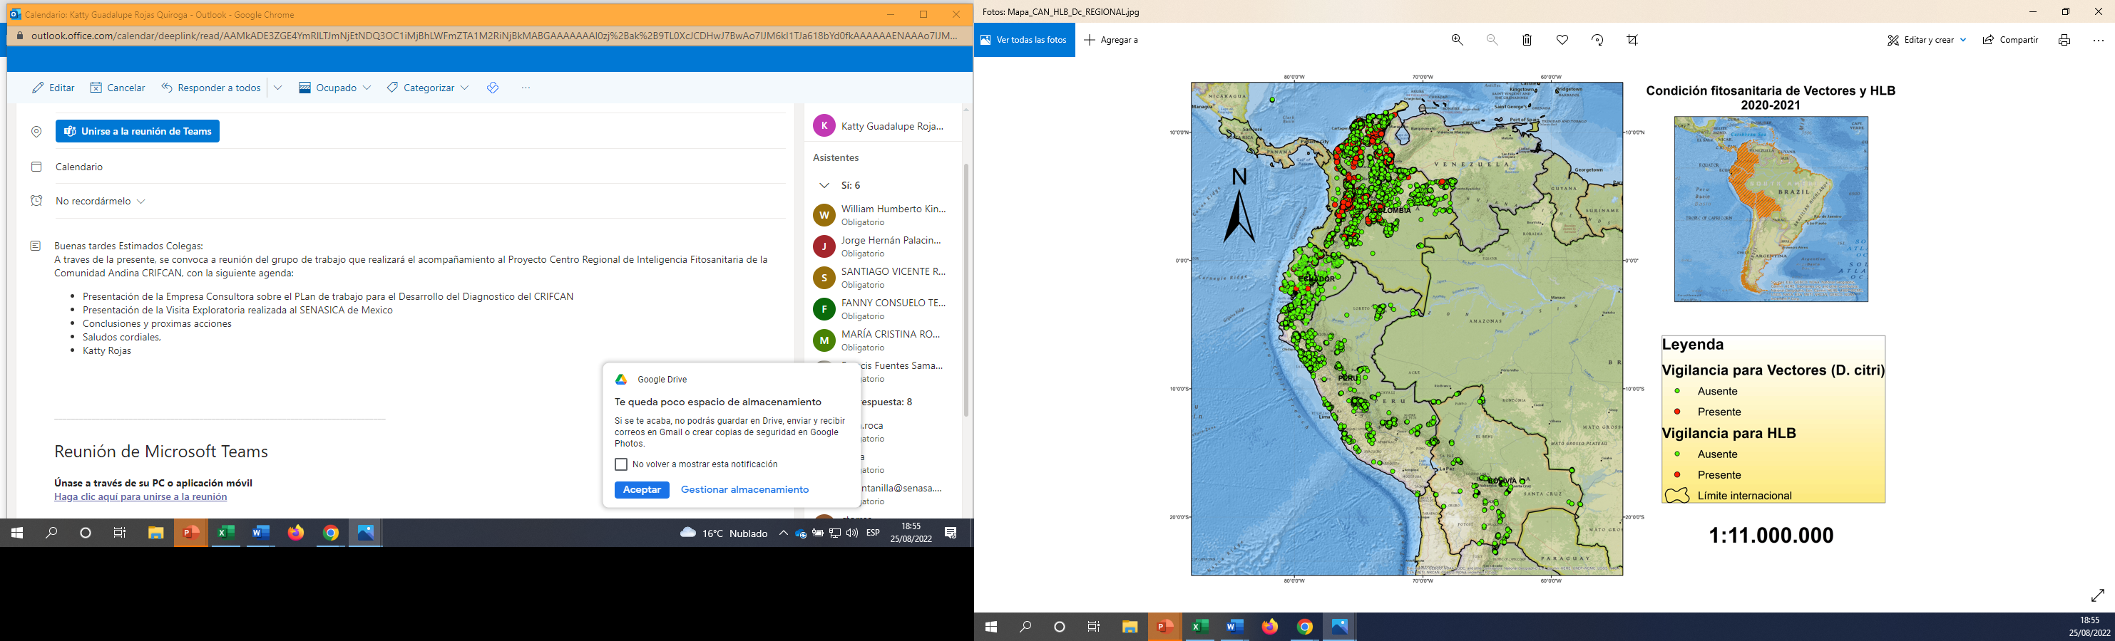
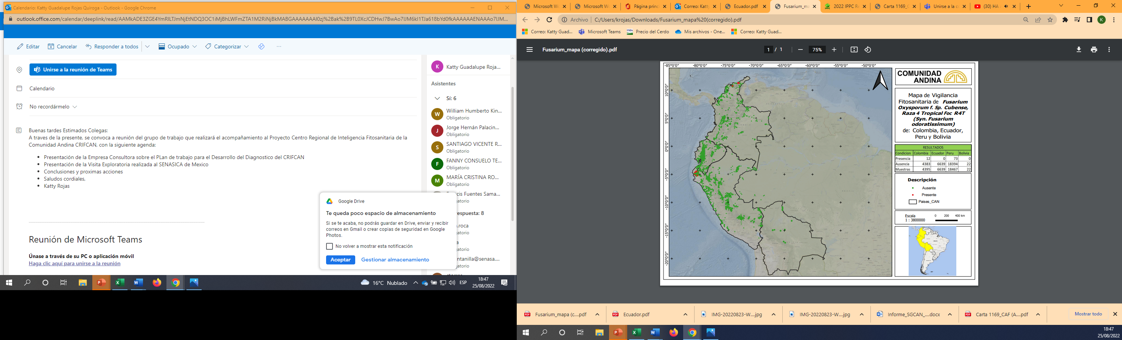
3. MONITORING PROJECTS AND ACTIVITIES
In compliance with resolutions 1850 and 2234 which oblige NPPOs of Member Countries to report on Phytosanitary Surveillance activities and issue epidemiological bulletins for Foc R4T and HLB respectively:

Slide 8
3. MONITORING PROJECTS AND ACTIVITIES
a) Decision No. 895 approved the Project: Diagnosis for a Regional Phytosanitary Intelligence Center of the Andean Community, for an amount of $ 218,500.00 (In execution).
b) With Note STDF/PG/838, the Standards and Trade Development Facility STDF approved the request for a donation of US$1 million for the implementation of the Regional Center for Phytosanitary Intelligence of the Andean Community.
c) Within the framework of the Andean Agricultural Agenda, three profiles have been developed. One corresponds to the establishment of an Andean Exchange Network for the management of knowledge on sanitary and phytosanitary challenges facing the requirements of Andean countries and third countries (RAGO).

Slide 9
4. PROPOSALS FOR FURTHER COLLABORATION/COOPERATION
There is interest from Member Countries for the implementation of a Regional Phytosanitary Command.
Establish guidelines for the development of phytosanitary simulations and drills.
It would be interesting to have the experience of the countries in the development and implementation of a Phytosanitary Emergency Plan.

Slide 10
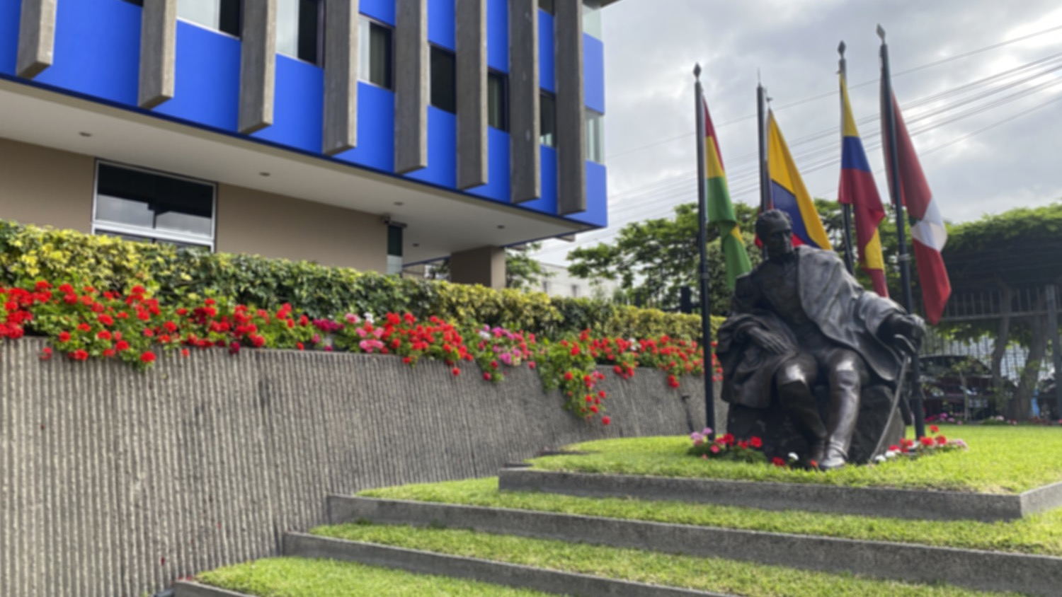
¡THANKS!
Av. Paseo de la Republica 3895, Lima 27 – Perú
Teléfono: (511) 710 6400
www.comunidadandina.org

