Slide 1
EPPO Activities 2021 - 2022
Nico Horn
Director-General
OEPP/EPPO 21 bd Richard Lenoir, Paris 75011 www.eppo.int

Slide 2
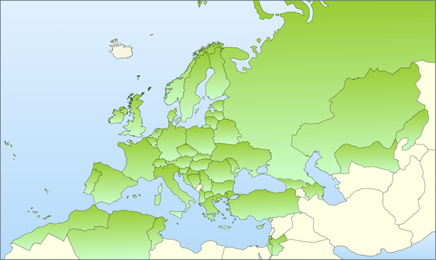
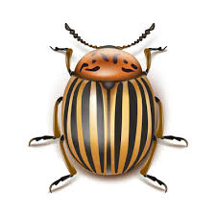
EPPO European and Mediterranean Plant Protection Organization
Intergovernmental Organization
Created in 1951 by 15 countries (EPPO Convention)
52 member countries in 2022
International cooperation in plant health - plant quarantine - plant protection products
Works for and with National Plant Protection Organizations
www.eppo.int

Slide 3
EPPO Standards for approval
Update: PM 3/77 (2) Vegetable plants for planting under protected conditions – inspection of places of production
Update: PM 3/81 (3) Inspection of consignments for Xylella fastidiosa
Update: PM 3/82 (3) Inspection of places of production Xylella fastidiosa
Update: PM 3/66 Plant health risks of biowaste of plant origin
Update: PM 4/17 Pathogen-tested olive trees and rootstocks
New Standard: Raising professional operators’
awareness of regulated and emerging plant pests
Many new and revised Diagnostic Protocols
All for approval by Council this year

Slide 4
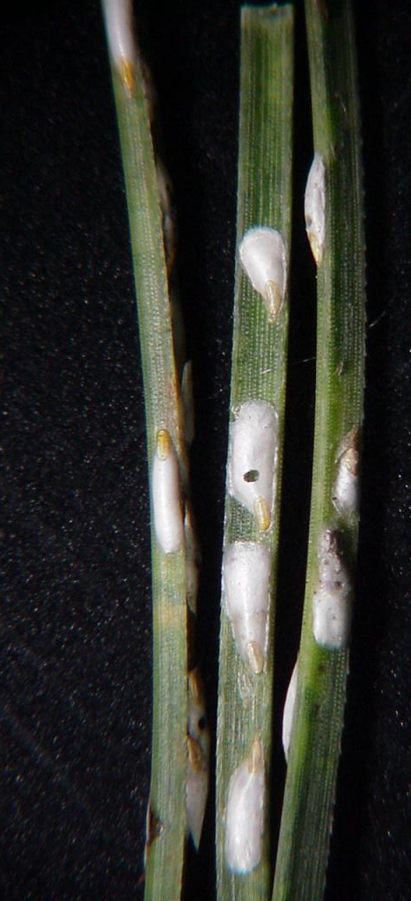
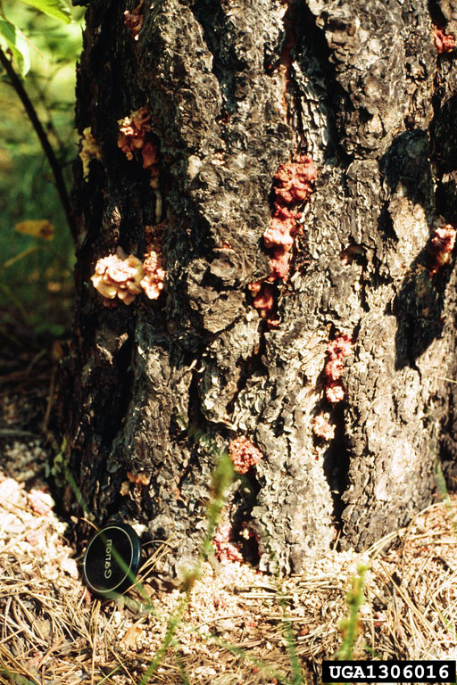
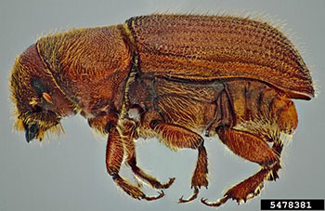
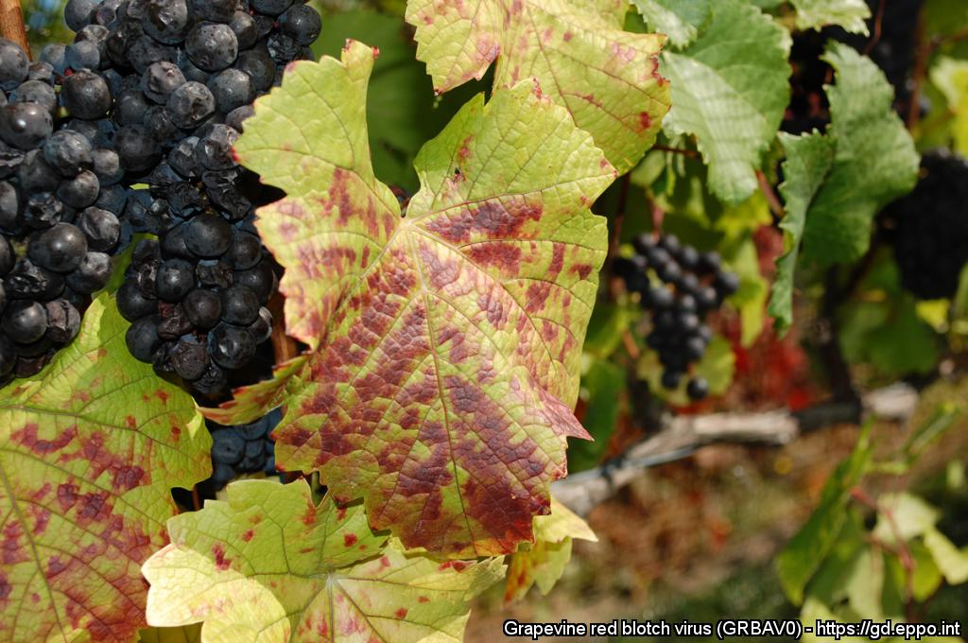
PRAs and listed on EPPO A1 list
Chionaspis pinifoliae
Dendroctonus valens A1
Grapevine red blotch virus
Daniel Miller, USDA Forest Service, Bugwood.org
Adult D. valens – Steven Valley, Oregon Department of Agriculture, Bugwood.org
Pinot noir: Red blotch on leaves of Vitis vinifera ‘Pinot noir’
Courtesy: Professor Marc Fuchs, Cornell University

Slide 5
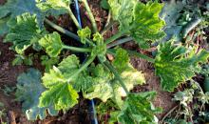
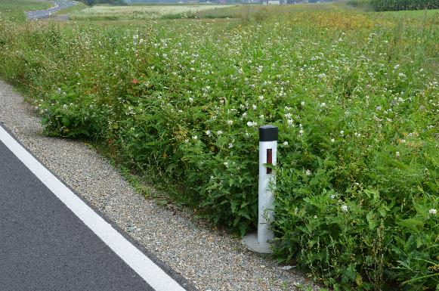
PRAs and listed on EPPO A2 list
Tomato leaf curl New Delhi virus
Solanum carolinense
(invasive plant)

Slide 6
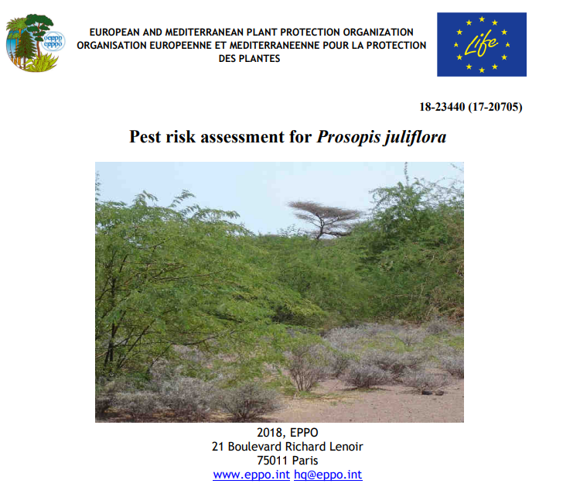
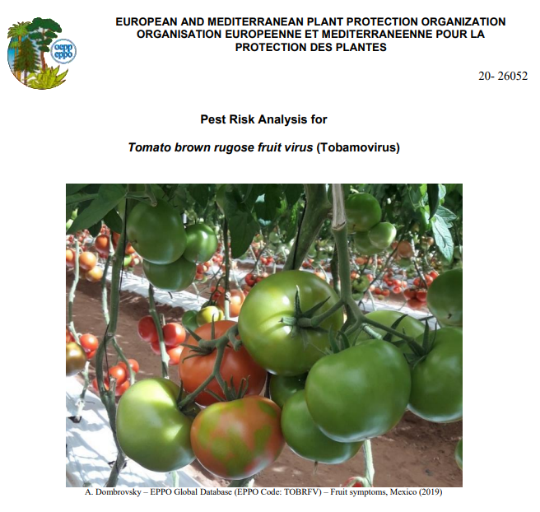
PRA Platform (pra.eppo.int)
Central hub for risk assessments in EPPO countries
More than 1500 documents available (partly restricted access)
Includes EPPO, EFSA, national assessments + relevant documents (e.g. ISTA list)

Slide 7
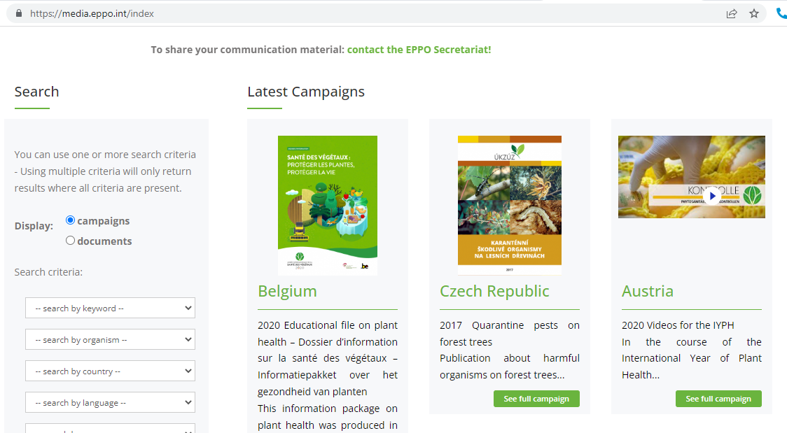

Slide 8
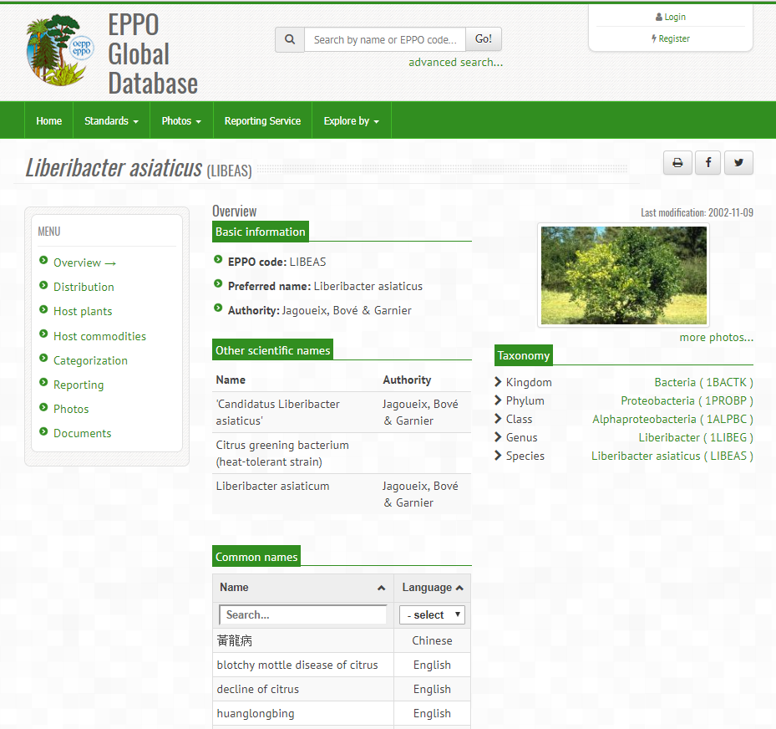
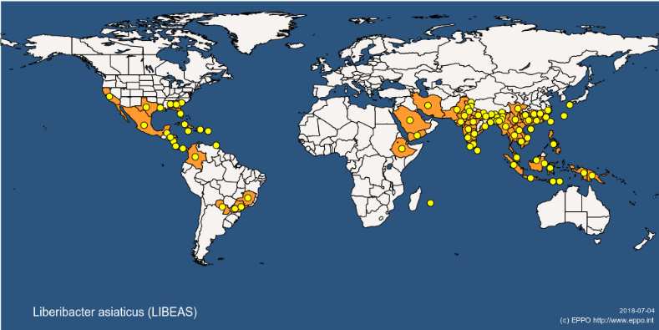
> 190 new and revised dynamic Datasheets
https://gd.eppo.int

Slide 9
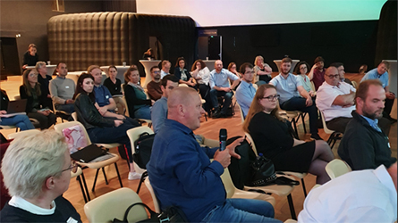
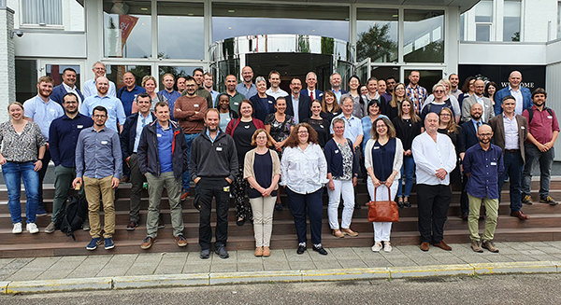
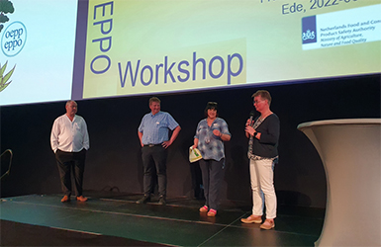
Recent workshop(s)
Difficult due to COVID-19 restrictions
Several workshops postponed:
EPPO workshop on pest reporting, EPPO Inspector’s workshop on targeted inspection, EPPO/EU workshop on Agrilus plannipennis, monitoring and control
Recently first workshop since 2019: end of June, Workshop on the use of digital technology in efficacy evaluation of plant protection products
Outcome of workshop: amongst others, EPPO will develop a Standard to support its use and acceptance

Slide 10
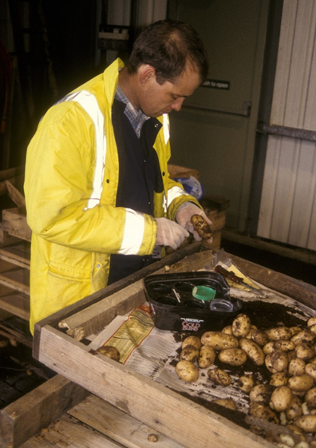
Future activities
Continue work on Diagnostic Protocols, PRA, information Services, Biological control agents, efficacy testing of plant protection products.
EPPO workshop on pest reporting, including pest status according to revised ISPM 8, first half 2023
EPPO Inspector’s workshop on targeted inspection, first half 2023
Both workshops with practical case studies

Slide 11
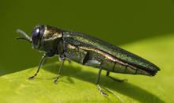
Challenges
Courtesy: Eduard Jendek
Coordinated monitoring of the spread and control of Agrilus planipennis, the Emerald Ash Borer
Geopolitical situation: makes travelling in the region more difficult
Consultation deadline 31st August for draft Specifications: during holiday time, no discussion in RW
Avoiding overlap of work, e.g. EFSA and EU reference laboratories

Slide 12
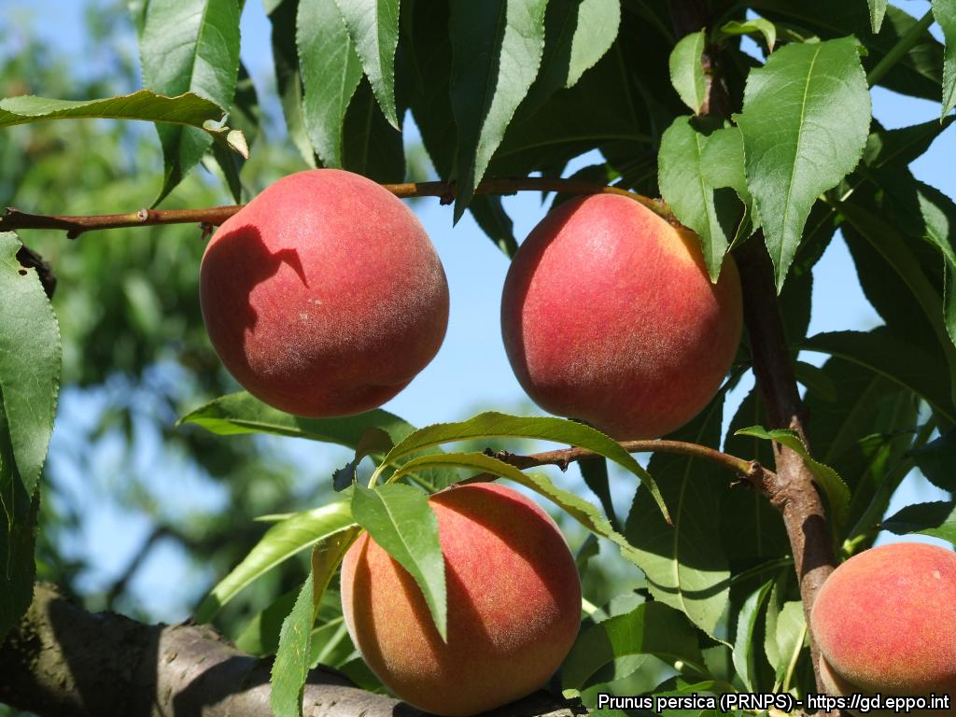
Thank you !

