Slide 1
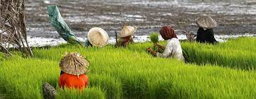
Plant pests and phystosanitary challenges in Asia and Pacific Region
Yubak Dhoj GC, PhD
Senior Agriculture Officer (Plant Protection)
Member Secretary
Asia and Pacific Plant Protection Commission (APPPC)
FAO Regional Office for Asia and the Pacific (RAP)
Bangkok, Thailand
21 September, 2022, UK, London
Yubak.gc@fao.org

Slide 2
Key regional challenges- crop protection, plant pests, diseases and phytosanitary
1) Invasive plant pests and diseases
FAW, Desert locust, Fruit fly, BPH, Wheat yellow rusts:
UG99: A virulent strain of stem rust, a recent threat for wheat in Central and South Asia
2. Phytosanitary issues (MRLs, non-compliances and trade)
3. Dominance of chemical pesticides
4. Inadequate institutional strengths on,
Monitoring and early warning system
Surveillance and capacity retention
Pest alerts and risk communication
Addressing second generation problem
The Fall Armyworm
A major threat to food security and spreads quickly
From 2018, its march is continued till pacific
Estimated value of loss:
USD 2400 to 4800 million per year
Non compliance rate (N)
Desert locust fastest flying transboundary plant pest
Iran, Afghanistan, Pakistan, India and occasionally in some other countries

Slide 3
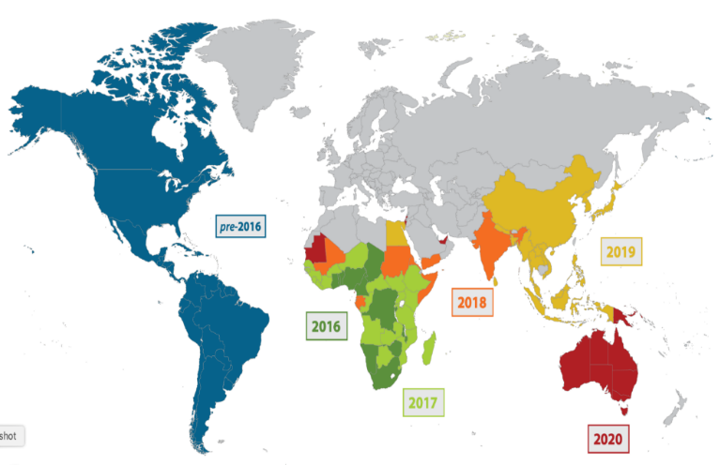
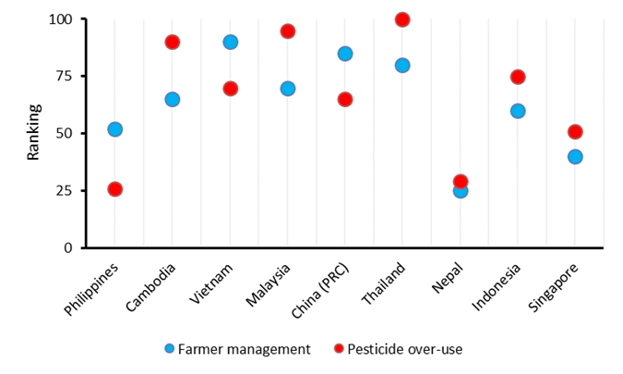
Birds eye view- AP Region
Food security and livelihood threats by FAW
Dominance of Chemical pesticides
Country-level efforts inadequate
Agro-ecological tactics are systematically- overlooked
Nature-based solutions- much talked but inadequately placed
Farmers’ pest management behavior

Slide 4
Regional Situation: Number of HHPs in 13 Asian Countries
Pesticide Use: dominant measure of pest control in AP region
Regional Situation: Proportion of Various Pesticides in Agriculture and PH (12 Asian Countries)
Proportion of various pesticides in agriculture and PH (a.i. as of type)

Slide 5
1. Technical and capacity development achievements
Level | Intervention type | Achievements/Impact
Individual level | FAWMEWS (900) -Cambodia, Indonesia, Lao PDR, Nepal, and the Philippines, Bangladesh, Pakistan, Timor Leste, PNG and other country | Individual skills, knowledge and performance
Organization level | Developing a SPS Technical Platform with guidance documents and toolkit | Plans, rules and regulations, partnerships, leadership
 | Technical guidance on Locust
 | Plant Protection Outlook in AP region
 | Technical guidance on FAW
 | Capacity building IPM (BCAs), ephyto (led by Australia) Capacity Building on Insect Pest Identification Using Remote Microscopy System in Philippines
Enabling environment level | Regional Steering Committee on FAW | Capacities improvement
 | National Plant Health Strategy (Vietnam), IPM policy (Nepal)
 | Review of pesticide rules, guidelines (Afghanistan, Bangladesh)
 | RSPM on mango, RIG on chili
 | Regional IPM Package on FAW
 | Developing Bio protection portal
 | APPPC Regional Workshop on Strategic Planning for 2022-2028
 | Surveillance projects and activities in Philippines supported by APQA

Slide 6
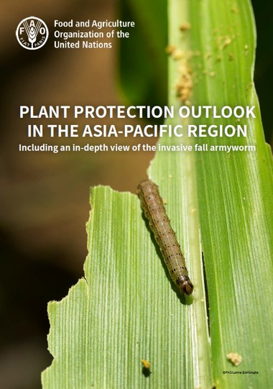
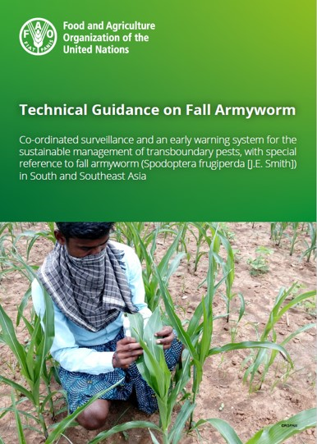
Achievements
1. Technical guidance on FAW management
https://doi.org/10.4060/cc0227en
2. Technical guidance on desert locust Early warning system and sustainable management of transboundary pests, with special reference to desert locust (Schistocerca gregaria [Forskål]) in South Asia https://doi.org/10.4060/cc0147en
3. Plant Protection Outlook in AP region with in depth studies on FAW https://doi.org/10.4060/cb7502en
4. Agro-ecology science relates to economic development but not global pesticide pollution” in Journal of Environmental Management (JEMA), ELSEVIER; https://www.sciencedirect.com/science/article/pii/S0301479722001025
5. Contrasting National Plant Protection Needs, Perceptions and Techno-Scientific Capabilities in the Asia-Pacific Region” in Front. Sustain. Food Syst https://doi.org/10.3389/fsufs.2022.853359
6. climate change mitigation High-profile Nature Food describes carbon footprint of insecticide-based (FAW) control and non-chemical alternatives https://www.sciencedirect.com/science/article/pii/S0301479722001025

Slide 7
Achievements: Regional FAW control initiative
Chair
FAO ADG, Regional Representative
Regional Steering Committees
National Task Force
Areas affected by FAW- reduced to below 5% (India and Philippines)
Monitoring and early warning and routine forecasting- China
IPM tactics validation- Philippines and China
Regional IPM Package- in process
Data collection on impact of FAW -India
Chair
Technical Committee
AFS-GL, RAP
Chair
FAO Sub-Regional Representative
Member (Foal Person and Experts)
Member Secretary
APPPC Secretariat
National Task Force
Chair- Agriculture Ministry and Experts

Slide 8
Achievement: Reduction of FAW infestation in some country
Fall Armyworm infestation in Indonesia

Slide 9
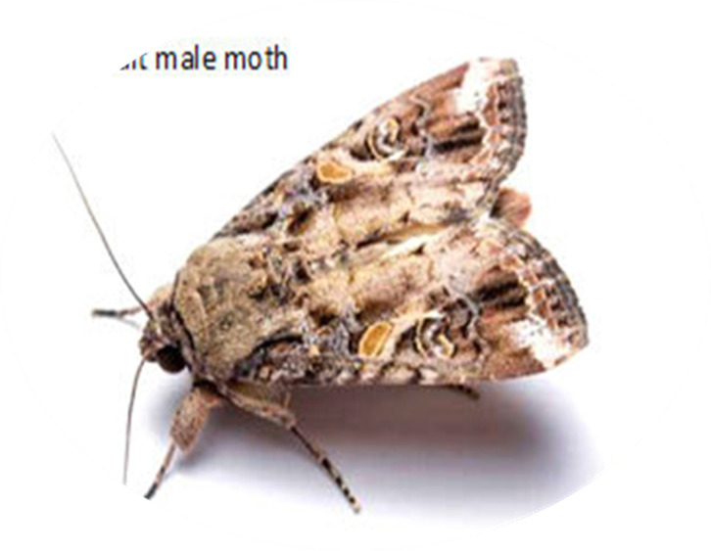
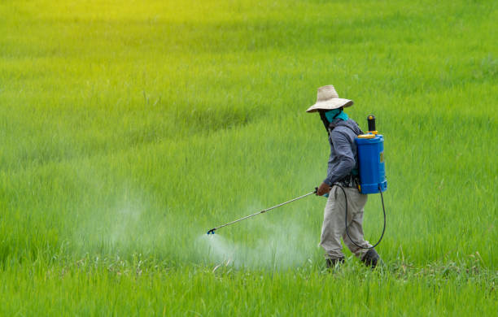
Emerging pests and issues
Pests
Fall armyworm on corn
Tropical race 4 of Fusarium oxysporum f. sp. cubense on banana
Tuta absoluta on tomato
Magnaporthe oryzae pathotype Triticum on wheat (wheat Blast)
Locust in south and south west Asia
Issues
Addressing country-specific emerging pests through agro-ecological approaches
Need for PCE of least developed NPPOs
Need of commodity specific standards on war footing
Capacity development for cross border paperless trade
Supporting NPPOs for developing a SPS Information Management System
Need to develop a web portal for regulated pests for seeds and import condition
Private seed sector engagement for phytosanitary compliances
Carbon footprints in the Asia-Pacific

Slide 10
Surveillance projects and activities
Australia
Pest surveillance activities in PNG and Timor-Leste with NPPO
Pest surveillance and project- ASEAN Regional Diagnostic Network Project and STDF
International trade of sea containers, contaminant and hitchhiker pests
Safe provision of humanitarian aid in disaster situations
Biosecurity capacity and capability of Pacific Island Countries
Implementation of ePhyto - South west Pacific countries
Extensive post-border surveillance on different pests Xylella (Xylella fastidiosa)/Glassy, Winged sharpshooter (Homalodisca vitripennis), Khapra beetle (Trogoderma granarium), Spotted-wing drosophila (Drosophila suzukii), Exotic/economic fruit fly, (Bactrocera, Zeugodacus and Ceratitis spp.), Citrus canker (Xanthomonas citri), Huanglongbing (Candidatus Liberibacter asiaticus), Spongy moths (Lymantria spp.), Brown marmorated stink bug (Halyomorpha halys), Internal and external bee mites/ Exotic bees (Apis spp.), Exotic invasive ants (Anoplolepis gracilipes, Brachyponera chinensis, Nylanderia fulva, Solenopsis spp., Wasmannia auropunctata)
Management of Spodoptera frugiperda (fall armyworm) detections in Australia www.outbreak.gov.au
Early Warning and Migration monitoring
FAMEWS and traditional monitoring
China: Migration monitoring on FAW through radar technology
Japan: Early warning monitoring of fruit fly (remote trapping), https://magpi/raspberrypi.com/articles/remote-agricultural-monitoring

Slide 11
Surveillance projects and activities
Issues
Surveillance programs: different levels of maturity, inclusiveness and technological advance
Traditional, labor-intensive approaches: most countries, pheromone traps
Radar-tracking (China), remote trapping (Japan), epidemiological modeling and forecasting: handful of nations
Developing Information Systems for Surveillance and Pest Reporting at national level
Engagement with stakeholders at national level (community, universities, Research Institutes, extension officers and farmers)
Managing and sharing surveillance data

Slide 12
Proposals for further collaboration/cooperation
1. Collaboration with STDF for scaling up projects on Asia pesticide risk mitigation for promotion of biopesticides (STDF/PG/634)
An STDF project is being implements in 9 of the South and South East Asian countries that needs to be complemented by APPPC in other countries of the pacific region with the following objectives:
Residue decline studies and field studies to work out the optimal pre-harvest interval period when biopesticides are to be sprayed in the field to avoid the residue (MRL) issues in export
Capacity building- researchers, manufacturing of microbial biopesticides
Regulatory coordination, registration and collaboration for biopesticides
Farmers outreach programme on biopesticide education
Promotion of nature-based solutions
Strengthen­ing national surveillance systems such as diagnostic laboratories
Establishing a regional platform for a knowledge exchange on monitoring and early warning system
2. Exploring collaborations with USDA, GIZ, regional organizations and other agencies
Strengthening need-based phytosanitary compliance actives by building institutional capacities and digitalization

