Slide 1
IPPC Secretariat Report
Osama El-Lissy, IPPC Secretary
CPM 2023/05

Slide 2
IPPC Secretariat Report
Core Work
+
Internal Management
=
Optimum IPPC
Standard Setting
Implementation & Facilitation
Integration & Support
E-Phyto
Secretariat Update
CPM-16 – Follow up
Future Initiatives
Resource Mobilization
Consistency
Focused & Effectiveness
Adaptable & Innovative
Protecting Plant Resources and Facilitating Safe Trade
Notes:
CPM-16 held virtually held for virtually with over 330 participants from 120 contracting parties and 20 observers

Slide 3
IPPC Secretariat Report
Core Work
+
Internal Management
=
Optimum IPPC
Standard Setting
Implementation & Facilitation
Integration & Support
E-Phyto
Secretariat Update
CPM-16 – Follow up
Future Initiatives
Resource Mobilization
Consistency
Focused & Effectiveness
Adaptable & Innovative
Protecting Plant Resources and Facilitating Safe Trade
Notes:
CPM-16 held virtually held for virtually with over 330 participants from 120 contracting parties and 20 observers

Slide 4
IPPC Secretariat Report
Core Work
+
Internal Management
=
Optimum IPPC
Standard Setting
Implementation & Facilitation
Integration & Support
E-Phyto
Secretariat Update
CPM-16 – Follow up
Future Initiatives
Resource Mobilization
Consistency
Focused & Effectiveness
Adaptable & Innovative
Notes:
CPM-16 held virtually held for virtually with over 330 participants from 120 contracting parties and 20 observers

Slide 5
IPPC Secretariat Report
Core Work
+
Internal Management
=
Optimum IPPC
Standard Setting
Implementation & Facilitation
Integration & Support
E-Phyto
Secretariat Update
CPM-16 – Follow up
Future Initiatives
Resource Mobilization
Consistency
Focused & Effectiveness
Adaptable & Innovative
Notes:
CPM-16 held virtually held for virtually with over 330 participants from 120 contracting parties and 20 observers

Slide 6
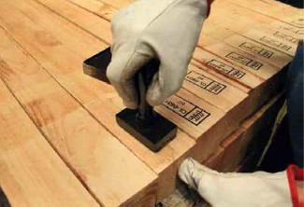
IPPC Secretariat Report
Core Work
+
Internal Management
=
Optimum IPPC
Standard Setting
Implementation & Facilitation
Integration & Support
E-Phyto
Mr. Avetik Nersisyan, Unit Lead
Ms. Sophie Peterson (Australia) elected as new chairperson in May 2022
Four Technical Panels: Technical Panel on Phytosanitary Treatments (TPPT), Technical Panel on Diagnostic Protocols (TPDP), Technical Panel on Commodity Standards (TPCS), and Technical Panel for the Glossary (TPG) progressed very well throughout the year.
Three expert working groups (EWGs) met to draft text on the use of an Annex to ISPM 39, of an Annex to ISPM 37, and to reorganize the PRA standards
Notes:
CPM-16 held virtually held for virtually with over 330 participants from 120 contracting parties and 20 observers

Slide 7
IPPC Secretariat Report
Core Work
+
Internal Management
=
Optimum IPPC
Standard Setting
Implementation & Facilitation
Integration & Support
E-Phyto
Mr. Avetik Nersisyan, Unit Lead
Ms. Sophie Peterson (Australia) elected as new chairperson in May 2022
Two webinars: Standard setting process and IPPC commodity standards
Two focus groups: Sea containers and Safe provision of food and other humanitarian aid
Notes:
CPM-16 held virtually held for virtually with over 330 participants from 120 contracting parties and 20 observers

Slide 8
IPPC Secretariat Report
Core Work
+
Internal Management
=
Optimum IPPC
Standard Setting
Implementation & Facilitation
Integration & Support
E-Phyto
Ms. Sarah Brunel, Unit Lead
Mr. Dominique Pelletier (Canada) chairperson since 2019
Four e-learning courses on Pest Risk Analysis, Surveillance and Reporting Obligations, Phytosanitary Export Certification System and Phytosanitary Inspection
IPPC guides for Regulation of Wood Packaging Material, E-commerce, Emergency Management, and TR-4 being finalized
Phytosanitary Capacity Evaluations (PCEs) were undertaken in several countries
PCE facilitator-training course delivered
Notes:
CPM-16 held virtually held for virtually with over 330 participants from 120 contracting parties and 20 observers

Slide 9
IPPC Secretariat Report
Core Work
+
Internal Management
=
Optimum IPPC
Standard Setting
Implementation & Facilitation
Integration & Support
E-Phyto
Mr. Arop Deng, Team Lead
Annual CPM-16 Conference
Ten CPM Bureau monthly meetings
Strategic Planning Group (SPG) meeting; 70th Anniversary of the IPPC
Three meetings of the 33rd Technical Consultation among Regional Plant Protection Organizations (TC RPPO)
Seven IPPC Regional Workshops
Inter-Africa Phytosanitary Council and Economic Community of West African States
Three Focus Groups: Communication, Climate Change, and implementation of the IPPC Strategic Framework
Notes:
CPM-16 held virtually held for virtually with over 330 participants from 120 contracting parties and 20 observers

Slide 10
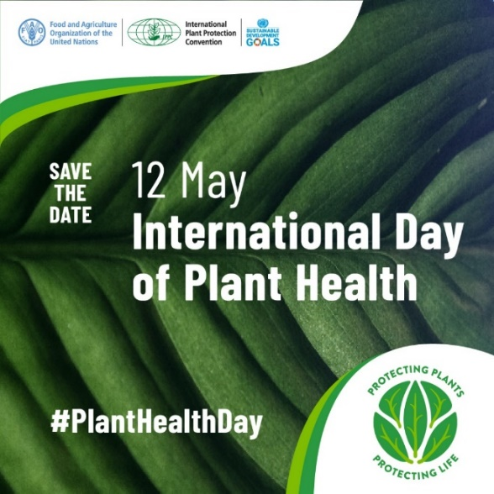
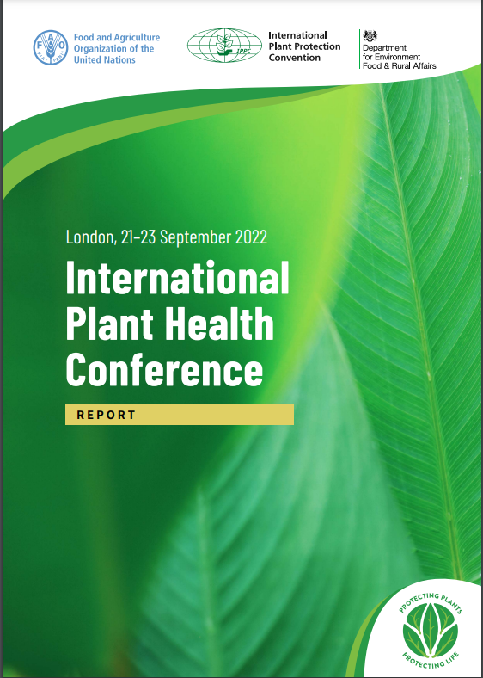
IPPC Secretariat Report
Core Work
+
Internal Management
=
Optimum IPPC
Standard Setting
Implementation & Facilitation
Integration & Support
E-Phyto
Mr. Arop Deng, Team Lead
International Day of Plant Health
International Plant Health Conference
Notes:
CPM-16 held virtually held for virtually with over 330 participants from 120 contracting parties and 20 observers

Slide 11
IPPC Secretariat Report
Core Work
+
Internal Management
=
Optimum IPPC
Standard Setting
Implementation & Facilitation
Integration & Support
E-Phyto
Mr. Arop Deng, Team Lead
IPPC Monthly Newsletter
Notes:
CPM-16 held virtually held for virtually with over 330 participants from 120 contracting parties and 20 observers

Slide 12
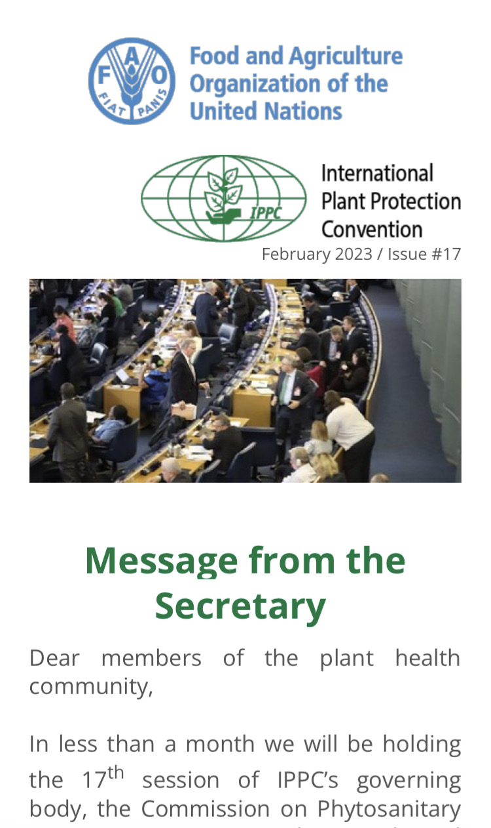
IPPC Secretariat Report
Core Work
+
Internal Management
=
Optimum IPPC
Standard Setting
Implementation & Facilitation
Integration & Support
E-Phyto
Mr. Arop Deng, Team Lead
IPPC Monthly Newsletter
Notes:
CPM-16 held virtually held for virtually with over 330 participants from 120 contracting parties and 20 observers

Slide 13
IPPC Secretariat Report
Core Work
+
Internal Management
=
Optimum IPPC
Standard Setting
Implementation & Facilitation
Integration & Support
E-Phyto
Mr. Craig Fedchock, Program Manager
Increased ePhytos passing through the system from 68,000 per month in 2021 to 122,000 in 2022
Increased participation from 73 to 122 countries registered
Arabic and French language versions of ePhyto GeNS system are now available
Facilitated the development of digital signature for all GeNS countries
Notes:
CPM-16 held virtually held for virtually with over 330 participants from 120 contracting parties and 20 observers

Slide 14
IPPC Secretariat Report
Core Work
+
Internal Management
=
Optimum IPPC
Standard Setting
Implementation & Facilitation
Integration & Support
E-Phyto
Secretariat Update
CPM-16 – Follow up
Future Initiatives
Resource Mobilization
Consistency
Focused & Effectiveness
Adaptable & Innovative
Protecting Plant Resources and Facilitating Safe Trade
Notes:
CPM-16 held virtually held for virtually with over 330 participants from 120 contracting parties and 20 observers

Slide 15
IPPC Secretariat Report
Core Work
+
Internal Management
=
Optimum IPPC
Standard Setting
Implementation & Facilitation
Integration & Support
E-Phyto
Secretariat Update
CPM-16 – Follow up
Future Initiatives
Resource Mobilization
Consistency
Focused & Effectiveness
Adaptable & Innovative
Protecting Plant Resources and Facilitating Safe Trade
Notes:
CPM-16 held virtually held for virtually with over 330 participants from 120 contracting parties and 20 observers

Slide 16
IPPC Secretariat Report
Core Work
+
Internal Management
=
Optimum IPPC
Standard Setting
Implementation & Facilitation
Integration & Support
E-Phyto
Secretariat Update
CPM-16 – Follow up
Future Initiatives
Resource Mobilization
Consistency
Focused & Effectiveness
Adaptable & Innovative
Notes:
CPM-16 held virtually held for virtually with over 330 participants from 120 contracting parties and 20 observers

Slide 17
IPPC Secretariat Report
Core Work
+
Internal Management
=
Optimum IPPC
Standard Setting
Implementation & Facilitation
Integration & Support
E-Phyto
Secretariat Update
CPM-16 – Follow up
Future Initiatives
Resource Mobilization
Consistency
Focused & Effectiveness
Adaptable & Innovative
Notes:
CPM-16 held virtually held for virtually with over 330 participants from 120 contracting parties and 20 observers

Slide 18
Osama El-Lissy
Secretary
Marko Benovic
Budget and Finance Specialist
Tanja Lahti
Secretariat Office Assistant
Standard Setting Unit
Implementation & Facilitation Unit
Integration & Support Team
ePhyto Program
Avetik Nersisyan
Unit Leader
Sarah Brunel
Unit Leader
Arop Deng
Team Leader
Craig Fedchock
ePhyto Manager
Adriana Moreira
Standard Setting Officer
Deputy to Unit Leader
Descartes Koumba
Implementation Facilitation Officer
Paola Sentinelli
Information Management Specialist
Daxing Yang
(in-kind contribution)
Artur Shamilov
Standard Setting Officer
Natsumi Yamada
Implementation Facilitation Officer (in-kind)
Aoife Cassin
IPPC Programme Specialist
Chiara Pellegrini
Office Assistant
Temporary Assistant Pool
Janka Kiss
Standard Setting Associate
Dominique Menon
Implementation Facilitation Senior Expert (in-kind
Rokhila Madaminova
Programme Support Specialist
John Gilmore
Integration and Support Officer (in-kind)
Mutya Frio
Communications Specialist
Aixa del Greco
Standard Setting Assistant (part-time)
Ilona Kudzzyirava
Office Assistant
Temporary Assistant Pool
Barbara Peterson
Implementation Facilitation Unit Officer (in-kind )
Vladimir Mijatovic
Public Information Specialist
Karen Rouen
Editor (part-time)
Fitzroy White
Implementation Facilitation Officer
Vacant
G- Staff Assistant
Maki Iizuka
Agricultural Officer (in-kind )
Daniel Torella
Standard Setting Intern
Camilo Beltran Montoya
Implementation Facilitation Consultant
Cristiana Giovannini
Art Director (part-time)
Emmanuel Krah
Standard Setting Intern
Juan Rull Gabayet
Implementation Facilitation Consultant
Vacant
Communications Specialist
Lorenzo Monterosa
Standard Setting Intern
Vanant
G-Staff Unit Assistant
Lisa Ferraro
Communications and Outreach
Vacant
G-Staff Unit Assistant
Notes:
CPM-16 held virtually held for virtually with over 330 participants from 120 contracting parties and 20 observers

Slide 19
Osama El-Lissy
Secretary
Marko Benovic
Budget and Finance Specialist
Tanja Lahti
Secretariat Office Assistant
Standard Setting Unit
Implementation & Facilitation Unit
Integration & Support Team
ePhyto Program
Avetik Nersisyan
Unit Leader
Sarah Brunel
Unit Leader
Arop Deng
Team Leader
Craig Fedchock
ePhyto Manager
Adriana Moreira
Standard Setting Officer
Deputy to Unit Leader
Descartes Koumba
Implementation Facilitation Officer
Paola Sentinelli
Information Management Specialist
Daxing Yang
(in-kind)
Artur Shamilov
Standard Setting Officer
Natsumi Yamada
Implementation Facilitation Officer (in-kind)
Aoife Cassin
IPPC Programme Specialist
Chiara Pellegrini
Office Assistant
Temporary Assistant Pool
Janka Kiss
Standard Setting Associate
Dominique Menon
Implementation Facilitation Senior Expert (in-kind
John Gilmore
Integration and Support Officer (in-kind)
Aixa del Greco
Standard Setting Assistant (part-time)
Rokhila Madaminova
Programme Support Specialist
Mutya Frio
Communications Specialist
Ilona Kudzzyirava
Office Assistant
Temporary Assistant Pool
Barbara Peterson
Implementation Facilitation Unit Officer (in-kind )
Vladimir Mijatovic
Public Information Specialist
Karen Rouen
Editor (part-time)
Fitzroy White
Implementation Facilitation Officer
Vacant
G- Staff Assistant
Daniel Torella
Standard Setting Intern
Maki Iizuka
Agricultural Officer (in-kind)
Camilo Beltran Montoya
Implementation Facilitation Consultant
Emmanuel Krah
Standard Setting Intern
Cristiana Giovannini
Art Director (part-time)
Consultant
Juan Rull Gabayet
Implementation Facilitation Consultant
Lorenzo Monterosa
Standard Setting Intern
Lisa Ferraro
Communications and Outreach
Intern/Temporary
Vacant
G-Staff Unit Assistant
In-Kind Contribution
Vacant
G-Staff Unit Assistant
Vacant
G- Staff Assistant
Notes:
CPM-16 held virtually held for virtually with over 330 participants from 120 contracting parties and 20 observers

Slide 20
IPPC Secretariat Report
Core Work
+
Internal Management
=
Optimum IPPC
Standard Setting
Implementation & Facilitation
Integration & Support
E-Phyto
Secretariat Update
CPM-16 – Follow up
Future Initiatives
Resource Mobilization
Consistency
Focused & Effectiveness
Adaptable & Innovative
Notes:
CPM-16 held virtually held for virtually with over 330 participants from 120 contracting parties and 20 observers

Slide 21
Economic Community of West African States (ECOWAS) to become the eleventh RPPO
IPPC Secretariat Report
Notes:
CPM-16 held virtually held for virtually with over 330 participants from 120 contracting parties and 20 observers

Slide 22
Economic Community of West African States (ECOWAS) to become the eleventh RPPO
IPPC Secretariat Report
In June 2022, IPPC Secretariat hosted a meeting in Rome
Meeting participants included ECOWAS, IAPSC, AU, CPM Chair, and IPPC Secretariat
The purpose of the meeting was to discuss the underpinning rationale for ECOWAS request and identify a way forward
Notes:
CPM-16 held virtually held for virtually with over 330 participants from 120 contracting parties and 20 observers

Slide 23
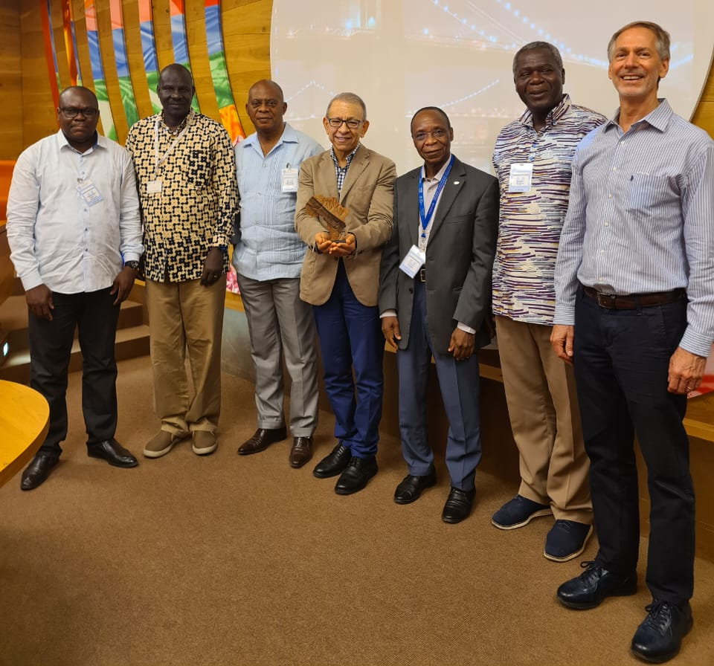
Economic Community of West African States (ECOWAS) to become the eleventh RPPO
IPPC Secretariat Report
In June 2022, IPPC Secretariat hosted a meeting in Rome
Meeting participants included ECOWAS, IAPSC, AU, CPM Chair, and IPPC Secretariat
The purpose of the meeting was to discuss the underpinning rationale for ECOWAS request and identify a way forward
Notes:
CPM-16 held virtually held for virtually with over 330 participants from 120 contracting parties and 20 observers

Slide 24
Economic Community of West African States (ECOWAS) to become the eleventh RPPO
IPPC Secretariat Report
The way forward (tentative agreement):
1. Africa to continue to have one RPPO (IAPSC), in order to foster the strategic “One Africa Voice” in the international and regional fora.
2. AUC and IAPSC to work towards strengthening the technical working groups (TWGs) in the regions (RECs) for effective coordination and implementation of plant health related activities in the continent.
3. ECOWAS continues its important role in coordinating phytosanitary activities among its member countries, including IPPC standard development and implementation.
Notes:
CPM-16 held virtually held for virtually with over 330 participants from 120 contracting parties and 20 observers

Slide 25
Economic Community of West African States (ECOWAS) to become the eleventh RPPO
IPPC Secretariat Report
The way forward (action items):
1. IPPC Secretariat to meet with the ECOWAS commission
2. IPPC Secretariat to meet with African Union and the Commissioner of Agriculture.
3. IPPC Secretariat to draft a proposal on Africa’s Phytosanitary Program (APP) with a vision to safeguarding agriculture and facilitating safe trade in the continent.
4. IPPC Secretariat to socialize the concept of APP within the FAO as well as international, regional and national organizations.
Notes:
CPM-16 held virtually held for virtually with over 330 participants from 120 contracting parties and 20 observers

Slide 26
Economic Community of West African States (ECOWAS) to become the eleventh RPPO
IPPC Secretariat Report
The way forward (action items):
1. IPPC Secretariat to meet with the ECOWAS commission
2. IPPC Secretariat to meet with African Union and the Commissioner of Agriculture.
3. IPPC Secretariat to draft a proposal on Africa’s Phytosanitary Program (APP) with a vision to safeguarding agriculture and facilitating safe trade in the continent.
4. IPPC Secretariat to socialize the concept of APP within the FAO as well as international, regional and national organizations.
Notes:
CPM-16 held virtually held for virtually with over 330 participants from 120 contracting parties and 20 observers

Slide 27
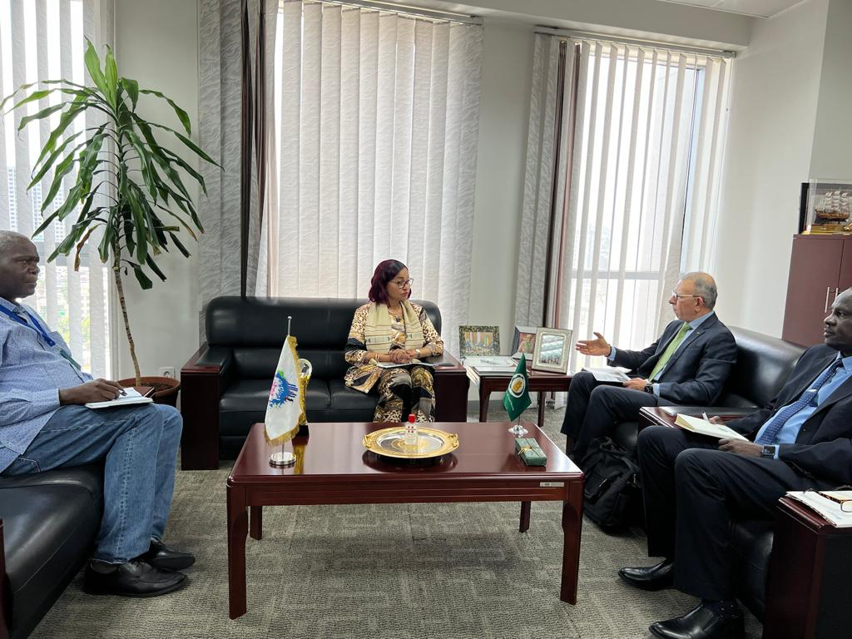

Slide 28
On the ECOWAS request: The Commissioner stated that “AUC has been and is discouraging the establishment of additional organizations in Africa with the view of fostering a one voice concept for Africa and as such, DARBE recognizes IAPSC as the only RPPO in the Continent.”

Slide 29
IPPC Secretariat Report
Core Work
+
Internal Management
=
Optimum IPPC
Standard Setting
Implementation & Facilitation
Integration & Support
E-Phyto
Secretariat Update
CPM-16 – Follow up
Future Initiatives
Resource Mobilization
Consistency
Focused & Effectiveness
Adaptable & Innovative
Notes:
CPM-16 held virtually held for virtually with over 330 participants from 120 contracting parties and 20 observers

Slide 30
IPPC Secretariat Report
Core Work
+
Internal Management
=
Optimum IPPC
Standard Setting
Implementation & Facilitation
Integration & Support
E-Phyto
Secretariat Update
CPM-16 – Follow up
Future Initiatives
Resource Mobilization
Consistency
Focused & Effectiveness
Adaptable & Innovative
Notes:
CPM-16 held virtually held for virtually with over 330 participants from 120 contracting parties and 20 observers

Slide 31
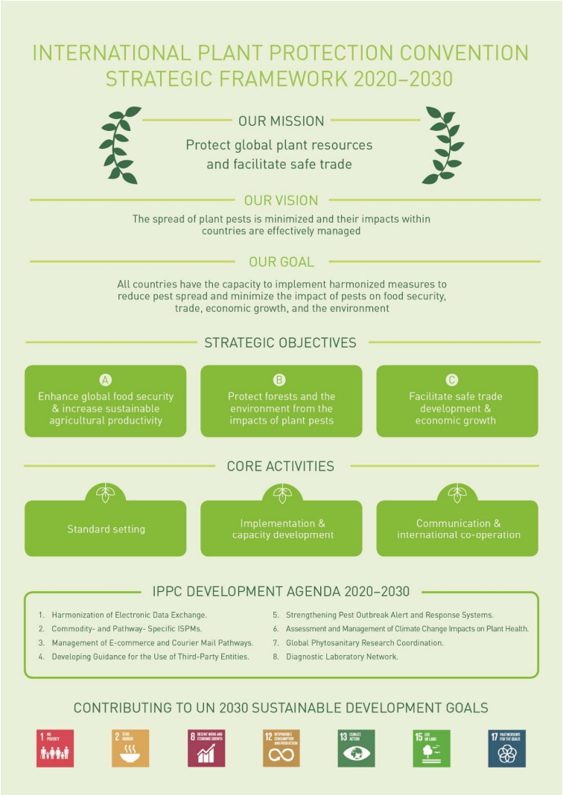
IPPC Secretariat Report
Core Work
+
Internal Management
=
Optimum IPPC
Standard Setting
Implementation & Facilitation
Integration & Support
E-Phyto
Secretariat Update
CPM-16 – Follow up
Future Initiatives
Resource Mobilization
Consistency
Focused & Effectiveness
Adaptable & Innovative
Notes:
CPM-16 held virtually held for virtually with over 330 participants from 120 contracting parties and 20 observers

Slide 32
IPPC Secretariat Report
Core Work
+
Internal Management
=
Optimum IPPC
Standard Setting
Implementation & Facilitation
Integration & Support
E-Phyto
Secretariat Update
CPM-16 – Follow up
Future Initiatives
Resource Mobilization
Consistency
Focused & Effectiveness
Adaptable & Innovative
Notes:
CPM-16 held virtually held for virtually with over 330 participants from 120 contracting parties and 20 observers

Slide 33
Initiative #1: Global Phytosanitary Programme
Notes:
Plant health is crucial to:
Enhance global food security, increase sustainable agriculture productivity, protect the environment, facilitate safe trade and boost economic development

Slide 34
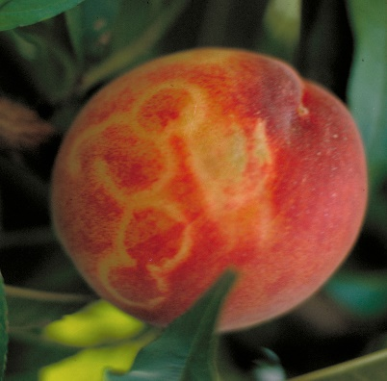
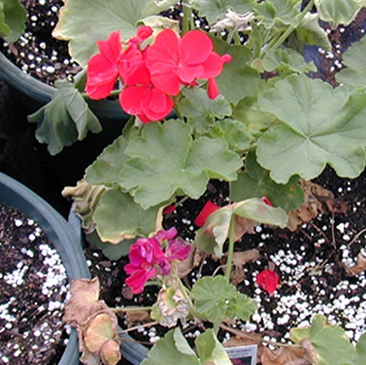
Challenges

Slide 35
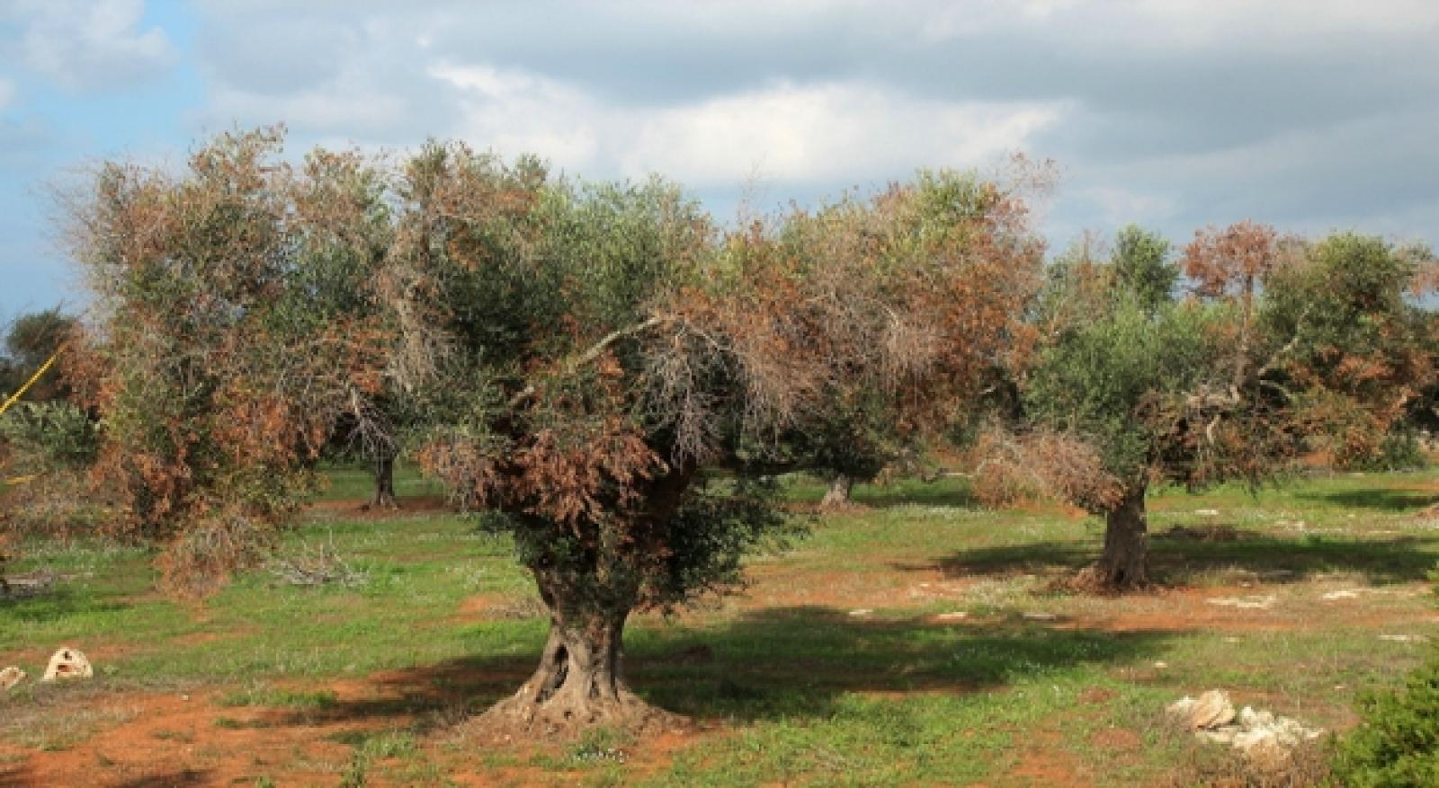
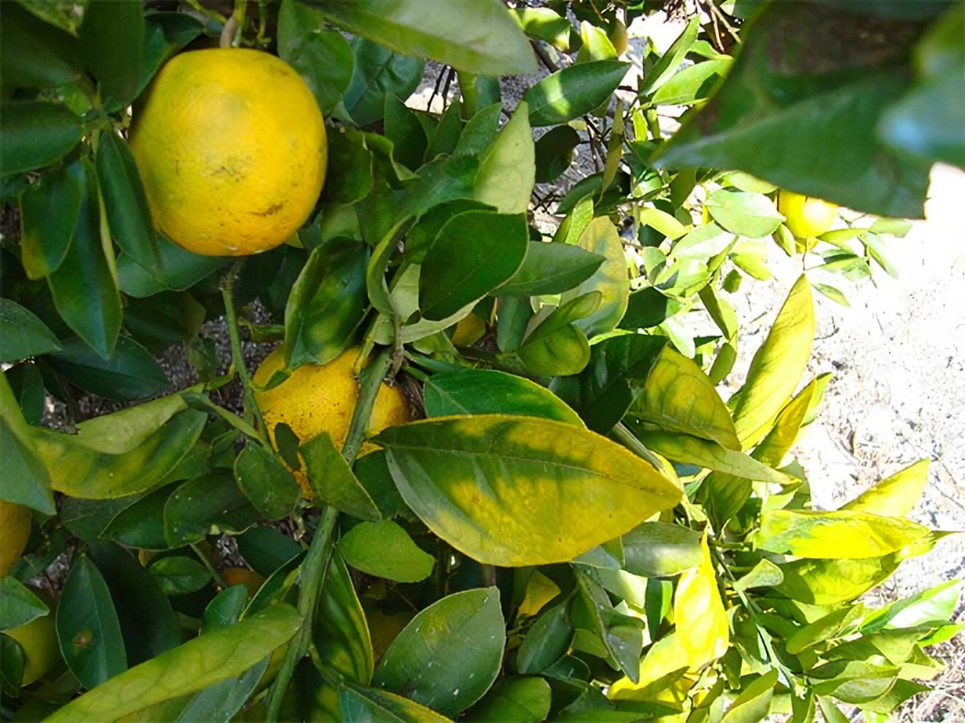
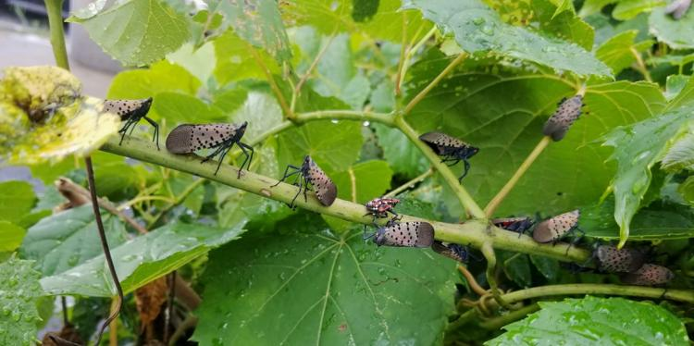
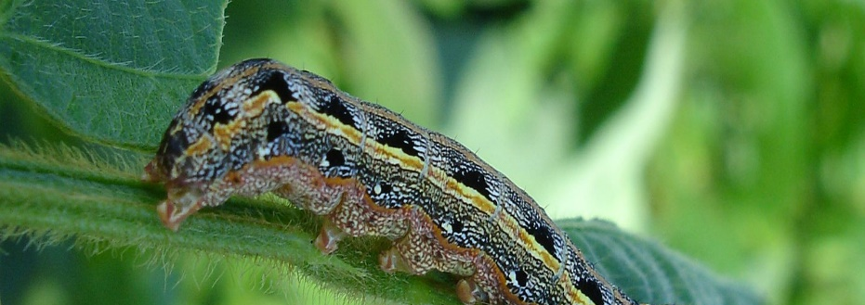
Xylella fastidiosa
Invasive plant pests increased by 40%
Citrus greening disease
Banana fusarium
Tephritid fruit flies
Red palm weevil
Spotted Lanternfly
Coffee leaf rust
Fall armyworm (Spodoptera frugiperda)

Slide 36
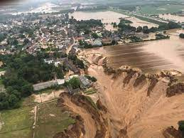
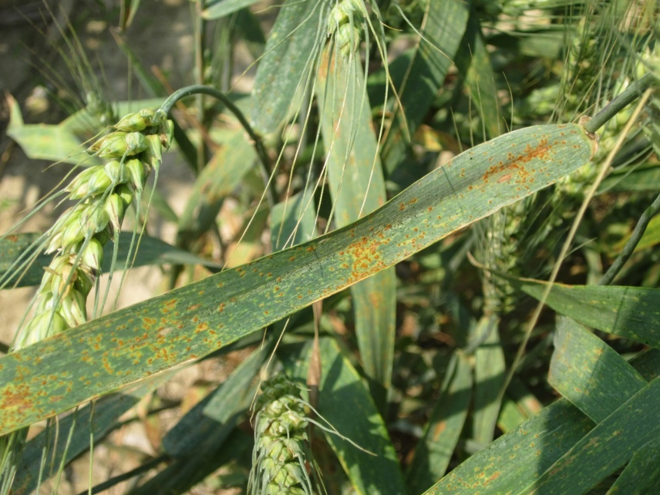
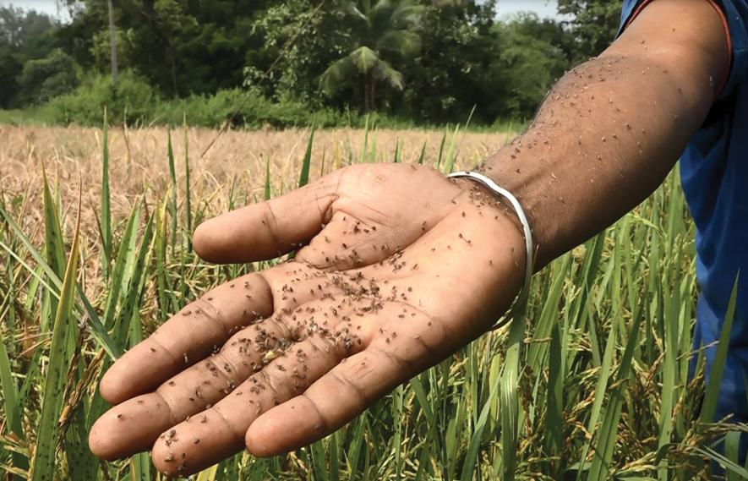
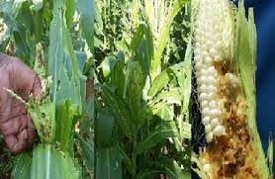
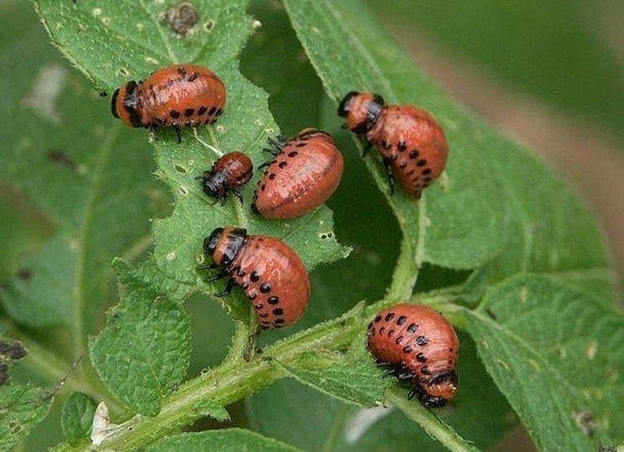
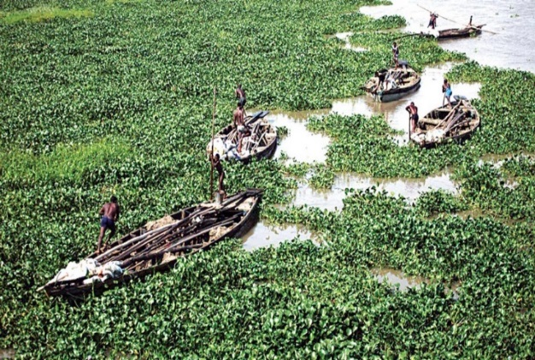
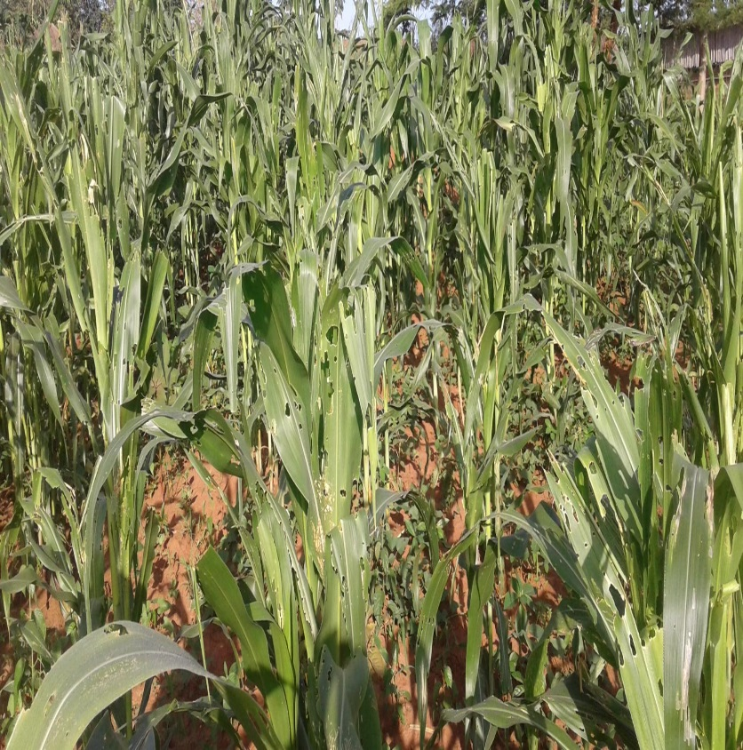
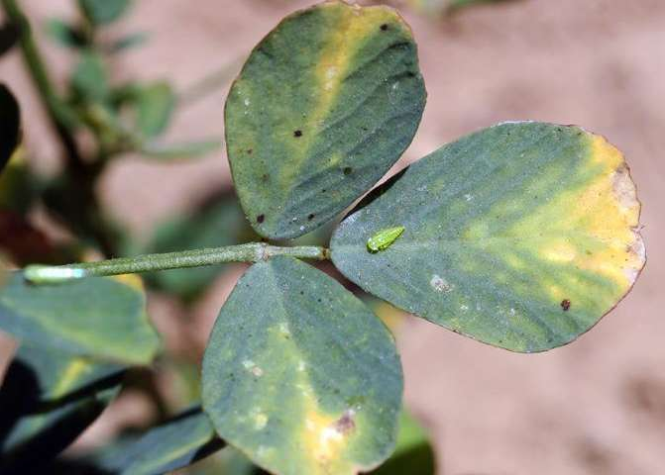
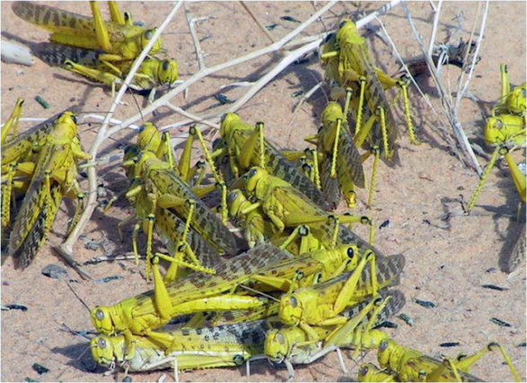
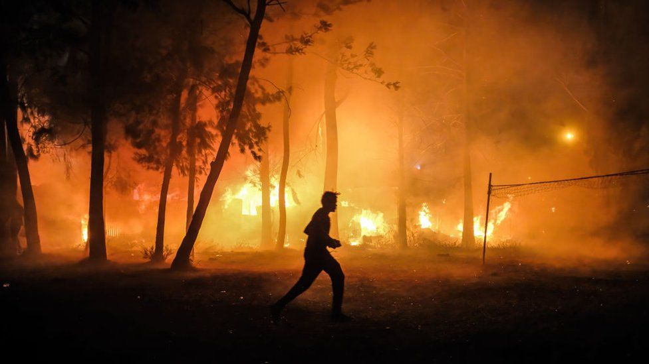
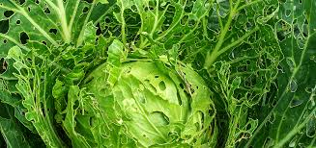
Impact of climate change on plant health

Slide 37
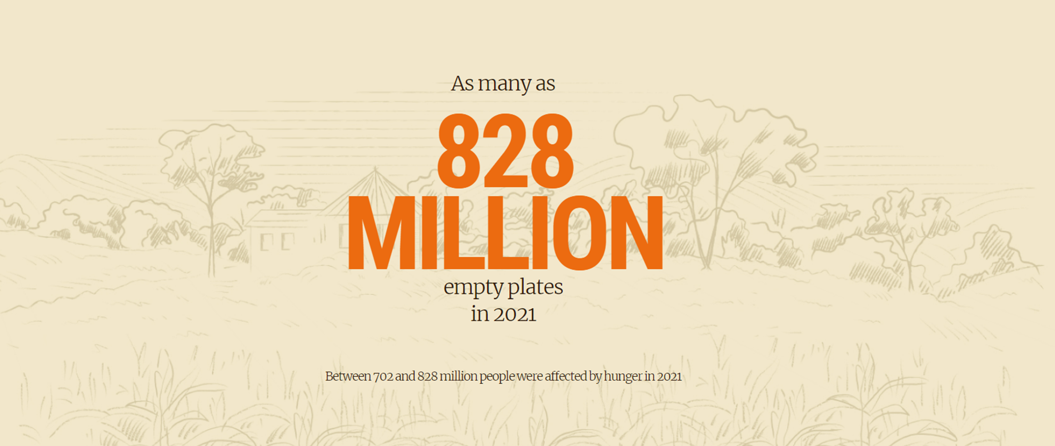
Challenges

Slide 38
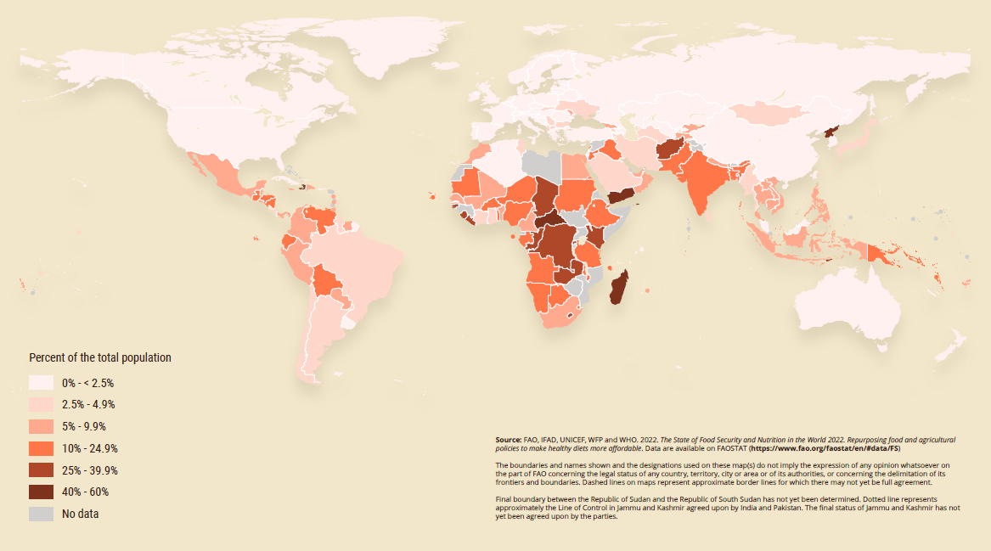
World Hunger Map 2021
Challenges

Slide 39
Initiative #1: Global Phytosanitary Programme
Notes:
Plant health is crucial to:
Enhance global food security, increase sustainable agriculture productivity, protect the environment, facilitate safe trade and boost economic development

Slide 40
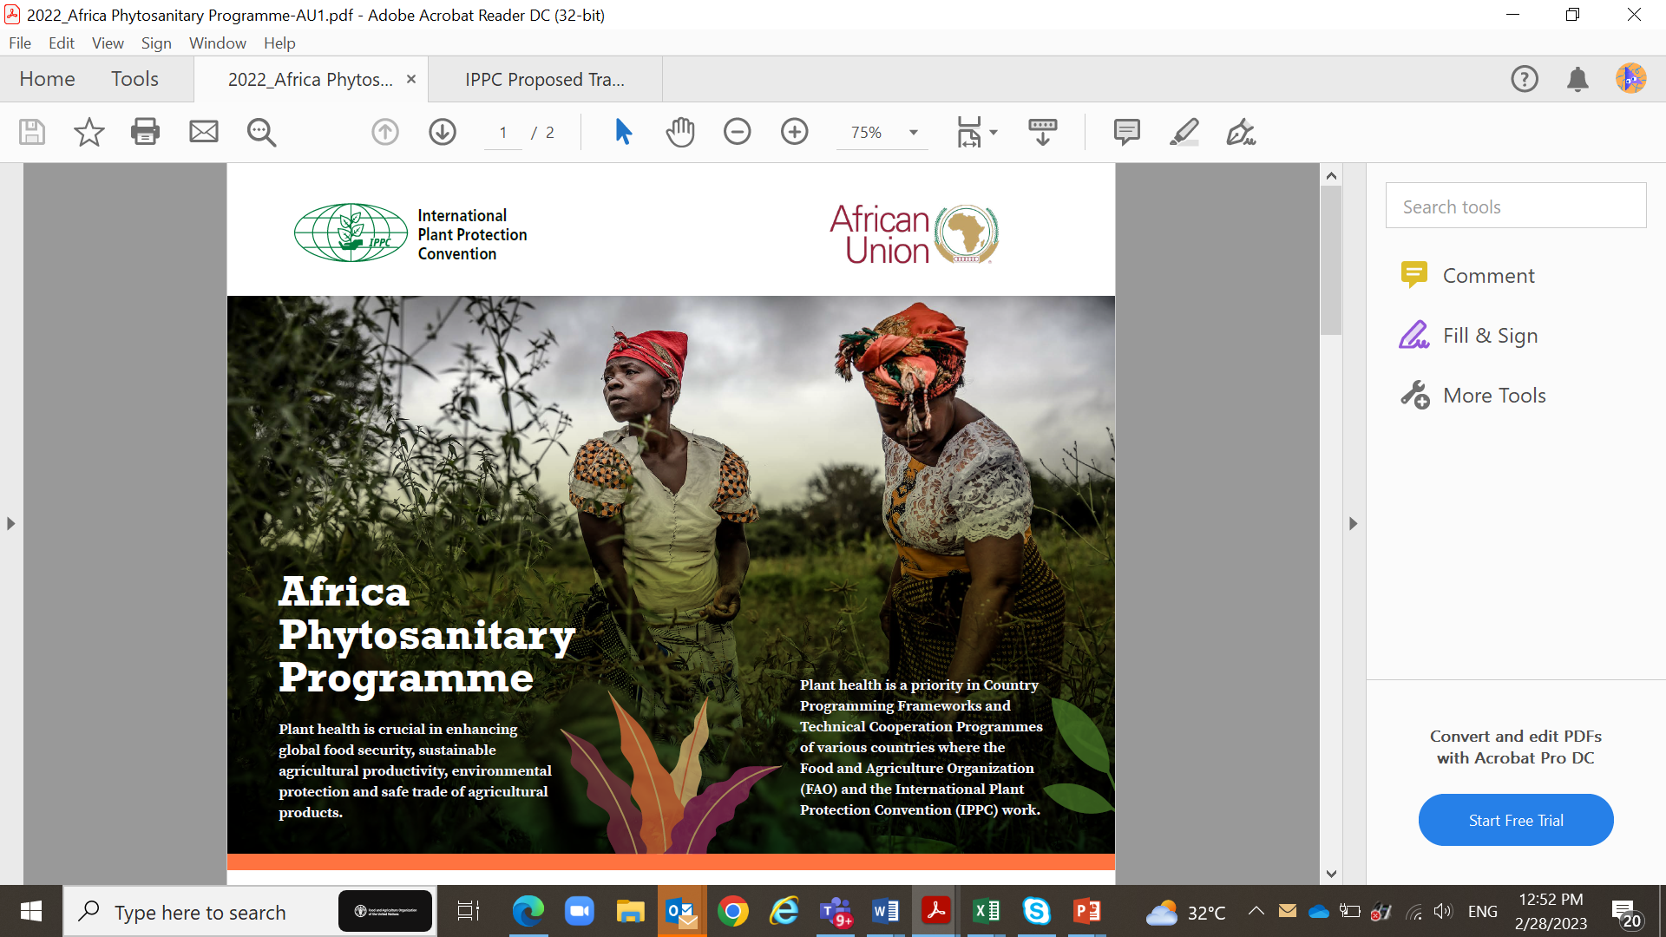

Slide 41
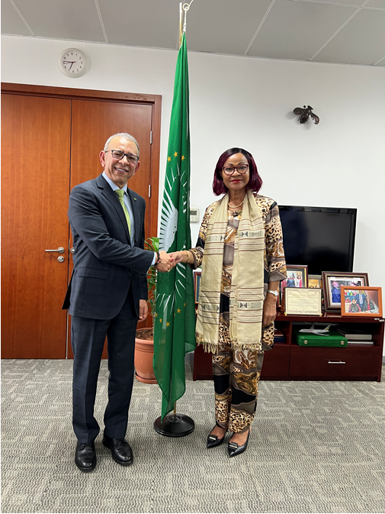

Slide 43
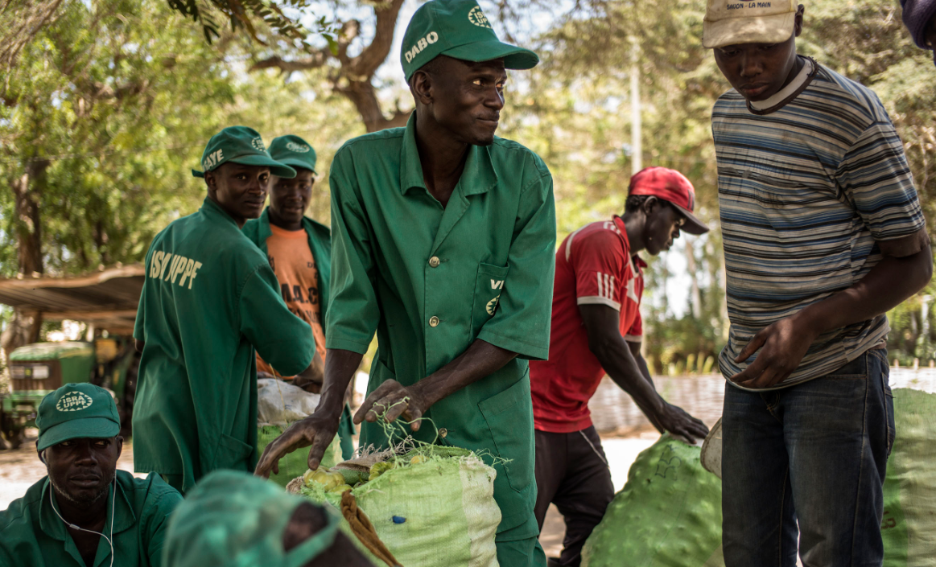
Africa Phytosanitary Programme
Main objectives:
The programme aims to provide the NPPOs the capacity to effectively and timely detect plant pests of regulatory, economic, and environmental significance.

Slide 44
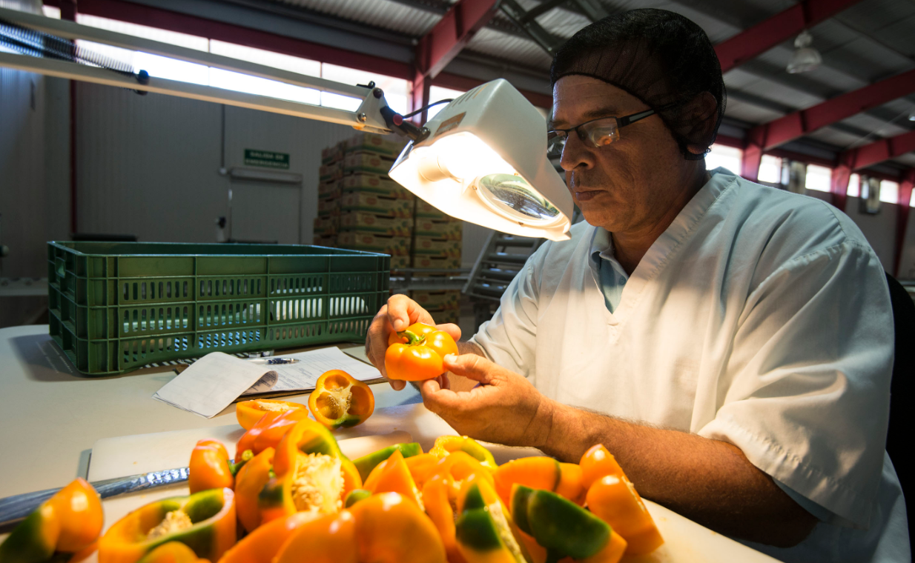
Africa Phytosanitary Programme
Main objectives:
Provides early detection of pests;
Positions NPPOs and RPPOs:
to prepare for
respond to and
recover from plant pests.

Slide 45
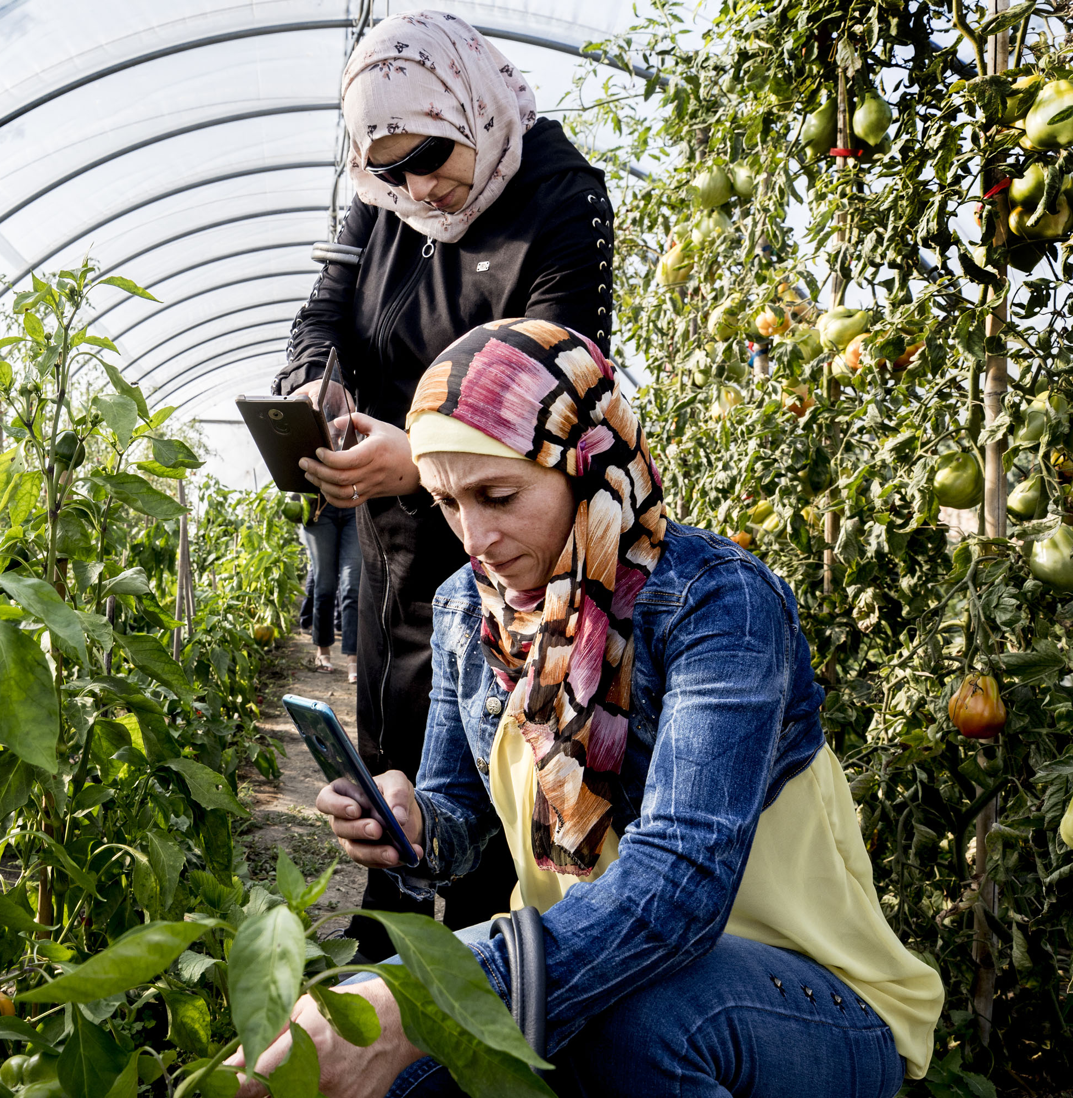
Safeguarding aid NPPOs in protecting agriculture and natural resources against the introduction and spread of plant pests.
Pest Surveillance
Data Management
Capacity Development and Support
Pest Management
Notes:
Safeguarding is designed to aid NPPOs in protecting agriculture and natural resources against the introduction and spread of plant pests and diseases. It includes the following components:
Pest Selection – Each country or region will select a number of pests and diseases (initially five), based on set phytosanitary criteria.
Pest Surveillance – Coordinating with cooperators, the IPPC Secretariat will engage subject matter experts to develop the survey, identification, and diagnostics methodology and protocol for each of the selected pests and diseases.
Data Management – Coordinating with cooperators, the IPPC Secretariat will facilitate the selection of the information management system, including data collection devices, data storage, and the analytics designed to provide timely and consumable reports.
Capacity Development and Support – Coordinating with cooperators, the IPPC Secretariat will facilitate the training, both virtually and in person to ensure consistency in the capacity of implementing the program.
It is important to note that the survey data for the selected pests will be used to develop the emergency preparedness, response, and recovery plans as part of the safeguarding component of the program.

Slide 46
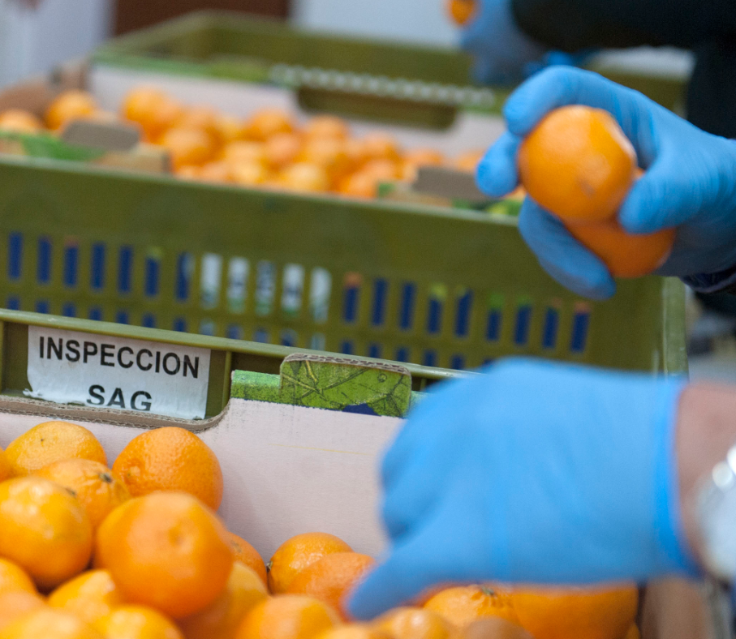
Safe Trade aid NPPOs to facilitate the imports and exports of agricultural products in a safe phytosanitary manner.
Pest free area
Import requirements
Inspection and testing of imported cargoes for plant pests
Phytosanitary export certification
Expansion of international and regional market access of agricultural products
Notes:
Safeguarding is designed to aid NPPOs in protecting agriculture and natural resources against the introduction and spread of plant pests and diseases. It includes the following components:
Pest Selection – Each country or region will select a number of pests and diseases (initially five), based on set phytosanitary criteria.
Pest Surveillance – Coordinating with cooperators, the IPPC Secretariat will engage subject matter experts to develop the survey, identification, and diagnostics methodology and protocol for each of the selected pests and diseases.
Data Management – Coordinating with cooperators, the IPPC Secretariat will facilitate the selection of the information management system, including data collection devices, data storage, and the analytics designed to provide timely and consumable reports.
Capacity Development and Support – Coordinating with cooperators, the IPPC Secretariat will facilitate the training, both virtually and in person to ensure consistency in the capacity of implementing the program.
It is important to note that the survey data for the selected pests will be used to develop the emergency preparedness, response, and recovery plans as part of the safeguarding component of the program.

Slide 47
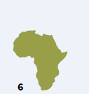
Phased-in implementation strategy targeting the 54 countries of Africa
Pilot phase: 2 countries from
each of the five
Africa’s Regional Economic Communities (RECs)
10 Countries
2 additional
Countries per RECs (or 10 additional countries)
20 Countries
2 additional
Countries per RECs (or 10 additional countries)
30 Countries
2 additional
Countries per RECs (or 10 additional countries)
40 Countries
Will cover the
remaining 14
countries in Africa
54 Countries
Maintenance phase:
Aims to empower countries to
build on their gained experiences
and sustainably expand the
program. Countries and regions
would have the capacity to
address additional pests of
concern and collaborate
consistently and in synergy.
Notes:
Safeguarding is designed to aid NPPOs in protecting agriculture and natural resources against the introduction and spread of plant pests and diseases. It includes the following components:
Pest Selection – Each country or region will select a number of pests and diseases (initially five), based on set phytosanitary criteria.
Pest Surveillance – Coordinating with cooperators, the IPPC Secretariat will engage subject matter experts to develop the survey, identification, and diagnostics methodology and protocol for each of the selected pests and diseases.
Data Management – Coordinating with cooperators, the IPPC Secretariat will facilitate the selection of the information management system, including data collection devices, data storage, and the analytics designed to provide timely and consumable reports.
Capacity Development and Support – Coordinating with cooperators, the IPPC Secretariat will facilitate the training, both virtually and in person to ensure consistency in the capacity of implementing the program.
It is important to note that the survey data for the selected pests will be used to develop the emergency preparedness, response, and recovery plans as part of the safeguarding component of the program.

Slide 48
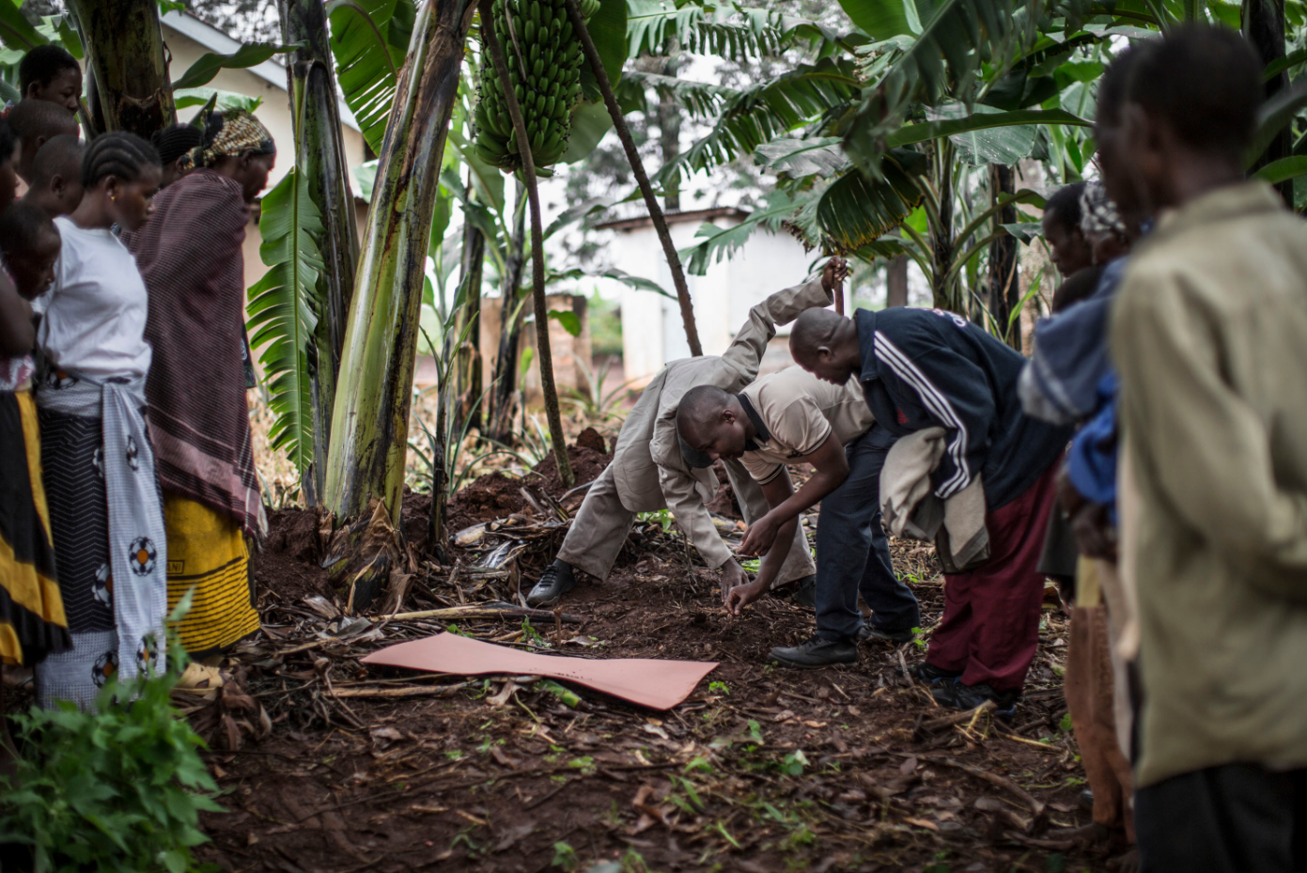
Africa phytosanitary programme
Estimated Budget
The overall budget estimate for the entire programme,
including all 54 countries, is USD 37.8 million for five years.
Estimated costs (USD) per country (for five years)
Capacity Building (Training) | 100 000
Travel | 50 000
Coordination | 50 000
Technical Cooperation Agreement | 500 000
TOTAL | 700 000

Slide 49
Initiative #2: Global Phytosanitary Trade Support Team
IPPC secretariat trade support team would serve as a focal point for providing timely information on trade-related ISPMs in support of facilitating safe trade between and among contracting parties.
Notes:
Plant health is crucial to:
Enhance global food security, increase sustainable agriculture productivity, protect the environment, facilitate safe trade and boost economic development

Slide 50
Initiative #2: Global Phytosanitary Trade Support Team
Responsive interaction
Proactive engagement
Notes:
Plant health is crucial to:
Enhance global food security, increase sustainable agriculture productivity, protect the environment, facilitate safe trade and boost economic development

Slide 51
Initiative #2: Global Phytosanitary Trade Support Team
Responsive interaction
Proactive engagement
ISPM -38
Establish a team with credible expertise in ISPMs
Provides timely and proper information on trade related ISPMs in support of safe trade
Notes:
Plant health is crucial to:
Enhance global food security, increase sustainable agriculture productivity, protect the environment, facilitate safe trade and boost economic development

Slide 52
ISPM-38 Implementation
STAGE 01
Pest Risk Analysis:
ISPM 2, ISPM 11, ISMP 12, ISPM 21, and ISPM 32
Pest Risk Mitigations:
ISPM 4, ISPM 10, ISPM 14, ISPM 20, ISPM 22, ISMP 29, and ISPM 34
STAGE 02
STAGE 03
STAGE 04
Inspection & Testing:
ISPM 23, ISPM 31, ISPM 24, and ISPM 27,
Import & Export Requirement:
ISPM 1, ISPM 12 , ISPM 20, ISPM 23, ISPM 24, ISPM 27, and ISPM 31
Market Access Request
ISPM 2 (Framework for pest risk analysis)
ISPM 11 (Pest risk analysis for quarantine pests)
ISPM 21 (Pest risk analysis for regulated non-quarantine pests)
ISPM 32 (Categorization of commodities according to their pest risk)
Bi-lateral Phytosanitary Agreement
ISPM 4 (Requirements for the establishment of pest free areas)
ISPM 10 (Requirements for the establishment of pest free places of production and pest free production sites)
ISPM 14 (The use of integrated measures in a systems approach for pest risk management)
ISPM 22 (Requirements for the establishment of areas of low pest prevalence)
ISPM 29 (Recognition of pest free areas and areas of low pest prevalence)
ISPM 34 (Design and operation of post-entry quarantine stations for plants)
Implementation
ISPM 1 (Phytosanitary principles for the protection of plants and the application of phytosanitary measures in international trade))
ISPM 12 (Phytosanitary certificates)
ISPM 20 (Guidelines for a phytosanitary import regulatory system)
ISPM 23 (Guidelines for inspection)
ISPM 24 (Guidelines for the determination and recognition of equivalence of phytosanitary measures)
ISPM 27 (Diagnostic protocols for regulated pests)
ISPM 31 (Methodologies for sampling of consignments)

Slide 53
IPPC Secretariat Report
Core Work
+
Internal Management
=
Optimum IPPC
Standard Setting
Implementation & Facilitation
Integration & Support
E-Phyto
Secretariat Update
CPM-16 – Follow up
Future Initiatives
Resource Mobilization
Consistency
Focused & Effectiveness
Adaptable & Innovative
Notes:
CPM-16 held virtually held for virtually with over 330 participants from 120 contracting parties and 20 observers

Slide 54
IPPC Secretariat Report
Core Work
+
Internal Management
=
Optimum IPPC
Standard Setting
Implementation & Facilitation
Integration & Support
E-Phyto
Secretariat Update
CPM-16 – Follow up
Future Initiatives
Resource Mobilization
Consistency
Focused & Effectiveness
Adaptable & Innovative
Notes:
CPM-16 held virtually held for virtually with over 330 participants from 120 contracting parties and 20 observers

Slide 55
Resource Mobilization
IPPC Secretariat Report
Donor Organizations (USD 50k), 2022
Million USD
MDTF | Projects | In Kind
Australia | European Union | Australia
Canada | Germany | Brazil
Ireland | China | Canada
Finland | Japan | France
Republic of Korea |  | Japan
USA/NAPPO |  | Republic of Korea
 |  | United States of America
Notes:
CPM-16 held virtually held for virtually with over 330 participants from 120 contracting parties and 20 observers

Slide 56
Thank you!
IPPC Secretariat Food and Agriculture Organization of the United Nations (FAO) ippc@fao.org | www.ippc.int

