Slide 1
Update on IPPC Governance and Strategy
4.1 Prepared for the IPPC Regional Workshops 2025​

Slide 2
OUTLINE
1. The IPPC, what is it?
  1.1 Introduction and brief history
  1.2 Vision, mission, objectives and core activities
2. Governance and Strategy Achievements
  2.1 Meetings
  2.2 CPM-19 key moments
  3. Communication, Advocacy and Knowledge Management
  4. International Cooperation

Slide 3
1.1 The IPPC, what is it?
The International Plant Protection Convention (IPPC) is the intergovernmental treaty of 185 contracting parties that aims to protect the world's plants, agricultural products and natural resources from plant pests.
It develops, adopts and promotes the application of International Phytosanitary Measures (ISPMs) as the main tool to safeguard global food security, facilitate safe trade and protect the environment.
The first international agreement for plant protection (Phylloxera Convention of 1881), followed by International Convention for the Protection of Plants of 1929 in Rome, which was reviewed and adopted by sixth Conference of FAO in 1951 and came into force in 1952.

Slide 4
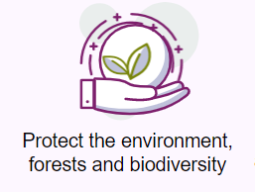
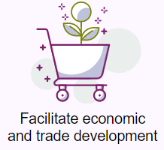

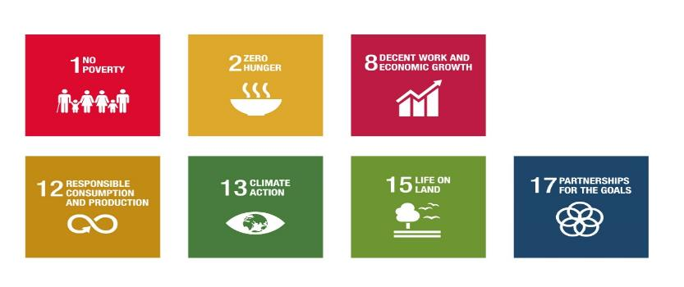
1.2 Vision, mission, objectives and core activities
Strategic Objectives (Anchored on 4 Betters)
IPPC Mission: Protect global plant resources and facilitate safe trade.
IPPC Vision: The spread of plant pests is minimized and their impacts within countries are effectively managed.
IPPC Objective: All countries have the capacity to implement harmonized measures to reduce pest spread and minimize the impact of pests on food security, trade, economic growth, and the environment.
IPPC Core Activities: Standards Setting, Standards Implementation and Communication and International Cooperation

Slide 5
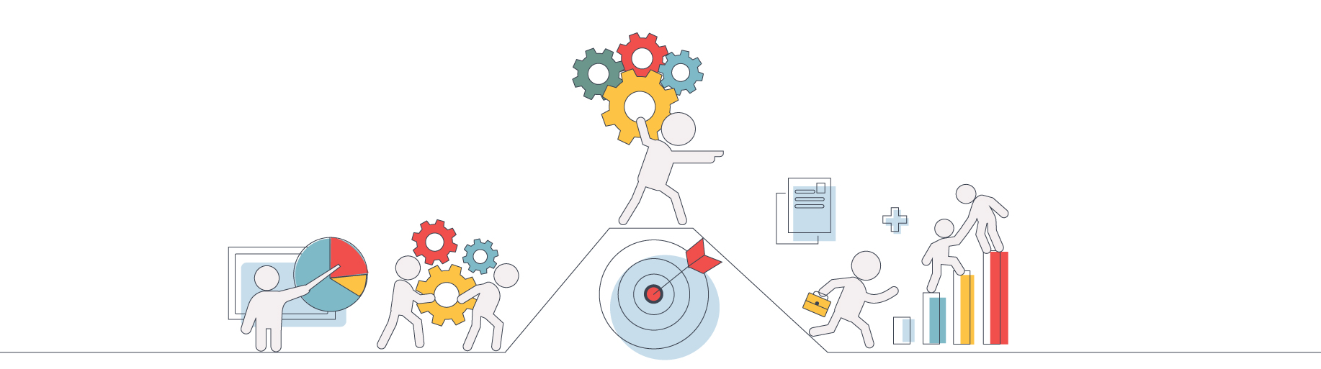
2. Governance and Strategy, 2024-25 Achievements
2.1 Meetings
2.2 CPM-19 key moments

Slide 6
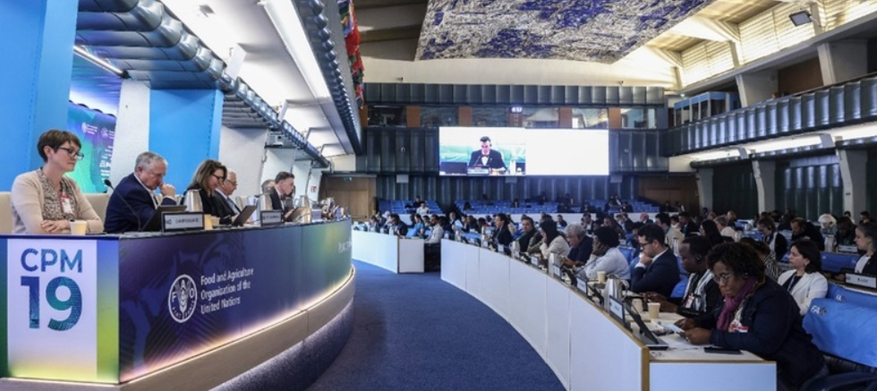
2.1 Meetings
Governing and subsidiary bodies meetings (1)
CPM-19 was successfully held with over 300 participants from 129 contracting parties, over 20 observer organizations as well as 2, 056 watched the livestream.
Role: to promote cooperation of CPs and partners to help implement the objectives of the IPPC.
Two CPM Bureau in person meetings in 2025 (March and June) to ensure continuity of IPPC work plan.
Role: to provide guidance to the IPPC Secretariat and CPM on strategic direction, cooperation, financial, operational management and provide continuity between CPM sessions.

Slide 7
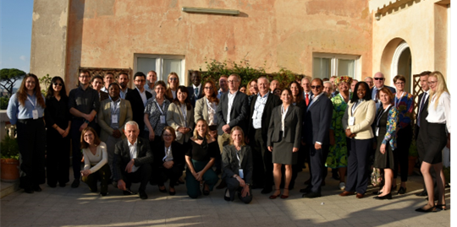
2.1 Meetings
Governing and subsidiary bodies meetings (2)
2024 IPPC Strategic Planning Group (SPG #13) was successfully held last year and discussions focused on enhancing plant health standards, resource mobilization and capacity development. The secretariat and now preparing for the next SPG in October 2025.
Role: to provide strategic perspective to the work of the IPPC, and support improvement through the provision of recommendations and strategic advice to the CPM on specific issues.

Slide 8
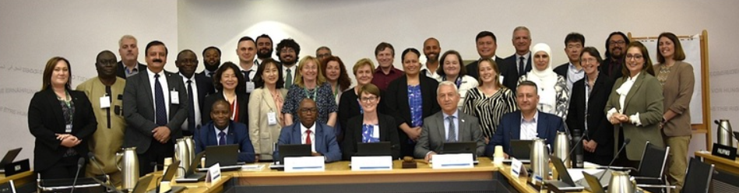
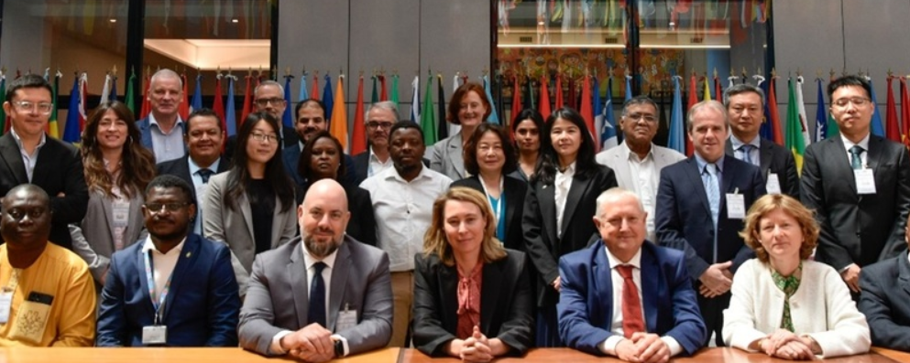
2.1 Meetings
Governing and subsidiary bodies meetings (3)
The Standards Committee (SC) convened 1 in person May 2025 inclusive of SC-7 meeting.
Role: to oversee the IPPC standards setting process, manages the development of ISPMs and provides guidance and oversight to the TPs and EWGs.
The Implementation and Capacity Development Committee (IC) convened 1 in person meeting in May 2025.
Role: to provide technical oversight of activities to enhance the capacities of CPs to implement the IPPC and meet the specific objectives agreed by CPM

Slide 9
2.1. CPM Focus Groups’ and other meetings (4)
The following FGs continue to perform their duties as per TORs:
    Strengthening Pest Outbreak Alert and Response Systems.
    Climate Change and Phytosanitary Issues.
    Sea Containers.
    Safe Provision of Food and Other Humanitarian Aid.
    Global Phytosanitary research coordination.
    Plant health in the context of One Health.
    Diagnostic Laboratory Network (to be formed).
  Africa Phystosanitary Programme (APP)
    Held several meetings with AU-IAPSC, RECs, NPPOs, donors and Ministers of Agriculture in the 11 pilot countries
    Held a workshop in South Africa in June 2025 to launch phase 2
Notes:
Focus groups meet at varying intervals. Some meet virtually bi-weekly or monthly while others meet in person 1-2 times per year.

Slide 10
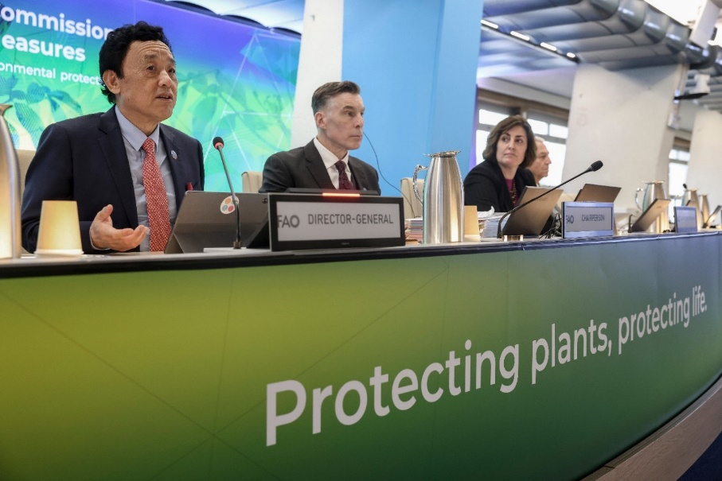
2.2 CPM-19 key moments
Adopted the first of the next generation of ISPMs namely, ISPM 46 on the trade of fresh mango fruit, and the annex to ISPM 39 on systems approaches for wood in international trade.
Approved the draft specification for a new ISPM titled "Safe Provision of Humanitarian Aid in the Phytosanitary Context", with high priority.
Launched the Plant Health Campus
Pledged contributions of USD 1.8 million to support global efforts to protect plants.
Science session on The importance of Plant Health in One Health

Slide 11
3. Communication, Advocacy and Knowledge Management

Slide 12
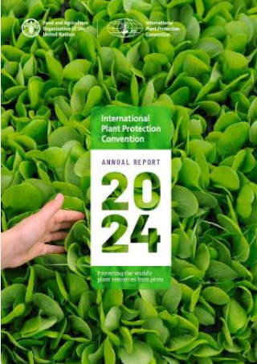
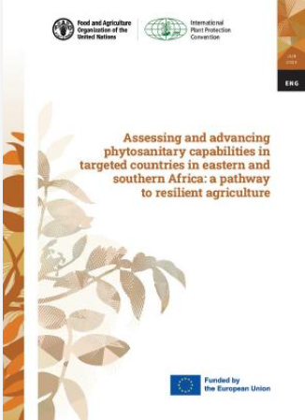
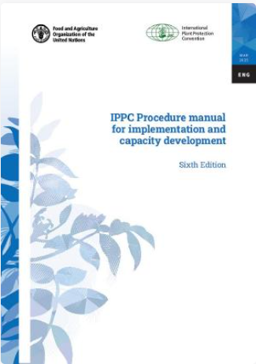
International Day of Plant Health, 12 May 2025
Key outcomes
3.1 Communications and advocacy: key progress
9 publications produced including the IPPC Annual Report 2024
982K
Users reached on social media
1 300
Virtual
Participants and livestream views
1000+
Views of new video on plant health and One Health
45
Media outlets covered IDPH around the world
60+
Countries celebrating and organizing an IDPH event

Slide 13
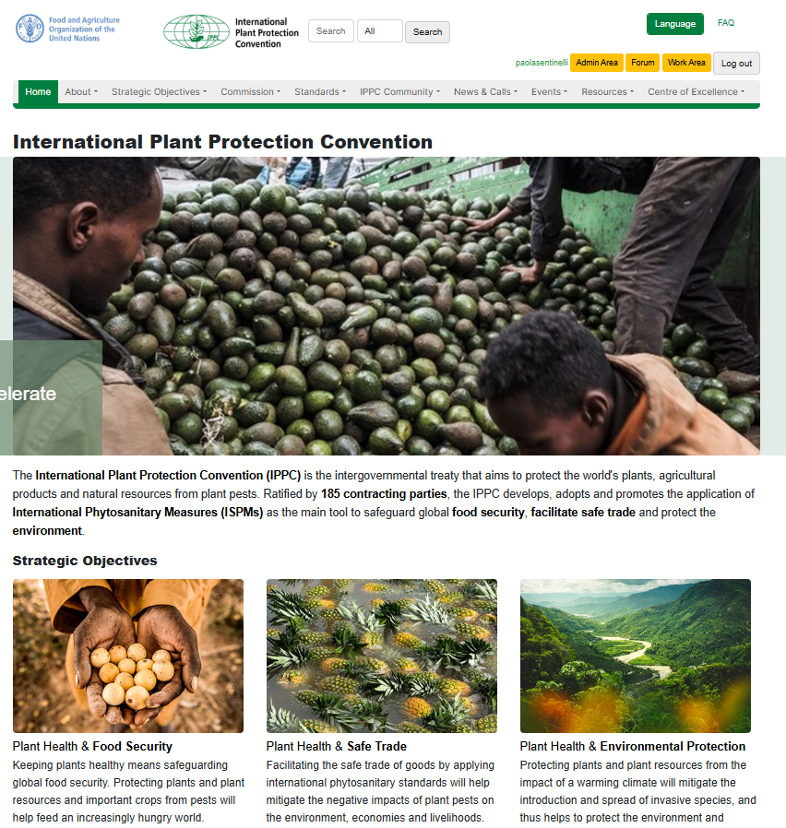
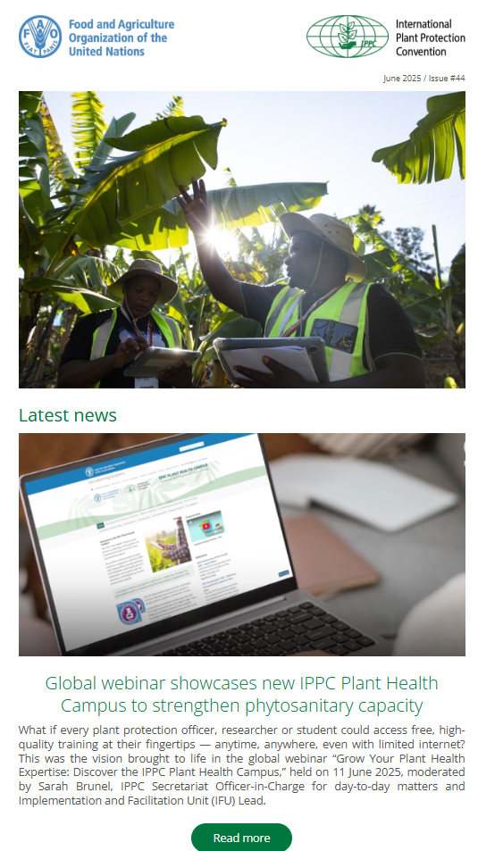
3.2 Knowledge management
IPPC newsletters - 12 releases (6 from July 2024 and 6 series in 2025), produced, and published 67 headline news and 132 announcements that covered the secretariat’s breadth of work.
IPPC Website (IPP) ongoing work of maintenance and continue work pf reorganization and redesigned of different pages on the website; produced the IPPC brand and design for CPM-19.

Slide 14
4. International Cooperation & Network Activities

Slide 15
4.1 Achievements
International Cooperation- Regional Workshops and TC-RPPOs
Seven regional workshops successfully held in 2024
  Africa, Asia, Carribean, Europe, Latin America, Near East & Pacific
The 36th Technical Consultation among Regional Plant Protection Organizations (36th TC-RPPO) was convened in Panama City, Panama on October 1-4, 2024.
The 2025 TC-RPPO meeting will be convened in Bangkok, Thailand on 23-26 September 2025
The TC-RPPO includes representation from nine RPPO's
  Andean Community, APPPC, AU-IAPSC, CAHFSA, COSAVE, EPPO, NAPPO, NEPPO & PPPO

Slide 16
Thank you
IPPC Secretariat
Food and Agriculture Organization
of the United Nations (FAO)
ippc@fao.org | www.ippc.int

