Slide 1
Updates from the IPPC Secretariat on Communications
International Day of Plant Health and Regional Communications Network
XX. Prepared for the IPPC Regional Workshops 2025​

Slide 2

Key progress
Implemented Secretariat-wide communication activities and products, guided by the
IPPC Secretariat Annual Communications Plan 2025
Based on the same milestones in the IPPC Global Communications Strategy
Developed internal tools to track communication activities, products and events
Notes:
SCRIPT:
The IPPC Secretariat developed and implemented secretariat-wide communication activities and products, guided by the IPPC Secretariat Annual Communications Plan 2025.
The plan is based on the same milestones in the IPPC global Communications Strategy.
Internal tools to monitor and track secretariat communication activities, products and events.

Slide 3
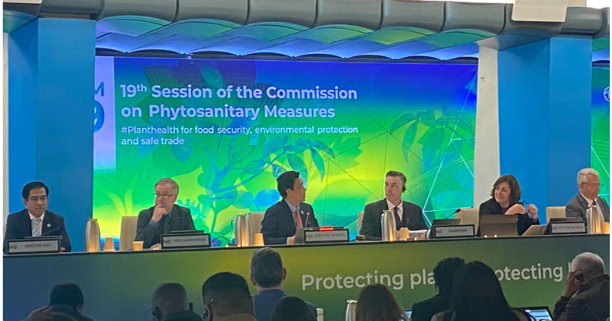
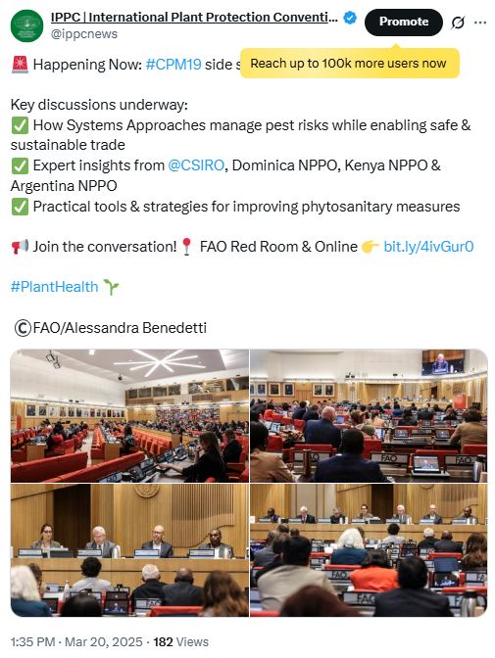
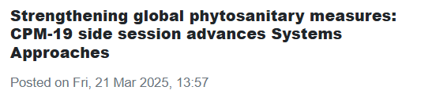
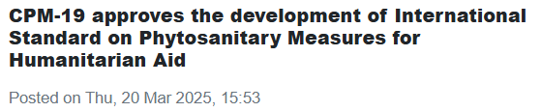
CPM-19 branding and promotions
To raise IPPC visibility
stage design at the FAO Plenary Room
internal promotions within FAO offices
social media promotion
news articles on the IPP
promotion of side sessions
CPM-19 photos added to FAO Digital Media Hub (publicly accessible)
Notes:
SCRIPT:
The IPPC Secretariat developed branding for CPM-19 to raise our visibility among contracting parties and within the FAO.
This includes stage design in the FAO Plenary room, promoting CPM-19 internally within FAO, and on IPPC social media.
We also published several news articles on key CPM-19 decisions,
We promoted the side sessions
And we documented the week-long session on the FAO Digital Media Hub which is available publicly.

Slide 4
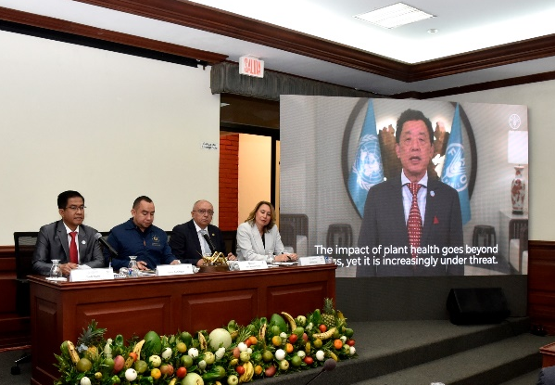
International Day of Plant Health, 12 May 2025
High-Level Hybrid Event – El Salvador (hosted by OIRSA)
Theme: The importance of plant health in One Health
Opened by FAO DG QU Dongyu (video), NSP Director moderating
Speakers: Ministers (El Salvador, Honduras), OIRSA, Nobel laureate Rigoberta Menchú Tum
Interdisciplinary and inclusive technical session
First time IDPH was held outside FAO HQ to showcase regional innovation, i.e. OIRSA's 3D virtual reality for pest surveillance
The IPPC Secretariat wishes to extend its deep appreciation to OIRSA for an excellent organization of the high-level event and their extensive promotion in the media and on social media.
Notes:
SCRIPT:
The International Day of Plant Health held on 12 May was held in El Salvador and hosted by OIRSA.
FAO Director-General Qu Dongyu opened the event via video message and the NSP Director, Yurdi Yasmi moderated the event.
Speaking at the high-level event were the minsters for agriculture of El Salvado and Honduras, OIRSA Executive Director and Nobel laurate Rigoberta Menchu Tum who is a champion for Indigenous People’s rights.
The technical session was interdisciplinary and inclusive, with geographic and gender representation.
This was the firs time that IDPH was held outside FAO headquarters since the first observance in 2023. It was an opportunity to showcase regional innovation, particularly OIRSA’s 3D virtual reality simulation of pest surveillance as part of its training programme.
The IPPC Secretariat wishes to extend its deep appreciation to OIRSA for an excellent organization of the high-level event and their extensive promotion in the media and on social media.

Slide 5

Key outcomes
1+ billion
Impressions on IDPH content (number of times IDPH content was displayed online)
187+ million
Users reached (number of unique individuals who saw IDPH content
1300
Virtual
Participants and livestream views
1000+
Views of new video on plant health and One Health
45
Media outlets covered IDPH around the world
60+
Countries celebrating and organizing an IDPH event
Notes:
SCRIPT:
Notably, the IDPH campaign gained more than a billion impressions, or the number of times that IDPH was displayed online.
More than 187 million users were reached by IDPH content, significantly more than the World Potato Day (100+ million) and World Bee Day and World Tea Day combined (170+ million).
1300 virtual participants watched the livestream of the high-level event
More than 1000 viewed the new promotional video on plant health and One Health
45 media outlets covered IDPH around the world
And more than 60 countries celebrated and organized IDPH events worldwide.

Slide 6
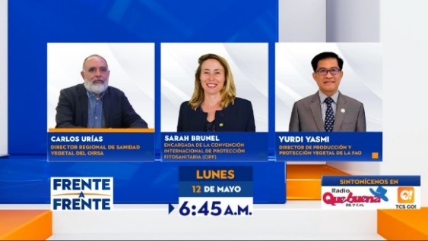
IDPH in the media
To drum up interest on the Day in El Salvador, Yurdi YASMI, Sarah BRUNEL, and Raúl Antonio Rodas SUAZO gave interviews to local media TCS’ Frente a Frente show.
This is one of the most-watched programs in the entire Republic of El Salvador. The program is hosted by journalist Moisés Urbina and broadcast on open television throughout El Salvador.
Watch the interview here.
In addition, statements were made to other television channels, including Channel 12 and Channel 21 in El Salvador.
Notes:
SCRIPT:
To drum up interest on the Day in El Salvador, Yurdi YASMI, Sarah BRUNEL, and Raúl Antonio Rodas SUAZO gave interviews to local media TCS’ Frente a Frente show.
This is one of the most-watched programs in the entire Republic of El Salvador. The program is hosted by journalist Moisés Urbina and broadcast on open television throughout El Salvador.
In addition, statements were made to other television channels, including Channel 12 and Channel 21 in El Salvador.

Slide 7
Update on IPPC Regional Communications Network
Dec 2025 - CPM Bureau approved the IPPC Secretariat’s proposal to conduct a survey on NPPOs’ and RPPOs’ information needs
The survey results will help determine how best to bridge the information gaps first, before scaling up to set up complex communications networks that may have low uptake from some regions.
Further steps are put on hold until a new Secretary is on board to provide insights and further guidance.
Notes:
SCRIPT;
In December 2025 , the CPM Bureau approved the IPPC Secretariat’s proposal to conduct a survey on NPPOs’ and RPPOs’ information needs.
The survey results will help determine how best to bridge the information gaps first, before scaling up to set up complex communications networks that may have low uptake from some regions.
Further steps are put on hold until a new Secretary is on board to provide insights and further guidance.

Slide 8
New strategic approach to communications
TARGETS:
Create greater impact
Achieve greater visibility
Build brand recall and association
STRATEGIES:
Do less with more impact
Identify short-, medium-, long-term priorities
Segment audiences
Communicate RESULTS
Measure outreach (quantitative and qualitative)
Notes:
SCRIPT:
To enhance communication, the IPPC Secretariat is taking a strategic approach by targeting to create greater IMPACT, more VISIBLITY, and build BRAND RECALL and BRAND ASSOCIATION.
How we intend to do is by
Doing with less but with greater impact
Identify short-, medium-, long-term priorities
Segment audiences
Communicate RESULTS
And measure our outreach (quantitative and qualitative)

Slide 9
We’d like to hear from you
What key information do you need to communicate to your stakeholders?
How can the IPPC, NPPOs and other RPPOs support you to communicate better?
How can the media (regional or national) help you to communicate better?
Participants are encouraged to provide feedback by sending an email to:
Mutya Frio, IPPC Communications Specialist: mutya.frio@fao.org
Feedback will be consolidated and discussed at the secretariat for potential next steps.
Notes:
SCRIPT:
We’d like to get your feedback, queries and suggestions.
We would encourage you to send your feedback via email to IPPC Communications Specialist, Mutya Frio.
[Or note down any interventions from participants that may not be related to the above questions].
Thank you.

Slide 10
Thank you
IPPC Secretariat
Food and Agriculture Organization
of the United Nations (FAO)
ippc@fao.org | www.ippc.int

