Slide 1
Update on Standards Committee activities​ and the Standard Setting Unit of the IPPC Secretariat)
​
​
4.3. 2025 IPPC Regional Workshops Meeting​

Slide 2
Introduction – Role of the Standards Setting Unit (SSU)
Coordinates the development of International Standards for Phytosanitary Measures (ISPMs) and Commission on Phytosanitary Measures (CPM) recommendations.
Supports the Standards Committee (SC), Standards Committee Working Group (SC‑7), Technical Panels (TPs), and Expert Working Groups (EWGs).
Provides technical guidance to help contracting parties implement the IPPC Strategic Framework.

Slide 3
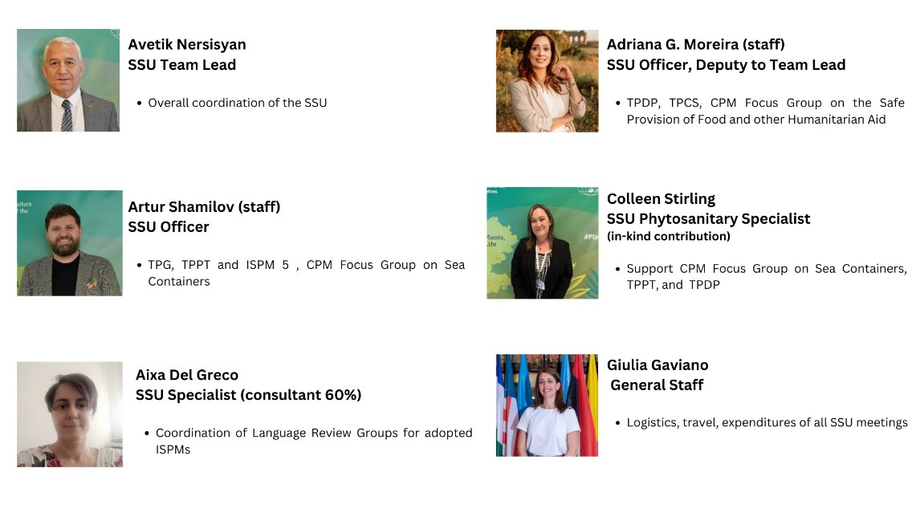
Standard Settings Unit Staff

Slide 4


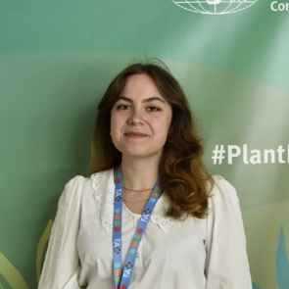

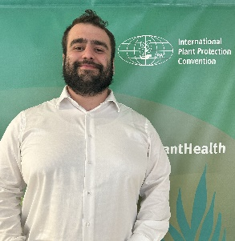
Daniel Torella
SSU Support Specialist
Emmanuel Krah
SSU Support Specialist
SC7 and TPG support
SC, TPs support
Marina Martino
Phytosanitary Support Specialist
Karen Rouen
SSU Assistant (35%)
TPDP and TPCS support
Report Writer
Levon Rukavishnikov
Intern
Support of SSU tasks

Slide 5





Planned Standard Setting Unit work in 2025
Standards Committee Meetings
SC May: 12‑16 May 2025 – FAO HQ, Rome (concluded).
Standards Committee Working Group (SC-7): 19‑22 May 2025 – FAO HQ, Rome (concluded).
SC November: 17‑21 November 2025 – FAO HQ, Rome.
Technical Panels
TP Commodity Standards (TPCS): 09 – 13 June 2025, Auckland New Zealand
08- 12 December 2025 – Rome, Italy
TP Phytosanitary Treatments (TPPT): 16‑20 June – Yokohama, Japan.
TP Diagnostic Protocols (TPDP): 21-25 July 2025 - Angers France
TP Glossary (TPG): November 2025 – dates to be confirmed.

Slide 6
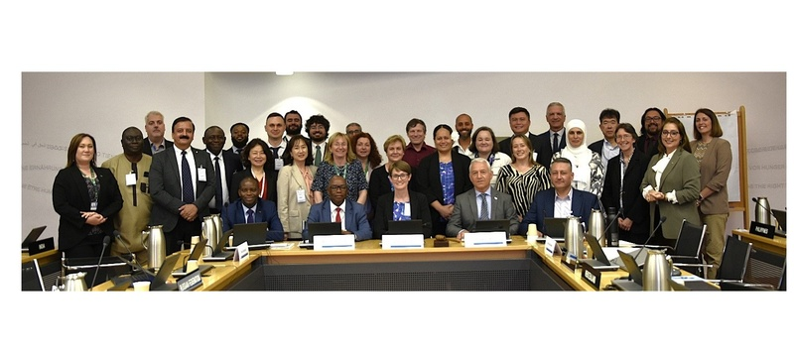
Standards Committee (SC) - 12th to 16th May 2025​
​

Slide 7
Draft ISPMs – Approved by SC May 2025 (First Consultation)
Draft ISPMs
Draft annex International movement of fresh Musa spp. fruit (2023-028) to ISPM 46 (Commodity-specific standards for phytosanitary measures)
Draft annex International movement of fresh Colocasia esculenta corms (2023-023) to ISPM 46
Draft specifications
Draft specification: Annex Remote audits (2023-031) to ISPM 47 (Audit in the phytosanitary context);
Draft specification: Revision of ISPM 12 (Phytosanitary certificates) (2023-020); and
Draft specification: Revision of ISPM 23 (Guidelines for inspection) (2023-014).

Slide 8
Draft ISPMs – Approved by SC May 2025 and SC-7 2025 (Second Consultation)
Draft ISPMs
Draft revision of ISPM 26 (Establishment and maintenance of pest free areas for fruit flies (Tephritidae)) (2021-010);
Draft annex Field inspection (2021-018) to ISPM 23 (Guidelines for inspection).
Draft annexes to ISPM 28
Draft annex to ISPM 28: Irradiation treatment for Pseudococcus baliteus (2023-033)

Slide 9
Draft Diagnostic Protocols – Approved by SC for DP Notification Period
DP notification period: 01 July – 15 August (45-day notification period*)
Draft Diagnostic Protocols (DPs)
Meloidogyne mali (2018-019), Annex to ISPM 27
Pospiviroid species (2018-031), Annex to ISPM 27
* 45-day notification period prior adoption of diagnostic protocols annexes to ISPM 27

Slide 10
Other SC related Issues
Call for Topics – New Process & Timeline
The SC agreed on a timeline for reviewing topic submissions during the ongoing 2025 IPPC Call for Topics.
Emphasize the trial of a year-round call (instead of biennial), with an assessment due in 2027.
Useful to remind contracting parties and RPPOs to submit topics early so they can be reviewed in the SC’s November meeting.
Future of ISPMs – Small Working Group Formed
SC created a working group to explore accessibility, complexity, and plain language in ISPMs.
A discussion paper is being developed for IPPC Strategic Planning Group (SPG) 2025.
Suggest engaging participants to provide regional perspectives on ISPM clarity and usability.

Slide 11
Thank you
IPPC Secretariat
Food and Agriculture Organization
of the United Nations (FAO)
ippc@fao.org | www.ippc.int

