Slide 1
Getting In Touch About Strengthening Pest Outbreak and Response Systems (POARS)
4.5 Prepared for the IPPC Regional Workshops 2025​

Slide 2
Overview
Background
POARS Steering Group Main Tasks
Process Identifying Emerging Pests
Call for nominations of potential emerging pests
Tools developed in case of emerging pest
    Prevention, preparedness and response
    Communications
  Alert
Points for further discussion at the POARS SG

Slide 3
Strengthening Pest Outbreak Alert and Response Systems (POARS)
1 of the 8 development agenda items (DAIs) of the IPPC Strategic Framework 2020–2030
Work initiated in 2020 with the Commission on Phytosanitary Measures (CPM) establishing a CPM Focus Group on POARS (FG POARS) which produced recommendations
CPM-16 (2022) established the POARS Steering Group with a two-year mandate
The POARS SG started the work in March 2024, consisting of 11 experts from around the world

Slide 4
POARS Steering Group
Tasks have been split into four areas:
1. Technical capability
POARS procedure
Emerging pest criteria
Prevention, preparedness and response components
2. Governance
To compare functions and activities with the IC, APP and other IPPC bodies
To analyse the pros and cons of setting up a subsidiary body and other governance structures
3. Collaboration and resource mobilisation strategies
Develop strategies for resource mobilisation and building a collaborative network
Develop operational plans for setting up incident working groups
4. Financial capability
Assess staffing and financial needs for the POARS
Estimate necessary resource and financial allocation

Slide 5
Identifying emerging pests

Slide 6
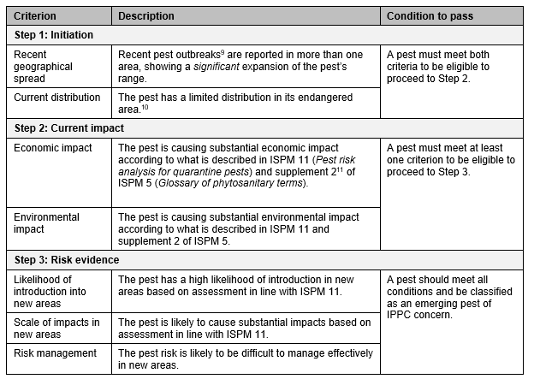
Emerging pest criteria
Based on the assessment, pests are categorized as follows:
Emerging pest: A pest that meets the relevant criteria of all three steps.
Non-emerging pest for the watch list: Pests that meet the criteria of the first step but do not meet all the criteria at the current impact and risk evidence steps. These pests require ongoing observation with reassessment if new data becomes available.
Non-emerging pest with no follow-up actions: A pest that does not meet any of the criteria in Step 1 for distribution and spread.

Slide 7
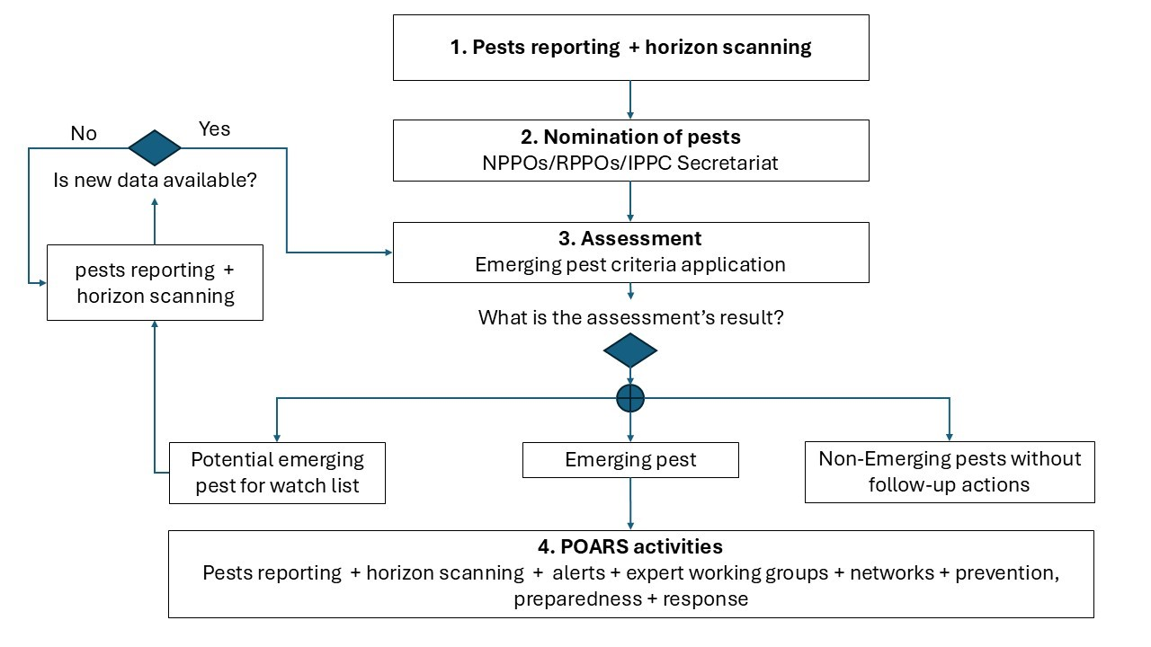
Process for identifying emerging pests

Slide 8
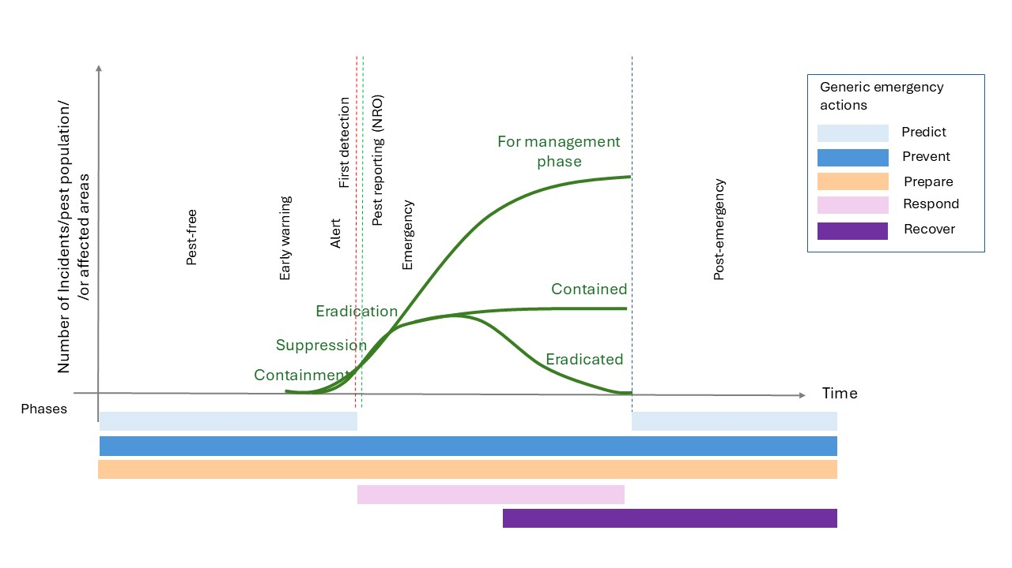
Qualified as an emerging pest of global concern?
Then tools will be developed for:
Prevention: guidance on phytosanitary measures
Preparedness : strengthening the overall capacity and capability e.g. provision of contingency plans, diagnostic protocols, training activities and simulations
Response: establishment of networks and pest-specific expert groups to provide advice
Figure. Phases and Actions in Plant Health Emergency Management adapted from the Animal Health Good emergency management practice: the essentials (GEMP) manual.
Notes:
Prediction: Horizon scanning, assessment and research projects which inform the risk of introduction, impact and spread of the emerging pest.
Prevention: Actions to prevent the introduction and spread of emerging pests, with a focus on setting and enforcing phytosanitary measures.
Preparedness: The capacity and capability of NPPO and RPPO systems and stakeholders to implement effective strategies for managing pest outbreaks. Preparedness comprises operational capacity, readiness of diagnostic laboratories, surveillance schemes, risk management frameworks, contingency planning, policy and regulation development, effective risk communication strategies, and institutional coordination.
Response: Coordinated technical and operational efforts to contain and eradicate pest outbreaks. When eradication is not achievable, response efforts may focus on containment and/or suppression. This often requires close collaboration among government authorities, private sector entities, and other stakeholders.
Recovery: Prevention and preparedness measures to avoid reintroduction of the emerging pest and to lift emergency response measures following eradication. This category also covers lessons exercises, review processes, and the recovery of affected individuals, businesses, communities, and environments following an outbreak of the emerging pest.

Slide 9
Pilot phase of POARS
Application of the criteria
Resulted in further refinement and the creation of a guidance document
IPPC call for nomination of potential emerging pests
31st January 2025 to 3rd March 2025
Evaluation of the potential emerging pests
Implementation of the response system for the emerging pests of a global concern

Slide 10
Call for nominations of potential emerging pests
Jan 31st – Mar 3rd
# | Submitter | Pest
1. | COSAVE | Pepper chat fruit viroid
2. | COSAVE | Rhizonia theobromae
3. | COSAVE | Bactrocera dorsalis
4. | COSAVE | Orobanche cumana
5. | COSAVE | Rhynchophorus ferrugineus
6. | COSAVE | ‘Candidatus Liberibacter solanacearum’
7. | IPPC Secretariat | Xylella fastidiosa
8. | IPPC Secretariat | Cryphonectria parasitica
9. | IPPC Secretariat | Thaumetopoea processionea
10. | IPPC Secretariat | Sri Lanka cassava mosaic virus
11. | IPPC Secretariat | Clavibacter nebraskensis
12. | Netherlands | Synchytrium endobioticum (new pathotypes)
13. | Netherlands | Bactericera cockerelli
# | Submitter | Pest
14. | Nigeria | Cassava brown streak viruses
15. | Nigeria | Anomis leona
16. | South Africa | Citrus greening disease
17. | South Africa | Xylella fastidiosa
18. | South Africa | Fusarium oxysporum f. sp. cubense TR4
19. | South Africa | Zeugodacus cucurbitae
20. | South Africa | Drosophila suzukii
21. | South Africa | Halyomorpha halys
22. | South Africa | Euwallacea fornicatus
23. | South Africa | Banana bunchy top virus
24. | South Africa | Lycorma delicatula
25. | South Africa | Maize lethal necrosis
26. | South Africa | Eriococcus ironsidei

Slide 11
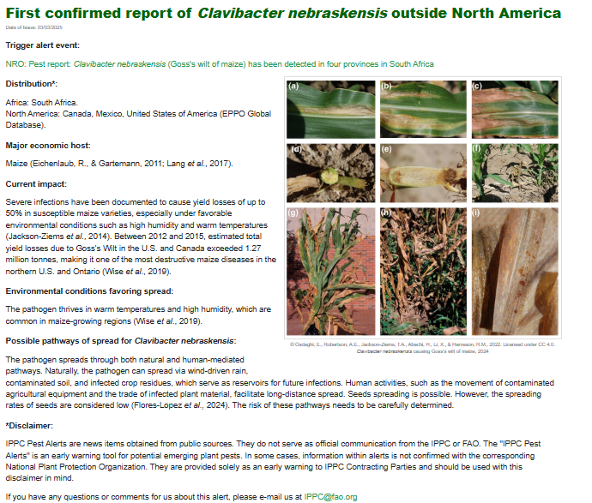
First alert was sent on March 3rd 2025
IPPC Pest Alerts - International Plant Protection Convention

Slide 12
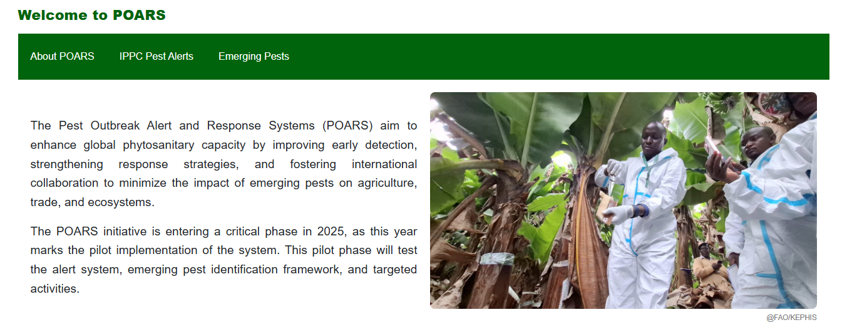
Communications
Pest Outbreak Alert and Response System (POARS) - International Plant Protection Convention

Slide 13
After the pilot phase of POARS
provide a global alert system to the IPPC community based on the agreed criteria
focus on new emerging pests that pose a global thread
establish global experts’ networks for emerging pest responses
a global emergency response mechanism
quickly mobilizing tools and support to aid a countries or region’s response to emerging pests

Slide 14
Thank you
IPPC Secretariat
Food and Agriculture Organization
of the United Nations (FAO)
ippc@fao.org | www.ippc.int

