Slide 1
Update on the CPM Focus Group on Climate Change and Phytosanitary Issues (FG-CCPI)
4.5 Prepared for the IPPC Regional Workshops 2025​

Slide 2
1. Introduction and Mandate
• Established by CPM-15 (2021); mandate extended until March 2026.
• Composed of 9 members + IPPC Secretariat + CPM Bureau Champion (currently vacant).
• Main task: Develop and support implementation of the IPPC Action Plan on Climate Change Impacts on Plant Health.
• Action Plan aligned with IPPC Strategic Framework 2020–2030.
Notes:
The Focus Group on Climate Change and Phytosanitary Issues (FG-CCPI) was established by the Commission on Phytosanitary Measures in 2021 (CPM-15). Its mandate was extended at CPM-19 until March 2026, which will then be reviewed at CPM-20 (2026). The group is composed of nine members representing the seven FAO regions with specialized skills and experience in climate change and phytosanitary issues, and knowledge of the IPPC and its activities. The FG-CCPI also includes a CPM Bureau representative (“Champion”). With recent changes in CPM Bureau membership and the former Bureau champion now the CPM Bureau Chair, a new Bureau champion is needed. Currently, the FG-CCPI does not have a representative from the Intergovernmental Panel on Climate Change (IPCC) after the previous representative resigned. The second member for North America, from the USDA has recently resigned. Current members are listed in Appendix 1.
The primary role of the FG-CCPI is to coordinate the development of the “IPPC Action Plan on Climate Change Impacts on Plant Health” and to support the implementation and delivery of its activities over the years.
The 2022-2025 action plan was based on the implementation of the IPPC Strategic Framework 2020–2030 development agenda item: “Assessment and management of climate change impacts on plant health”. To support the implementation of the action plan, three major action plan outcomes were identified:
raising awareness of the impacts of climate change on plant health;
enhancing the evaluation and management of risks of climate change to plant health; and
enhancing the recognition of phytosanitary matters in the international climate change debate.

Slide 3
2. Key Achievements
(1)drafted and published the Climate-change impacts on plant pests: a technical resource to support national and regional plant protection organizations;
(2) developed and delivered a series of webinars in September 2024;
(3) developed a webpage on the impacts of climate change on plant health on the IPP, which includes various external technical resources;
(4) provided technical inputs to a resource mobilization flyer to support the IPPC’s work on climate change and phytosanitary issues;
(5) participated in and presented information at national, regional and international meetings; (5) provided comments on revisions to ISPM 2 and ISPM 11; and
(6) promoted and encouraged the Implementation and Capacity Development (IC) Committee to incorporate climate change in their work.

Slide 4
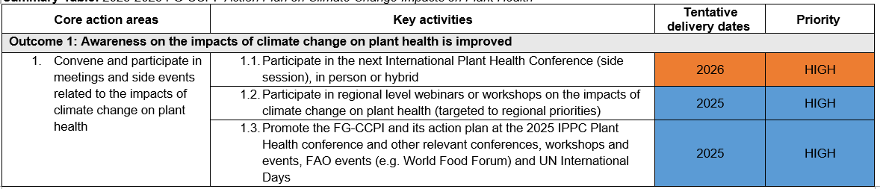
3. Remaining Work (2025–2026)
Orange – Unlikely or uncertain to be completed by March 2026
Blue – Ongoing tasks that could be completed by March 2026
Green – Ongoing tasks that are on track for completion by March 2026

Slide 5
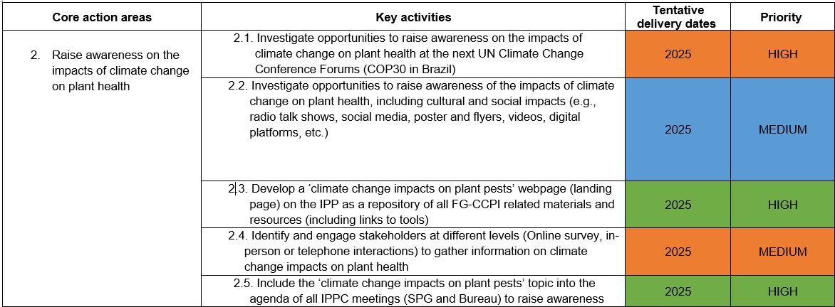
3. Remaining Work (2025–2026)
Notes:
Orange – Unlikely or uncertain to be completed by March 2026
Blue – Ongoing tasks that could be completed by March 2026
Green – Ongoing tasks that are on track for completion by March 2026

Slide 6
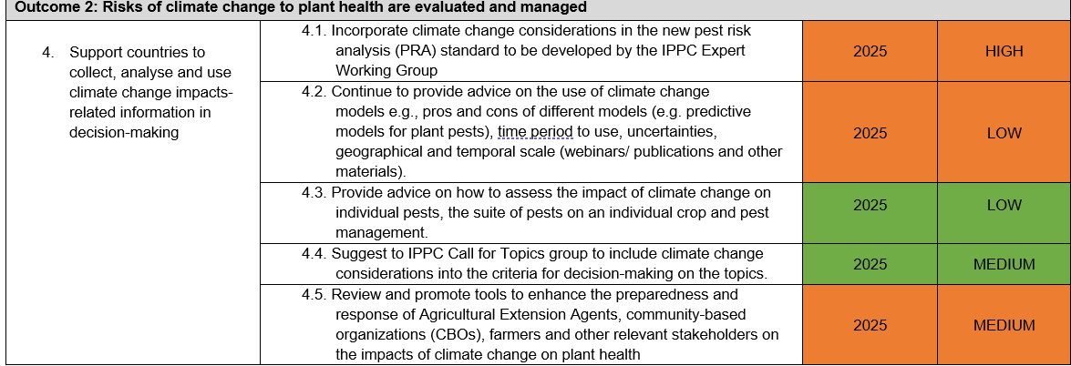
3. Remaining Work (2025–2026)
Notes:
Orange – Unlikely or uncertain to be completed by March 2026
Blue – Ongoing tasks that could be completed by March 2026
Green – Ongoing tasks that are on track for completion by March 2026

Slide 7
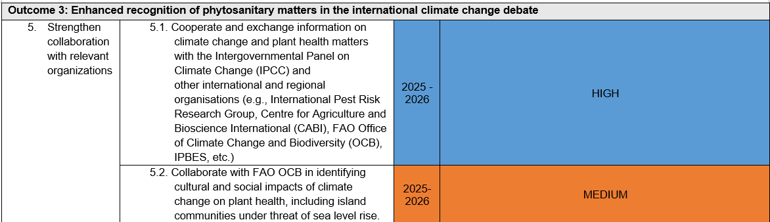
3. Remaining Work (2025–2026)
Notes:
Orange – Unlikely or uncertain to be completed by March 2026
Blue – Ongoing tasks that could be completed by March 2026
Green – Ongoing tasks that are on track for completion by March 2026

Slide 8
5. Strategic Value of FG-CCPI
• Enables cross-sector dialogue and engagement.
• Elevates phytosanitary issues in climate change debates.
• Contributes to SDGs, especially climate action and food security.
• Strengthens global phytosanitary resilience.

Slide 9
6. Next Steps & Recommendations
• Propose a session on climate change and plant health at CPM-20.
• Support completion of ongoing Action Plan tasks.
• Consider mandate extension to 2030 for Strategic Framework alignment.

Slide 10
Thank you
IPPC Secretariat
Food and Agriculture Organization
of the United Nations (FAO)
ippc@fao.org | www.ippc.int

