Slide 1
CPM Focus Group on Global Phytosanitary Research Coordination
(FG-GPRC)
Prepared for the IPPC Regional Workshops 2025​

Slide 2
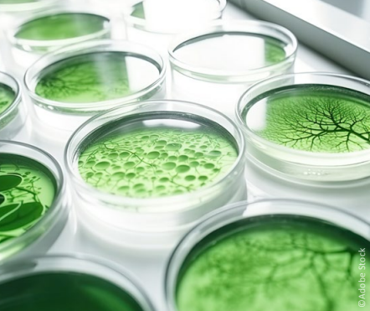
Background
Research is a vital component in advancing the science of plant protection. International research collaboration among countries, institutions and disciplines leads to higher scientific quality, efficient resource use, better outcomes and wider adoption of results.
The benefits of collaborating can be realized through mutual interest and common goals, effective leadership, facilitation of processes and structure and funding for both research and collaborative activities. Synergistic collaboration can be achieved by balancing both strategic and applied research.
CPM-17 (2023) approved the establishment of a global phytosanitary research coordination mechanism to allow regular identification of common plant health research priorities, to eliminate duplication of research activities and to facilitate the efficient use of financial and human resources.
A focus group was established to carry out a study to explore current international and regional phytosanitary research structures to determine if there are gaps to be filled or if an improved mechanism should be established

Slide 3
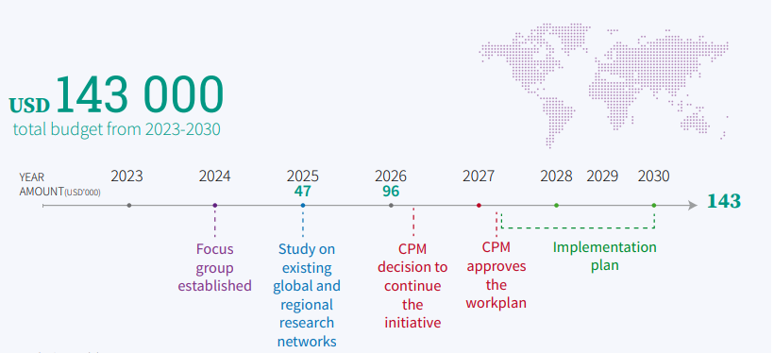
Development agenda item (DAI) timeline and budget

Slide 4
Achievements to date
The focus group developed a questionnaire and sent it to research networks in their respective countries and regions. Responses were used to create an inventory of relevant research networks.
The listed research networks (more than 120) have been assessed for four criteria:
    Scope of the network ̶ prioritizing networks with a wide range of interests within plant health, rather than those focused on a single disease or commodity
    Geographical coverage ̶ considering networks that operate across a significant geographical area, potentially encompassing diverse climatic and ecological conditions
    Phytosanitary relevance ̶ prioritizing networks with a strong focus on sanitary issues (preferably plant health related)
    Policy relevance ̶ prioritizing networks that actively engage with policy makers and thus can influence policy decisions.
The focus group created a shortlist and selected several research networks to interview.

Slide 5
Next Steps in 2025
Bi-Weekly FG-GPRC Meetings to:
  Conduct scoping study interviews with selected phytosanitary research networks to determine:
    Current status and focus of ongoing phytosanitary research
    If there are research gaps that are not being addressed and require attention.
    If an improved mechanism should be established to address any research gaps identified.
  Compile the list of recommendations in the “final” report to CPM-20 (2026)

Slide 6
Support and Participation Moving Forward
Member countries are encouraged to support the FG-GPRC work by:
  Ensuring regional research organizations from all nine RPPO's participate in this study. Global participation will help ensure that FG-GPRC study results do not have a regional bias.
  Regions not currently represented in the focus group:
    Latin America and Caribbean
    Africa
  Review and provide feedback on draft report prepared for consideration by CPM-20 in March 2026.

Slide 7
Thank you
IPPC Secretariat
Food and Agriculture Organization
of the United Nations (FAO)
ippc@fao.org | www.ippc.int

