Slide 1
Draft Annex to ISPM 46: International movement of fresh Musa spp. fruit (2023-028)
IPPC first consultation 1 July to 30 September 2025

Slide 2
Background
Banana (Musa paradisiaca) as an Annex to ISPM 46 was proposed as a topic and added to the work programme as priority 1 in 2024 (CPM 18).
2024-05 Standards Committee (SC) assigned the steward.
The draft Annex was developed by the Technical Panel for Commodity Standards (TPCS) in December 2024.
The TPCS recommended to broaden the scope to encompass other species of Musa than only bananas.
The SC approved through e-forum and CPM 19 confirmed Musa spp. as priority 1.
2025-05 Standards Committee approved the draft for first consultation.

Slide 3
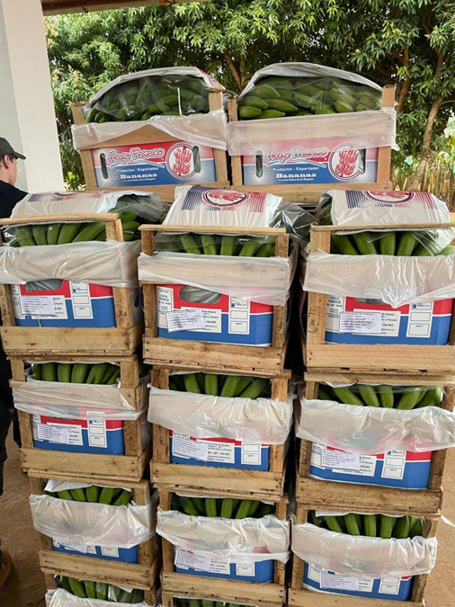
Scope and Intended Use
This commodity standard provides guidance for NPPOs on pests associated with fresh Musa spp. fruit and options for phytosanitary measures for the international movement of fresh Musa spp. in hands or in clusters, but not in bunches.
It applies to fruit that has been produced for international trade and is intended for consumption or processing in an importing country.
It does not apply to fruit that has already been processed (e.g. chopped, dried, frozen, smashed).

Slide 4
Pests
The Table 1 lists pests regulated on Musa fruit by at least one contracting party, based on information material submitted by 9 contracting parties.
A pest was only included if there was a specific measure identified to manage its risk.
The TPCS do not make assessments of pest risk.
The inclusion of a pest in the annex does not constitute technical justification for regulation by a contracting party.

Slide 5
Options for Phytosanitary Measures
The options for measures include general and pest-specific measures.
General measures (Table 2) include those that may be relevant to all pests (for example: PFA, PFPP, inspection)
Pest-specific options (Table 3) were submitted by at least one contracting party or are available as ISPMs.
Options in bold in Table 3 are relevant ISPMs:
Pest Free Area for fruit flies (ISPM 26: Establishment of pest free areas for fruit flies (Tephritidae));
Irradiation treatments (Annexes to ISPM 28 :Phytosanitary treatments for regulated pests);
Systems approach for fruit flies (ISPM 35: Systems approach for pest risk management of fruit flies (Tephritidae))

Slide 6
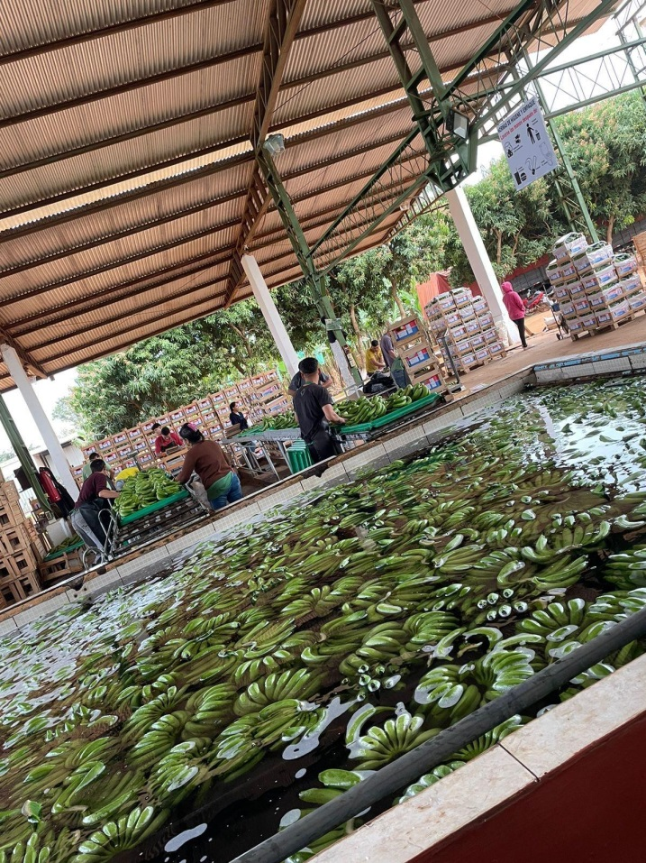
Options for Systems Approaches
ISPM 35 (Systems approach for pest risk management of fruit flies (Tephritidae)) can be used to manage the pest risk of fruit flies listed in Table 1.
Some examples of systems approaches to manage the pest risk of scales, mealybugs and fungi were submitted by contracting parties and are also listed in Table 5.

Slide 7
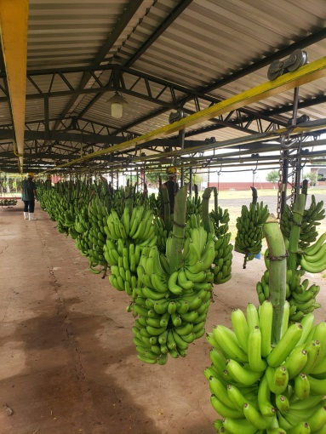
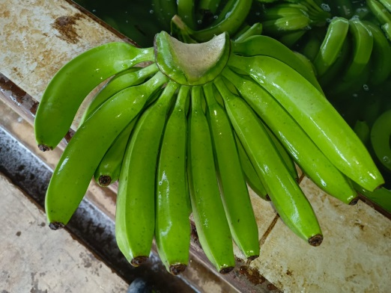
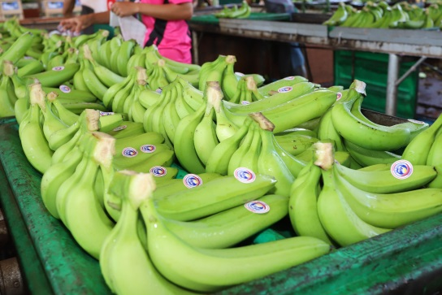
Further Reading and Appendix 1
PRAs and other relevant material submitted by contracting parties during the call for information material are available in section “Further reading”.
An Appendix provides pictures of hands, clusters and bunches of Musa spp., as referred in the description of the commodity (Section 2).

Slide 8
Thank you
IPPC Secretariat
Food and Agriculture Organization
of the United Nations (FAO)
ippc@fao.org | www.ippc.int

