Slide 1
Draft Annex to ISPM 46: International movement of fresh Colocasia esculenta corms (2023-023)
First consultation: July 1 – 30 September 2025

Slide 2
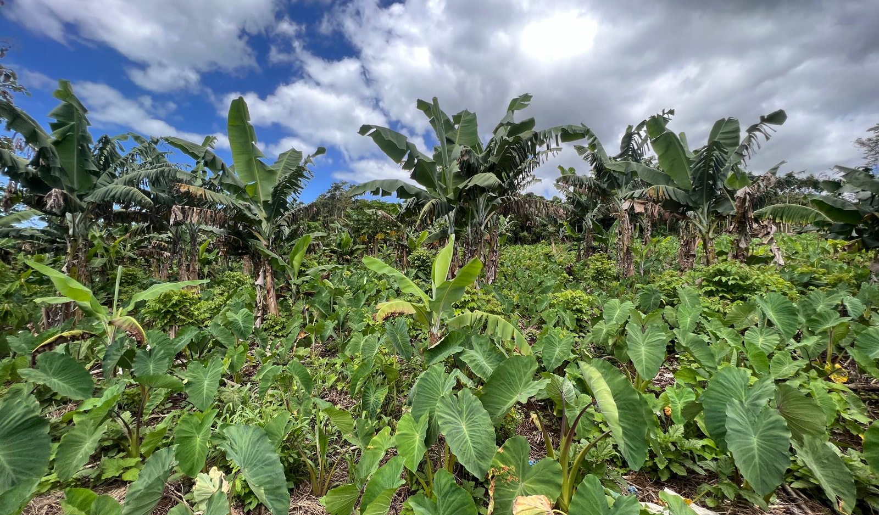
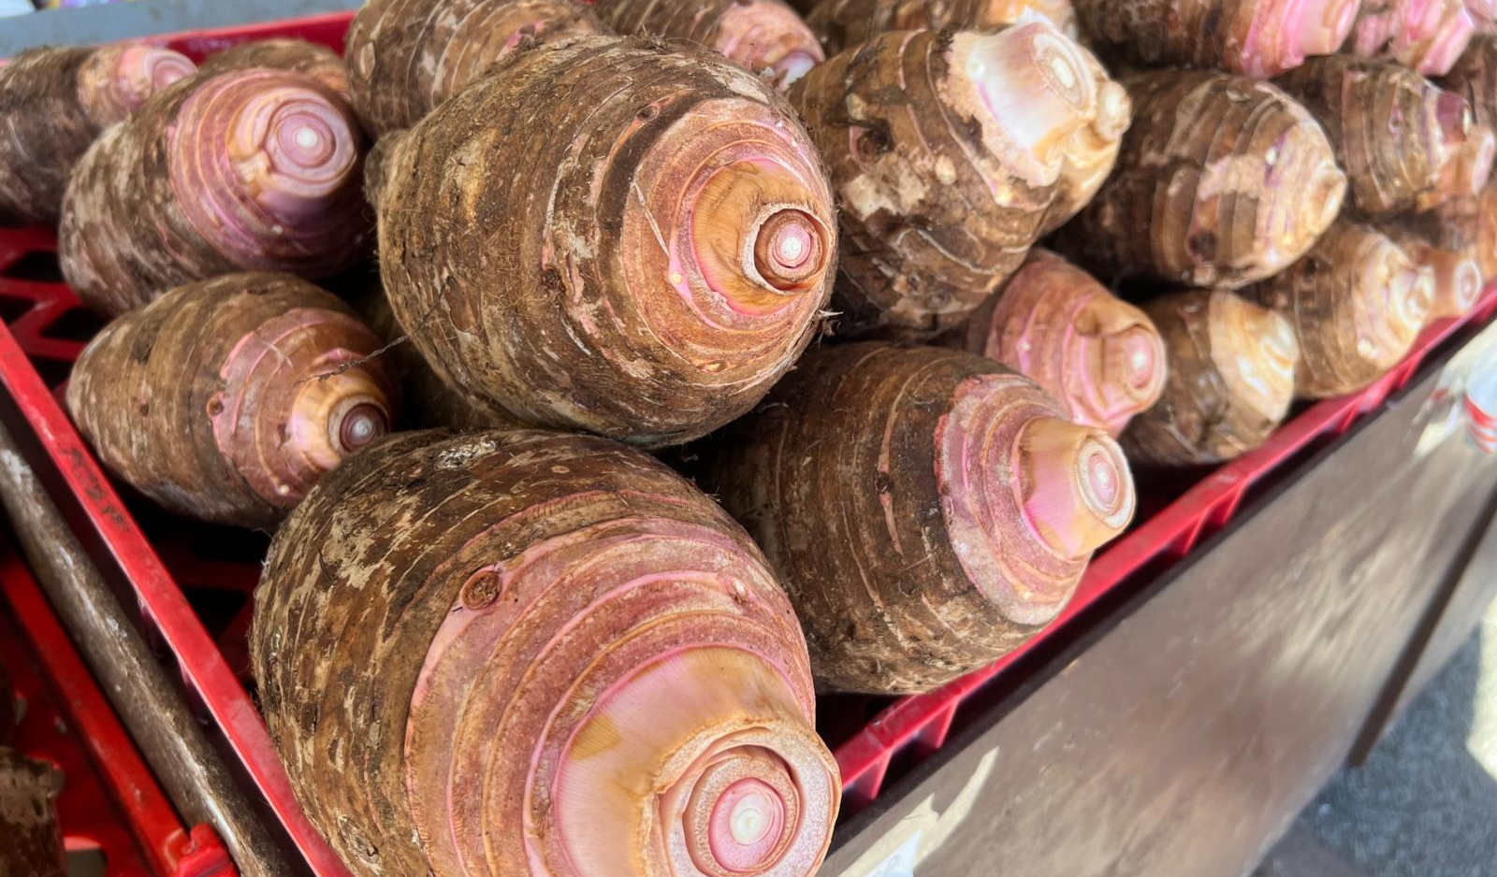
Background
Colocasia esculenta (Taro) was:
  proposed as an Annex to ISPM 46 in 2023
  added to the TPCS work program by CPM 18 (2024) and;
  drafted in December 2024
Reminder - Commodity Standards:
  Are “Subjects” (not “Topics”)
  Do not have “specifications”
  Are added to the TPCS work program by CPM
Photo credit: S. Siakimotu 2024
Notes:
By way of background, Taro (Colocasia esculenta) was proposed by the South-West Pacific region with support from the Asian region and some Caribbean countries in the 2023 Call for Topics.
After consideration through the Taskforce for Topics (TFT), the Standards Committee and with input from the Technical Panel for Commodity Standards, this commodity was proposed to CPM-18 and added to the TPCS work program in 2024.
A reminder on the process for Subjects:
there is no “Specification” like there is for an ISPM
As such, there is no country consultation on a Subject
For the TPCS, as a new Technical Panel and due to the implications on trade for Commodity Standards, the CPM has maintained authority to add (or not) subjects to the TPCS work program for now.
Other subjects (for the Technical Panels for the Glossary, Diagnostic Protocols and Phytosanitary Treatments) remain under the authority of the SC, as delegated by the CPM.

Slide 3
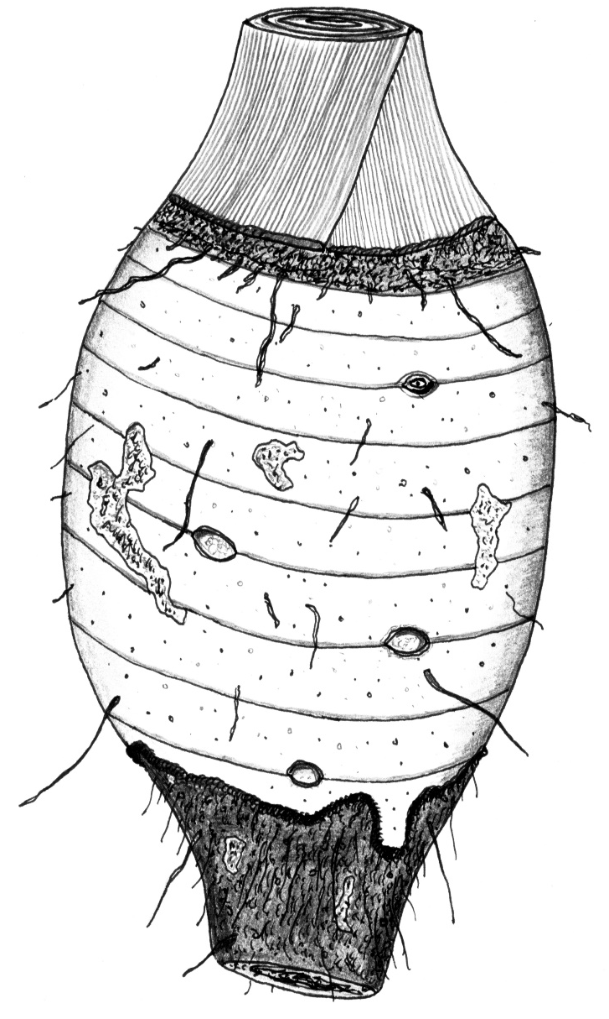
Scope, Description and intended use
Scope
  Articulates the Annex covers taro for consumption or processing
Description of the commodity and its intended use:
  Fresh corms for consumption or processing
    without leaves or lateral buds
  Not corms that have already been processed
Image credit: Biosecurity Australia 2011
1 cm
Notes:
Commodity Standard annexes have a template and format that comes from ISPM 46.
The Scope of the document articulates the Annex covers taro for consumption or processing
The Description of the commodity and its intended use specifies fresh corms for consumption or processing without leaves or lateral buds and not processed

Slide 4
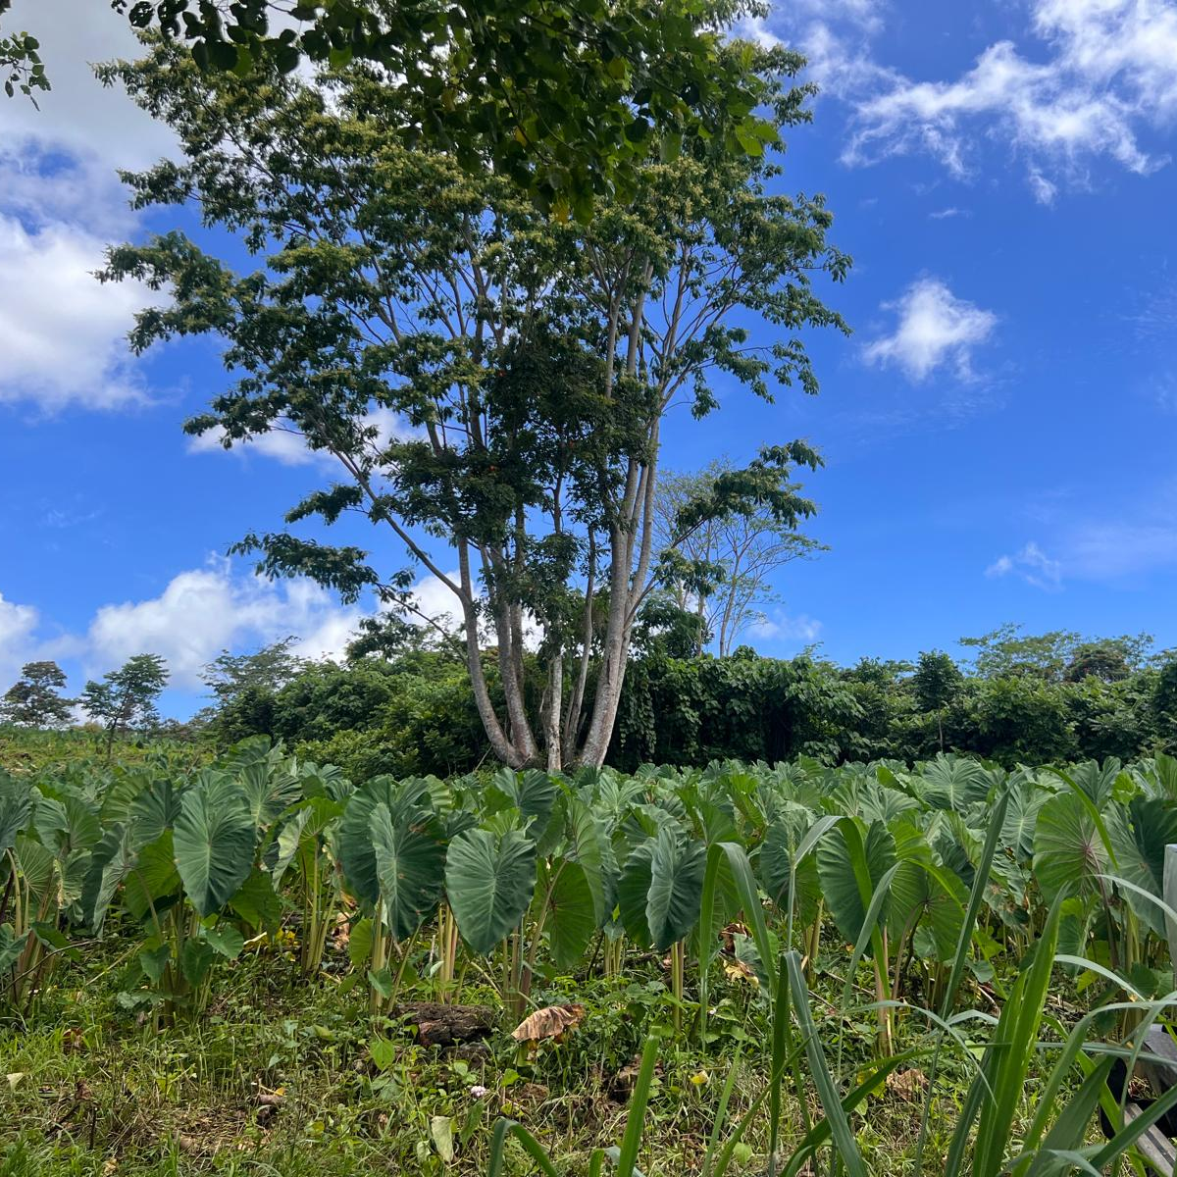
Pests
17 Pests listed in this draft
Includes viruses at this stage
  Value contracting party comment on this inclusion, noting Considerations in this presentation
All pests listed have associated “options for phytosanitary measures” used in trade
Photo credit: S. Siakimotu 2024
Notes:
In this draft, there are 17 Pests of Taro listed with corresponding options for measures that are used in trade.
As one contracting party submitted viruses that are mitigated through a phytosanitary measure, these are also included at this stage. This was due to the ease of propagation of taro from the commodity, meaning the risk from potential diversion of intended use was considered greater than in other commodities we have addressed so far.
This issue will also need consideration in the assessment of other commodities (potentially potatoes in the future, for example) that are or are mainly vegetatively propagated.

Slide 5
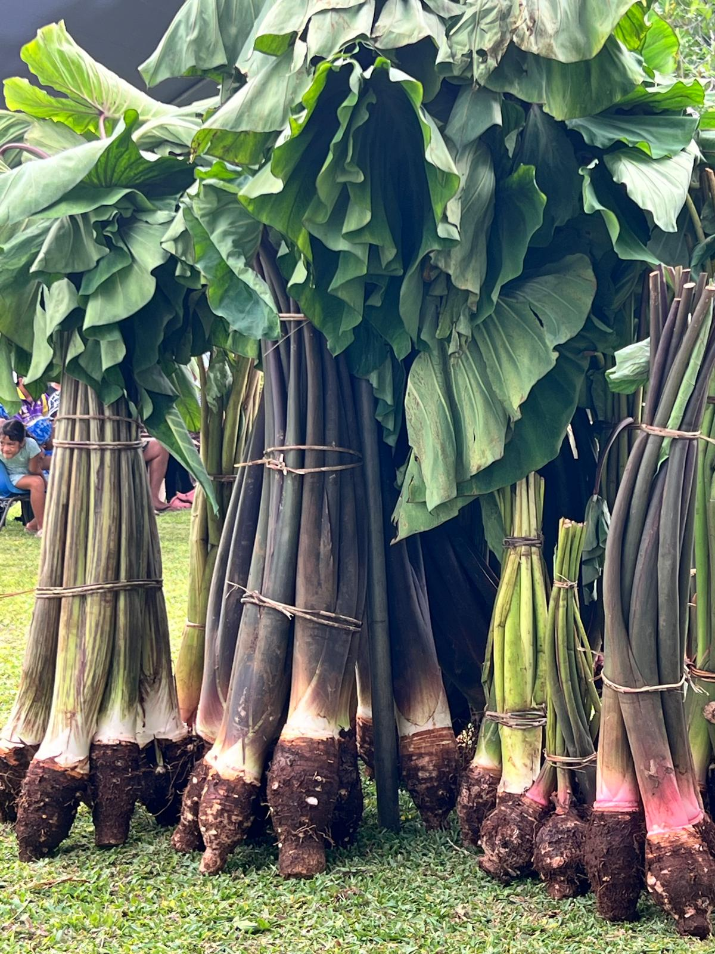
Considerations
This root crop is inherently:
  Dirty
  Rough surfaced
  Difficult to inspect for pests.
New text to try to address this has been included at paragraph [13]
Photo credit: S. Siakimotu 2024
Notes:
Other considerations with this commodity that required a different approach to relatively “clean” commodities that have been assessed to date (Mango and Banana) is that this is a root crop and so inherently “dirty”.
Additionally, the surface of the Taro is rough and so can easily trap soil and also conceal pests. The rough surface can also have an impact on the ease of inspection, making this more time consuming.
You will see that some new text has been added at paragraph 13 to try to describe this issue and alert contracting parties to this consideration.

Slide 6
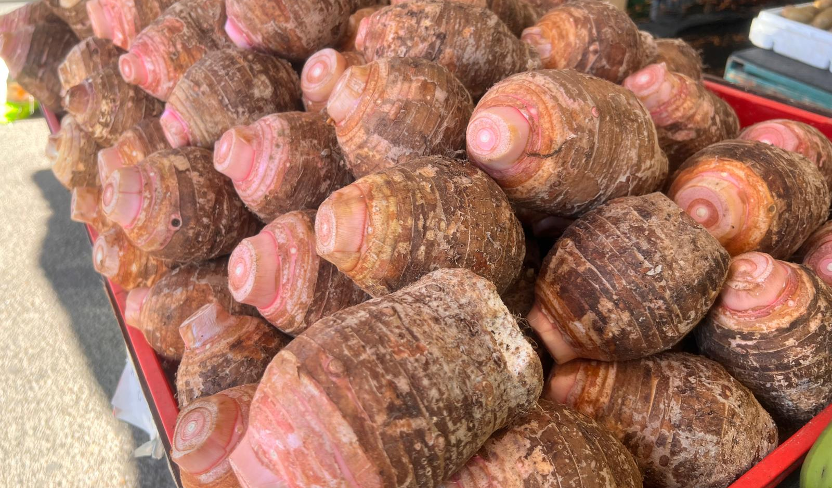
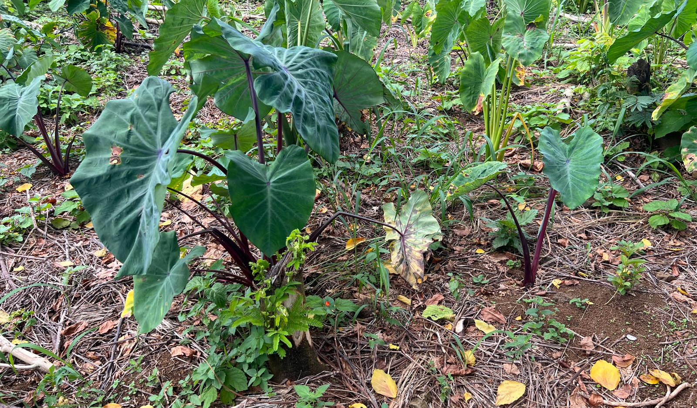
Importance of your comments
Taro is a “new” type of commodity to be assessed.
  Relatively few Pests but novel issues to accommodate
Steward and Standard Committee appreciate
feedback, proposed modified text and other comments
to improve Commodity Standard annexes
Photo credit: S. Siakimotu 2024
Notes:
Given this is a new “type” of commodity, as with the Mango standard when it was first done, some different considerations are needed for Taro. Compared to some commodities, there are relatively few Pests, but the other considerations do need some review and will be improved through consultation.
Further thoughtful consideration of this draft and the unique or novel issues this type of crop and commodity provides is appreciated and will serve to support the Steward and the Standards Committee improve the document.

Slide 7
Thank you
IPPC Secretariat
Food and Agriculture Organization
of the United Nations (FAO)
ippc@fao.org | www.ippc.int

