Slide 1
Draft Revision of ISPM 26 (Establishment of pest free areas for fruit flies (Tephritidae)) (2021-10)
IPPC second consultation 1 July - 30 September 2025

Slide 2
Background: Major stages
CPM 16
(2022)
Topic added to work programme
SC Nov
(2022)
Specification approved
EWG July
(2023)
First draft developed
SC May
(2024) Approved for 1st consultation
Second Consultation
July – Sept 2025
SC-7 May (2025)
Revised and approved for 2nd consultation
First Consultation
July – Sept 2024

Slide 3
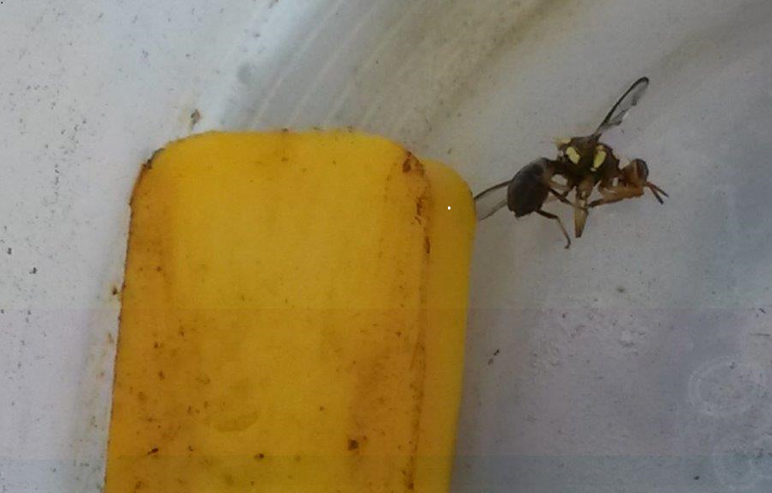
822 comments were received from 1st consultation
The main comments were to:
Main comments from consultation
Annex ISPM 26 to ISPM 4
Make changes to terminology
Add further explanatory text to parts of the draft ISPM
Remove references to timeframes
Remove duplication
Also considered was how to retain the annex and appendices that were removed, until they can be relocated.
Photo courtesy of MPI, NZ

Slide 4
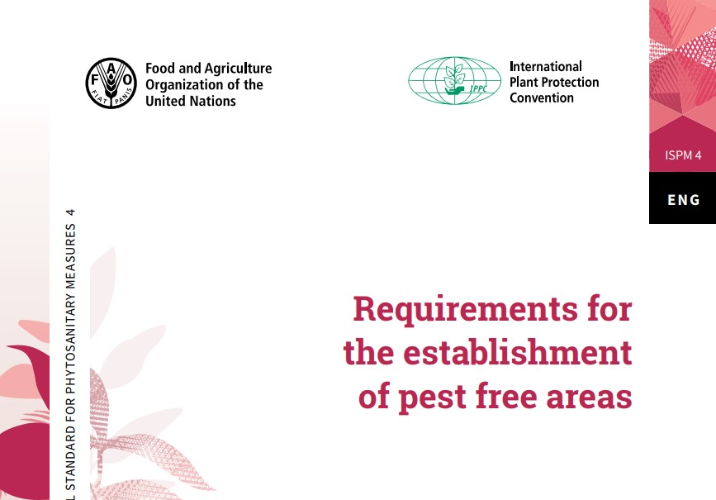
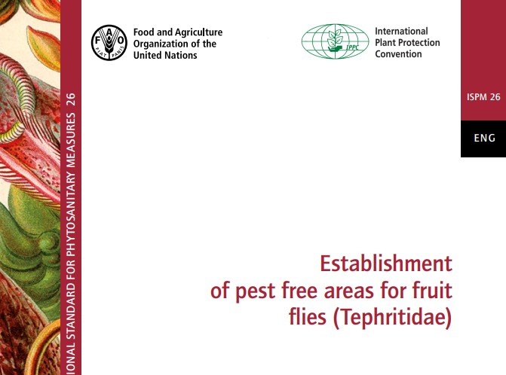
Annexing ISPM 26 to ISPM 4
The SC decided that it is not time to annex ISPM 26 to ISPM 4 because the proposal:
is not on the IPPC list of topics; and
does not align with specification 75

Slide 5
Changes to Terminology
‘Host material’, ‘hosts’ and ‘host commodities’ were replaced with ‘host fruit’ for consistency
‘Transient’, was removed where appropriate, and replaced with ‘breeding population’ that is established or not
‘Wild adults’ was replaced with ‘fertile adults’ to avoid confusion with ‘non-native’ and ‘exotic’
‘Inseminated’ was replaced with ‘gravid’ as sterile insects can be inseminated but not fertile

Slide 6
Additional Explanatory Text
Note: Best attempts were made to develop new text when proposals were not provided
1. To clarify the use of Sterile Insect Technique (SIT) in a PFA
New text was added to clarify how detections of sterile fruit flies, as part of a SIT programme, affect fruit fly free status of an area. New text was added to:
Outline of requirements
5.5 Criteria for the area to qualify as a fruit fly pest free area
7.2 Reinstatement
2. To describe the potential for interference of attractants used for trapping
‘The potential for interference and contamination between attractants used and the consequential reduction in trap efficacy should be considered when trapping several species of fruit fly.’

Slide 7

Additional Explanatory Text
3. To describe examples of relevant data that should be recorded for the handling of samples and identification of species (Annex 1, Section 3):
‘Information about the sample should be recorded. For example:
date and location of where the sample was collected,
type of sample (fruit or trap sample),
type of trap and attractant if applicable,
condition of the sample (fresh or decayed),
name and contact details
any other observations.’

Slide 8
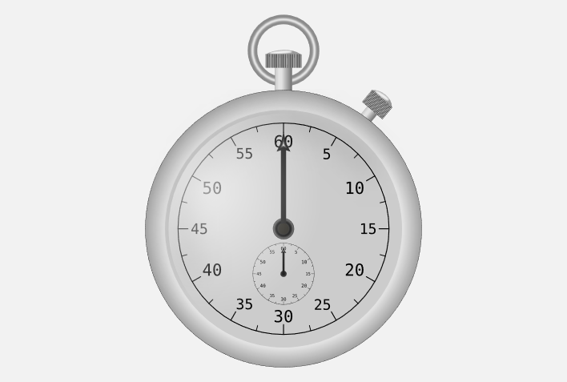
Removing Timeframes
Timeframes were removed for:
the reporting of detections of fruit flies (48 hours);
declaring eradication (three generations).
because timeframes are not achievable for all NPPOs and are not always based on technical justification.

Slide 9
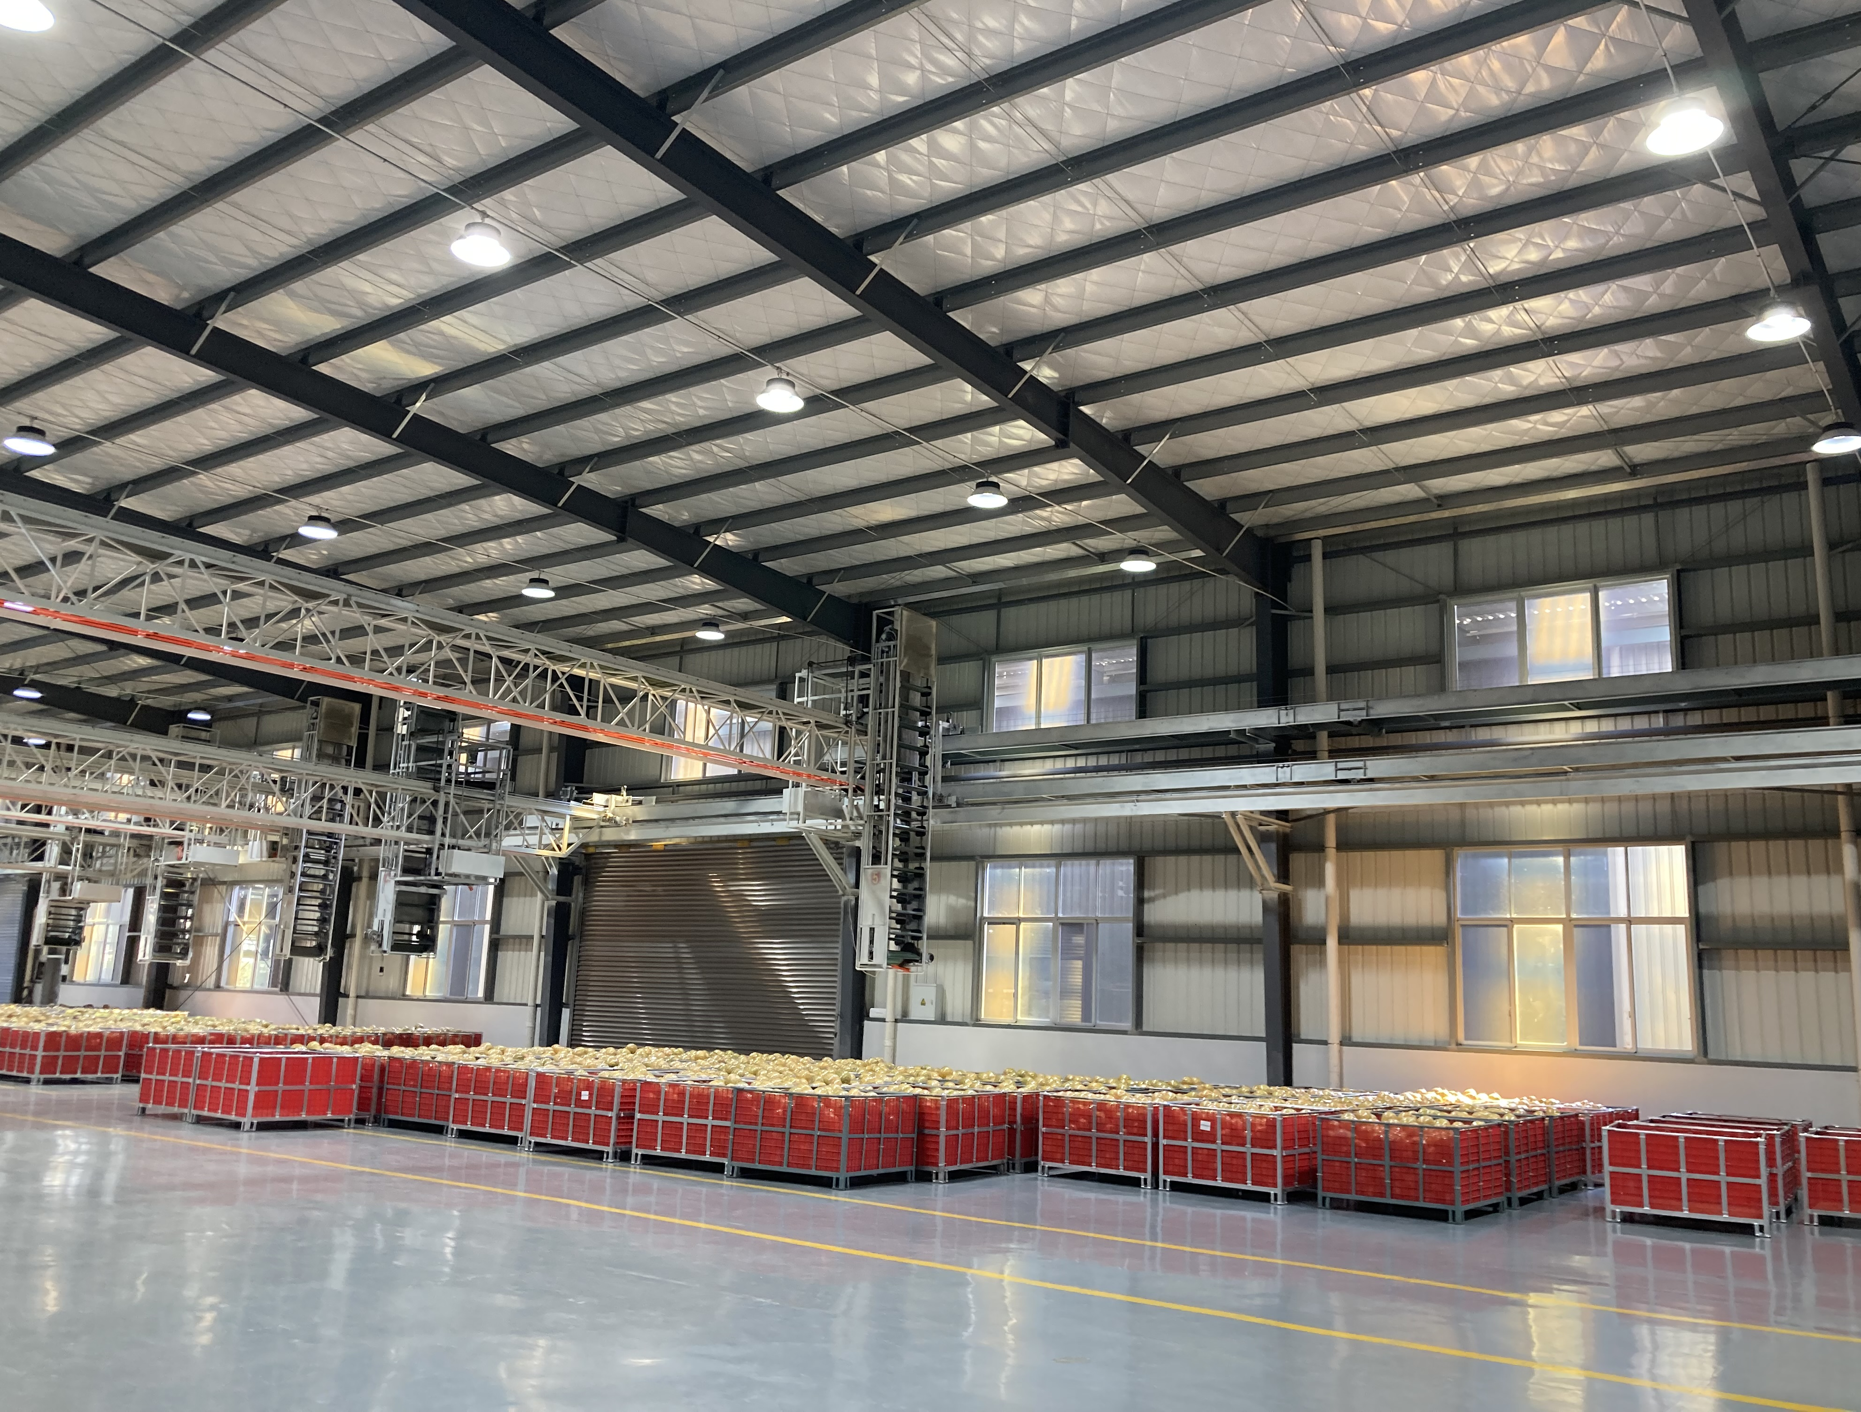

Removing Duplication
Duplication was removed from Annex 3 by combining the requirements for:
Packing and packing facilities
Storage and storage facilities
Treatment and treatment facilities
Now: Packing, storage, processing and treatment facilities

Slide 10
Retaining Information from Removed Appendices in Annexes
The appendices and annex removed from the revised ISPM have been renamed and included at the back of the draft standard until such time that they can be moved to a suitable location. These were:
  Annex 3: Phytosanitary procedures for fruit fly management.
  Appendix 1: Fruit fly trapping (2011)
  Appendix 2: Fruit sampling

Slide 11
Thank you
IPPC Secretariat
Food and Agriculture Organization
of the United Nations (FAO)
ippc@fao.org | www.ippc.int

