Slide 1
DRAFT ANNEX TO ISPM 23: Field inspection (2021-018)
IPPC second consultation 1 July to 30 September 2025

Slide 2
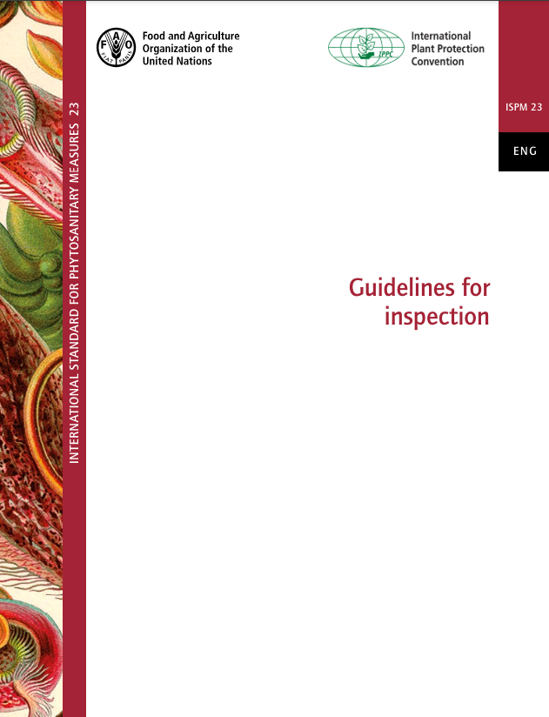
Background
CPM-16 (2022) added topic Field inspection (Annex to ISPM 23: Guidelines for inspection) was with priority 2.
Standards Committee (SC) approved Specification 74 (Field inspection) in November 2022.
Expert working group drafted the annex in October 2023.
SC reviewed and approved the draft Annex for the 1st consultation in May 2024.
The 1st consultation form June to September in 2024, and the draft Annex was revised by the steward.
SC reviewed and approved the draft Annex for the 2nd consultation in May 2025.
Notes:
Standards Committee (SC) in November 2022 approved Specification 74 (Field inspection) (2021-018).
The Expert Working Group (EWG) met in person on 16–20 October 2023 and drafted this annex.
During the 2024 consultation, 573 comments (421 English, 130 Spanish, and 22 French) were received.
The steward revised the draft based on these comments.
The SC-7 May 2025 reviewed the draft and then presented it to 2nd country consultation (2025/07/01 to 2025/09/30).

Slide 3
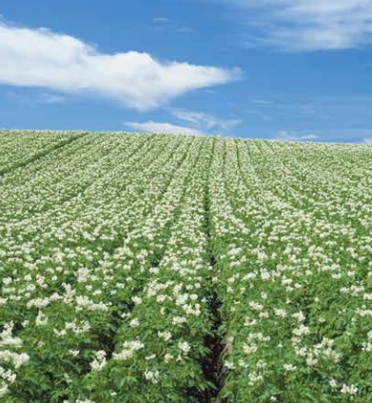
Main points of revision based on the 2024 country comments
Based on country comments, the annex was restructured to provide a more logical flow and reduce duplication:
The “Scope” section was moved to the beginning.
The interpretations of the terms of ‘field inspection’ and ‘pest’ in “2. Concept of field inspection” were moved to the “Scope” section.
“2. Concept of field inspection” was renamed as “2. Objectives of field inspection”, and some texts were moved from "7.2 Specific objectives of field inspection" to here because objectives of field inspection should be described in beginning of the annex.
Section 7.2 was deleted.
Some texts in “7.3 Circumstances when field inspection may be used” were moved to “7. Field-inspection methods” section, and section 7.3 was deleted.
The sentences in passive voice were changed to active voice.
Photo by Yokohama Plant Protection Station, Japan

Slide 4
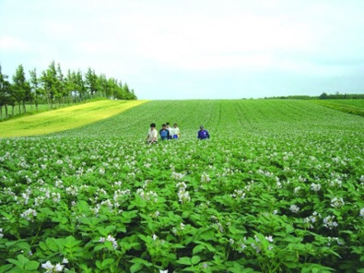
Stand-alone ISPM vs Annex to ISPM 23
The SC May (2025) discussed the country comment "this annex should be a standalone ISPM because it relates to plants that do not necessarily form a consignment whereas the overarching ISPM 23 (Guidelines for Inspection) only relates to consignments".
The SC concluded that the draft annex Field inspection (2021-018) to ISPM 23 should continue to be developed as an annex to ISPM 23 and confirmed that the SC-7 (2025) should proceed with its review of the draft annex.
The full revision of ISPM 23 (Guidelines for inspection) (2023-014) has been decided and its draft specification is submitted to the country consultation in 2025. The revision covers "The revised standard will also connect to the content of the newly developing annex 'Field inspection' (2021-018)."
Photo by Yokohama Plant Protection Station, Japan

Slide 5
Usages of terms
The term “pest” may refer to a single regulated species or multiple regulated species(in scope)
a specified pest / the pest of concern
a specified pest – used in conceptual statements, such as when referring to the objectives of field inspection
the pest of concern – used when referring to the conduct of an individual field inspection
phytosanitary import requirements / phytosanitary requirements
phytosanitary import requirements - used only when specifically in the context of import (reference to an importing country)
phytosanitary requirements - used more general statements
Changed “tolerance level” to “threshold”
tolerance level (of a pest): Incidence of a pest specified as a threshold for action to control that pest or to prevent its spread or introduction (ISPM5)
Notes:
The terms used in this annex are revised based on the opinions described in the slide.
The term “pest” may refer to a single regulated species or multiple regulated species.
a specified pest / the pest of concern
a specified pest – used in conceptual statements, such as when referring to the objectives of field inspection
the pest of concern – used when referring to the conduct of an individual field inspection (“the pest of concern” for the first mention in a relevant section; “the pest” thereafter).
phytosanitary import requirements - used only when specifically in the context of import (reference to an importing country)
phytosanitary requirements - used more general statements. In the glossary definition of “inspection”, the term “phytosanitary requirements” is used intentionally because inspection can be at scenarios other than at import, e.g., inspection can be carried out in scenarios other than at import, like at place of production or production site or at export.
Changed “tolerance level” to “threshold”
Exceeding a “tolerance level” (according to the ISPM 5 definition) triggers an action to control the pest, but declining export certification based on the outcome of field inspection is not considered to be an action to control the pest

Slide 6
1. Scope
This annex describes field inspection as a phytosanitary measure in relation to plants being produced for international trade. It provides requirements for field inspection as a stand-alone phytosanitary measure, as a component of a systems approach, or in combination with another phytosanitary measure or measures, to detect pests, or signs or symptoms of pests, or verify conformity with phytosanitary requirements. The annex outlines assumptions involved in the application of field inspection as well as the requirements for the field-inspection process and the associated documentation.
In the context of this annex, the term “field inspection” applies to the inspection of plants during the growing period or dormant stage. The term “pest” may refer to a single regulated species or multiple regulated species.
If symptoms are detected during field inspection, it may be necessary to take samples for examination by a qualified expert or for laboratory testing to verify the absence of the pest. Such phytosanitary actions are outside the scope of this annex.
The annex does not cover inspection of consignments.
Notes:
The “Scope” section was moved to the beginning. The interpretations of the terms of ‘field inspection’ and ‘pest’ described in “Concept of field inspection” were moved to the “Scope” section.
Compared to the draft for the 1st consultation, it is clarified wordings and modified redundant expression.

Slide 7
2. Objectives Concept of field inspection
Field inspection is the inspection of plants in fields (including plants in open fields, in nurseries, and in controlled environments). NPPOs may use field inspection as a phytosanitary measure when it is applied to detect pests, or signs or symptoms of pests, or to verify conformity with phytosanitary requirements.
The objectives of field inspection as a phytosanitary measure include, but are not limited to:
- detection of pests, or signs and symptoms of pests; and
- verification of conformity with phytosanitary requirements, including:
as part of a systems approach,
for the establishment and maintenance of a pest free place of production or production site,
to verify that plants in a field are free from a specified pest, or
in certification programmes for export, to verify that infestation of plants for planting by a specified pest has not exceeded the specified threshold.
Notes:
“2. Concept of field inspection” was renamed as “2. Objectives of field inspection” to make clear the objectives for field inspection in beginning of the annex. And the texts about objectives of field inspection described in "7.2 Specific objectives of field inspection" were consolidated here.

Slide 8
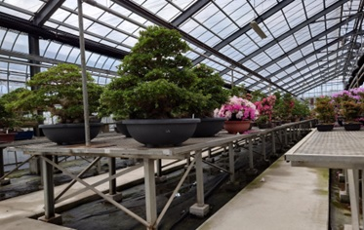
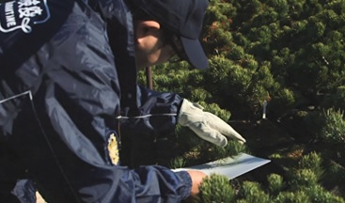
3. Difference between Field inspection and specific surveillance
Field inspection may be used to verify conformity with phytosanitary requirements for international movement of plants as described in this annex, but it can be also used as part of specific surveillance (ISPM6 Surveillance) to determine pest status in accordance with ISPM 8. Specific surveillance, on the other hand, is defined as an official process to determine the presence or absence of pests in an area (by detection survey), to establish the boundaries of an area considered to be infested by or free from a pest (by delimiting survey), or to verify the characteristics of a pest population in an area (by monitoring survey).
Photos by Yokohama Plant Protection Station, Japan
Notes:
To avoid the duplication, the latter part of the content was deleted as it is already described in ISPM6.

Slide 9
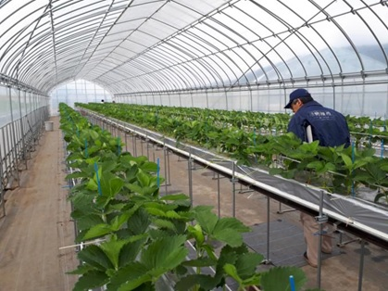
4. Assumptions involved in the application of field inspection
In addition to the assumptions outlined in section 1.2 of the core text of this standard, the use of field inspection to verify the absence of a specified pest or to determine pest incidence in a field is based on the following assumptions:
- The pest or its sign or symptom is visually detectable at a certain stage of plant growth.
- If the pest is detected during field inspection, the commodity derived from those plants may be infested.
- Field inspection can be more effective or practical than testing or inspection of consignments (e.g. rootstocks, seeds).
Photo by Yokohama Plant Protection Station, Japan
Notes:
Amendment in this section is to clarify wordings.
Regarding the 3rd indent, in some cases, it is more effective or practical to conduct field inspection for an entire field than to conduct sample-based testing or inspections of consignments.

Slide 10
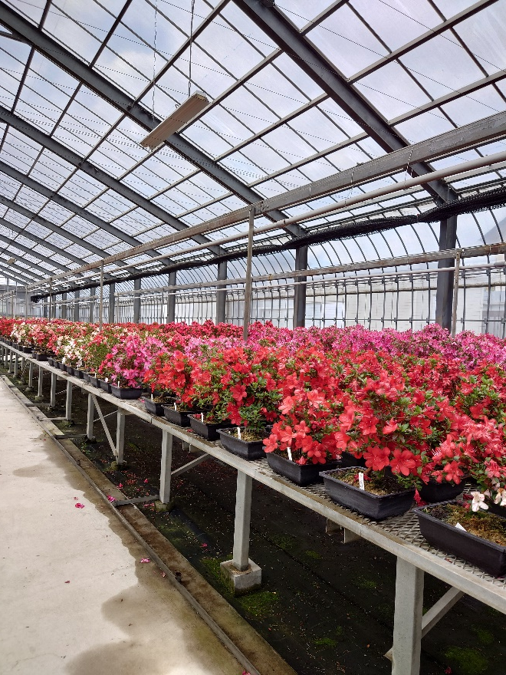
5. Other considerations for field inspection
In addition to the factors listed in section 1.5 of the core text of this standard, NPPOs may also consider the following when deciding on the use of field inspection as a phytosanitary measure:
- pest status in the area (present or absent);
- pest prevalence and pest distribution in the field;
- pest biology;
- phenological stage of plants;
- the susceptibility of the plant species and variety or cultivar to the pest of concern;
- the origin of the plants being inspected;
- inspection method, timing and frequency, and the technical equipment needed;
- field size and configuration;
- other biotic factors (e.g. presence of other pests, natural enemies, hosts in the vicinity) and abiotic factors (e.g. climate);
- cultural practices and control measures; and
- length of time between inspection and harvest.
Photo by Yokohama Plant Protection Station, Japan
Notes:
Amendments in this section are to clarify wordings and to add new elements for other considerations for field inspection

Slide 11
“7.3 Circumstances when field inspection may be” deleted, with texts moved to “7 Field-inspection methods”, specifically:
When selecting the timing and frequency of field inspection, the NPPO should take into account the biology of the pest and the plants:
- The timing should coincide with a life stage of the pest that is suitable for detection and for the plants to show signs or symptoms. This varies between pest and plant species and may depend on the growing conditions and local cropping practices.
- The length of time between the inspection and date of harvest may need to be considered.
Visual examination of plants in the field may not be sufficient to verify absence of the pest. Examples of such circumstances include the following:
- the pest is known to exhibit latency;
- infested plants can be asymptomatic;
- the phenological stage of the plants is not appropriate for pest detection (e.g. young plants);
- suspicious signs or symptoms cannot be immediately identified; and
- the life stage of the pest at the time of inspection is difficult to detect.

Slide 12
10. Responsibilities of national plant protection organizations
The responsibilities of NPPOs that conduct field inspection should include the following:
- designing a field inspection programme in accordance with the factors listed in section 1.5 of the core text of this standard and other considerations in section 5 of this annex;
- sharing the field inspection programme with the NPPOs of importing countries, if appropriate;
- ensuring that the field inspection programme is consistently implemented;
- providing sufficient human resources and equipment to design and implement the field inspection programme;
- training personnel to ensure that their skills and expertise are maintained at an adequate level to plan and conduct field inspections effectively and consistently;
- ensuring that inspectors can fulfil the requirements described in section 1.4 of the core text of this standard;
- developing, reviewing and evaluating field-inspection processes as needed; and
- determining the roles and responsibilities of producers with regard to field inspections.
Notes:
New items of responsibilities of NPPOs were added.

Slide 13
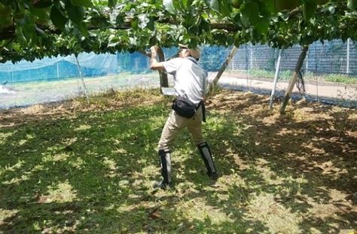
Potential implementation issues
Given the variety of possible pest/ plant combinations, developing the guides on field inspection for specific commodities, with the case studies, would be very helpful for the contracting parties
Photo by Yokohama Plant Protection Station, Japan

Slide 14
Thank you
IPPC Secretariat
Food and Agriculture Organization
of the United Nations (FAO)
ippc@fao.org | www.ippc.int

