Slide 1
DRAFT SPECIFICATION FOR ISPM: Revision of ISPM 23 (Guidelines for inspection) (2023-014)

Slide 2
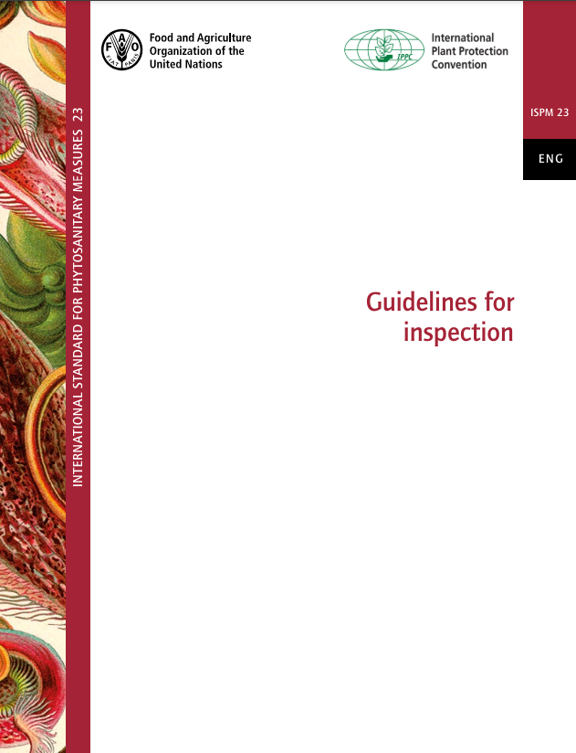
Background
In 2023 the topic Revision of ISPM 23 (Guidelines for inspection) was submitted during the IPPC call for topics.
CPM-18 (2024) approved adding this topic as priority 2 to the list of subjects for the IPPC standards.
SC May in 2025 reviewed daft specification Revision of ISPM 23 (Guidelines for inspection) (2023-014) and approved for the country consultation in 2025.

Slide 3
Reason for the revision of the standard
Since its adoption by the 7th ICPM in 2005, many countries have used ISPM 23 for “the inspection of plants, plant products and other regulated articles moving in international traffic”.
Since then, the definitions of “inspection” and other relevant terms (i.e., “compliance procedure (for a consignment)”, “identity”, “integrity”) in ISPM 5 have been modified or newly added. A gap has therefore been created between the requirements of ISPM 23 and the definitions of these ISPM 5 terms. For example, the ISPM 5 defines that “inspection” is “official visual examination of plants, plant products or other regulated articles to determine if pests are present or to verify conformity with phytosanitary requirements”. However, the term “inspection” is used in a broader sense in ISPM 23, including other compliance procedures such as the examination of documents and verification of identity and integrity of the consignment.
To build the gap, there is a need to revise ISPM 23 to clarify some of the requirements for inspection procedures , and to accommodate modern methodologies and technologies.
Additionally, the core text of ISPM 23 needs to be revised to connect to the annex (draft annex Field inspection (2021-018)) under developing.

Slide 4
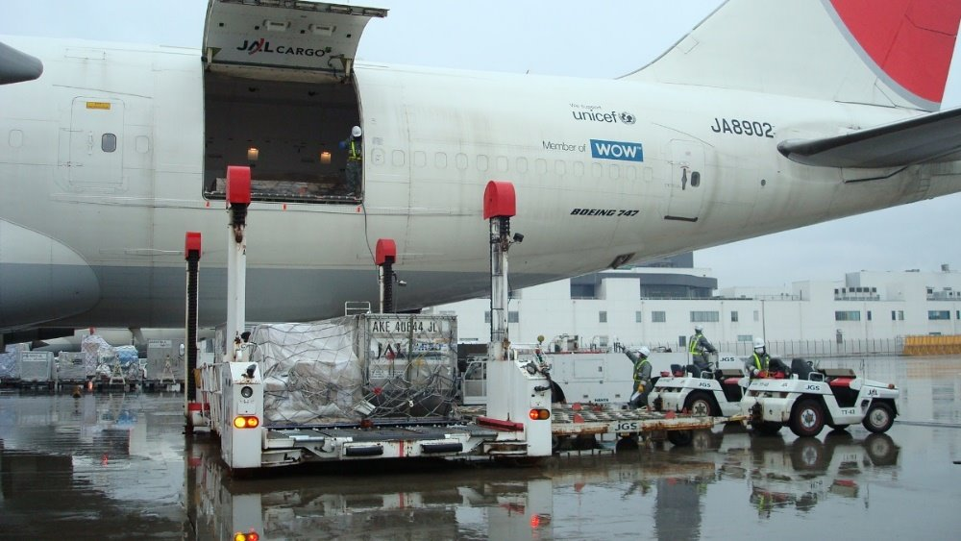
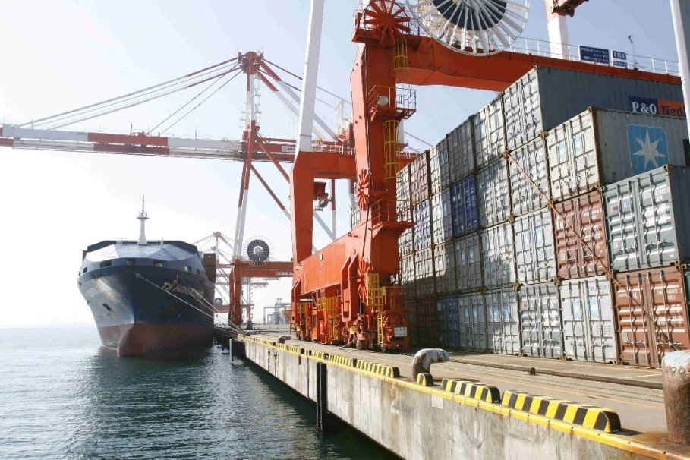
Scope
ISPM 23 describes procedures for the inspection of plants, plant products and other regulated articles before export and at import.
The revision of ISPM 23 should include the following:
ensuring consistency with the definitions of relevant terms in ISPM 5;
clarifying the inspection procedure and other relevant compliance procedures (e.g., document and integrity checks); and
updating the requirements that cover the necessary steps in the inspection procedure
Purpose
The purpose of the revision is to update and clarify the requirements in ISPM 23 and ensure that the standard is consistent with the relevant ISPM 5 definitions.
The revised standard will also connect to the content of the newly developing annex Field inspection (2021-018) to ISPM23.
Photos by Yokohama Plant Protection Station, Japan

Slide 5
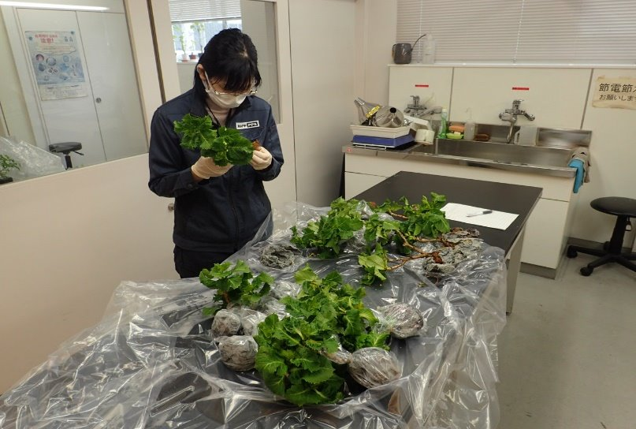
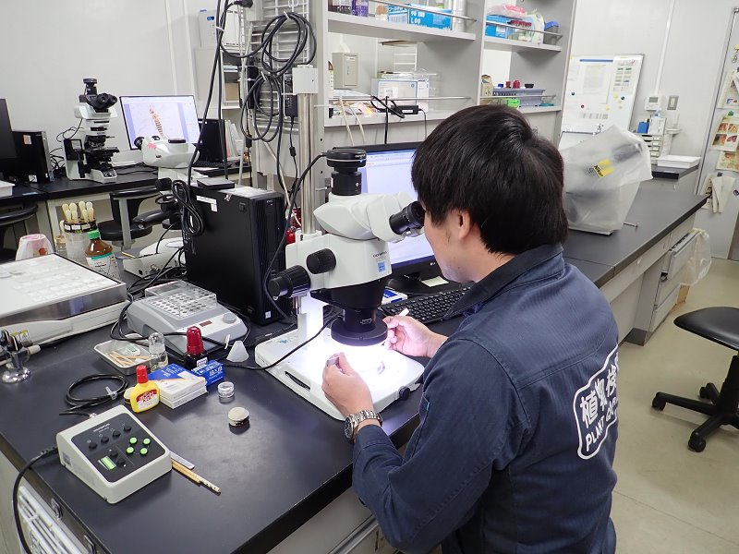
Main tasks that the future EWG should undertake
Identify the sections of ISPM 23 that align with the ISPM 5 definition of “inspection” and the sections that describe inspection in a broader sense that goes beyond the ISPM 5 definition (including compliance procedures other than inspection).
Revise the contents of ISPM 23 to ensure that all aspects of inspection are included, additionally to better connect the draft annex Field inspection (2021-018) to the core text.
Review the text of ISPM 23 and identify which sections, or parts thereof, if any, could be moved to implementation materials. Advise whether any updates to these sections (or parts) would be required and whether any terms would benefit from a definition being included in ISPM 5.
Review all references to ISPM 23 in other ISPMs to ensure they are still relevant and propose consequential changes if necessary.
Photos by Yokohama Plant Protection Station, Japan

Slide 6
Expertise and Participants
Expertise required for members to work for the revision of ISPM23.
Members should have collective knowledge of, and experience in, consignment and field inspection, compliance procedures and pest risk management.
Members of the former EWG on Field Inspection (2021-018) are encouraged to apply.
Participants to the future EWG for the revision of ISPM23
5 to 7 members.
In addition, a member of the Implementation and Capacity Development Committee (IC) should be invited to attend as an invited expert or an IC representative.
Photo by Yokohama Plant Protection Station, Japan

Slide 7
Thank you
IPPC Secretariat
Food and Agriculture Organization
of the United Nations (FAO)
ippc@fao.org | www.ippc.int

