Slide 1
Identification of IPPC implementation issues to be shared with the IC
IPPC Secretariat
Notes:
The objective of this presentation is to highlight how IPPC Regional workshops can serve as a forum to help identify challenges faced by the contracting parties in the IPPC and ISPMs implementation.
These identified difficulties will then be forwarded to the implementation committee.

Slide 2
Content
Overview of IPPC
Critical role of ISPMs
IPPC Secretariat support to implementation
IPPC implementation challenges
Regional discussion on IPPC/ ISPMs implementation
Notes:
To do this, we will first provide a reminder of the IPPC as a Convention,
highlight the crucial role of the standards committee and the implementation committee,
Present how to move from a theoretical approach to the identification of implementation challenges,
finally, the presentation will be followed by a discussion on the challenges faced by countries in the implementation of the Convention and the ISPMs.

Slide 3

Implementing International Plant Protection Standards: Challenges and Solutions
The International Plant Protection Convention (IPPC) is a vital intergovernmental treaty established in 1951 to protect the world's plants, agricultural products, and natural resources from pests.
With 185 contracting parties, the IPPC develops and promotes International Standards for Phytosanitary Measures (ISPMs) to safeguard global food security, facilitate safe trade, and protect the environment.
This presentation explores how IPPC Regional Workshops could contribute to identify IPPC implementation challenges faced by countries.
Notes:
The International Plant Protection Convention (IPPC) is a vital intergovernmental treaty to protect the world's plants, agricultural products, and natural resources from pests
Implementing the International Plant Protection Convention (IPPC) presents several challenges for countries, including resource limitations, capacity building needs, and the complexities of integrating phytosanitary measures into national systems.
Specifically, developing countries often struggle with access to resources for developing guides and training materials, as well as building the necessary capacity for effective implementation.
This presentation explores how IPPC Regional Workshops could contribute to identify IPPC implementation challenges faced by countries.

Slide 4
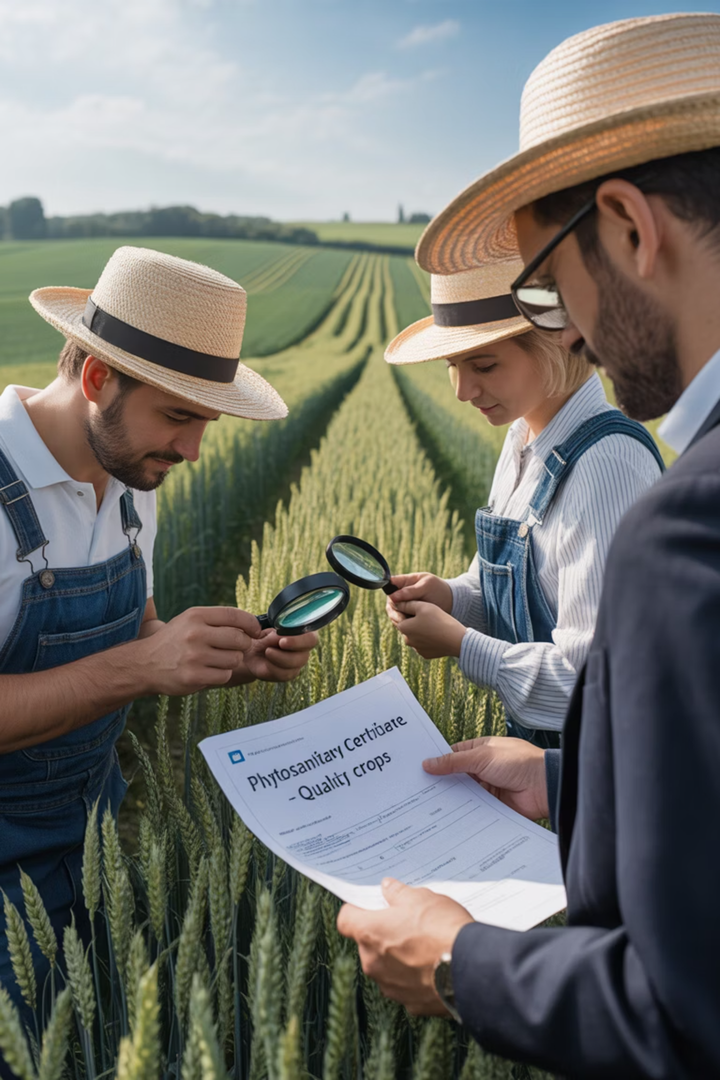
The Critical Role of International Standards (ISPMs)
Scientific Foundation
ISPMs ensure that national or regional-level plant protection measures are scientifically justified, encouraging fair trade while preventing the use of unjustified barriers to trade.
Comprehensive Coverage
The 46 ISPMs, 31 Diagnostic Protocols, and 45 Phytosanitary Treatments address critical issues including pest surveillance, risk analysis, wood packaging regulations, inspection protocols, and international movement of seeds and wood.
Trade Facilitation
Standards like ISPM 7 guide countries in developing export certification systems to produce valid phytosanitary certificates, confirming that plant consignments meet importing country requirements.
Notes:
The IPPC standard setting process is a structured approach to developing International Standards for Phytosanitary Measures (ISPMs). It involves several stages: developing a list of topics, drafting the standards, consulting with stakeholders, and finally, adoption and publication. The process is led by the Standards Committee (SC)
ISPMs provide a framework for countries to harmonize phytosanitary measures, ensuring consistent approaches to pest control and preventing the introduction of pest through international trade.
Ensuring consistent and effective application of International Standards for Phytosanitary Measures (ISPMs) across diverse national contexts and coordinating efforts with various stakeholders can be difficult.

Slide 5

IPPC Secretariat: Supporting Global Implementation
The IPPC Secretariat facilitates the implementation of the convention and the application of harmonized standards. It supports contracting parties in developing and strengthening their phytosanitary systems and technical capacity through various initiatives:
Developing plant health standards through collaborative structures
Creating e-learning courses and producing guides
Promoting knowledge exchange and information sharing
Providing forums for discussion and coordinated action
Notes:
The IPPC actively supports global implementation through various initiatives focused on building capacity and fostering collaboration among its contracting parties.
These efforts aim to enhance the effectiveness of NPPOs and facilitate the global exchange of safe plants and plant products.
- The IPPC provides technical assistance to countries to strengthen their NPPOs and improve their ability to implement phytosanitary measures.
- This includes support for developing and revising phytosanitary legislation, implementing International Standards for Phytosanitary Measures (ISPMs), and enhancing pest surveillance and diagnostic capabilities.
- The IPPC also offers training and resources to help contracting parties understand and implement ISPMs and CPM recommendations.

Slide 6

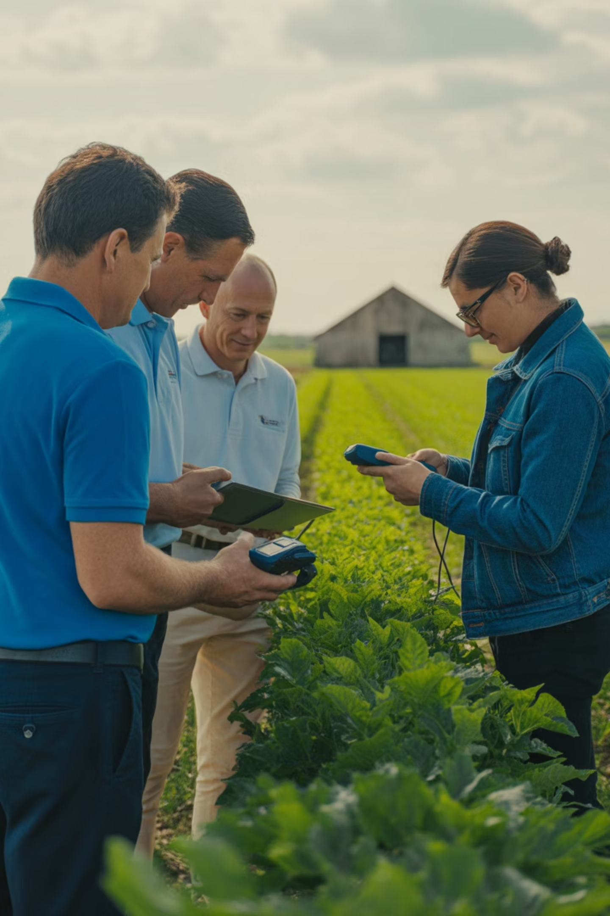


Implementation & Capacity Development Support
The IPPC places strong emphasis on technical assistance to facilitate implementation of the Convention, particularly for developing countries. The Implementation and Capacity Development Committee (IC) develops, monitors and oversees an integrated programme to support the IPPC implementation and strengthen the phytosanitary capacity of contracting parties.
Infrastructure Enhancement
Strengthening plant protection infrastructures of NPPOs through targeted technical support and resource development.
Dispute Avoidance
Promoting preventative measures and clear communication channels to minimize trade disputes related to phytosanitary measures.
Legislative Enhancement
Assisting contracting parties in updating their plant health legislation to align with international standards and best practices though the PCE process.
Notes:
The IC focuses on enhancing the capacity of contracting parties to implement the IPPC and its standards.
identifies needs, develops strategies, and oversees activities to strengthen plant health systems globally.
develops and facilitates the delivery of guides, training materials, and other resources to support IPPC implementation.
facilitates collaboration among IPPC members, sharing experiences and best practices to improve phytosanitary systems worldwide.

Slide 7

Regional Workshops: Identifying Implementation Challenges
IPPC Regional Workshops serve as critical forums for identifying implementation challenges and exchanging ideas between NPPOs), RPPOs, FAO offices, and the IPPC Secretariat.
IPPC Regional Workshops have been restructured to be more interactive and collaborative, allowing the IPPC Secretariat to better understand NPPOs' concerns and promote synergies between all stakeholders.
Key Workshop Objectives
More focus on implementation challenges
Enhancing phytosanitary capacity,
Review ISPMs and specifications in consultation, Promoting technical resources to support IPPC and ISPMs implementation,
Raising awareness about the IPPC Community's activities.
The 2025 workshops will allow time for discussions on implementation challenges faced by countries to inform future guide and training material development.
Notes:
The primary objectives of IPPC regional workshops are to foster collaboration, build phytosanitary capacity, and enhance understanding of plant health standards within specific geographic regions
Participants learn how to analyze and provide feedback on draft ISPMs and implementation materials
Workshops provide a platform for sharing experiences, best practices, and lessons learned among countries within a region, promoting regional cooperation on plant health issues.
The 2025 workshops are invited to discuss on implementation challenges faced by countries to be shared with the IC for consideration for future guide and training material development.

Slide 8

Implementation Challenges: From Theory to Practice
While ISPMs are recognized as high-quality technical standards, their practical application often presents challenges for contracting parties.
Despite inclusive consultation processes, it can be difficult to identify implementation obstacles before countries attempt to apply the standards in real-world situations.
The IC provides oversight to activities delivered by the IPPC Secretariat to address these challenges.
Implementation Attempt
Challenge Identification
Regional Workshop Discussion
Countries work to apply standards
in their national context
Practical difficulties emerge
during implementation
Challenges shared and
analyzed collectively
Guide/Training material Development
development of supporting materials
to address identified challenges
Notes:
Despite inclusive consultation processes, it can be difficult to identify implementation obstacles before countries attempt to apply the standards in real-world situations.
The objective of this session is to go beyond the potential implementation challenges that are identified during the consultation period by SC to highlight the concrete challenges faced by countries when implementing the IPPC and ISPMs.
This feedback can therefore serve as a basis for the IC to analyze which implementation tools could help adress this challenge.

Slide 9
Moving Forward : Call for Topics 2025
Considering the open Call for Topics for standards and implementation, regions are invited to engage with countries participating in the 2025 IPPC regional workshops to highlight specific challenges encountered in effectively implementing ISPMs.
This process involves identifying implementation issues based on practical, concrete cases that could become the subject of topic submissions for the development of updating IPPC guides or training materials.
Identify Specific Standards
2
Document Concrete Challenges
1
Participants are encouraged to identify particular ISPMs that present implementation difficulties in their NPPO activities.
Collect detailed information about practical obstacles encountered during implementation attempts.
Propose Solutions
4
Submit topic proposals
3
Suggest potential approaches or resources that could help overcome identified challenges.
Formally submit well-documented implementation issues for consideration in developing future guidance materials.
Notes:
Another objective is also to take advantage of the ongoing IPPC's call for Standards, Implementation and IPPC Observatory topics to encourage contracting parties to take the step and submit topics that could contribute to address the challenges identified.
The IPP call for topics is now open year-round, giving contracting parties more time to prepare their submissions and have more time to submit their topic proposals for guides, eLearning , or even training and conferences.

Slide 10

Regional discussion on implementation issues
Open discussion :
What are the difficulties you encounter in implementing the convention (IPPC) and the ISPMs?
‘’Participants are encouraged to be specific in identifying implementation challenges faced by to help the IC to effectively take appropriate actions’’.
Notes:
It is time now to open the discussion to identify challenges faced by contracting parties in implementing the convention (IPPC) and the ISPMs to help the IC to effectively take appropriate actions

Slide 11
Thank you
IPPC Secretariat
Food and Agriculture Organization
of the United Nations (FAO)
ippc@fao.org | www.ippc.int

