Slide 1
Introducing the IPPC Plant Health Campus
A global learning hub for strengthening phytosanitary capacity
Agenda 7.2 Prepared for the IPPC Regional Workshops 2025​

Slide 2
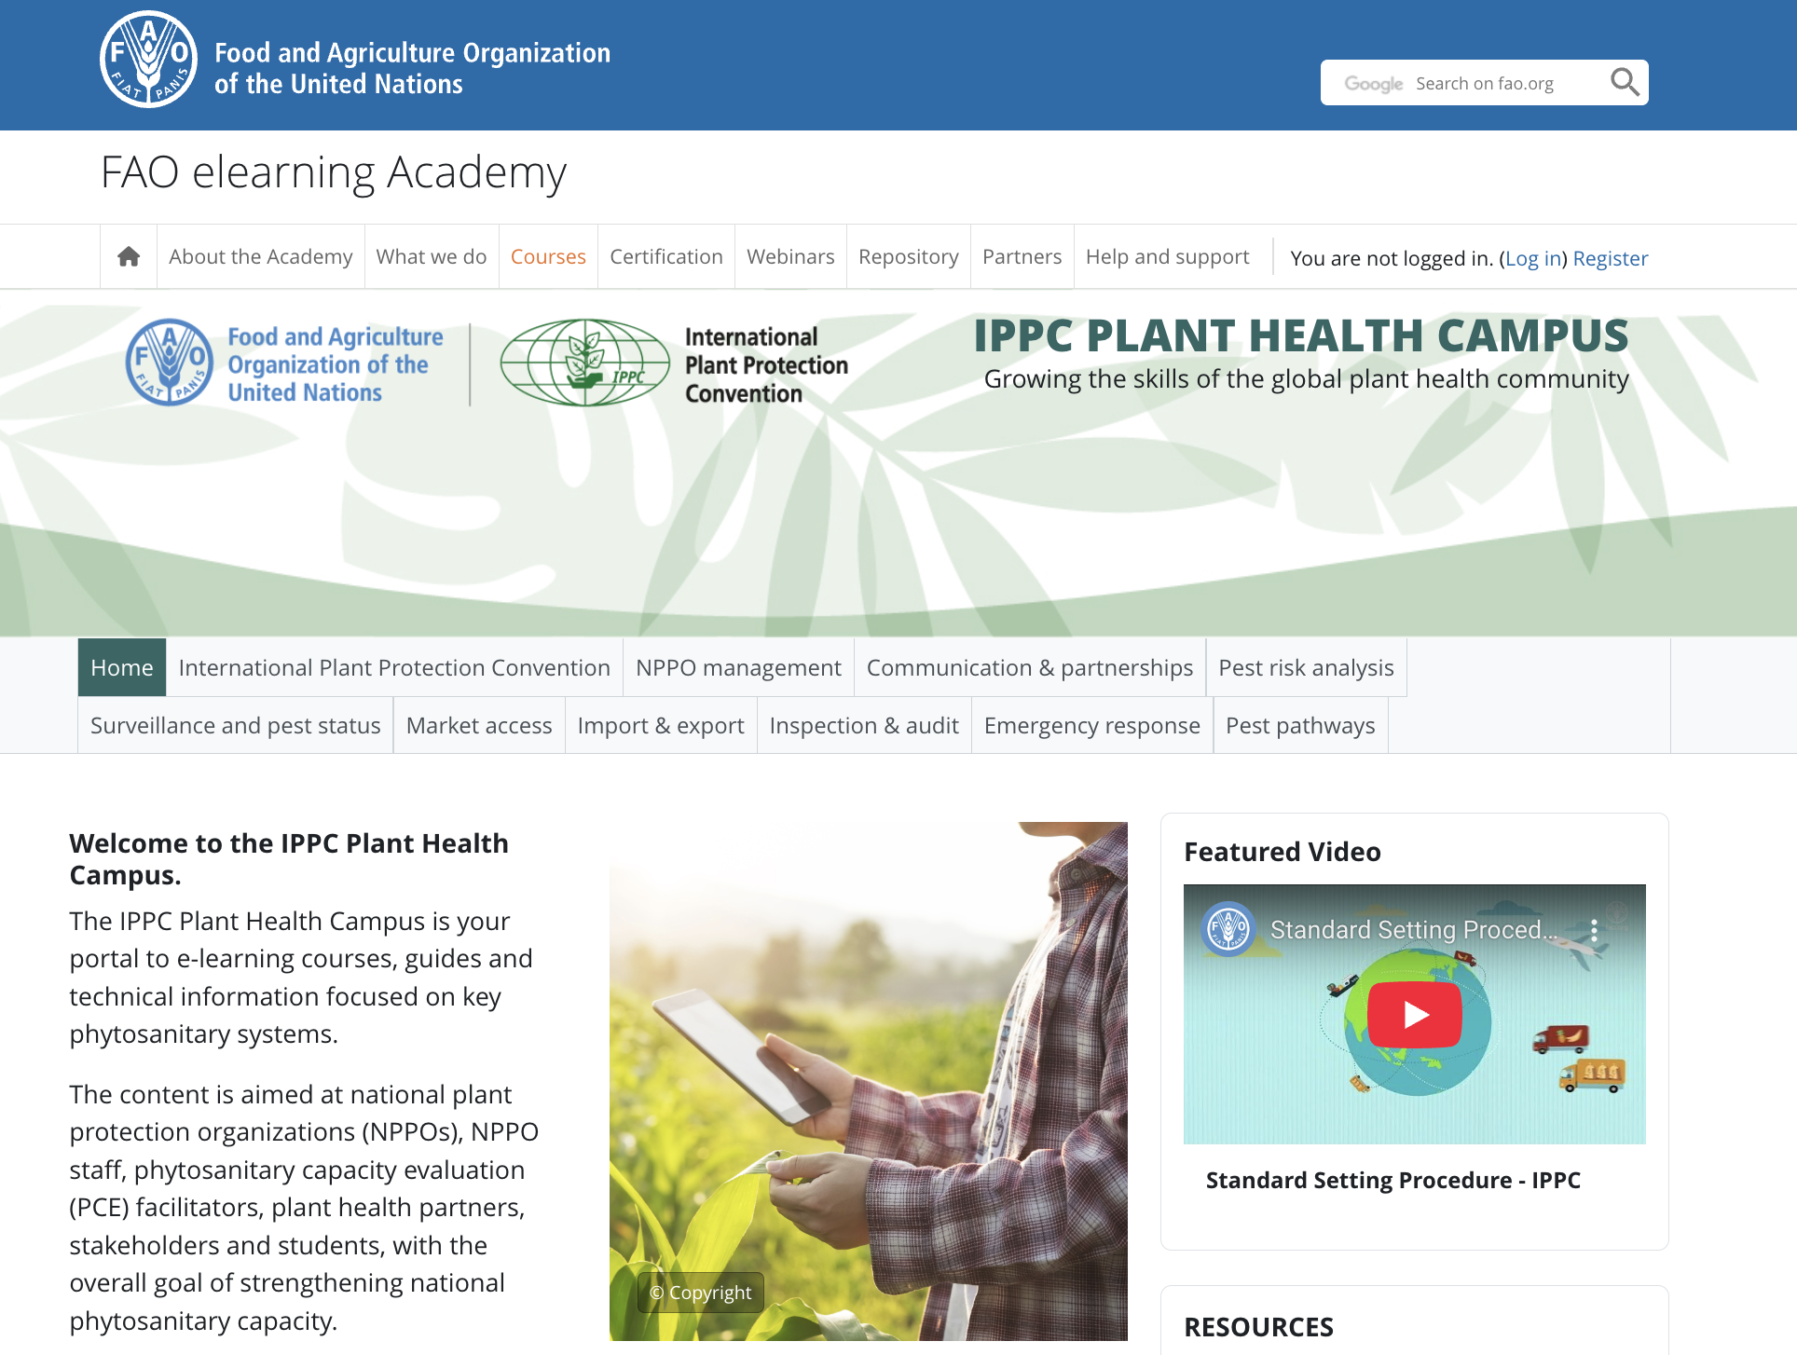
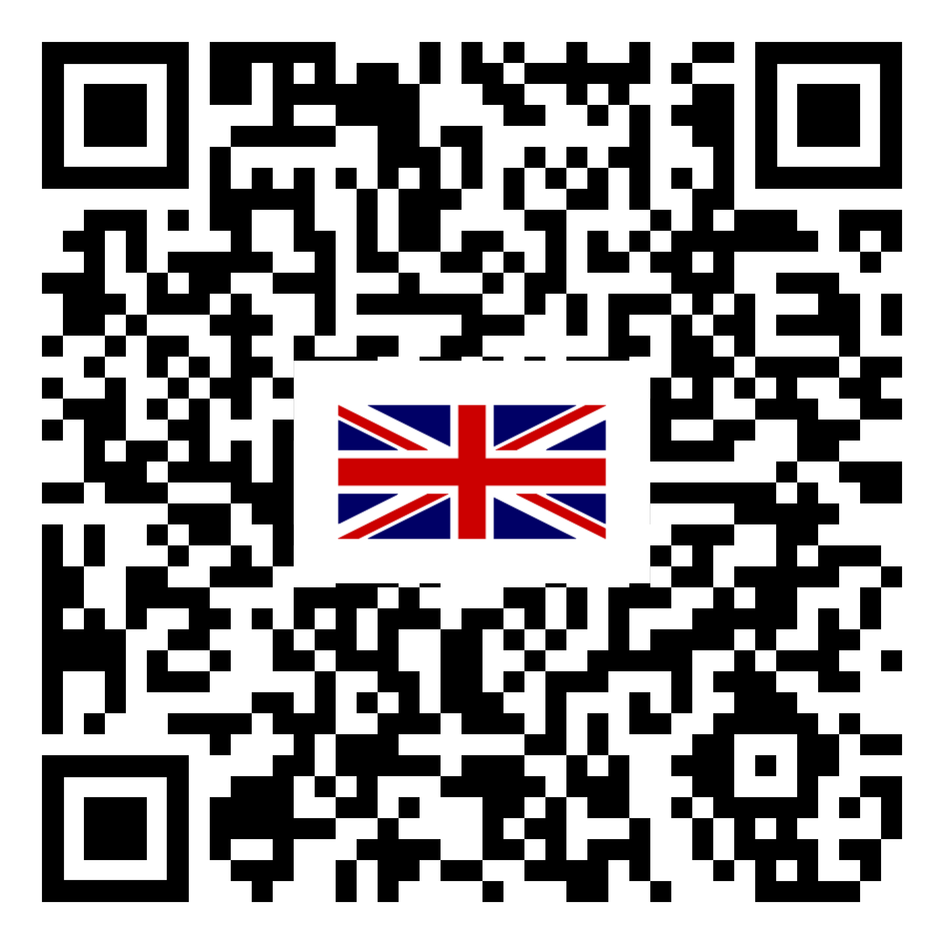
IPPC Plant Health Campus - A key milestone in plant health capacity development
Developed with support from the European Union
Convenient one-stop portal to all IPPC e-learning courses, and IPPC guides and other training materials
Free, certified e-learning courses
Developed with technical support from global plant health experts
Downloadable materials, available anytime, anywhere!
Better knowledge = better compliance and stronger biosecurity
Notes:
The IPPC Plant Health Campus is a key milestone in plant health capacity development. Developed with financial support from the European Union
The IPPC Plant Health Campus offers e-learning courses, IPPC guides and other training materials.
The IPPC e-learning courses, which were developed in collaboration with the FAO eLearning Academy, are free and aimed at NPPO staff, as well as other personnel, including PCE facilitators, farmers, exporters, importers, other government and non-government organizations involved in the phytosanitary system.
With more trade and travel around the world, the risk of spreading pests and plant diseases is growing. The IPPC Plant Health Campus is a new online portal that provides easy-to-access learning materials about plant health. Its goal is to help more people understand how plant protection works, especially the role of national plant protection organizations (NPPOs) and international requirements. When more people know what’s required, it helps improve compliance and keep our plants and ecosystems safe.
Learn at your own pace for independent learning or hybrid independent and group learning.

Slide 3
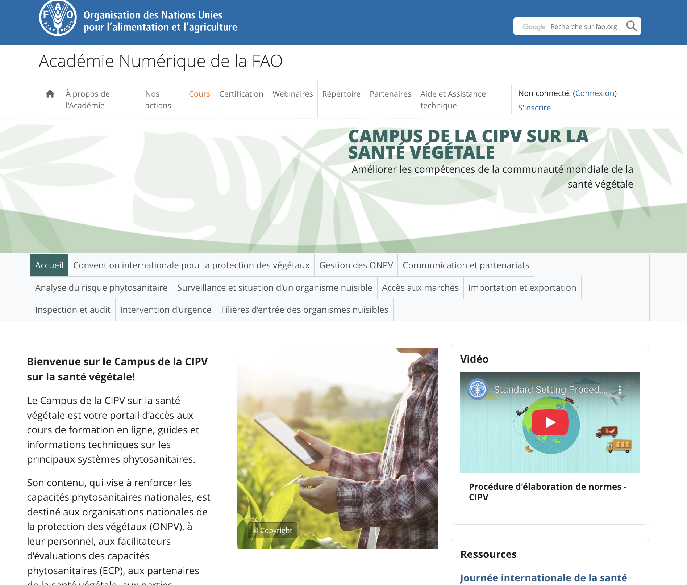

IPPC Plant Health Campus portal in other languages
The IPPC Plant Health Campus and all e-learning courses available in French
COMING UP - IPPC Plant Health Campus in Spanish
Notes:
The IPPC Plant Health Campus is also available in French. All IPPC e-learning courses are also available in French.
The IPPC Secretariat, in collaboration with FAO eLearning Academy, are also working on translating the campus to Spanish, along with all the e-learning courses.
The IPPC Secretariat would like to encourage NPPOs to provide financial support to translate the IPPC Plant Health Campus to other FAO languages, namely Arabic, Chinese, Russian

Slide 4
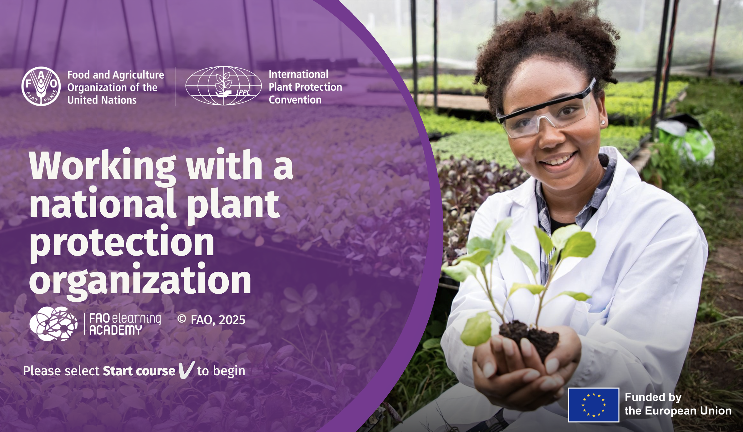
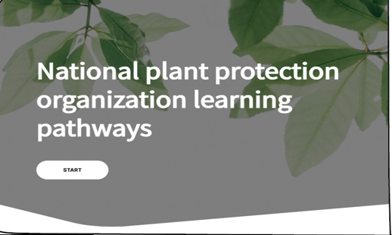



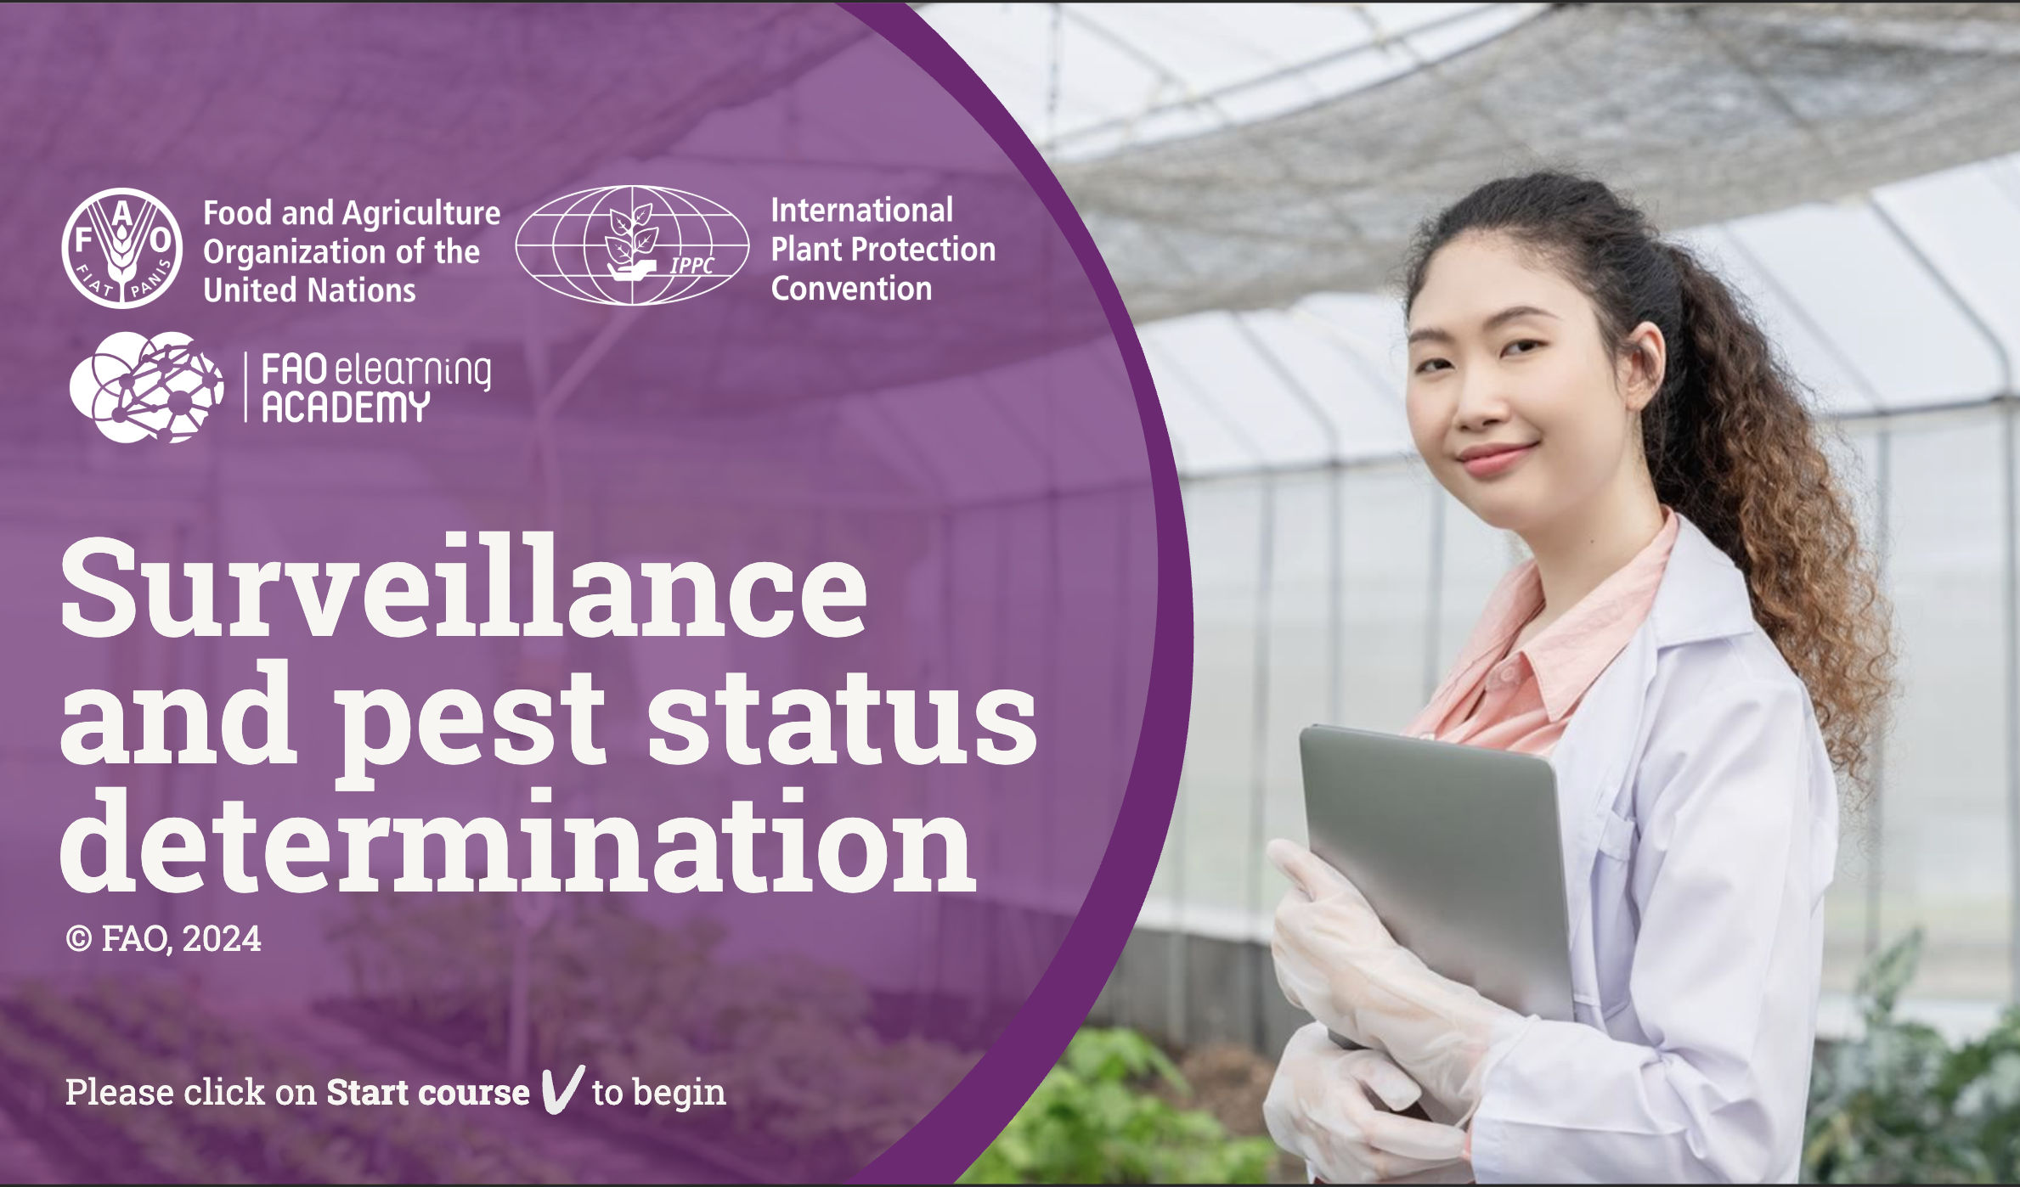

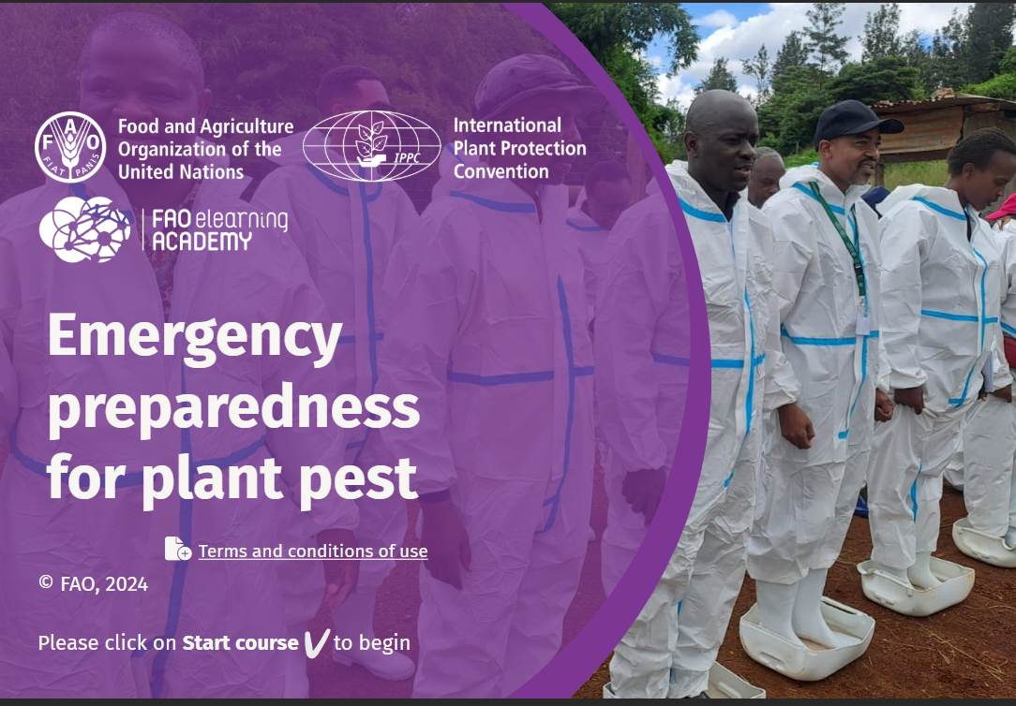


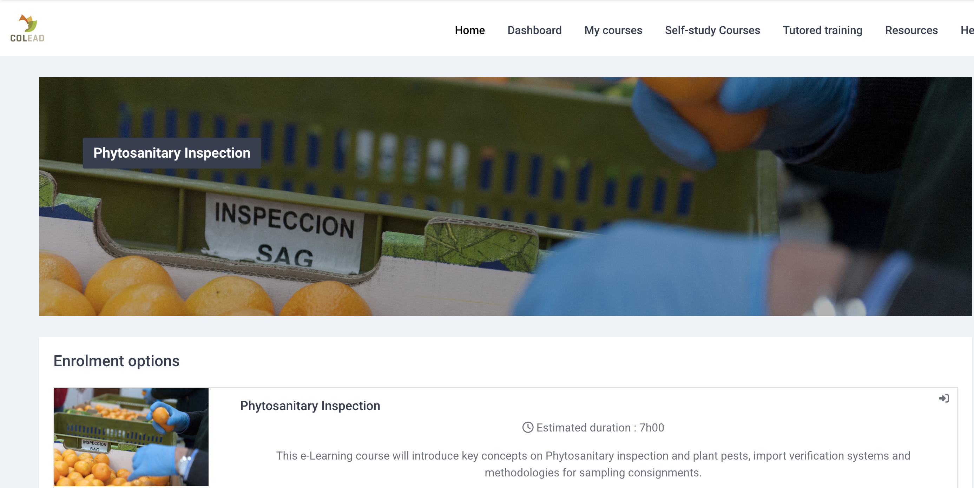


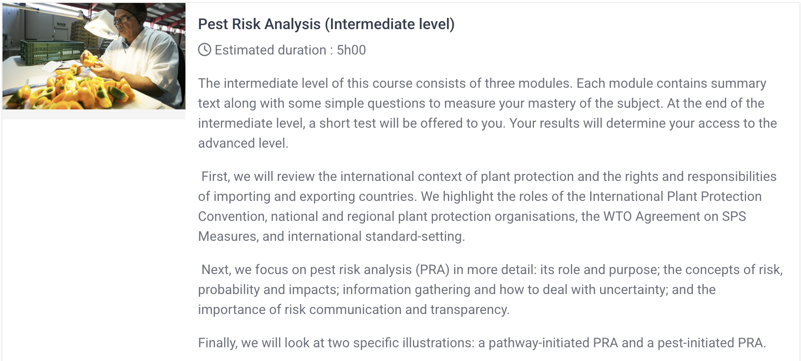
E-learning courses currently available
Notes:
List of IPPC courses currently available on the IPPC Plant Health Campus:
Working with a national plant protection organization is the first course. This is an onboarding course for anyone who is new to plant health.
The next is the National plant protection organization learning pathways tool that allows learners to understand some of the key roles in an NPPO- including the roles responsibilities, competencies and required qualifications. The tool then provides specific IPPC e-learning courses and IPPC guides that may be relevant for capacity development for that role. This tool may be of interest to NPPO staff who want to grow their career within the NPPO, and students or other stakeholders who want to understand the activities conducted by NPPOs.
There are a number of other courses, namely: How an NPPO functions which provides more in depth information than the onboarding course, Conducting a PCE, Mobilizing resources, surveillance and pest status determination, National reporting obligations, emergency preparedness, phytosanitary export certification system, achieving market access, wood packaging material, engaging with stakeholders, inspection, and PRA.

Slide 5
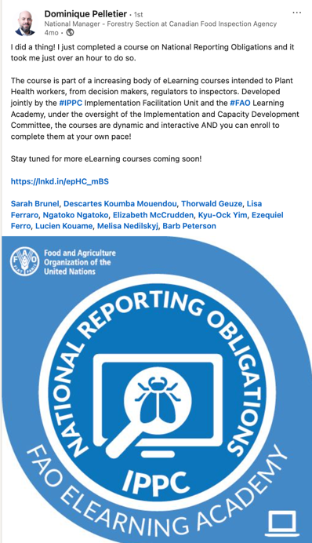
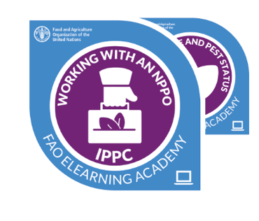
Certified Learning
Upon completing a course, learners receive a digital badge or certificate recognizing their achievement and acquired knowledge
Learners are encouraged to share their digital badges on LinkedIn and other platforms, helping to build a visible, global community of plant health professionals

Slide 6
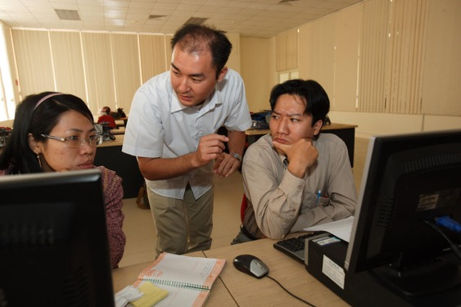
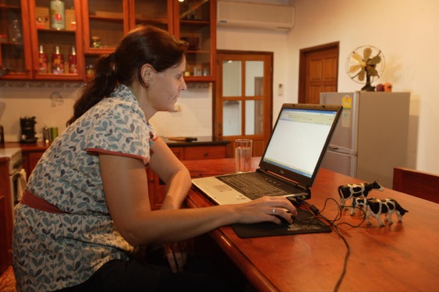
Designed to support both self-paced learning and structured training programmes
For plant health professionals:
Complete courses anytime, anywhere — at your own pace
For national plant protection organizations (NPPOs):
Easily integrate certified courses into staff training and capacity development programmes
For universities and academic institutions:
Incorporate high-quality IPPC content into plant health and phytosanitary curricula
Webinar delivered on 11 June to promote the campus.
  Recording can be seen here

Slide 7
Demo
Course: IPPC PLANT HEALTH CAMPUS | FAO elearning Academy
Cours : CAMPUS DE LA CIPV SUR LA SANTÉ VÉGÉTALE | Académie Numérique de la FAO
Notes:
Let’s go through a demo of the website: Notes provided here to help navigate the website: IPPC Plant Health Campus navigation notes for presenter.docx

Slide 8
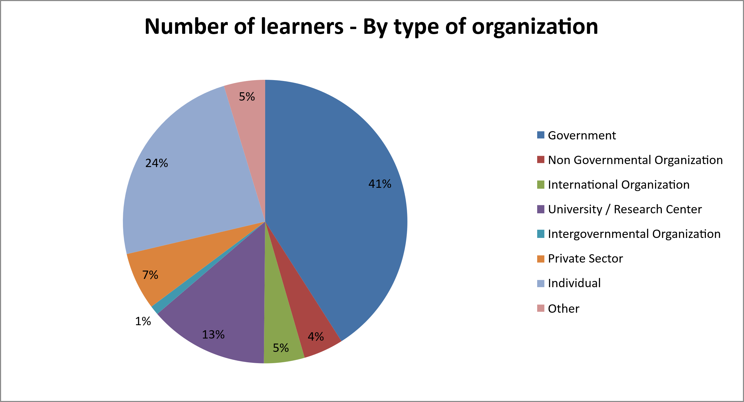
Uptake of Plant Health Campus
Between June 2024- June 2025, we have had 6,290 students

Slide 9
Thank you
IPPC Secretariat
Food and Agriculture Organization
of the United Nations (FAO)
ippc@fao.org | www.ippc.int

