Slide 1
Updates on Fusarium TR4 Global Coordination
Fusarium oxysporum f.sp. cubense activities
Agenda 7.3 Prepared for the IPPC Regional Workshops 2025​

Slide 2
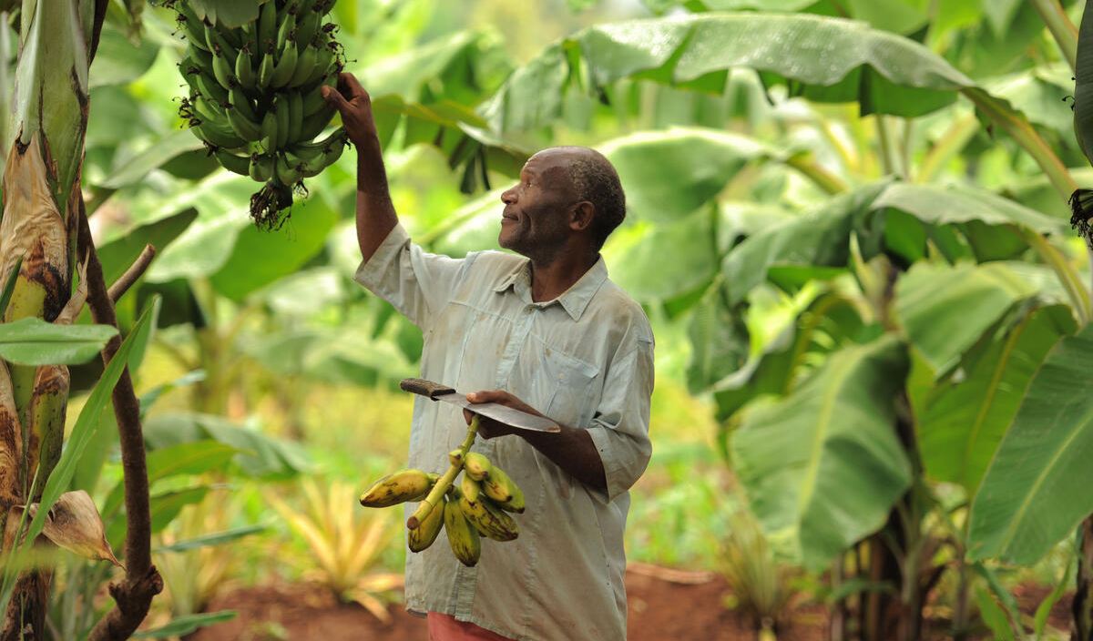
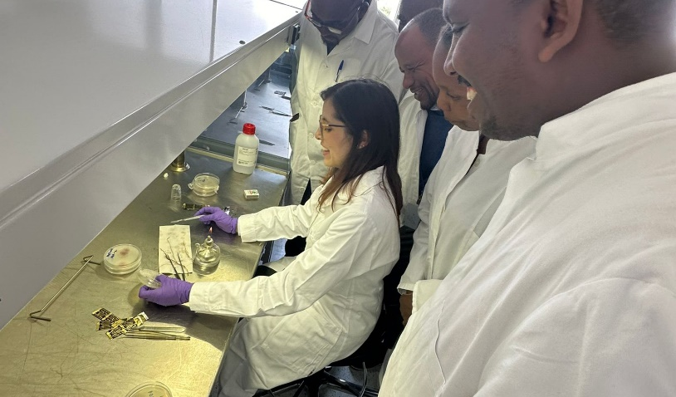
Background
The CPM-17 (2023) requested the IPPC Secretariat to coordinate the global action on Fusarium Tropical Race 4 (TR4), using the proposals presented by the Latin American and Caribbean group (GRULAC) in CPM 2023/CRP/08 as an initial framework.
In 2024, the secretariat, with technical support from the IC team on Fusarium TR4, FAO Mesoamerica, and Joint FAO/IAEA Centre of Nuclear Techniques in Food and Agriculture, delivered three capacity development activities in Common Market for Eastern and Southern Africa (COMESA).
IC Team on TR4 has completed the agreed activities
Notes:
The three capacity development activities were:
hands-on diagnostic training course delivered in Vienna,
virtual training course on surveillance, and
hands-on simulation exercise on responding to a potential Fusarium TR4 outbreak.
With the completion of these activities, the IC Team on Fusarium TR4 has completed its agreed and planned activities. Implementation and Capacity Development Committee meeting in November will determine next steps for IC Team on Fusarium TR4

Slide 3
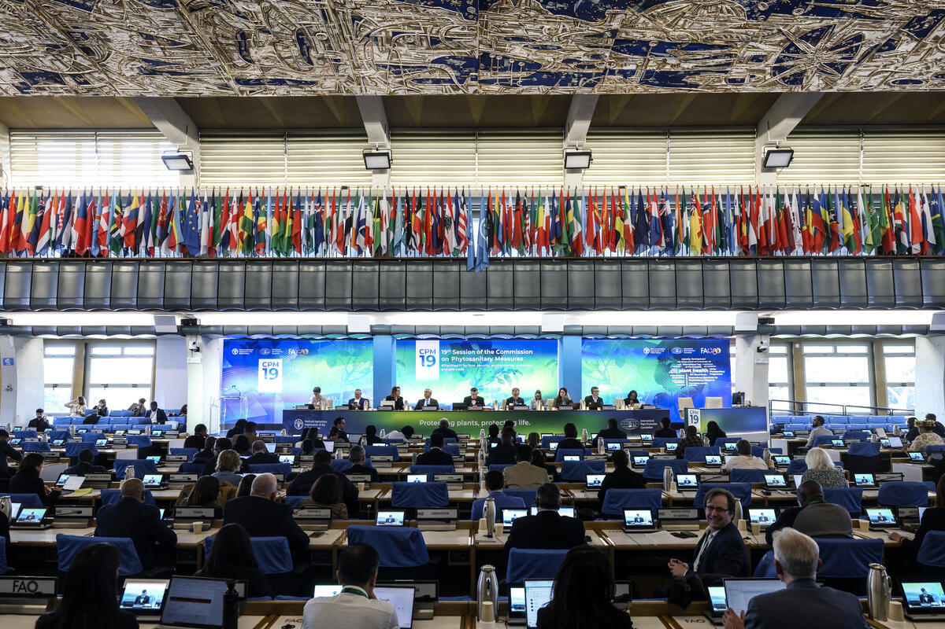
Next steps: FAO coordination on Fusarium TR4 activities
CPM-19 (2025)
recognized the strong need for increased financial and in-kind resources from contracting parties and the private sector, to ensure the sustainability of Fusarium TR4-related activities.
renewed request from contracting parties for the secretariat coordination on FAO Fusarium TR4 activities
The secretariat delivered a side-session on innovative research and tools to prevent and contain Fusarium TR4 spread and tools for capacity development to respond to outbreaks.
Notes:
The CPM-19 (2025) recognized the strong need for increased financial and in-kind resources from contracting parties and the private sector to ensure the sustainability of Fusarium TR4-related activities.
CPM-19 requested the IPPC Secretary, in conjunction with the advice and guidance of the Financial Committee, consider the proposed provision of adequate financial resources for core and priority IPPC activities that are not funded or underfunded – including POARS, and where there are synergies and sufficient funds, Fusarium TR4 activities.
There was a renewed request from contracting parties for the IPPC Secretariat to organize regular on-going coordination meetings with other FAO divisions working on Fusarium TR4 activities, including Plant Production and Protection Division (NSP), World Banana Forum (WBF), and Joint FAO-IAEA Centre of Nuclear Techniques in Food and Agriculture, as well regional FAO offices.
This will allow identification of synergies between FAO activities on TR4 for efficient and effective use of resources
IPPC conducted the first coordination meeting between IPPC, FAO NSP, WBF, Joint FAO Centre for IAEA, regional offices. Each unit shared shared their upcoming activities.
The secretariat to organize regular on-going coordination meetings
Expected outcome is
Improved understanding of each others mandates and activities
Finding synergies, where possible, for resource allocation
During CPM-19, the secretariat delivered a knowledge sharing side-session on innovative research and tools to prevent and contain Fusarium TR4 spread as well as for capacity development to respond to Fusarium TR4 outbreaks. The expert panel speakers included representation from regional plant protection organization (OIRSA), FAO regional office of Mesoamerica, research institutions working on breeding resistant varieties of banana, a national plant protection organization, and representative from the banana public sector.

Slide 4
Thank you
IPPC Secretariat
Food and Agriculture Organization
of the United Nations (FAO)
ippc@fao.org | www.ippc.int

