Slide 1
Phytosanitary Capacity Evaluations (PCE) and latest developments
7.5 Prepared for the IPPC Regional Workshops 2025​

Slide 2
Overview
Background
Snap shot on recent and current PCEs
PCE success stories
Update on EU-FAO Partnership Achievements through PCE
Updates on the road map implementation progress to improve the PCE, based on the Desk Study conducted in 2023
Highlights from the PCE improvement through first-hand user insights
Spotlight on PCE Publication

Slide 3




What is the Phytosanitary Capacity Evaluation?
Coordination
NPPO designates a PCE National Coordinator
Stakeholders
The PCE is a fully comprehensive NPPO-led, facilitator-enabled, IPPC Secretariat-supported process of multiple phases, with a wide range of benefits, to help countries evaluate their phytosanitary capacities
Actively participate and contribute to the PCE and improvement of a country's phytosanitary capacities
Consensus
PCE consists of three consensus workshops (It is not a one-man task)
Facilitation
IPPC identifies a list of facilitators
NPPO selects a PCE Facilitator
Int. and nat. legal consultants

Slide 4
Modalities to access a PCE​
The following three modalities are available for conducting a PCE:
Facilitated modality with the support of an IPPC-certified PCE facilitator with technical guidance from the IPPC Secretariat.
Facilitated modality with the support of an IPPC-certified PCE facilitator but without IPPC Secretariat involvement.
Independent modality, the NPPO takes all responsibilities.

Slide 5
System (3)
Tailored and modular gap identification assessment:
Three levels of assessment
Each module contains a set of questions
Allows to identify gaps and their prioritization
Up to five gaps are prioritized per module
Countries can select the number of modules that suit their necessities and context
A full assessment is also possible
Arranged into an online system:
Country Profile
Legislation
Environmental forces
Organizational (3)
NPPO’s mission and strategy
NPPO’s structure and processes
NPPO’s resources
Core activities (7)
Pest Diagnostic capabilities
Surveillance and pest reporting
Pest eradication
Import regulation
Pest risk analysis
Pest-free areas
Export certification & transit
Modularity
Secure store
Confidentiality
Online System = FAO (Web + Security + Confidentiality + Modularity + 13 Modules + Structure format) + Users

Slide 6
1
1
Dominica
(in progress)
St. Lucia Completed; MIS and SOP projects t
1
Mongolia
Completed, draft revision of the plant health legislation
Tunisia
(project funded by the EU)
completed
1
1
Mali
Self-funded PCE
Uzbekistan
Completed
1
Trinidad and Tobago
(in progress)
1
1
1
Nepal
Completed; prioritized projects under development for funding; funded by the World Bank
Bahamas
(in progress)
Guinea
(project funded by STDF)
completed
Nigeria
Completed
Ethiopia
project funded by STDF)
Laos
(In progress)
Pakistan
(In progress)
1
1
Philippines
Self-funded PCE
Nicaragua
Completed
New phytosanitary law 3 months after PCE.
1
11AU Countries
GCP/GLO/949/EC
“Strengthening food control and phytosanitary capacities and governance”
Comoros
1
1
Sri Lanka
Completed; upgraded border inspection points
Sierra Leone
In progress
Vietnam
(In progress)
1
1
Madagascar
All modules completed; project funded by the EU
Namibia
Completed
Fiji
Completed
Draft revision of plant health law
1
Snapshot of PCEs 2020 – 2024

Slide 7
PCE in Action: National Benefits at a Glance!

Slide 8
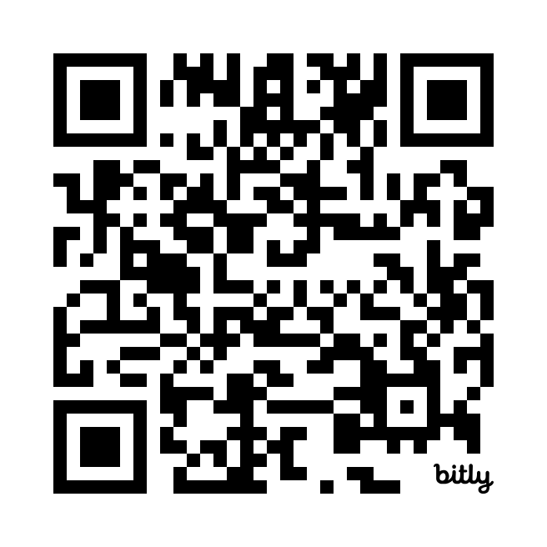
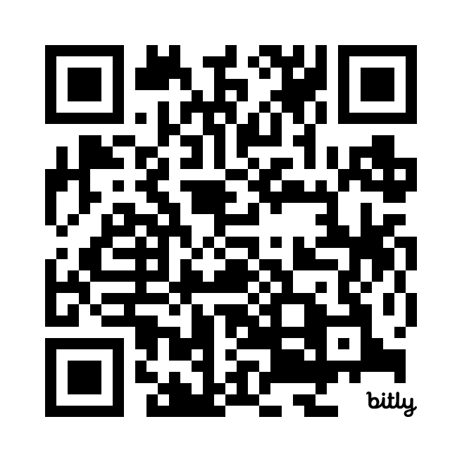
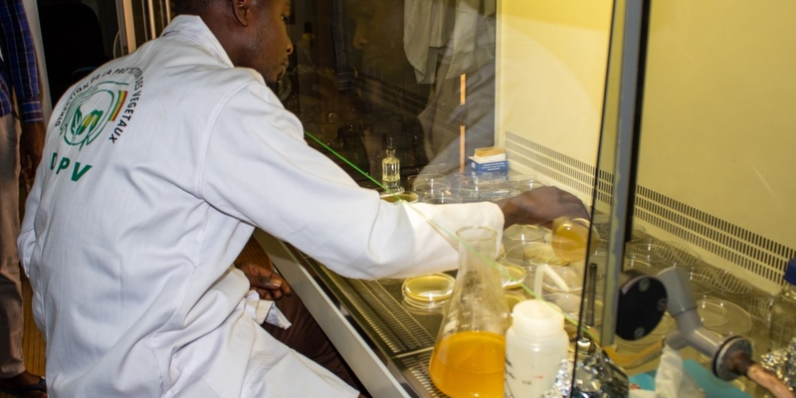
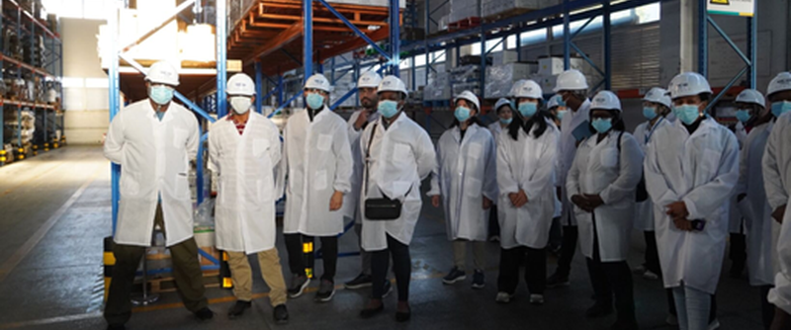
SPOTLIGHT: Building a resilient plant health system in Senegal
South-South Cooperation: End of project heralds positive changes for plant health in Cambodia and Sri Lanka
PCE process:
Situation analysis
Strategic planning
Validation
National Phytosanitary Capacity Development Strategy
PCE outcomes:
New/revised legislation/regulation

Slide 9
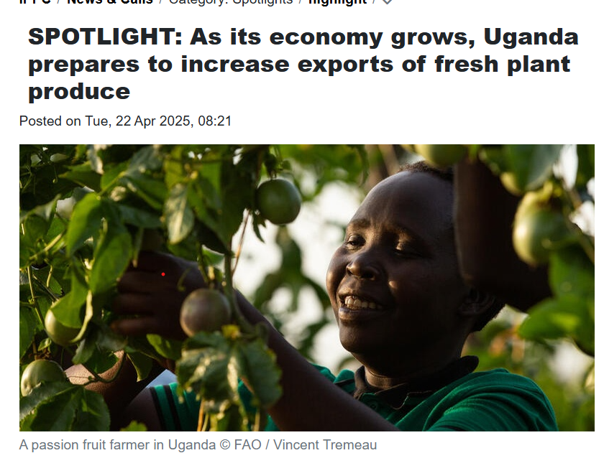
More stories at:
Ethiopia
Saint Lucia
Sri Lanka
Zimbabwe
Ugandan's commitment to using the PCE and in In a significant step forward, Uganda was able to secure EUR 8 million from the EU to implement the lessons it learned from the PCE process. The Ugandan finance ministry also pledged another USD 5.5 million toward the effort, recognizing the importance of supporting the ministry responsible for plant health. The country now plans to enhance its skills when it comes to inspections, diagnostics, and surveillance. It will also improve training for staff in both the public and relevant private sectors,and develop communications for stakeholders.
https://www.ippc.int/en/news/spotlight-as-its-economy-grows-uganda-prepares-to-increase-exports-of-fresh-plant-produce/

Slide 10
Strengthening Global Plant Health: Update on EU-FAO Partnership Achievements through PCE

Slide 11
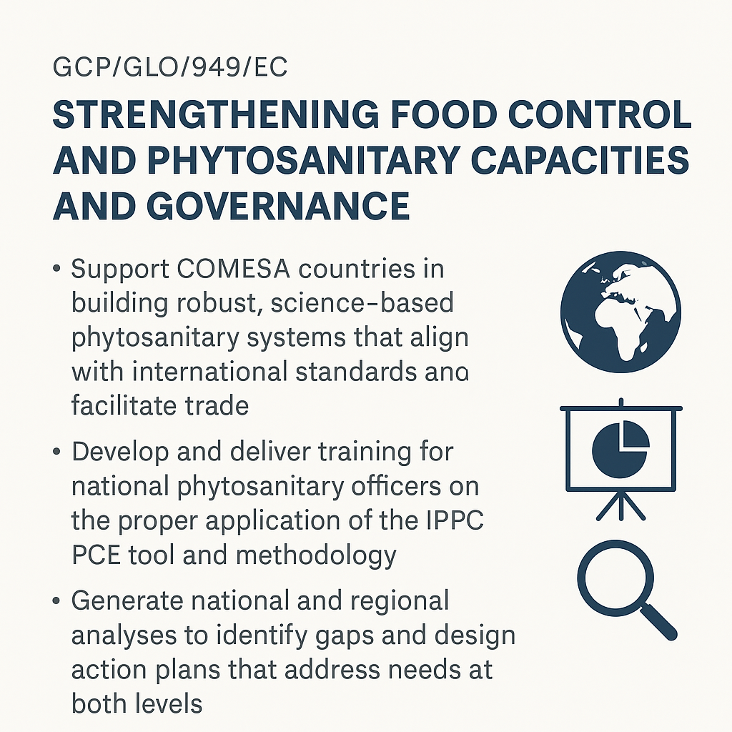
Focus on the PCE in COMESA
The project “Strengthening Food Control and Phytosanitary Capacities and Governance” was designed to support COMESA countries in building robust, science-based phytosanitary systems that align with international standards and facilitate trade.

Slide 12
🌿Key Plant Health Achievements within the Project
📊11 PCEs completed
Countries conducted structured evaluations of their national phytosanitary systems, identifying strengths, gaps, and priority areas for improvement.
⚖️8 legal module reviews
Countries have begun updating phytosanitary legislations, clarifying institutional roles, and aligning frameworks with international standards.
📝11 national strategies developed
Each country produced a costed, multi-year strategy to guide reform, enhance coordination, and support resource mobilization.
🎓6 PCE facilitators certified
A new group of certified facilitators was trained to lead future evaluations and promote sustained national and regional capacity.
💼8+ donor-ready proposals prepared
Countries translated their strategies into investment-ready proposals to attract support from development partners.
🌐IPPC Plant Health Campus launched
A multilingual, learning platform offering free certified e-learning courses, guides, and tools to build capacity across NPPOs, academia and beyond.
🔍Cross-cutting themes integrated​
​
🌾 SPS GAP analysis | 🧠 PCE thinking study | 👩‍🌾 Gender & Youth​
​

Slide 13
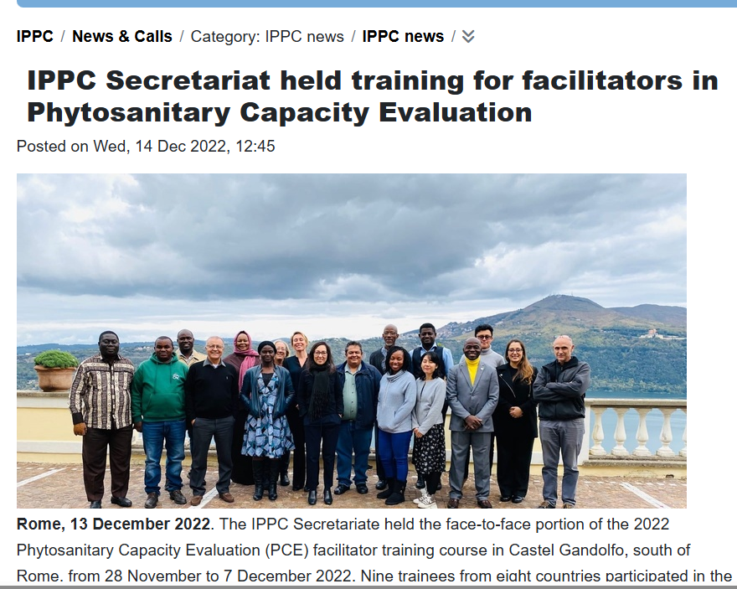
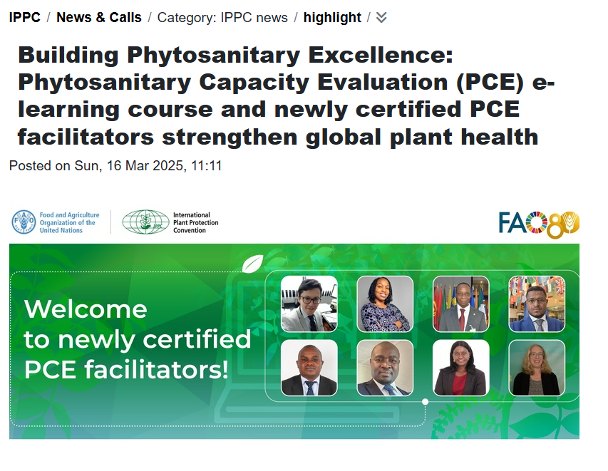
Meet the new certified facilitators
IPPC Secretariat held training for facilitators in Phytosanitary Capacity Evaluation - International Plant Protection Convention
Building Phytosanitary Excellence: Phytosanitary Capacity Evaluation (PCE) e-learning course and newly certified PCE facilitators strengthen global plant health - International Plant Protection Convention

Slide 14
Updates on the road map implementation to improve the PCE, based on the Desk Study conducted in 2023!

Slide 15
🧭 Overview on the Roadmap Origins
Based on a comprehensive Desk Study review conducted in 2023.
Roadmap approved by the Implementation and Capacity Development Committee (IC) in May 2024 and revised in November 2024.
Objective: Ensure the PCE remains fit-for-purpose, effective, and widely accessible.

Slide 16
🔑 Key Result Areas & Progress
Key Result Area: Software and Platform Reliability
Goal: Improve the PCE online system to ensure usability and technical reliability.
Progress:
📌 Frequent IT issues identified through user feedback.
💼 UNICC engaged for IT needs assessment (quoted: USD 18,830).
🚀 Migration to a modern platform planned for 2025/26.
Key Result Area: Tool Revision and Strategic Updates
Goal: Keep PCE modules current, relevant, and inclusive.
Progress:
📝 Module Revision: Initial revision conducted with input from national stakeholders.
🛠️ Enhancement Workshop (Apr 2025): Collected feedback to improve module structure.
📚 Pre-PCE Training Package: Developed to better prepare NPPO staff and coordinators.
🌐 Gender & Youth Integration: Guidance under development with FAO teams.

Slide 17
🔑 Key Result Areas (KRAs) & Progress
Key Result Area: Strengthening Expertise
Goal: Expand and strengthen the network of trained PCE facilitators.
Progress:
🧑‍🏫 10 New Facilitators Certified following the 2021 certification procedure.
🎯 Training Delivered: Results-Based Management & Logical Framework Approach training delivered to 11 countries.
🌍 Facilitator Community: Networking and experience-sharing structures in development.
Key Result Area: Monitoring and Evaluation
Goal: Measure the impact of PCEs and foster continuous learning.
Progress:
🎓 IPPC Plant Health Campus Launched: Supports eLearning and facilitator development.
💻 R-SAT Virtual Course (Oct 2024): 4-week training successfully delivered.
📈 Project Definition Workshop: Improved donor engagement and proposal quality.
🤝 Restitution Workshop (Apr 2025): Peer learning and donor outreach event delivered.

Slide 18
🌟 Cross-Cutting Achievements
📣Awareness & Communication
🌐 PCE Webpage updated with modules and guidance.
📽️ Global outreach materials developed (impact video, example outputs).
📊 SPS Gap Analysis completed.
💰 Sustainable Funding
💬 Cost structure shared with all IPPC bodies.
📑 Resource mobilization strategy in progress.
💵 CPM-19 encouraged allocation of USD 50,000 for system support.
⚙️ Institutional Improvements
🔄 Post-PCE review processes being institutionalized (e.g. regional follow-ups).
🤖 Exploration of AI and strategic dashboards for smarter planning and reporting.

Slide 19
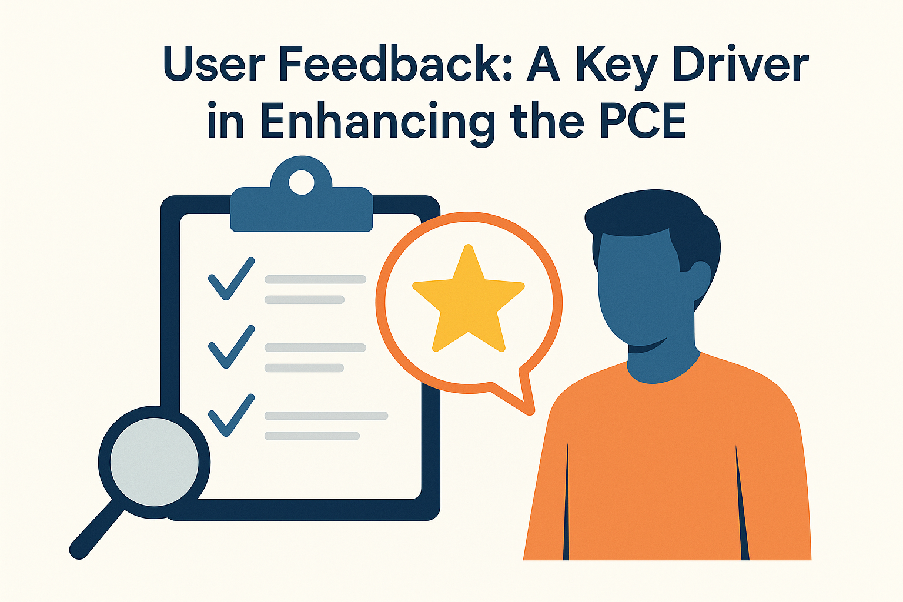
Updates on Enhancing the PCE Through First-Hand User Insights
Notes:
As part of the continuous effort to enhance the Performance and Country Engagement (PCE) tool, feedback from first-hand users played a critical role in shaping improvements. This process provided direct insights into usability, accessibility, and overall effectiveness from those actively engaging with the PCE across various contexts.
By capturing user experiences and lessons learned, the initiative ensured that future iterations of the PCE are more intuitive, responsive to user needs, and aligned with real-world application.

Slide 20
Feedback from National Coordinators and PCE Facilitators to improve the PCE
📅 Technical Workshop Held – April 2025: A technical face-to-face workshops to strengthen the PCE process
📌Key Recommendations Generated: The PCE Improvement Workshop generated key recommendations to enhance the PCE process

Slide 21
According to the six key result areas PCE strategy 2020-2030
Revision of the PCE modules
learning from Other organization
In April, IPPC secretariate along with facilitators initiated comprehensive revision to the modules structure, order, relevance and questions
1
2
The IPPC invited the World Organization for Animal Health to share insights from its PVS tool to explore best practices & innovations that could enhance the PCE
Milestones
Milestones
Software and platform enhancement
Pre-PCE training
A new e-learning course on the PCE, developed with the FAO eLearning Academy, was launched to train national coordinators and NPPO staff in effectively using the tool and applying its recommendations.
6
3
The tool will be enhanced with new features, e.g. including automatic generation of similar questions and answers, as well as improved data retrieval and analysis capabilities.
Integration of AI Features in Tool Enhancement
Gender & Youth mainstreaming
5
The tool will include AI features to extract shared themes and ideas, analyze data, identify gaps, and suggest targeted solutions to address weaknesses.
4
The IPPC, in collaboration with the Gender and Youth team, developed a guiding document to better integrate gender and youth considerations into the PCE process, offering clear guidance on how to incorporate gender effectively

Slide 22
Spotlight on PCE Publications

Slide 23
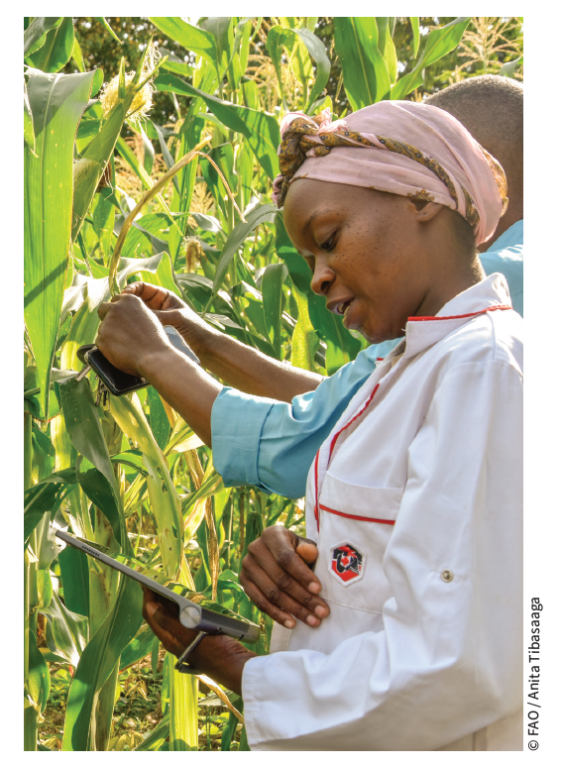
Assessing and advancing phytosanitary capabilities in targeted countries in eastern and southern Africa: a pathway to resilient agriculture
Main Gaps Identified
Outdated legislation and limited legal enforcement
Weak diagnostic and surveillance infrastructure
Poorly defined NPPO structures and limited staffing
Inadequate border inspection capacity
Governance and strategic planning under-addressed
Recommendations
Modernize phytosanitary legislation
Strengthen technical infrastructure (labs, ePhyto, PRA tools)
Establish regional training hubs and databases
Integrate PCE results into national budgets and development plans
Promote coordinated regional strategies through COMESA & AU-IAPSC
content

Slide 24
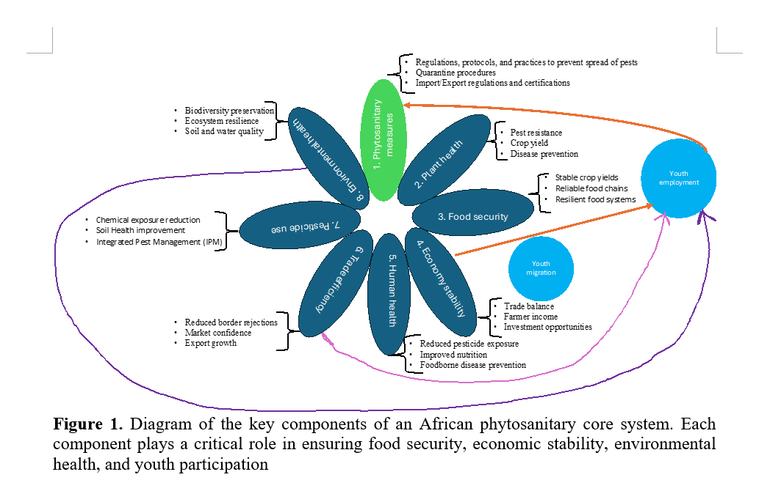
2. Phytosanitary systems and agricultural development: modeling the impact of phytosanitary capacity evaluations in Africa
The study focuses on the following specific objectives:
Analysis of interactions between phytosanitary measures, plant health, human health, environmental health, and economic outcomes
Assessment of the impact of phytosanitary measures on trade efficiency, economic growth, and youth employment/migration trends
Provision of evidence-based policy recommendations
Results:
Notes:
This is in the pipeline. To be published soon

Slide 25

3. How to integrate gender and youth in Phytosanitary Capacity Evaluations (PCE).
“Sanitary and phytosanitary measures (SPS) are critical for protecting plant health, ensuring food safety, safeguarding biodiversity, and enabling access to international markets. Yet, the successful implementation of these measures depends not only on technical expertise, but also on whether systems are inclusive, equitable and socially responsive. In many countries, critical social dimensions—including gender and age—remain under-considered in phytosanitary planning, limiting the resilience, legitimacy, and long-term impact of national plant protection efforts (Henson, 2018).”
Notes:
Not published yet. In copy-editing process.

Slide 26
Initiate the pathway for an improved phytosanitary system in your country !!
Visit the IPP to learn how to access a PCE! https://www.ippc.int/en/about/core-activities/capacity-development/phytosanitary-capacity-evaluation/

Slide 27
Thank you
IPPC Secretariat
Food and Agriculture Organization
of the United Nations (FAO)
ippc@fao.org | www.ippc.int

