Slide 1
IPPC Global Workshop on Systems Approaches
7.7. Prepared for the IPPC Regional Workshops 2025​

Slide 2
Why Systems Approaches?
Complex trade pathways require integrated, adaptive solutions.
Risk-based and least trade-restrictive approach.
Supports modern production and trade practices.
Leverages new technologies to manage phytosanitary risk.
ISPM-14: The use of integrated measures in a systems approach for pest risk management
Trade Complexity
Risk Sensitivity
Modern Practices
System Approaches
Safe Trade
Innovation
Compliance
Notes:
ISPM 14: Outline of Requirements
ISPM 2 (Framework for pest risk analysis), ISPM 11 (Pest risk analysis for quarantine pests) and ISPM 21 (Pest risk analysis for regulated non-quarantine pests) provide general guidance on measures for pest risk management. Systems approaches, which integrate measures for pest risk management in a defined manner, could provide an alternative to single measures to meet the appropriate level of phytosanitary protection of an importing country. They can also be developed in situations where no single measure is available. A systems approach requires the integration of different measures, at least two of which act independently, with a cumulative effect.
Systems approaches range in complexity. The application of critical control points system in a systems approach may be useful to identify and evaluate points in a pathway where specified pest risks can be reduced and monitored. The development and evaluation of a systems approach may use quantitative or qualitative methods. Exporting and importing countries may consult and cooperate in the development and implementation of a systems approach. The decision regarding the acceptability of a systems approach lies with the importing country, subject to consideration of technical justification, minimal impact, transparency, non-discrimination, equivalence, and operational feasibility. A systems approach is usually designed as an option that is equivalent to but less restrictive than other measures.
Purpose of Systems Approaches
Many of the elements and individual components of pest risk management are described in ISPM 2, ISPM 11 and ISPM 21. All phytosanitary measures must be technically justified according to Article VII.2(a) of the IPPC. A systems approach integrates measures to meet phytosanitary import requirements. Systems approaches provide, where appropriate, an equivalent alternative to procedures such as treatments or replace more restrictive measures like prohibition. This is achieved by considering the combined effect of different conditions and procedures. Systems approaches provide the opportunity to consider both pre- and post-harvest procedures that may contribute to the effective management of pest risk. It is important to consider systems approaches among pest risk management options because the integration of measures may be less trade restrictive than other risk management options (particularly where the alternative is prohibition).

Slide 3
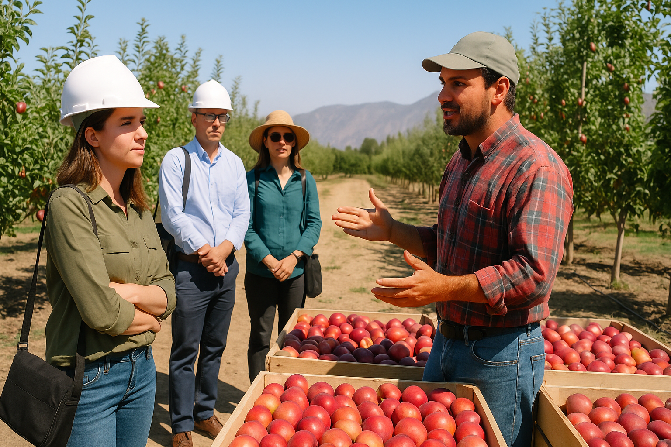
SAVE THE DATE!
The workshop will take place:
1 to 5 December 2025, in Santiago, Chile.
Confirmed by the CPM Bureau in April and supported by COSAVE.
Organized by IPPC and supported by the Chilean NPPO and regional partners such as IICA, COSAVE, and IPPC contracting parties such as Australia, Canada, and USA.
Venue proposals under review, estimated for 100 participants.
Call for Participation to be open in September – STAY TUNED!

Slide 4



Organizing Committee Phase 1
CPM Bureau
IPPC Secretariat
Host (Chile NPPO)
Canada
COSAVE (Comité de Sanidad Vegetal del Cono Sur)
Argentina
Australia
USA
IICA (Inter-American Institute for Cooperation on Agriculture )
Subcommittees:
Programme
2. Logistics & Finances
3. Communications

Slide 5




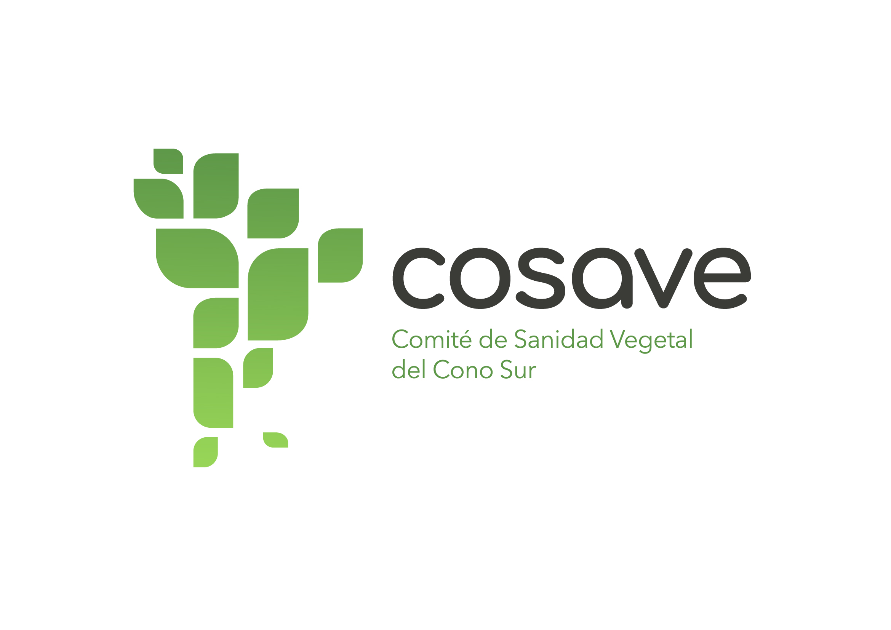

Logistical Coordination
CHILE → Venue, on-site logistics, and interpretation
IPPC Secretariat → Programme development, speaker coordination, communications, and co-funding (with support from Australia, Canada, and USDA)
IICA → Co-funding and participant registration
Participants → Engage in technical sessions, learn how IPPC standards are used, share national experiences, contribute to programme discussions, and participate in the field visit
COSAVE → Interpretation En-Sp-En

Slide 6


Call for Participants – Early September 2025
The official Call for Participants is expected to be launched in September 2025.
Participation will be open to NPPOs, RPPOs, and key stakeholders involved in systems approaches.
Up to 100 participants are expected to attend.
Participants will: Engage in technical sessions, learn how IPPC standards are used, share national experiences, contribute to programme discussions, and participate in the field visit
The call will include:
Application procedures and selection criteria
Workshop details (venue, dates, agenda highlights)
Information on financial support (where applicable)
The IPPC Secretariat will circulate the call through the IPP portal and direct outreach.

Slide 7



Prepare to Contribute – Engage with the Global Dialogue on Systems Approaches
Prepare your success story on systems approaches for submission.
The Call for Participants opens in September 2025.
Showcase your experience, highlight innovations, and contribute to global dialogue.
Strengthen collaboration and help shape the future of phytosanitary risk management.

Slide 8
Thank you
IPPC Secretariat
Food and Agriculture Organization
of the United Nations (FAO)
ippc@fao.org | www.ippc.int

