Slide 1
Africa Phytosanitary Programme (APP)
IPPC Secretariat

Slide 2

Modernization: Providing modern science and GIS digital tools
Safe trade: Promoting safe trade practices to protect plant health
Capacity building: Strengthening national phytosanitary systems
Enhancing the capacity of NPPOs in Africa to use science and digital technology for better surveillance, and timely and effective control of pests with regulatory, economic and environmental significance.

Slide 3
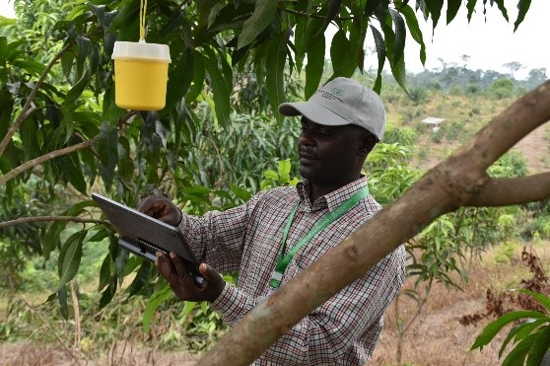
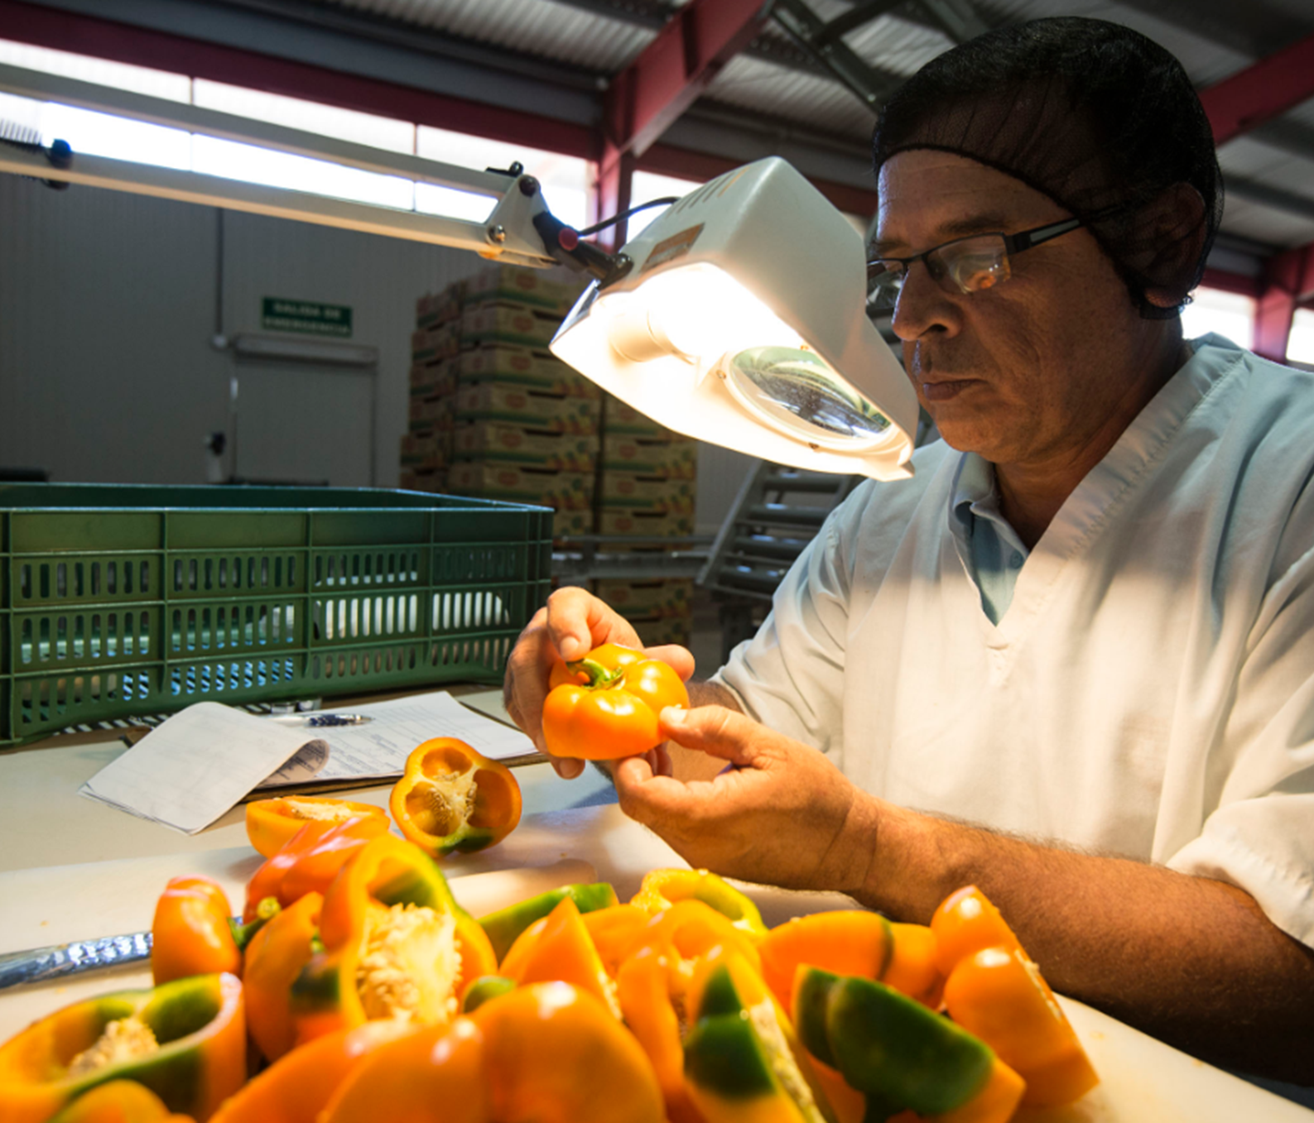
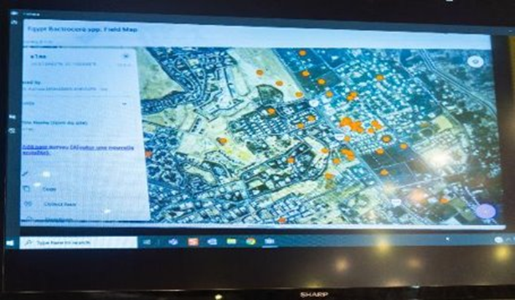
APP Objectives
1
Proactive surveillance of plant pests
2
Timely and accurate pest identification and diagnostics
3
Effective pest data collection, storage, and analytics

Slide 4

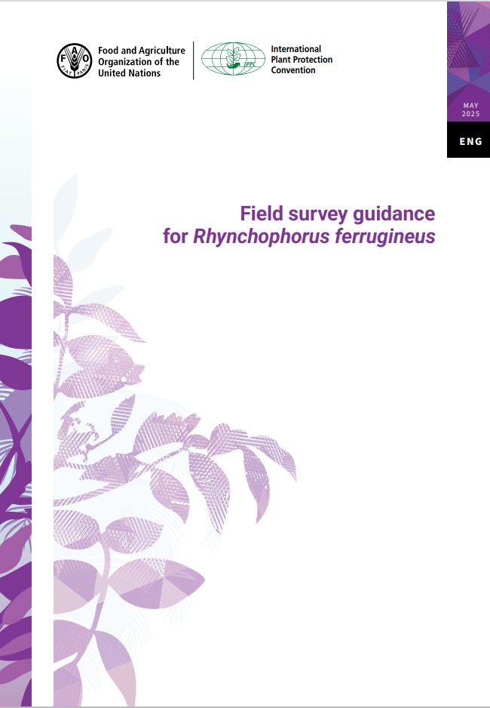
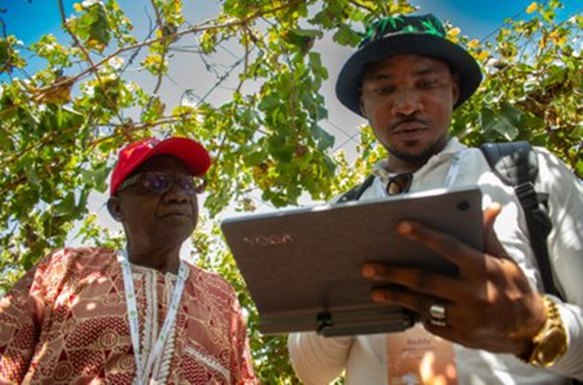
APP implementation
Plant pest survey protocols
1
Tablets for pest surveillance
2
GIS HUB & mobile applications
3
Field supplies
4
APP regional and national trainings
5
Technical support
6

Slide 5
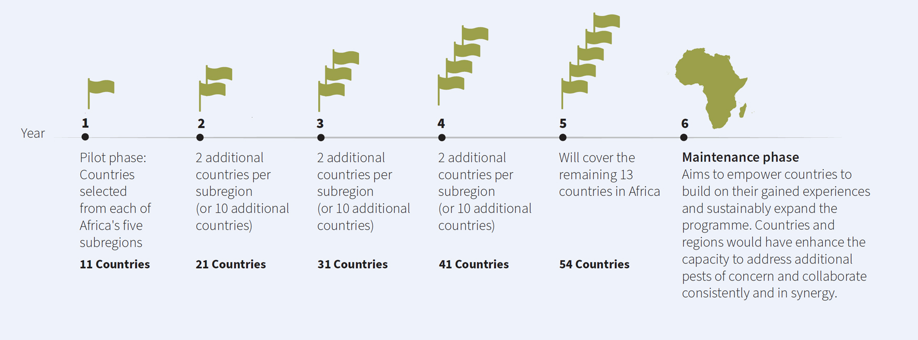
Phased implementation approach

Slide 6
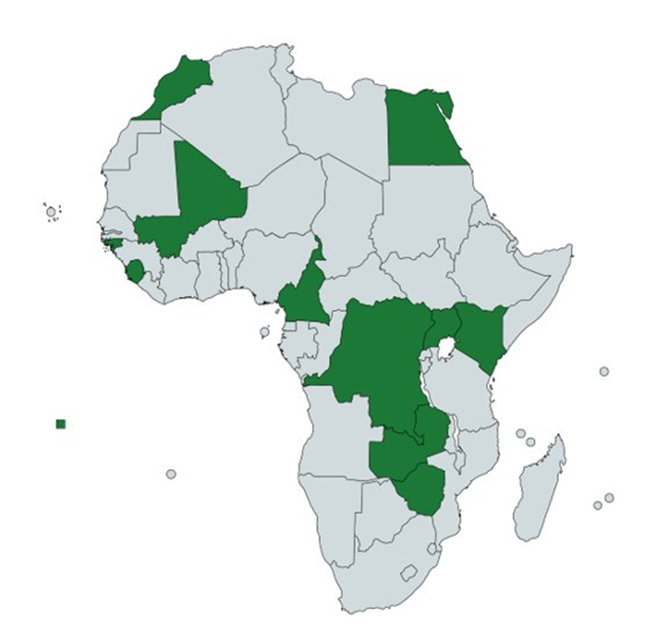
Selection of countries per sub-region
North Africa: Egypt and Morocco
East Africa: Kenya and Uganda​
01
04
West Africa: Guinea-Bissau, Mali and Sierra Leone
Southern Africa: Zambia and Zimbabwe
02
05
Central Africa: Cameroon and DRC
Selection of 5 pests of regulatory, economic and environmental importance.
03
Designation of 6 experts to become APP trainers for the 50 national field surveyors.

Slide 7
Pilot Phase Progress
All pilot countries submitted detailed operational plans to guide APP implementation
01
National trainings on pest surveillance and early detection.
IPPC e-learning courses
02
~46 tablets have been distributed to each pilot country, equipped with pre-loaded APP tools and resources
03
APP pilot countries are already using APP tools (Field maps, Survey 1,2,3, GIS HUB) for pest monitoring and surveys
04

Slide 8
Proposed APP Governance
Communication WG
Countries and FAO communication experts
IPPC Secretariat
Technical WG
Scientific and Research institutions
Operations Coordination Group
RPPOs (AU IAPSC and NEPPO) + 5 countries
NPPO + FAO
APP implementation at national level

Slide 9
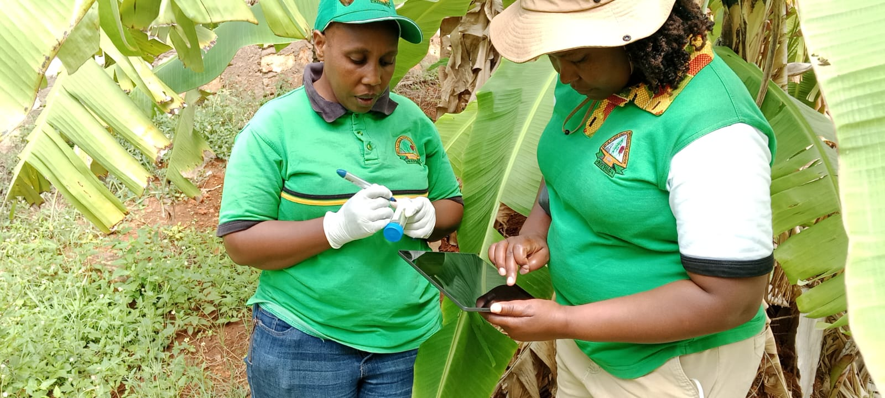
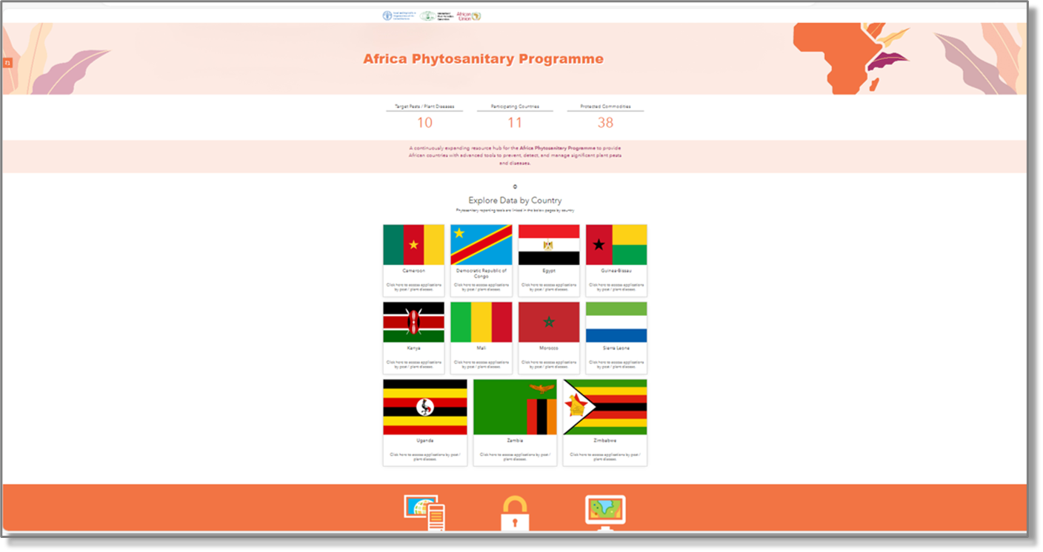
APP key achievements (1)
1
Technical
Infrastructure
570 ESRI user accounts created for 11 APP Phase 1 countries
500 tablets with APP software distributed to countries
2
Additional tablets for 8 APP Phase 2 countries
3
Technology
deployment
1 APP GIS HUB platform operational on the IPP
4
57 GIS maps of priority pests created
5
38 plant pest survey protocols developed
6

Slide 10
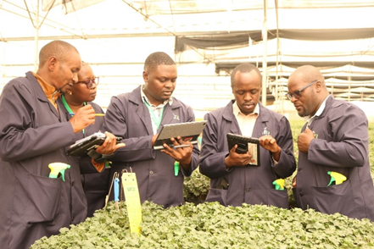
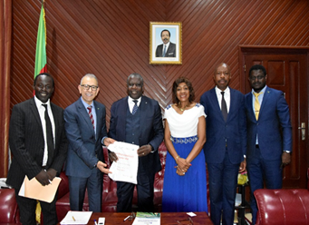
APP Key achievements (2)
2 Train-the-trainer workshop
1
8 APP national training sessions organized (5 training country-funded workshops)
2
Training and engagement
11 APP visits to ministers and FAO Representatives in Phase 1 countries
3
1 engagement with Africa Regional Group (ARG) to the three Rome-based United Nations agencies
4
The USDA – APHIS training of three IPPC Secretariat staff as transitional step
5

Slide 11
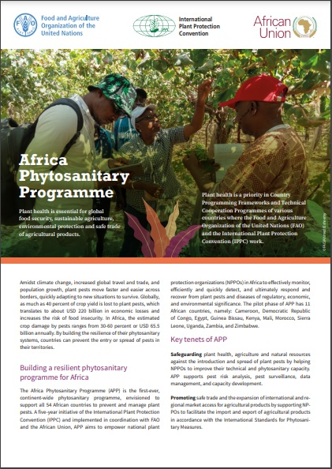
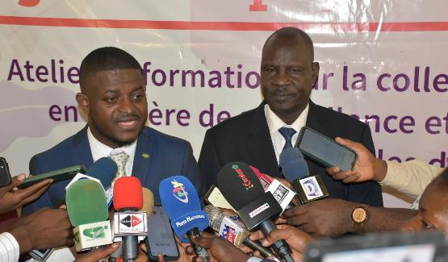
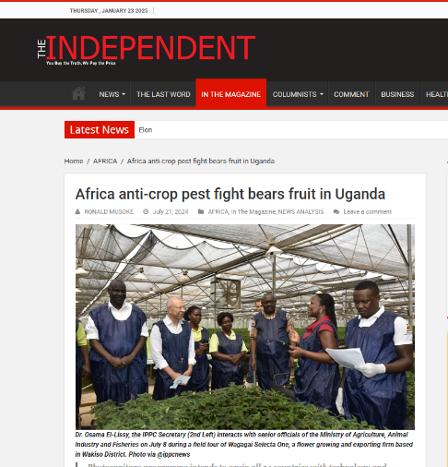
APP Key achievements (3)
1 APP brochure in 4 languages (AR, EN, FR, PT)
1
3 APP training videos (GIS HUB, citrus greening, mobile applications)
2
Communication & advocacy
102 APP mentions in national, regional, and international media
3
100+ social media messages on X, Facebook and LinkedIn with 150k views
4
1 Policy article in Frontiers science journal
5
11+ news articles on the IPPC website (IPP)
6

Slide 12
APP Phase 2
2024/2025 Nominated Countries
APP training phase 2 Countries
Sub-Region | Country
West Africa | Cape Verde, Liberia, Senegal
Central Africa | Congo, Chad
Southern Africa | Malawi, South Africa
North Africa | Algeria, Tunisia
Assessment for APP phase 1 countries
01
Organize a Train-the-trainer workshop for APP Phase 2 countries
23-27 June 2025 in South Africa
02
Each country : list of the top five priority pests
Nominated 5 experts for the onboarding training in June 2025

Slide 13


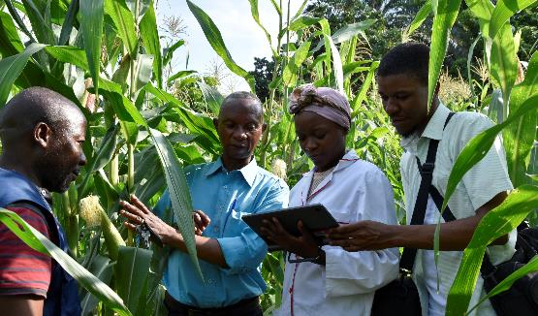


Recommendations
More strategic guidance to advance APP plans to support countries
More staff and specialized technical support to the IPPC secretariat
More countries and stakeholders' engagement to maximize impact
More resource mobilization to ensure APP’s long-term sustainability.

Slide 14

Resource Mobilization
1. Identify Potential Donors
2. Engage Strategically
3. Negotiate Funding Mechanisms
4. Implement and Operate Projects
5. Communicate Results
Technology and Data
Training Programs
Field Equipment
Enhancement of the APP GIS HUB
Survey Protocols
Operational Maintenance
Regional "Train-the-Trainers" workshops
Tailored in-country trainings to build local capacity
Tablets and other laboratory equipment.
Field Supplies (Lures, Traps, Pheromones, Diagnostic kits)
Continuous technical expertise
Communication and Advocacy
Coordination
Communication and outreach materials (brochures, headlining's, videos, blogs, stories, photography)
Coordination of the Programme by the APP team
Ability to provide support, assist in innovation and implementation by the APP team.
Sustainable Support
Robust financial resources to sustain and scale activities over time

Slide 15
Thank you
IPPC Secretariat
Food and Agriculture Organization
of the United Nations (FAO)
ippc@fao.org | www.ippc.int

