Slide 1
Information exchange
Communication
Report obligations
(legislation, pest report, contacts...)
Updates
Outcome
Public relations
Review of state
Ongoing work
Resources
Awareness raising
Discussion forum
Trust
Improved cooperation
Meeting info
Resource partners
Calls
Timeliness of updating the info
Accuracy
Authority (official info, or not)
Completeness

Slide 2

Info generation
WS to train IPP use, including editors
Member countries
- Report obligations
(pest, measures, contacts)
Comments
Secretariat
meeting info (venue, documents, reports)
adopted standards and other publications
calls, news
resources (database, training materials, ..)
e-assistance (Q&A, etc.)
Information
WS to train OCS use
Info updates
System maintenance
System development

Slide 3
Info use
WS to train IPP use
WS to train OCS use
Member countries
basic info
updated info (pest, measures)
publications
documents (fixed, ongoing)
resources
calls, news
Secretariat
comments
feedback
forum input
statistics
Information
Major provision
maintenance
facilitation
Others
- other organizations, general public, industries, academic, etc

Slide 4
Role of RPPO
Coordinate and participate in activities among their NPPOs in order to promote and achieve the objectives of the IPPC
Gather and disseminate information, in particular in relation with the IPPC
Cooperate with the CPM and the IPPC Secretariat in developing and implementing international standards for phytosanitary measures and regional standards
Meet annually at the technical consultation among RPPOs
Facilitate meeting national reporting obligations

Slide 5
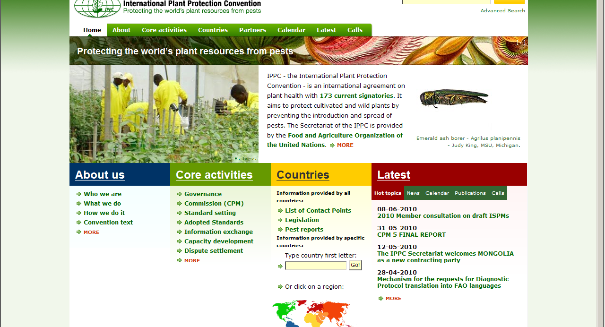
IPP: International Phytosanitary Portal
www.ippc.int

Slide 6
Information Exchange
Contracting parties provide:
  Official contact points
  Official information on NPPO, pests and phytosanitary measures
IPPC Secretariat:
  Provides official documents (ISPMs, reports, etc.)
  Maintains the IPPC website
  Facilitation role

Slide 7
Reporting Obligations
IPPC Official Contact Point
Description of the National Plant Protection Organization
Points of entry
Phytosanitary restrictions, requirements and prohibitions
Official Pest Reports
List of regulated pests
Emergency actions

Slide 8
Optional Reporting
Non-compliance
Organizational arrangements of plant protection
Pest status
Rational for phytosanitary requirements

Slide 9
Communication
Two-way conversation that is meant to build:
    awareness
    understanding, and
    Trust
    Synergies / cooperation
Stakeholders / audiences
    objective
    message

Slide 10
Communications cont.
Methodology
    Traditional: meetings, posters, pamphlets, press
    Newer; e-mail, TV, videos, social media, radio, FFS, plays/festivals, “ambassadors”

Slide 11
Communication cont.
Not something new
What, why and how …
Usually limited by resources
K.I.S.S. – keep it simple “stupid”
Systematic
Build slowly

