Slide 1
IPPC Audiences
EXTERNAL
AUDIENCES
Private Sector
INTERNAL
AUDIENCES
Civil society
IGOs
FAO
Contracting parties
Donors
IPPC staff
NPPOs
RPPOs
Heads of Government
Ministers
Governance Bodies
Media
National
administrations
Academia Students
Parliamentarians
Engaged public
Notes:
And here it’s all about accessibility

Slide 2
What for whom?
Audience
Tools
Engaged public
Better Life Index
Schools / students
IPPC Insights
IPPC Tables
Civil Society
Multi-lingual Summaries
Parliamentarians
At a Glance
‘Accessible’ content
Media
IPPC Factsheets
Private Sector
Magazine / newsletters
Governments, NPPOs, Donors; RPPOs
IPPC Papers, Surveys
Key Messages & Data
Heads of Government Ministers
Advisors, Experts
Proceedings/Book Series
Quarantine officers
IPPC databases / ISPMs
PhD Students
IPPC Brochures
‘Complex’ content
Researchers
Technical Working Papers
Notes:
AG
Members will remember this slide from the last presentation – but important to remind ourselves about the structure of the publishing programme and
where the publications originate
Directorates and Committees
From within PAC or with significant input from PAC
Use the Factbook & At a Glance family as an example of how PAC recognised best practice, developed it further and then spread it around the house (UK Amb loves this example)

Slide 3
Processes
Audience
Tools
Key Facts and Figures (brochures)
Engaged public
Better Life Index
Video
Articles (magazine)
Schools / students
IPPC Insights
Multi-lingual Summaries (Exec summary in >24 languages)
IPPC Tables
Civil Society
Multi-lingual Summaries
Parliamentarians
Country-focussed Highlights
At a Glance
‘Accessible’ content
Media
Blog postings
IPPC Factsheets
Private Sector
Magazine / newsletters
Visualisations
Governments, NPPOs
IPPC Papers, Surveys
Press releases / Editorials
Key Messages Key Data
Heads of Government; Ministers
Advisors, Experts
Proceedings/Book Series
Speeches
Quarantine officers
IPPC databases / ISPMs
PhD Students
Event (High-level)
IPPC Brochures
‘Complex’ content
Researchers
Technical Working Papers
Publication
&
Data
Notes:
AG
Members will remember this slide from the last presentation – but important to remind ourselves about the structure of the publishing programme and
where the publications originate
Directorates and Committees
From within PAC or with significant input from PAC
Use the Factbook & At a Glance family as an example of how PAC recognised best practice, developed it further and then spread it around the house (UK Amb loves this example)

Slide 4
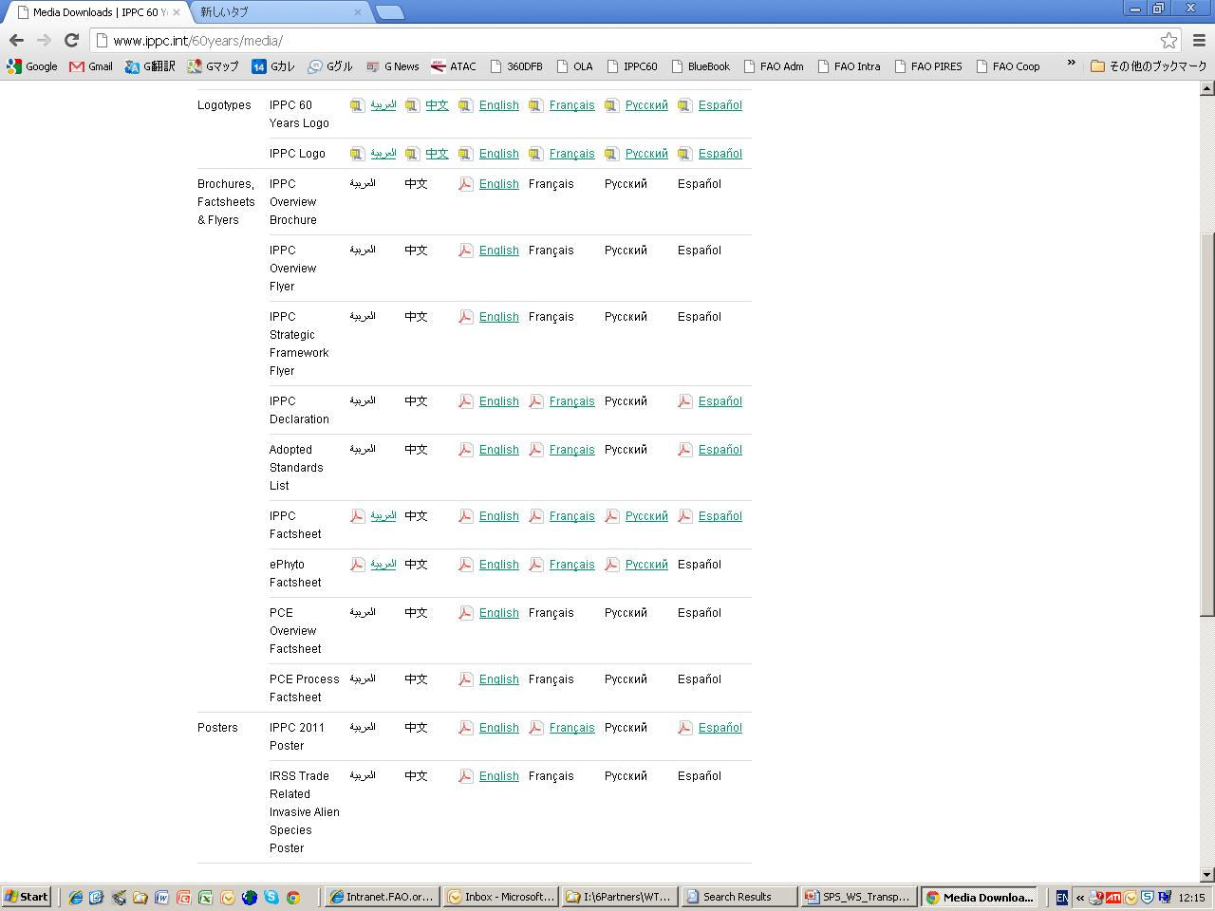

Slide 5
