Slide 1




May, 2011
Single Window :
Korea Customs Service & World Customs Organization’s experiences
World Customs Organization

Slide 2
Contents
Introduction of WCO
Single Window Concept
Updates on SW Environment since 2009
Single Window Survey 2011
Introduction of KCS
KCS’ Single Window history
SW establishment – before v. after
Benefits
Lessons Learned
Future Model
50 million people

Slide 3
Introduction of WCO
177 Members
WCO Instruments for Trade Facilitation
  Harmonization of Coding & Data
  : HS, WCO DM, UCR
  Standardization of Procedures
  : RKC, SAFE FoS,
  ISCM Guideline, TRS
Customs in 21st Century
  New Strategic Direction
C21
GNC
CBM
Intelligence driven Risk-Mgt
Customs-Trade partnership
Modern methods
Enabling technology
Enabling powers
Professional Service Culture
Capacity Building
Integrity

Slide 4
Single Window Concept
SW is to unify interface between Government and Trade
  Examines regulatory controls through eyes of trader
4 different approaches
UN/CEFACT Recommendation 33 | Facility for lodging standardized info & docs Single submission
CBM | Part of inter-agency collaboration
Virtual Enterprise | A legal entity with effective virtual presence
Collection of Services | Service organized into distinct, non-overlapping categories and hierarchies

Slide 5
Updates on SW Environment
Single Window Compendium
  “How to Build a Single Window Environment
  Volume 1 (Executive Guide)
    : Layout of chapters based on 3 stages of SW development
  Volume 2 (Professional Guide)
    : Survey Result, Business Process Framework,
    Data Harmonization Guideline, etc.
Guidelines to Dematerialization of Supporting Docs
  Section V of SW Compendium Volume 2
WCO Data Model Version 3.1
  Version 3.0 (Initial SW Version) was released in December 2009
  Annual update for correction of reported errors and inconsistencies
  Version 4.0 will be released in 2014 (5 year version roll-out cycle)

Slide 6
Single Window Survey 2011
56 Countries (20 APEC, 36 other regions) & 27 Questions
Key findings
  All Customs adopted automated cargo clearance system
  : more than 90% of goods declarations reported electronically
  Small number of CBRAs linked with Customs system (Ave. 3)
  : ICT infra, Budget & HR, Legal framework, Coordination issues
  34% operate SW model systems
  : All others are in the process of developing SW system
  77% harmonized SW data with international standard
  : WCO DM 40%, UNTDED, UN/EDIFACT
  Widespread use of the Internet prompted adoption of XML
  and Webservices
  PIN and PKI are the most adopted type of authentication tool
  Most of Customs do not share data with other CBRA
More efforts are needed in information exchange between CBRA

Slide 7
Introduction of KCS
Organization
KCS has: 6 administrative offices (Office of policy development and public relations, Clearance facilitation bureau, Audit policy bureau, Investigation and surveillance bureau, information mgnt. and Intl. affairs bureau, office of internal audit), 6 Main Customs, 47 Customs House, 5 surveillance post As of now, KCS had a total of 4,299 customs officials
Function
Control goods, vehicles and humans passing the border
Collect tax such as tariff, VAT, etc.
Establish International transaction order through illegal trade prevention
Compile Import-export statistics, revenue statistics, etc

Slide 8


KCS’ Single Window History
1
Building the Single Window System
1st phase
Basic System
Period : AUG ‘05 ~ MAR ‘06 (8 months)
Scale : 2,600 Mil. KRW (2.16 million USD)
Connection with 8 agencies such as KFDA and NVRQS
2
Extending the Single Window System
Single Window
2nd phase
Extended System
Period : AUG ‘06 ~ FEB ‘07 (7 months)
Scale : 1,400 Mil. KRW (1.16 million USD)
Connection with 13 agencies (adding 5 more agencies including KTR)
3rd phase
Advanced
System
3
Improve the Single Window system
Period : JAN ‘08 ~ JUL ‘08 (7 months)
Scale : 1,700 Mil. KRW (1.4 million USD)
Improving function and service for user convenience
Connection with 15 agencies (adding 2 more agencies such as FITI testing and research institute)

Slide 9
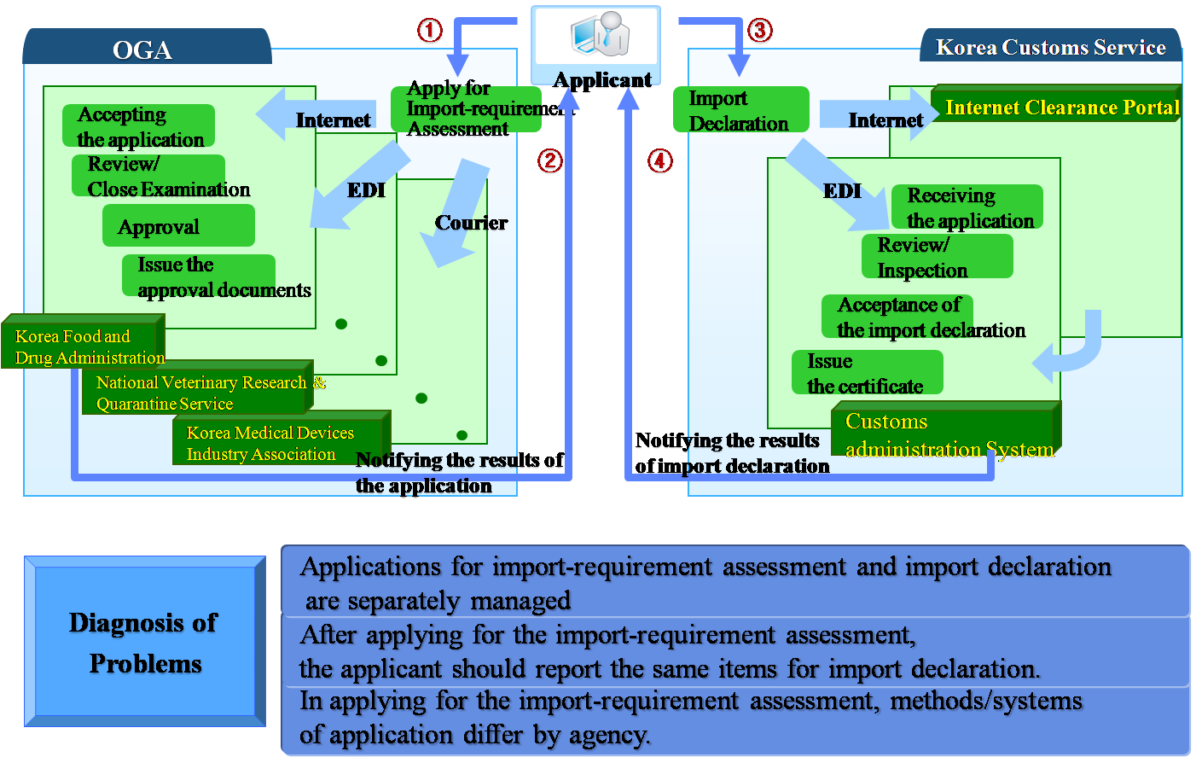
Work Process-Before

Slide 10
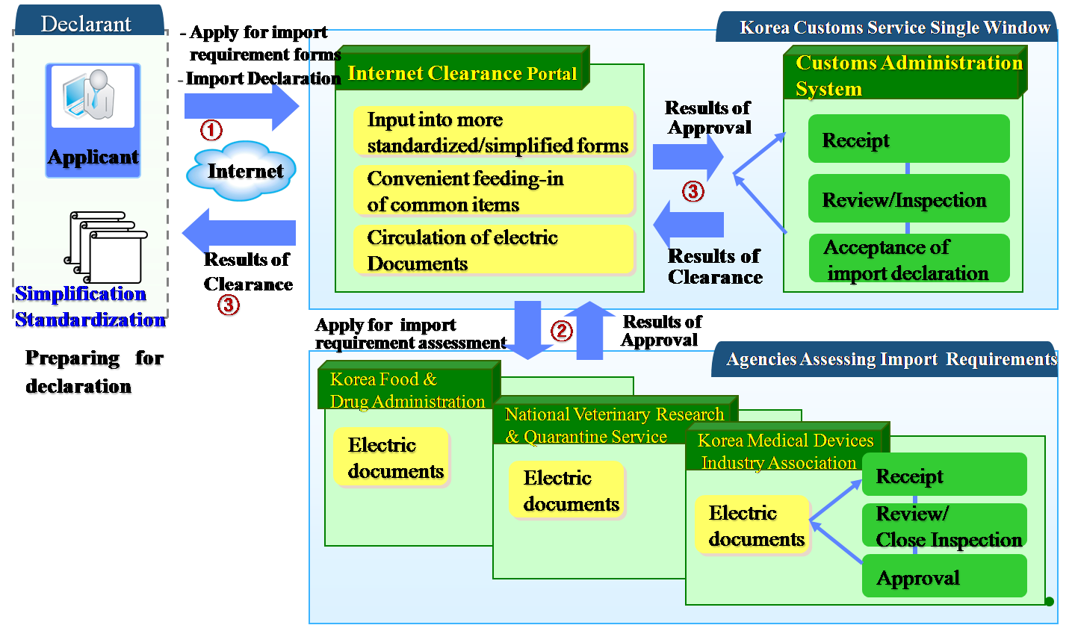
Work Process-After

Slide 11






System Configuration
http://portal.customs.go.kr
Internet Clearnace Portal
(UNI-PASS)
Users
Work Processing
Single Window
Im/export clearance
Im/export logistics
Customs drawback
Electric application
AEO management
Report form other government agencies
(44 forms)
Electronic Payment
Statistics
Verify the effectiveness
of certificates
Public certificate authority
General users
Internet
XML
Internet
XML
Other Government
System (OGA)
Im/Exporters
Import-Requirement
Assessment
Import
Declaration
Information Service
Customized Service
Import-
requirement
Assessment
User’s own record
Clearance info.
Company and statistic code info.
Preliminary introduction
Personalized webpage
User community
Bulletin board, questionnaire, Q&A
Shared screen, work consultation
Other Government Agency
( 23 Agencies)
Customs Broker
Work processing
Review on import requirements
Quarantine/ inspection
Electric application
Report of performance
Quarantine
Quality/sanitation management
Research
Various internal tasks
Consigner
/Consignee
Linked
processing
Others
Brokerage Firms
Customs administration information
System (Web Clearance System)
Web/EDI

Slide 12
Benefits
1. Simultaneous application for import requirement confirmation and import declaration reduces required time for customs clearance (1 day → Hours)
Approval of import-requirement application → Import declaration (day)
Application for import-requirement confirmation → Approval of the application (day
Import declaration → Acceptance (Hours)
Before Single Window
2 ~ 3
1
1:30
After
2 ~ 3
0
1:30
0
2. Economic Effects
Reduce logistics cost by shortening clearance time
Cut EDI transmission fee by using Internet
Provide better customer service with One-Stop Clearance service
Improve service through simplification of application document and items and information sharing

Slide 13
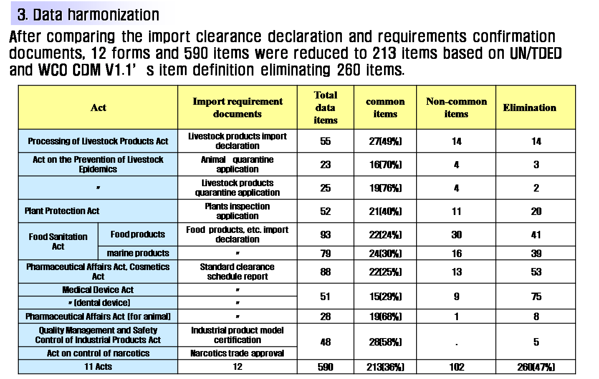
Benefits

Slide 14

Lessons Learned
Success Factors
Failure Factors
Lack of best practices
Compete with other government authorities
Data ownership (e.g. Conveyance Report SW)
Inconsistent government policy
Data standardization
Inconvenient services at the early stage
Not mandatory
Strong political support
Completion of e-Customs Project
Sufficient allocation of government budget
Active support from private sectors
Free of charge (internet-based system)
Customer-oriented services
Low maintenance expenses
Phased implementation

Slide 15
Future Model: Background
Expand Single Window-linked agencies and businesses
Connect with external network including export/import
logistics and electronic trade network
Adopt international standard including Customs Data Model
Exchange import/export data among customs houses through
global network
Expanding the scope of Single Window
in connection with other single windows under global standards
Regional
SW A
National
SW A
Global
SW
National
SW B
Regional
SW B

Slide 16
Future Model: Direction
Increase the use rate of the single window system and develop more advance customs-oriented services
Link with external G2B & B2B networks such as the im/export logistics and electronic trade networks
Introduce international standards such as Customs Data Model, UNeDocs
Implement Global Single Window System (Data exchange with other countries)
e-Customs contributing to international trade facilitation and safety

Slide 17
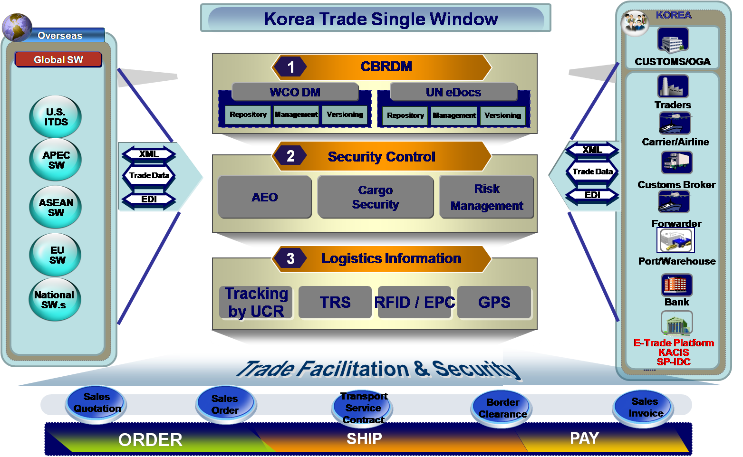
Future Model

Slide 18
Thank You !
Soyoung Yang
Korea Customs Service
yangsy@customs.go.kr
042-481-7951

