Slide 1
Phytosanitary Certificate Issuance and Tracking System (PCIT)
United States Department of Agriculture
Michael Perry
Export Specialist Riverdale, Maryland

Slide 2
Architecture
Web based
Role based system
XML output can conform to schemas
System is capable of sending XML messages

Slide 3
System Use Facts
Issues 500,000 + certificates per year
90% + of US certificates are issued through PCIT
Used by Federal, States, Counties, and Industry

Slide 4
Additional Functionality
Phytosanitary Export Database (PExD)
Training for certifying officials
Handles fees and billing
External Certificate Validation

Slide 5
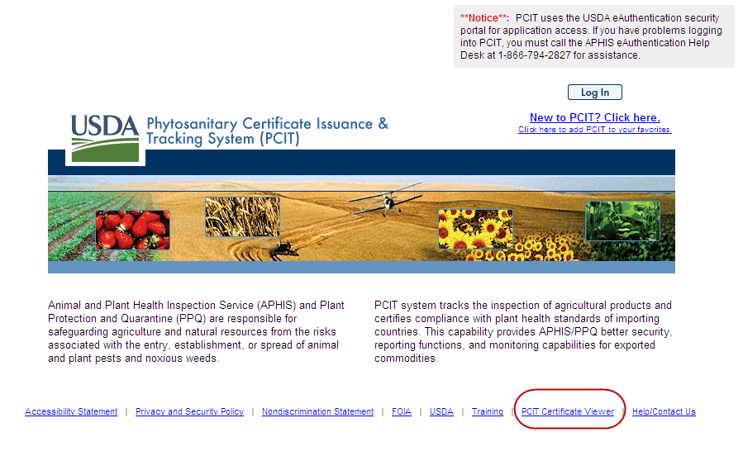

Slide 6
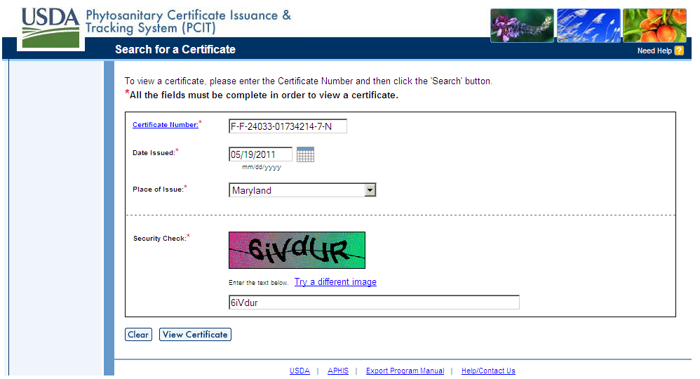

Slide 7
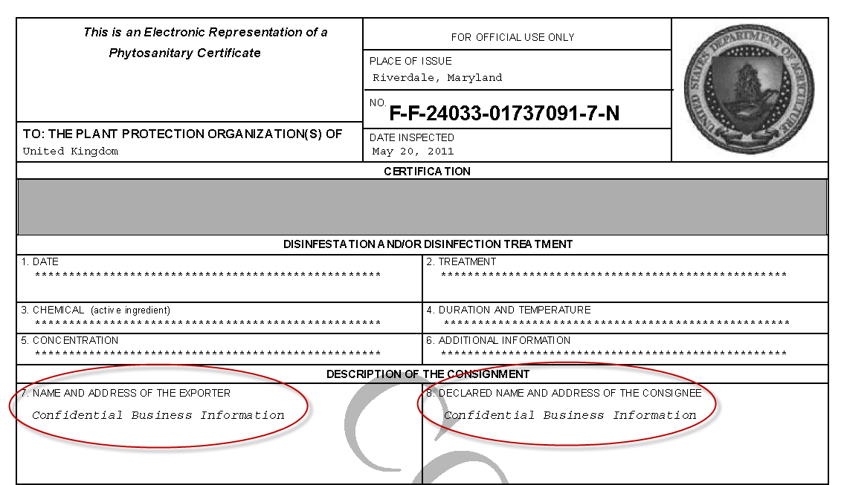

Slide 8
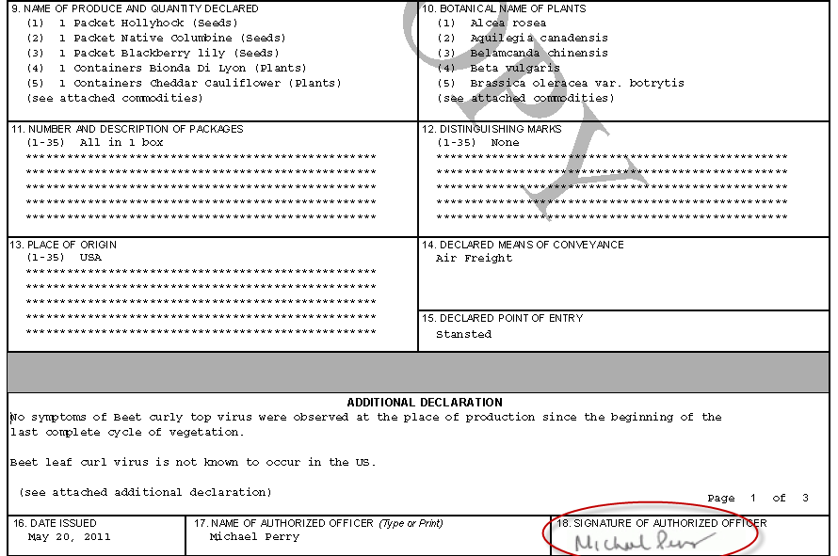

Slide 9
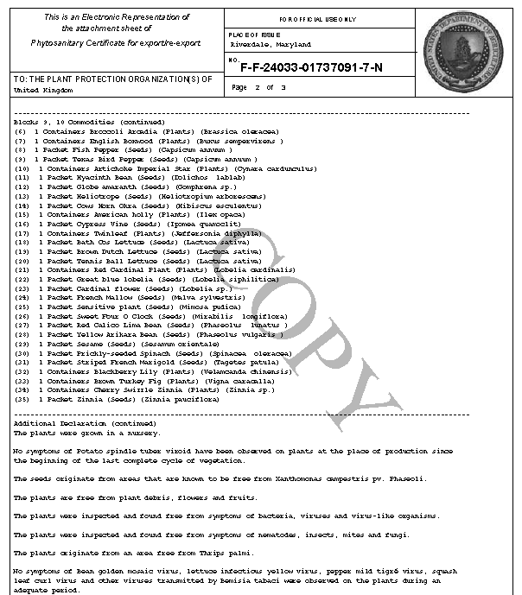

Slide 10
Next Steps to ePhyto
By the end of 2011 the ePhyto functionality will be in place
At that point PCIT will be able to send and receive ePhytos according to agreed protocols
The US will be looking for countries to test our system

