Slide 1
Internet Trade (e-Commerce) in Plants Potential Phytosanitary Risks
IPPC Secretariat
International Plant Protection Convention (IPPC)
2012

Slide 2
Scope
Preliminary findings of a desk study
Highlight of some potential risks
Consideration of approaches by previous related studies
Recommendations
Notes:
Desk study that explored the range of products being promoted for sale through the internet.
Highlights some potential risks that may be overlooked by NPPOs,
Considerations to bring to the fore what NPPOs need to take into account regarding e-commerce & its implications to phytosanitary protection.

Slide 3
Background
E-commerce as a pest pathway
Internet a convenient means for products to bypass the application of phytosanitary measures or scrutiny through PRA
Few NPPOs factor this pathway into their risk analyses
No effective mechanism, yet for detecting products sold online with phytosanitary risks
Notes:
E-commerce presents a pathway in which many small & uneasily recognizable consignments of plants / plant products & other products with potential phytosa3nitary risks move across international borders
Internet currently a means to promote trade in a range of products
Products often in small quantities imported and distributed within the countries. It is likely that most of the products with potential phytosanitary risks by-pass traditional screening methods by NPPOs
No effective mechanism due to rapid & direct door to door delivery to clientele by courier service providers

Slide 4
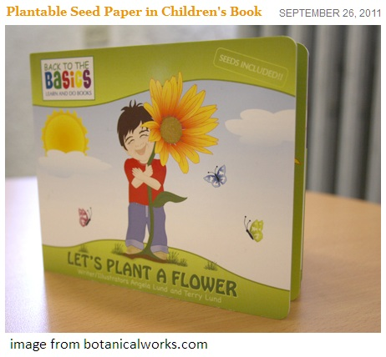
Background/2
Marketing of plants / plant products online
conventional forms e.g. packets of seeds, whole plants, plant parts
novelty items e.g. seed infused material such as greeting cards, bookmarks, even footwear! etc.
Shoes infused with seeds
Books infused with seeds

Slide 5
Methodology
Various categories selected:
plants & plant products i.e. plants for planting, novelties, handicrafts
insects & other organisms as pets
Sub-categories of each selection:
seeds, bulbs, corms, tubers, cuttings, rootstocks
novelty items / ecological products with seed
wood carvings
pets- insects
pests of economically important aquatic plants.
Notes:
Examples: used in aquatic ecosystems and aquaria, as toys, educational – science for learning purposes.

Slide 6
Methodology/2
Online searches using various key word combinations
In some instances further searches made using CABI Crop Protection Compendium to
determine pests that might ordinarily be associated with the articles of interest & as a matter of curiosity
No attempt made to conduct PRAs
Notes:
Searches as would be applicable when seeking to purchase the targeted products
From the resultant sites a small sample taken detailing when possible, names (common as well as scientific), quantities, unit costs, locations, global or localized shipping coverage
PRA is the responsibility of the country importing the article.

Slide 7
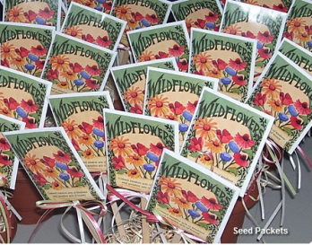
Results
A large number of websites found that promote the sale & distribution of plants/plant products e.g.
seeds (conventional & in novelty items)
bulbs, tubers, corms
lumber products
aquatic plants
other organisms – used as biocontrol agents or as pets
grass seed-fertilizer – mulch combination
wildflower seed packets
Gladiolus bulbs

Slide 8
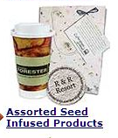
Results/2
Examples of seeds in conventional form & infused in paper material such as
book marks, greeting cards, gift wrappings,
foot wear, apparel,
packaging material
conventional form
novelty item with seed

Slide 9
Results/3 – Items with seed
Seed infused gift bags
Seed infused packaging

Slide 10
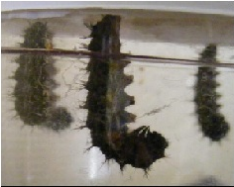
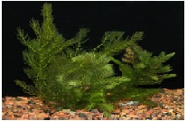
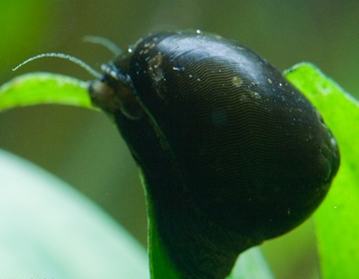
Results/4
Other products include
articles made of lumber e.g. craft, furniture & planks
organisms for “alleged” beneficial purposes
Aquatic plant species
Butterflies as pets e.g. painted lady (Cynthia cardui) and Monarch (Danaus plexippus)
Butterflies as pets
Aquatic plants Eichhornia crassipes & Ceretophyllum demersum
Nerita sp. snail advertised as biocontrol agent of algae in aquaria
Notes:
Pets e.g. butterflies
Aquatic plants
Beneficial purposes e.g. biological control in aquaria

Slide 11
Some features
Generally in small quantities
A few websites indicate the origin of products
Fewer provide information on shipping restrictions to certain countries
Much fewer indicate possible restrictions for their products in destination countries
Notes:
Features unique to plants & plant products offered for sale online

Slide 12
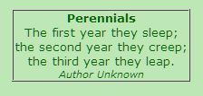
Key Considerations
Websites largely promote sale & worldwide distribution of articles without warnings on phytosanitary risks or notices on requirements for phytosanitary certification
Notes:
this essentially encourages the breach of phytosanitary legislation of many countries.
We found this notice on a site selling plants (Read the notice). Phytosanitary risk warning or not? Being from the phytosanitary field we interpreted this in the invasive sense!

Slide 13
Key Considerations
Delivery locations & information!!!!!!!! - “......but, if you need to have something shipped to you while you are in prison, there is detailed information for that as in this example:
[notable e-commerce site].com delivers to penitentiaries, but we strongly suggest you contact the prison first to confirm that they accept deliveries and to note any special regulations the prison might have.
Some prisons don't allow ...
Others place a limit on the number of items contained in a package.
Because inmates cannot sign for deliveries, packages must be sent via ...
Notes:
Why can’t e-commerce sites state phytosanitary warnings in this fashion for plants and plant products?131313

Slide 14
Key Considerations/2
Drop in the ocean
The study used English search terms but there is a growing number of non-English language e-commerce sites.
E-commerce is expanding and might involve greater trade in plant based products
Many sites visited channel products from vendors to the consumer & are not associated with the production of the items being sold online
Notes:
The sites visited is only a small fraction of those that could be supplying products with potential to spread pests internationally.
Some of the articles promoted through e-commerce have probably contributed in the spread of some pests of economic importance in agriculture and/or environment

Slide 15
Recommendations
NPPOs to establish mechanisms / procedures to monitor the internet
within the context of conducting PRAs, as well as for general surveillance, to identify potential products of concern that may be imported via this pathway.
Consideration be given to establishing a monitoring system hosted by the IPPC Secretariat to alert contracting parties of products with potential phytosanitary risks being traded on e-commerce sites
such a system should include provision for information exchange & data sharing among NPPOs.
Notes:
The recommendations based on the report of the IRSS study

Slide 16
Recommendations/2
NPPOs to work closely with in-country e-commerce vendors to ensure adequate information and warnings are provided to both the vendors and their customers.
This could involve standardization of labeling, development of standard written warnings, the provision of links to both the relevant NPPO contact point as well as seeking their cooperation to reduce risks (e.g. removal of the products from websites).
Contact internet trade groups and on-line fora in order to raise awareness of phytosanitary requirements and risks and to seek their co-operation. (modified from recommendations of the 22nd TC-RPPOs)

Slide 17
Recommendations/3
The IPPC should prepare a recommendation or an ISPM on the advertising / marketing/ distribution/sale of plants, plant products through e-commerce pathways including linking these with e-certification.
Raise awareness on risks, e.g. through social networking sites, IPP, NPPOs/RPPOs, etc. (modified from recommendations of the 22nd TC-RPPOs)

Slide 18
Recommendations/4
Enhance NPPO import verification systems including closer scrutiny of packages entering the country,
e.g. using X-ray, establishment of specific fines and penalties in cases of non compliance, co-operation with Customs courier service providers, and restricting the points of entry of the traded products to facilitate inspection. (modified from recommendations of the 22nd TC-RPPOs)

