Slide 1
منظمة وقاية النباتات للشرق الأدنى
NEAR EAST PLANT PROTECTION ORGANIZATION
25th Technical Consultation among regional Plant Protection Organizations
2013
Colonia del Sacramento (Uruguay), August 26-30, 2013

Slide 2
February, 1993
Signature of the Agreement, (Rabat, Morocco)
January, 2009
Enter into force
October, 2010
First Governing Council
Election of the Chair and Vice Chair,
Election of the Executive Commettee
Appointement of the Executive Director
10 Members: Algeria, Egypt, Jordan, Libya, Malta, Morocco, Pakistan, Sudan, Syria and Tunisia
Headquarter: Rabat (Morocco)
Staff: Executive Director and an Assitant

Slide 3
Participated in the Regional workshop for the review of draft International Standards for Phytosanitary Measures (ISPMs) held in Cairo, Egypt 09-13 September, 2012
Participated in the Meeting of the Commission on Phytosanitary Measures Standards Committee, 12-16 November 2012 and 6-10 May 2013 (Rome, Italy)
Participated in the 8th session of CPM, April 2013

Slide 4
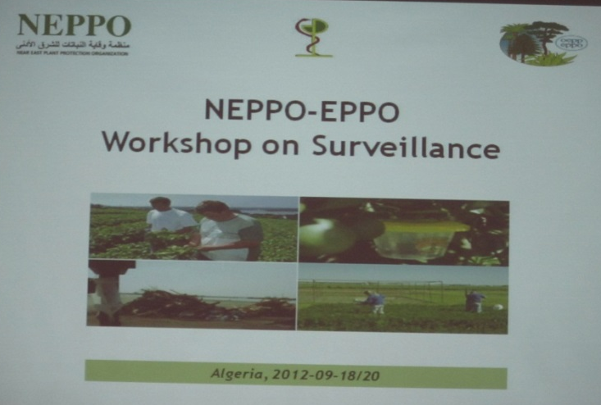
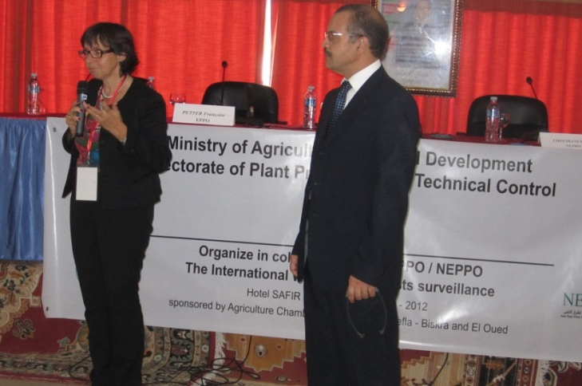
EPPO/NEPPO workshop on surveillance
Algeria: 18-20/09/2012
11 participants (2 Near East) (Algeria, Morocco)
Objectives:
to Promote exchanges of information on surveillance
To encourage networking between experts

Slide 5
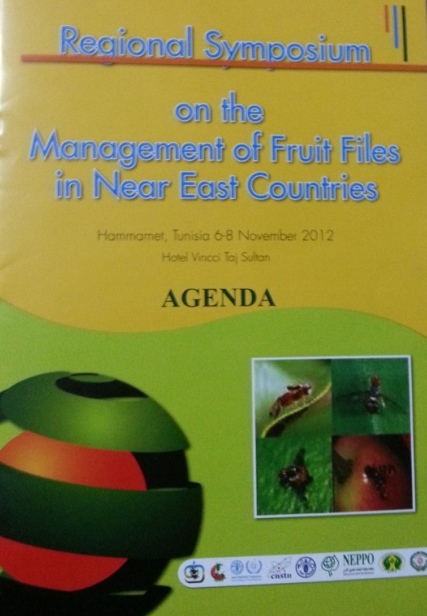
Regional symposium on management of fruit fly on the Near East region
jointly by FAO, FAO-IAEA, AAEA, NEPPO, IOBC North Africa Commission, NPPO in Tunisia and the Tunisian Association of Plant Protection (ATPP).
Hammamet (Tunis) November 4-6; 2012
100 Participants from 23 countries
Notes:
Threat of Fruit fly on production and trade
Regional strategy to face any introduction or spread;
Network (trapping, monitoring, ..)

Slide 6
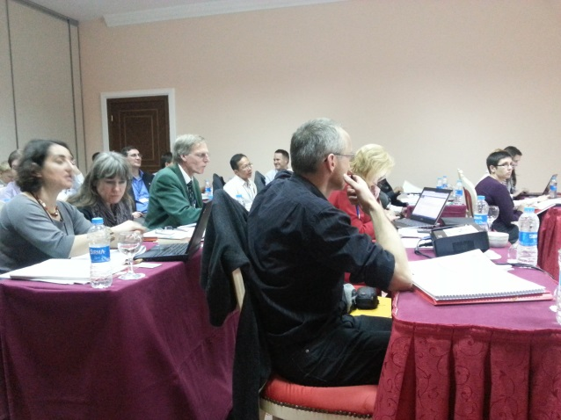
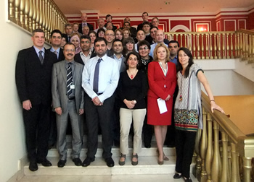
EPPO/NEPPO workshop on ISPMs 7 and 12
Antalya: 20-22 November 2012
35 participants from 22 countries
Aim: to harmonize the way these Standards are implemented within the both regions.

Slide 7
NEPPO participated in the regional workshop on strengthening regional cooperation and knowledge sharing in plant protection between the Near East countries, in Cairo, Egypt, 2-4/12/ 2012 and presented an overview on the Organization, And The importance of establishing a regional phytosanitary data base through a near east network linking nppos, universities and research institute.

Slide 8
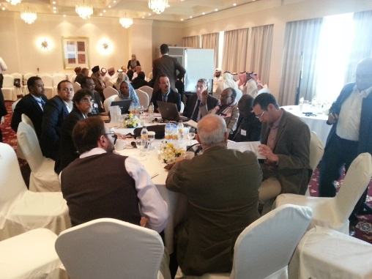
NEPPO participated in the Subregional capacity-building workshop to address invasive alien species and to achieve Aichi biodiversity target 9 in the Arab region. Dubai (UAE), 11-14/02/ 2013 and presented:
“the Role of regional plant protection organization to addressing invasive alien species in harmonized manner at the regional level”
And in EUPHRESCO Workshop - Exploring plant health problems of concern with special emphasis on Mediterranean partners of EPPO and EUPHRESCO. Monte Estoril (Portugal) 13/03/2013 where it presented:
“Important phytosanitary pests of concern and threats in the Near East region and in particular problem with pests originating from EU members states. Visions on possible future co-operation between NEPPO and EUPHRESCO”

Slide 9
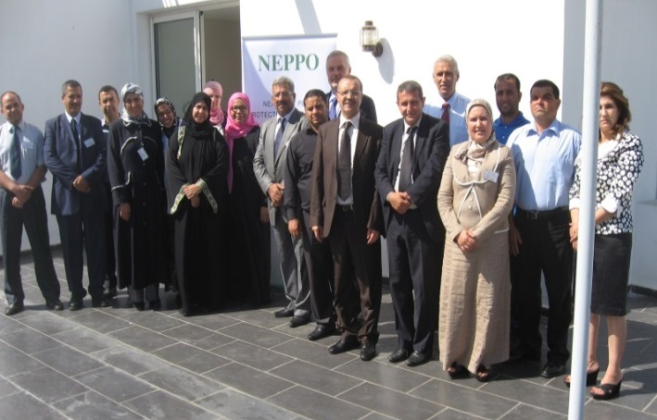
Workshop on “Plant quarantine and phytosanitary measures’”
Rabat, Morocco 24-26 June 2013
14 participants from 8 countries
Objectives:
Share information on regulation related to quarantine pests and phytosanitary measures implemented in the participant countries;
Establish a draft quarantine lists of the Near East Region;
Determine the most important topic (standards, diagnostic, treatment, etc.) on line with the need of the region
Determine the emergent pests within the Near East

Slide 10
Emerging pests of concern for the NEPPO region
Red Palm Weevil : Rhynchophorus ferrugineus : Big concern and potential highly negative environment and socioeconomical impact. Detected on ornemental palm trees in Morocco (Tangier, North) and Tunisia (Carthage), Not yet detected in Algeria,
Fruit flies: Bactrocera zonata and B, invadens, North Africa is surrounded by the both B. zonata in Lybia and B,invadens in Sénégal (Maybe in Mauritania).

Slide 11
Emerging pests of concern for the NEPPO region (Contin-d)
Huanglonging Citrus Disease (HLB). The Mediterranean and most Near East (Except Saudia Arabua and Yemen) area are free from HLB and its vectors (Except Iran). Important threat to Citrus Industry.
Tuta absoluta in some extent in the Middle east countries

Slide 12
Thank you very much for your attention
Any question?

