Slide 1
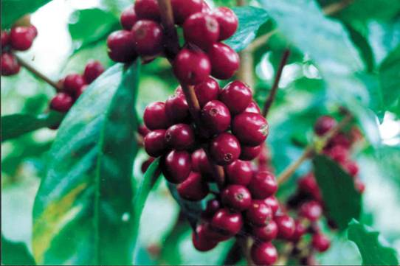
International Regional Organization for Plant and Animal Health
25th Technical Consultation among
Regional Plant Protection Organizations
Colonia del Sacramento (Uruguay), August 26-30, 2013

Slide 2
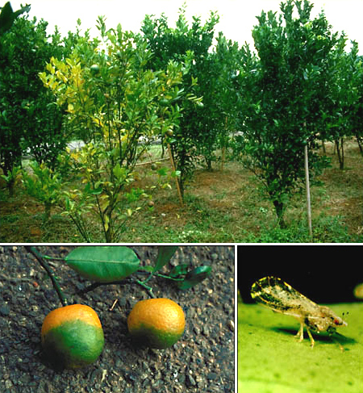
EMERGING PESTS OF CONCERN FOR THE OIRSA REGION
Pests recently introduced:
Candidatus Liberibacter asiaticus’ (HLB – citrus greening). Detected in the Dominican Republic in 2008; Belize, 2008; México, 2009. OIRSA developed a Regional Phytosanitary Campaign for surveillance and control.

Slide 3
Coffee Leaf Rust Phytosanitary Program
Hemileia vastratix Berk & Br.
Epidemic phytosanitary event from Mexico down to Panamá.
Disease Incidence 54%
Harvest Losses of 30%
OIRSA in coordination with IICA, CATIE, and PROMECAFE, developed a Regional Phytosanitary Program

Slide 4
Coffee Leaf Rust Phytosanitary Program
Phytosanitary Campaign methodology
Technical support
Training
Information
Supervision, and evaluation
Technical Coordination

Slide 5
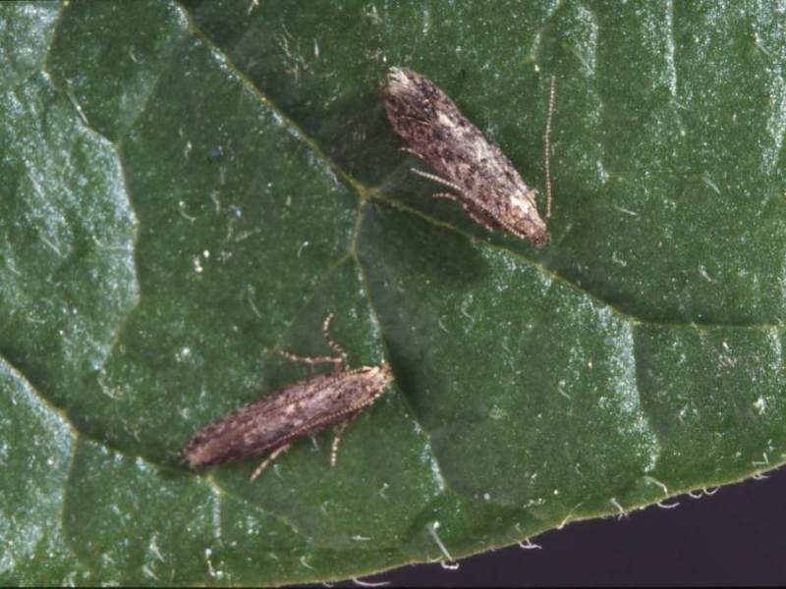
Tuta absoluta
Coordination with NAPPO for analysis of containment strategies, monitoring and control of this pest.
OIRSA gives support for surveillance and control programs carried out in infested areas and provides technical assistance.

Slide 6
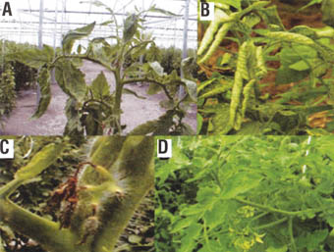
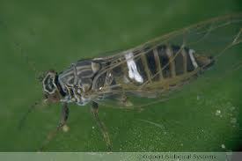
Bactericera cockerelli and Candidatus Liberibacter Solanacearum
OIRSA support its NPPO members on this pest, field identification of symptoms and diagnosis.

Slide 7
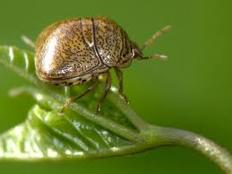
Pests pressing to gain entry to the region
Megacopta cribraria (Fabricius 1798) (Heteroptera: Plataspidae), kudzu bug. Distributed in Southeast Asia. Georgia (USA) in 2008, and extended to adjacent States.
Numerous interceptions in the region; live and dead insects, in many points of entry and different means of transportation.
The apprehension is that it may become a pest attacking legumes in Central America.

Slide 8
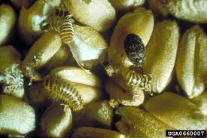
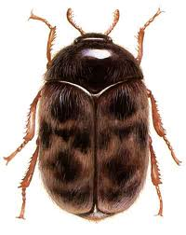
Trogoderma granarium Everts 1898, Khapra beetle
Intercepted not only dead but alive in various instances at points of entry to the OIRSA region.

Slide 9
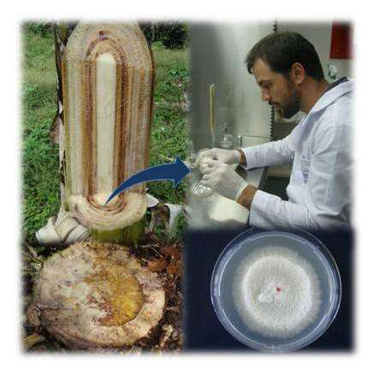
Pests considered as serious threats for the region
Fusarium oxysporum f.sp. cubense Race 4 Tropical (FOC R4T).
Cavendish, the most important variety of banana for export, is susceptible. Serious impact in Honduras, Costa Rica and Panama.
Phytosanitary Contingency Plan for FOC R4T

Slide 10
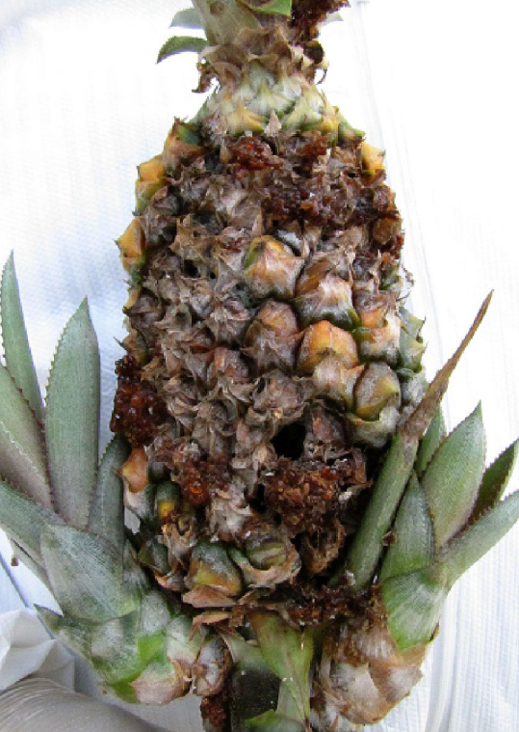
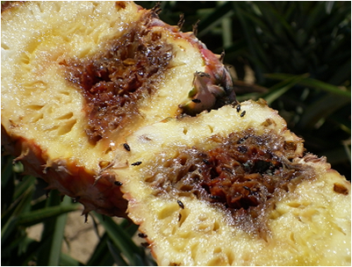
Fusarium guttiforme
present in Brazil
Threatening the pineapple industry of Central America: Costa Rica, Honduras, Mexico and Panama.

Slide 11
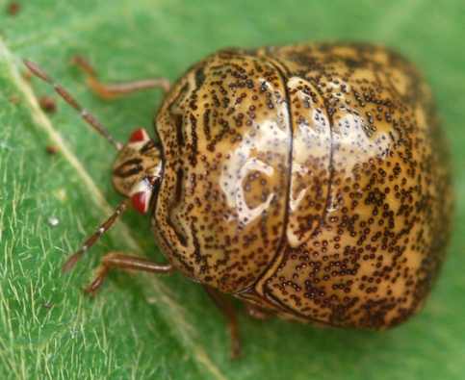
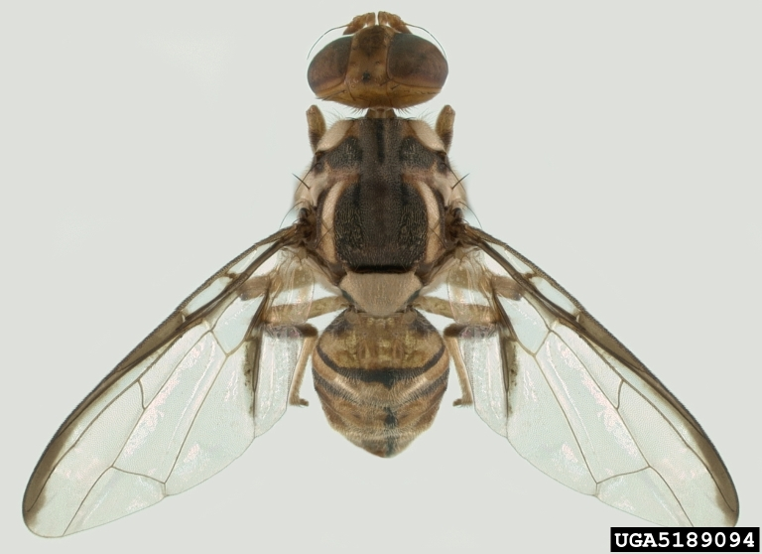
THANKS !!

