Slide 1
The European and Mediterranean Plant Protection Organization (EPPO) activities on Invasive Alien Plants
Notes:
Ce modèle peut être utilisé comme fichier de démarrage pour présenter des supports de formation à un groupe.
Sections
Cliquez avec le bouton droit sur une diapositive pour ajouter des sections. Les sections permettent d’organiser les diapositives et facilitent la collaboration entre plusieurs auteurs.
Notes
Utilisez la section Notes pour les notes de présentation ou pour fournir des informations supplémentaires à l’audience. Affichez ces notes en mode Présentation pendant votre présentation.
N’oubliez pas de tenir compte de la taille de la police (critère important pour l’accessibilité, la visibilité, l’enregistrement vidéo et la production en ligne)
Couleurs coordonnées
Faites tout particulièrement attention aux diagrammes, graphiques et zones de texte.
Tenez compte du fait que les participants imprimeront la présentation en noir et blanc ou nuances de gris. Effectuez un test d’impression pour vérifier que vos couleurs s’impriment correctement en noir et blanc intégral et nuances de gris.
Graphiques, tableaux et diagrammes
Faites en sorte que votre présentation soit simple : utilisez des styles et des couleurs identiques qui ne soient pas gênants.
Ajoutez une étiquette à tous les graphiques et tableaux.

Slide 2

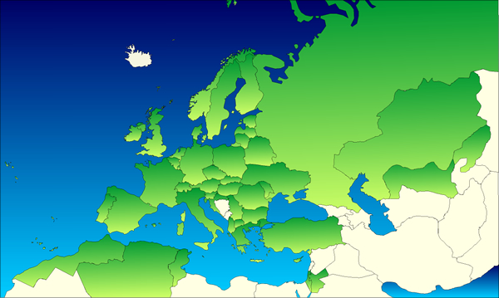

European and Mediterranean
Plant Protection Organization
Created in 1951 by 15 countries
Now 50 Member Countries
Under the International Plant Protection Convention (IPPC)
A Panel on Invasive Alien Plants
EPPO Secretariat based in Paris, 13 staff
www.eppo.int

Slide 3
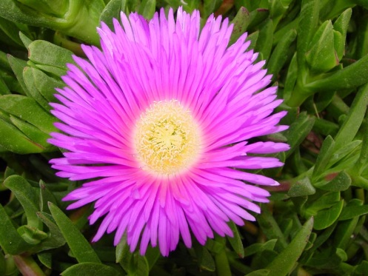
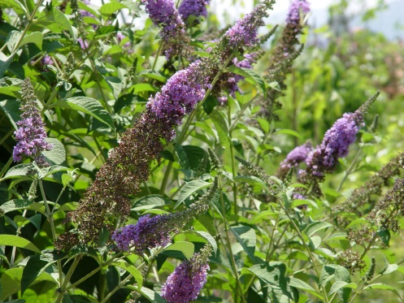
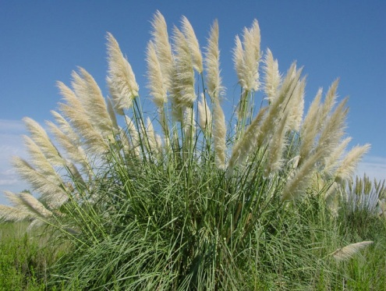
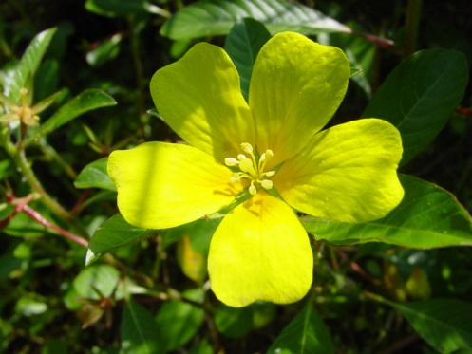
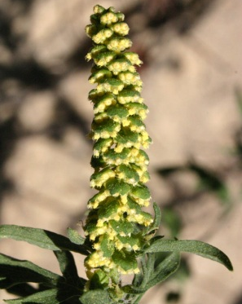
The EPPO Panel on Invasive Alien Plants
Created in 2002 with the following tasks:
  to collect data on invasive alien plants in the EPPO region,
  to collect information on official control measures existing in the EPPO region for invasive alien plants,
  to conduct pilot studies on pest risk assessment and pest risk management of specific invasive alien plants.
About 20 Panel members nominated by the National Plant Protection Organization of their countries.
Meets every year.

Slide 4
EPPO
Lists of Invasive Alien Plants

Slide 5
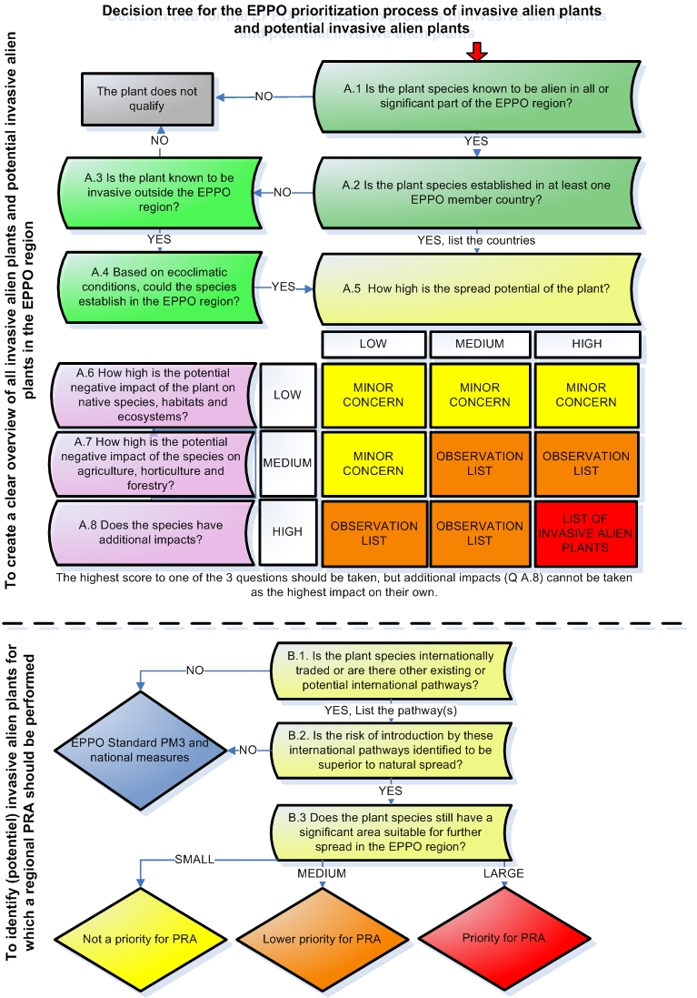
The EPPO prioritization process for IAP
General principles
The EPPO process is designed:
A. to produce a reference list of IAP that are established or could potentially establish in the EPPO region.
B. to determine which Invasive Alien Plants (IAP) have the highest priority for an EPPO pest risk analysis (= quick screening tool to identify potential quarantine organisms);
EPPO Standard freely available online

Slide 6
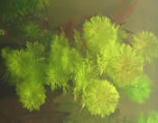
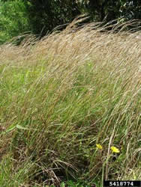
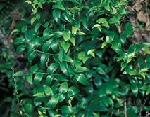
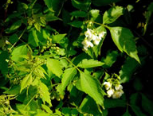
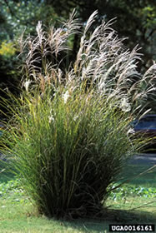
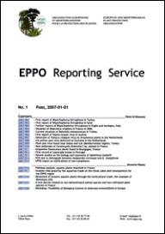

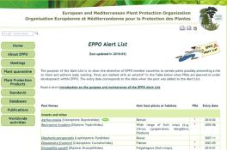
EPPO Alert List
Species included in the Alert List have been selected by the EPPO Secretariat or proposed by EPPO member countries, because they may present a risk to the EPPO region. Most species are still of limited distribution, or absent from the EPPO region.
Andropogon virginicus
Asparagus asparagoides
Cardiospermum grandiflorum
Limnophila sessiliflora
Miscanthus sinensis

Slide 7
Outcome of the first stage of the process:
Invasiveness categories (Combination of spread and impacts)
Spread capacity
Low Medium High
Invasiveness
High (list of IAP)
Medium (Observ. list)
Low (Minor concern)
High
Medium
Low
Impacts (highest impact recorded)

Slide 8
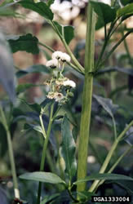
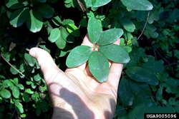
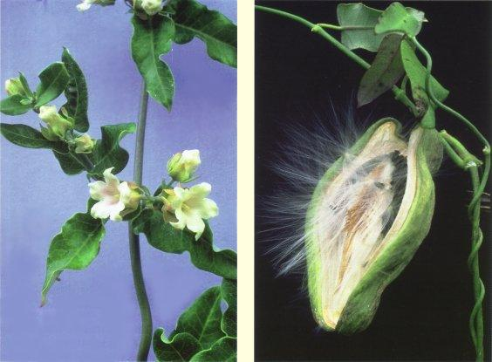
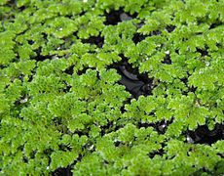
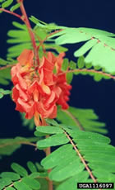
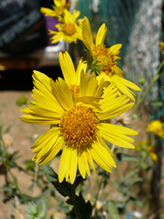
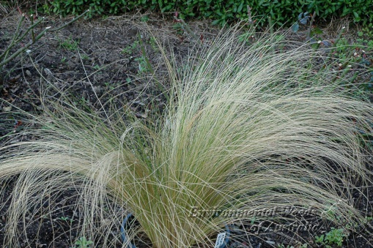
EPPO Observation List of Invasive Alien Plants
This list contains plant species (absent or present in the EPPO region) which present a medium risk or for which information currently available is not sufficient to make an accurate assessment.
Akebia quinata
Araujia sericifera
Azolla filiculoides
Gymnocoronis spilanthoides
Etc.
Sesbania punicea
Stipa neesiana
Verbesina encelioides

Slide 9


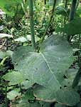
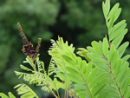

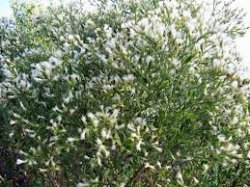
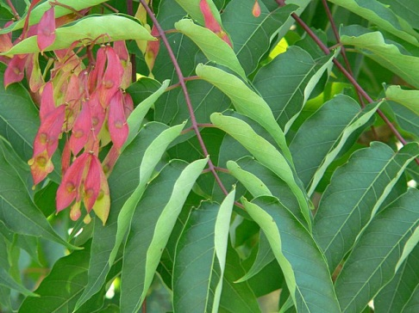
EPPO List of Invasive Alien Plants
40 terrestrial and aquatic species for which EPPO strongly recommends countries to take measures to prevent their introduction and spread or to manage unwanted populations
Carpobrotus edulis & acinaciformis
Amorpha fruticosa
Cortaderia selloana
Fallopia spp.
Etc.
Baccharis halimifolia
Ambrosia artemisiifolia
Ailanthus altissima
Visit: http://www.eppo.int/INVASIVE_PLANTS/ias_lists.htm

Slide 10
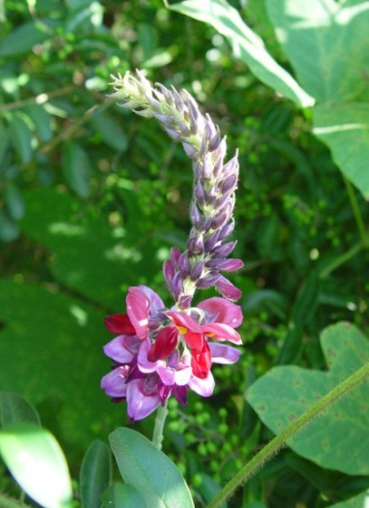
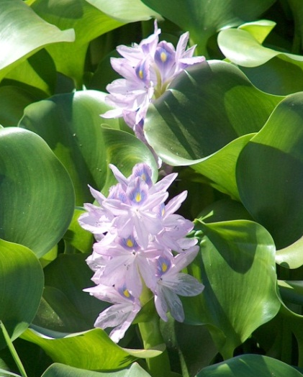
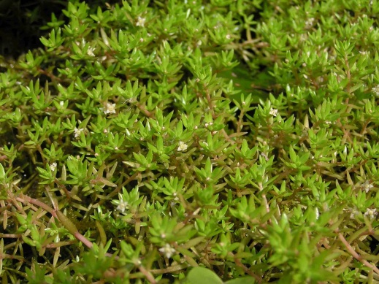
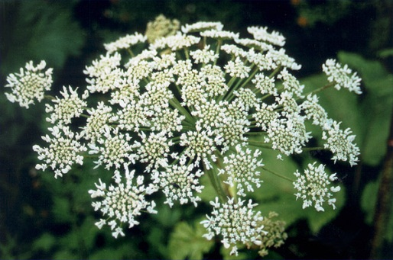
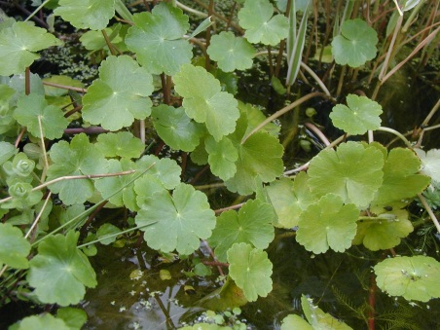
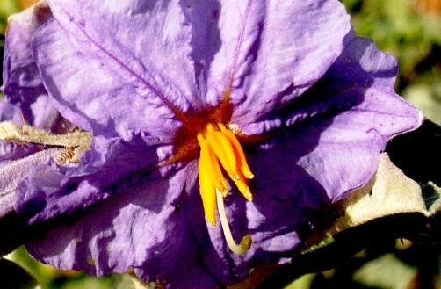
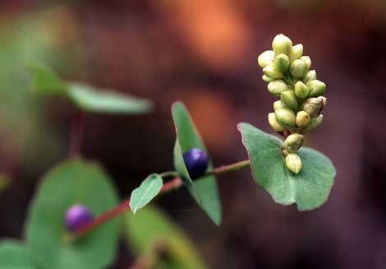
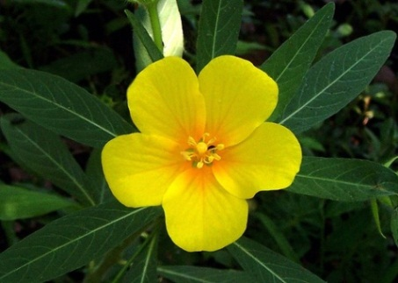
Invasive Alien Plants recommended for regulation by EPPO (A1/A2 List)
Heracleum sosnowskyi & H. persicum
Crassula helmsii
Pueraria lobata
Eichhornia crassipes
Hydrocotyle ranunculoides
Solanum elaeagnifolium
Polygonum perfoliatum
Ludwigia grandiflora & L. peploides
A Pest Risk Analysis is available for each of these species

Slide 11
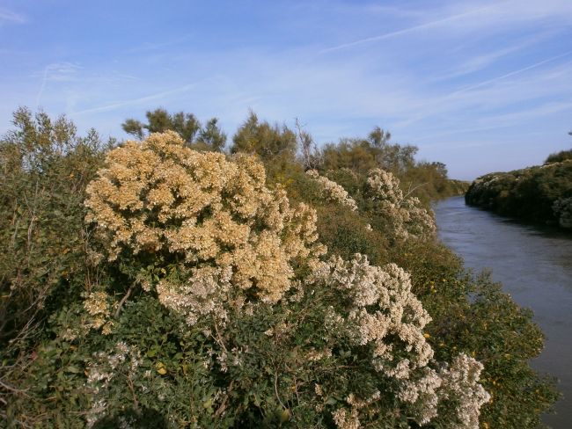
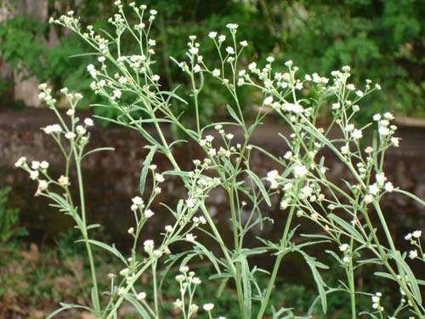
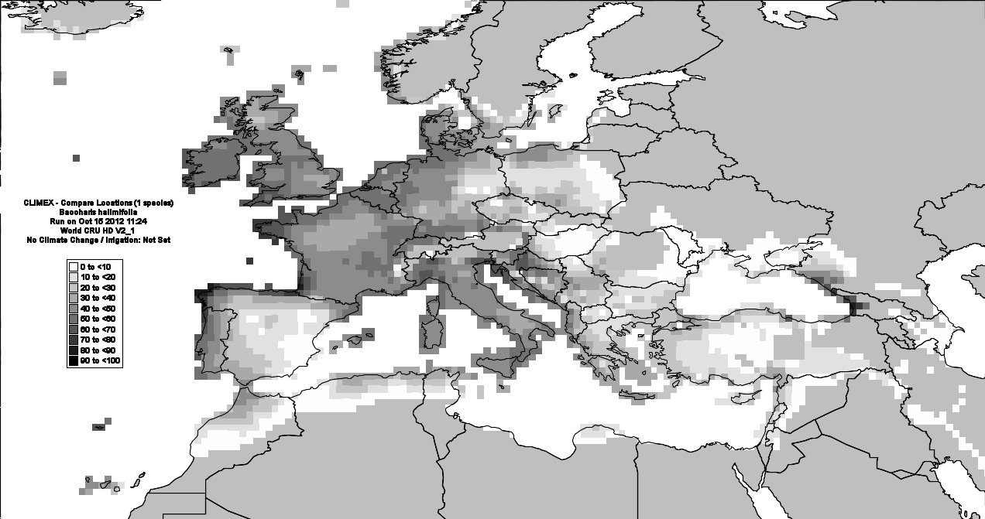
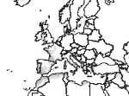
Next invasive alien plants to be recommended for regulation by EPPO
Baccharis halimifolia
Parthenium hysterophorus
EPPO Pest Risk Analysis to be approved in 2013 – Management Measures to be prepared
EPPO Pest Risk Analysis to be approved in 2014 - Management Measures to be prepared
Potential distribution of Baccharis halimifolia in the EPPO region with CLIMEX according to Sims-Chilton et al. (2010).
Potential distribution of Partenium hysterophorus in the EPPO region with CLIMEX according to Mc Conarchie et al. (2010)

Slide 12
EPPO
Information Service

Slide 13





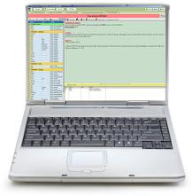
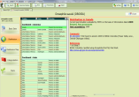
EPPO Early warning on invasive alien plants
Official pest reports from NPPOs
Literature, Internet surveys
Stored data

Slide 14
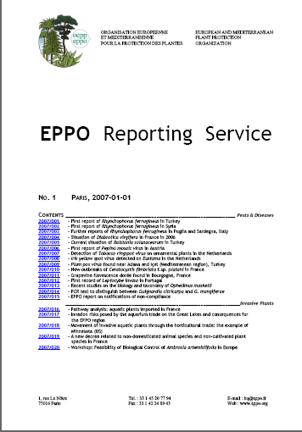
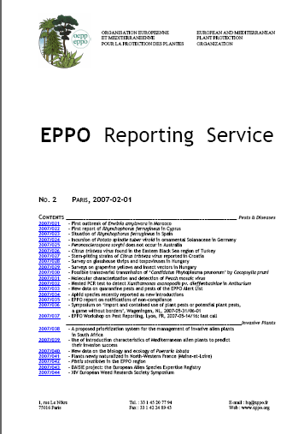

EPPO Reporting Service
New outbreaks and alerts
Pathways of introduction
Eradication and management
Biology and research
Events: conferences
Free registration at:
http://www.eppo.org/PUBLICATIONS/reporting/reporting_service.htm

Slide 15
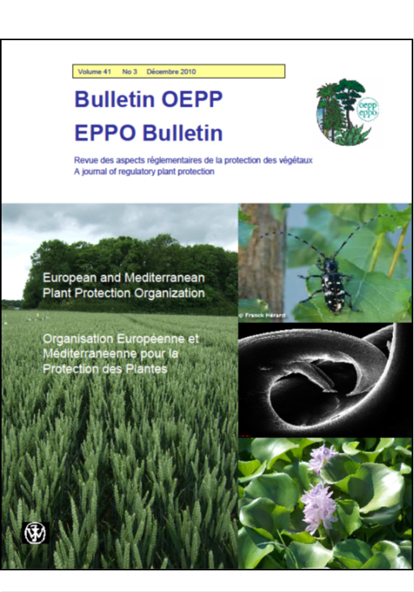
The EPPO Bulletin
Published 3 times a year, contains:
- Invited or submitted papers on all aspects of plant protection
- Papers presented at EPPO conferences (e.g. proceedings of the workshop on Eichhornia crassipes)
- EPPO Standards

Slide 16
EPPO Standards
on Invasive Alien Plants

Slide 17
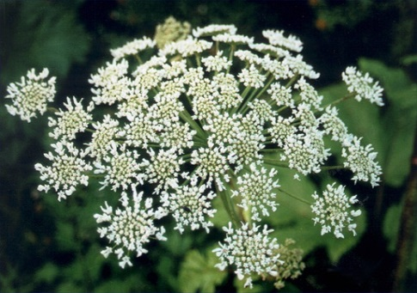
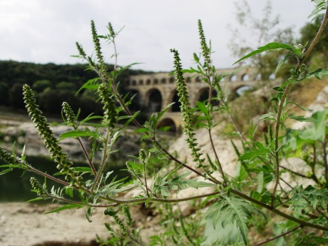
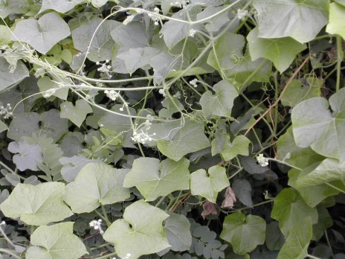

National Regulatory Control Measures (PM9)
Recommendations on the management of species
Heracleum spp.
Ambrosia artemisiifolia
Sicyos angulatus
Eichhornia crassipes
2 additional in preparation :
Baccharis halimifolia
Parthenium hysterophorus

Slide 18
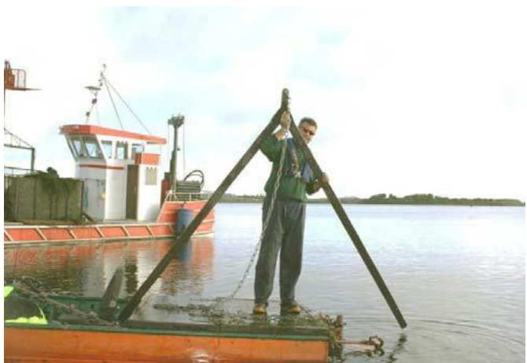
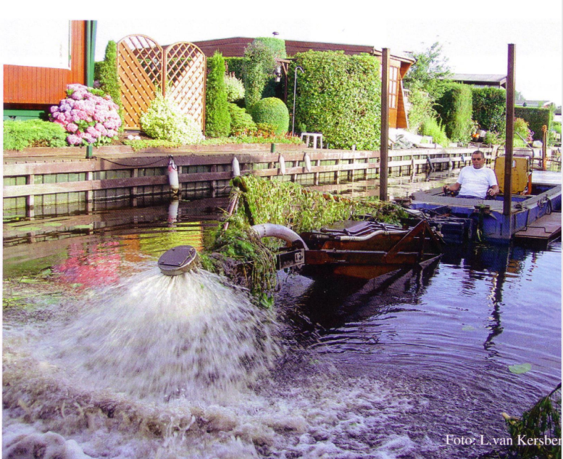
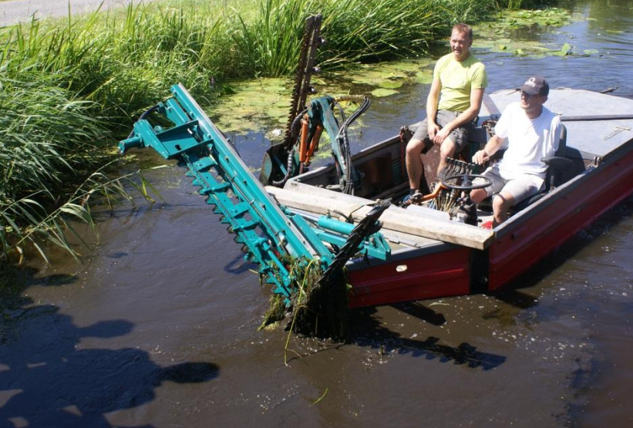
National Regulatory Control Measures (PM9)
Recommendations for the management of invasive alien plants
Development of an EPPO Standard on the management of invasive alien aquatic plants to be published in 2014.
V-blade used to cut Lagarosiphon major in Rinerroon Bay, Ireland (Caffrey & Acavedo, 2007
Dredging using a powerful water-jet in the Netherlands. On the picture, the water jet is raised above water to illustrate its operation. © L van Kersber.
A weed cutting boat with adjustable mowing gear used to manage invasive alien aquatic plants in the Netherlands (Photo: R. Pot).

Slide 19
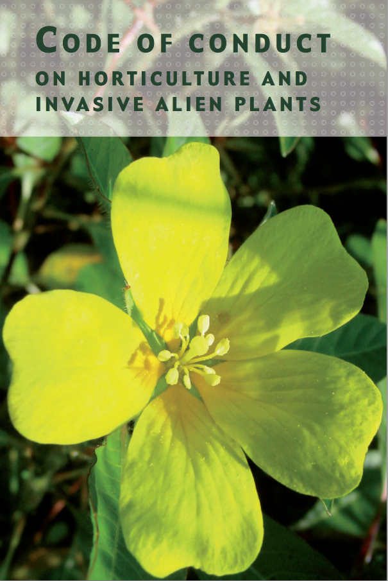
Code of conduct
on horticulture and invasive alien plants
To enlist the cooperation of the horticultural industry and associated professionals to adopt good practices;
Proposes for e.g. to apply good practices for labelling, to make substitutes for invasive alien plants available;
Implementation actions in 14 countries; translated into French, Italian, Spanish, Slovenian.

Slide 20
EPPO
conferences and trainings

Slide 21
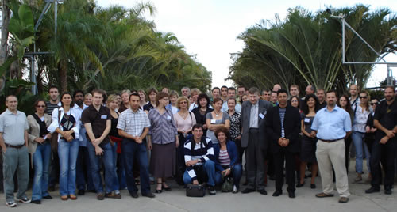

Organizing Training Workshops
Training on Pest Risk Analysis:
In Cyprus in 2008
For Russian speaking countries in 2009
For French speaking countries in 2010
CSIRO/EPPO Trainings on CLIMEX in Spain in 2009 and in France in 2011

Slide 22


Slide 23








Organizing Workshops
Workshop on
Eichhornia crassipes
(Water Hyacinth) in Merida, Spain in 2008
Workshop on
Solanum elaeagnifolium (Silverleaf nightshade) in Souss, Tunisia in 2006
2nd Workshop on Invasive Alien Plants in Mediterranean Type Regions of the World, Trabzon (TR), 2010-08-02/06
All presentations and conlusions available on the EPPO website

Slide 24
EPPO
works and publications

Slide 25

Current project of comparative study within the EPPO Panel on IAP
The EPPO prioritization process is compared with other such systems such as GABLIS (Essl et al. 2011), the ISEIA protocol (Branquart et al. 2010), the horizon scanning procedure for invasive non-native plants in Great Britain (Thomas 2010) and the risk assessment scheme of potentially invasive plant species in central Europe (Weber & Gut 2004).
34 species assessed with these different systems across different countries (Belgium, France, Germany, Italy, the Netherlands, Switzerland).
Experts of the EPPO Panel on Invasive Alien Plants

Slide 26










Solanum elaeagnifolium
Hydrilla verticillata
Ludwigia peploides
Hakea sericea
Humulus japonicus
Eicchornia crassipes
Myriophyllum heterophyllum
Ambrosia artemisiifolia
Alternanthera philoxeroides

Slide 27





80% of the invasive alien plants are imported for ornamental purposes.
Import data on aquatic plants from 9 countries was collected, and on about 250 species recorded:
Eicchornia crassipes
- 10 are considered invasive by EPPO (Azolla filiculoides, Crassula helmsii, Eichhornia crassipes, Egeria densa, Elodea nuttalli, Hydrilla verticillata, Lagarosipphon major, Ludwigia grandiflora, Myriophyllum aquaticum, Pistia stratiotes)
Ludwigia peploides
Myriophyllum aquaticum
6 additionnal represent a potential threat
(Alternanthera sessilis, Adiantum raddianum, Gymnocoronis spilanthoides, Hygrophila polysperma, Limnophila sessiliflora, Syngonium podophyllum)
Alternanthera philoxeroides

Slide 28






Recommendations for the management of invasive alien plants
- 34 eradication actions reported, 14 in Spain, 7 in Italy, 7 in France, 1 in Portugal, 1 in Malta, 1 in Israel and 1 in Tunisia.
- More than 90 management actions undertaken.
Eradication of Ailanthus altissima in areas in Italy and Spain
Eradication of Eichhornia crassipes in the Valencian region in Spain
Eradication of Carpobrotus spp. in areas in France, Malta, Spain
Eradication of Ludwigia peploides in areas in Spain
Eradication of Salvinia molesta in France, Italy and Portugal

Slide 29
EPPO
activities on communication

Slide 30


SCOOP IT Pages

Slide 31

How to communicate
on pests and invasive alien plants ?
The first workshop on the issue;
Aimed at collecting experiences, and knowledge on what worked and what did not work;
Oriented toward interdisciplinarity.
Registrations still open: http://archives.eppo.int/MEETINGS/2013_conferences/communication_pt.htm

Slide 32
Thank You www.eppo.int sb@eppo.int
Notes:
Ce modèle peut être utilisé comme fichier de démarrage pour présenter des supports de formation à un groupe.
Sections
Cliquez avec le bouton droit sur une diapositive pour ajouter des sections. Les sections permettent d’organiser les diapositives et facilitent la collaboration entre plusieurs auteurs.
Notes
Utilisez la section Notes pour les notes de présentation ou pour fournir des informations supplémentaires à l’audience. Affichez ces notes en mode Présentation pendant votre présentation.
N’oubliez pas de tenir compte de la taille de la police (critère important pour l’accessibilité, la visibilité, l’enregistrement vidéo et la production en ligne)
Couleurs coordonnées
Faites tout particulièrement attention aux diagrammes, graphiques et zones de texte.
Tenez compte du fait que les participants imprimeront la présentation en noir et blanc ou nuances de gris. Effectuez un test d’impression pour vérifier que vos couleurs s’impriment correctement en noir et blanc intégral et nuances de gris.
Graphiques, tableaux et diagrammes
Faites en sorte que votre présentation soit simple : utilisez des styles et des couleurs identiques qui ne soient pas gênants.
Ajoutez une étiquette à tous les graphiques et tableaux.

