Slide 1
Challenges with the Data Review and Evaluation Process
Expert Consultation on Cold Treatments
Buenos Aires
2-6 December 2013
Guy J. Hallman
USDA-ARS Manhattan, Kansas USA

Slide 2
A basic challenge is that it has been difficult to agree on specific standards for data presentation and evaluation, so each new treatment proposal may seem a new challenge.
It has been difficult to agree because contracting parties may not wish to set precedents that could be interpreted to cover unpredicted circumstances.
However, harmonization is happening and this ECCT has among its objectives suggest harmonized approaches.

Slide 3
arise from both directions
It may be challenging evaluating a treatment proposal based on the supporting evidence provided by the exporting party
The importing PPO may challenge the supporting evidence supplied

Slide 4
Challenges by the exporting party are mainly due to insufficient methodology, raw data, or analysis provided by the exporting party
Clarification is required as a first step to solving these types of challenges

Slide 5
Challenges of the supporting evidence by the permitting PPO may vary greatly, and harmonization of methodology and analysis could help

Slide 6
In the review of data too much emphasis may be given to statistical analyses of dose-response data when the models used (probit, logistic and others) cannot accurately predict the extreme levels of efficacy required of phytosanitary treatments without very large sample sizes.
Or it be be thought that mortality in the control is excessive.

Slide 7
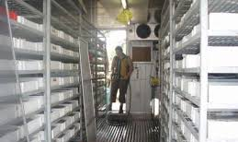
Another challenge is that reviewers may question the relevancy of laboratory colonies used in the research.

Slide 8
A challenge is if treatments are applicable across different cultivars of the same host used in the research.
E.g., does the size and shape of the host affect efficacy or the relationship of the quarantine pest to the host in a way that could affect efficacy?

Slide 9
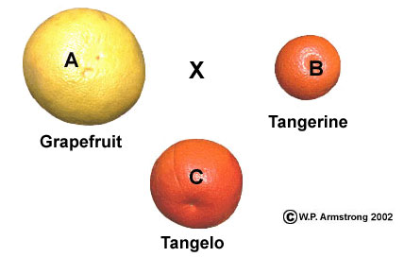
Challenges may be raised if hosts are hybrids of of species for which a treatment has not been developed for one of the parents

Slide 10
Some reviewers may demand that probit 9 efficacy (~93,000 insects treated with no survivors) be achieved for tephritids

Slide 11
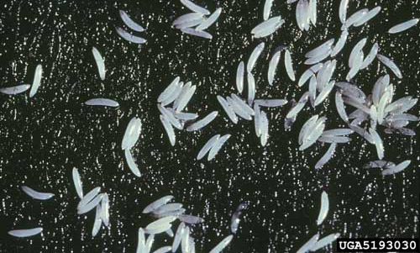
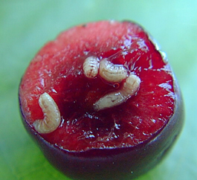
Questions on whether the most tolerant life stage was adequately used in the confirmatory research may be raised.

Slide 12
A challenge to this ECCT is to recommend supporting evidence that should be provided and how it should be evaluated

