Slide 1





Alternatives to evaluate the effect of Life Stage and Varieties on Cold Treatment:
Confidence intervals and Odds-Ratio measure

Slide 2
Objetive
Harmonize procedures for comparing life stage tolerances and the effect of varieties / species.
Answer the question: Which lethal dose levels will be used to determine MTLS?

Slide 3
Dose-Response Models
This model are used for bioassay results
The aim is to describe the probability (proportion or percentage) of “sucess” (i.e. control, mortality, survival) as a function of the dose (exposure time, temperature, etc)
Three commonly used models:
  Probit model
  Logit model
  Complementary log-log (clog-log) model

Slide 4
Link function for models
The link function is a transformation of the response in order to linearize the realtion between response (p) and dose (x) or logarithm of dose
Model | Link function | Model ecuation
Probit
Logit
Clog-log

Slide 5
Model selection
Selection can be done using any goodness of fit statistic:
  -2 log (maximum likelihood)
  Pearson χ²
  Pseudo R²
  AIC
Selection should be performed in each different bioassay
Replications should be including in the analysis (replications normally improve the fit)

Slide 6
Probit model
First use in binomial data was in 1934 (Bliss)
For nearly 40 years employment tables and interpolations to convert percentages or proportions of controlled individuals, obtaining graphics where it was expected to have a more or less linear relationship between dose and probit
Probit analysis can be done by eye, through hand calculations, or by using a statistical program (SAS,SPSS, R, S, S-Plus, EPA (IBM), TOXSTAT, ToxCalc, Stephan program).
Most common outcome of a dose-response experiment in which probit analysis is used is the LC50/LD50/LT50 and its respective intervals.

Slide 7
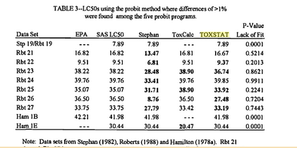
Estimated LD50 using Probit softwares

Slide 8
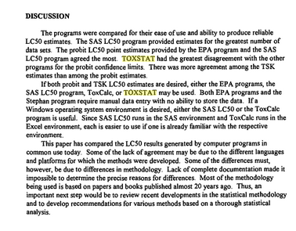
Little et al, 1998. Environmental Toxicology and Risk Assessment

Slide 9
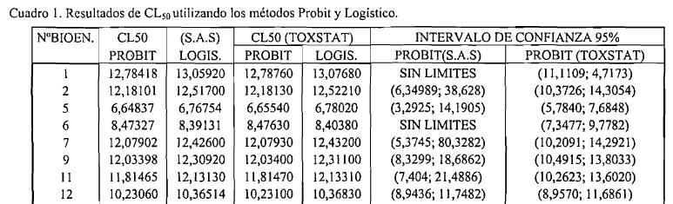

Estimated LD50 confidence intervals using Probit softwares

Slide 10
Origins of differences
Control Treatment (Dose=0): included or not in the analysis.
Mortality: corrected or not?
Parameters estimation: least squares methods or maximum likelihood?
Confidence intervals: how are calculate?

Slide 11
Corrected mortality
Data will be corrected if there is more than 10% mortality in the control (???).
Corrected mortality:

Slide 12
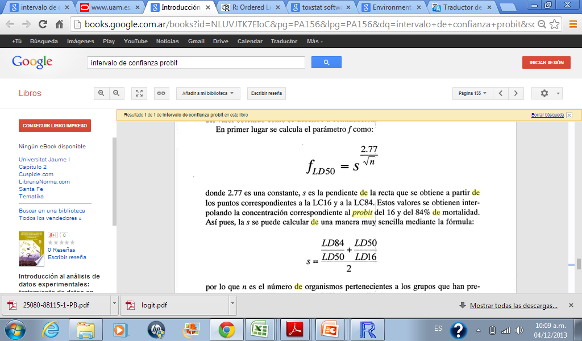
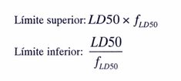
Confidence Intervals

Slide 13
Egg Stage |  |  | First and Second Larvae Stage |  |  | Third Larvae Stage
Dose | Size | Live | Dose | Size | Live | Dose | Size | Live
0 | 280 | 264 | 0 | 420 | 269 | 0 | 280 | 262
1 | 280 | 206 | 3 | 420 | 134 | 4 | 280 | 253
2 | 280 | 141 | 4 | 420 | 75 | 5 | 280 | 220
3 | 280 | 64 | 5 | 420 | 32 | 7 | 280 | 127
4 | 280 | 31 | 7 | 420 | 4 | 10 | 280 | 7
7 | 280 | 0 | 10 | 420 | 0 | 12 | 280 | 0
10 | 280 | 0 | 12 | 420 | 0 | 14 | 280 | 0
12 | 280 | 0 | 14 | 420 | 0 | 0 | 280 | 242
14 | 280 | 0 | 0 | 420 | 256 | 4 | 280 | 237
0 | 280 | 263 | 3 | 420 | 59 | 5 | 280 | 232
1 | 280 | 208 | 4 | 420 | 44 | 7 | 280 | 128
2 | 280 | 150 | 5 | 420 | 37 | 10 | 280 | 1
3 | 280 | 60 | 7 | 420 | 25 | 12 | 280 | 0
4 | 280 | 31 | 10 | 420 | 0 | 14 | 280 | 0
7 | 280 | 0 | 12 | 420 | 0 | 0 | 280 | 242
10 | 280 | 0 | 14 | 420 | 0 | 4 | 280 | 239
12 | 280 | 0 | 0 | 420 | 259 | 5 | 280 | 236
14 | 280 | 0 | 3 | 420 | 76 | 7 | 280 | 138
0 | 280 | 263 | 4 | 420 | 74 | 10 | 280 | 3
1 | 280 | 208 | 5 | 420 | 54 | 12 | 280 | 0
2 | 280 | 134 | 7 | 420 | 11 | 14 | 280 | 0
3 | 280 | 65 | 10 | 420 | 0
4 | 280 | 22 | 12 | 420 | 0
7 | 280 | 0 | 14 | 420 | 0
10 | 280 | 0
12 | 280 | 0
14 | 280 | 0

Slide 14
Best Model Selection
Stage | Model | Intercept | Dose | AIC | LD50 | SE (LD50)
Egg | Probit | -1.4876 | 0.7043 | 81.33 | 2.112 | 0.0364
 | Logit | -2.5261 | 1.2011 | 83.08 | 2.103 | 0.0363
 | clog-log | -1.9627 | 0.7213 | 101.22 | 2.212 | 0.0417
First and Second Larvae Stage | Probit | -0.63 | 0.3328 | 160.09 | 1.893 | 0.1531
 | Logit | -1.3594 | 0.634 | 171.99 | 2.144 | 0.1279
 | clog-log | -0.7259 | 0.2651 | 154.7 | 1.355 | 0.205
Third Larvae Stage | Probit | -4.8999 | 0.6963 | 106.51 | 7.037 | 0.0511
 | Logit | -9.0664 | 1.2914 | 109.67 | 7.021 | 0.0492
 | clog-log | -6.0744 | 0.7703 | 146.44 | 7.401 | 0.0573

Slide 15
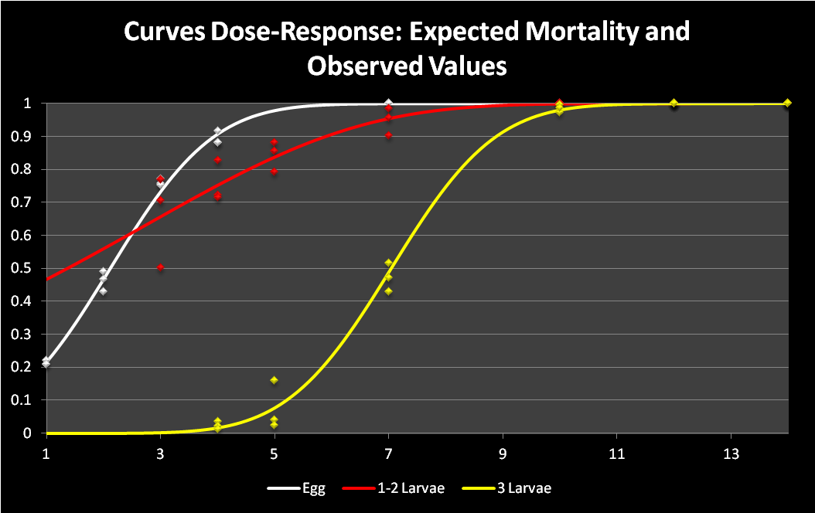

Slide 16
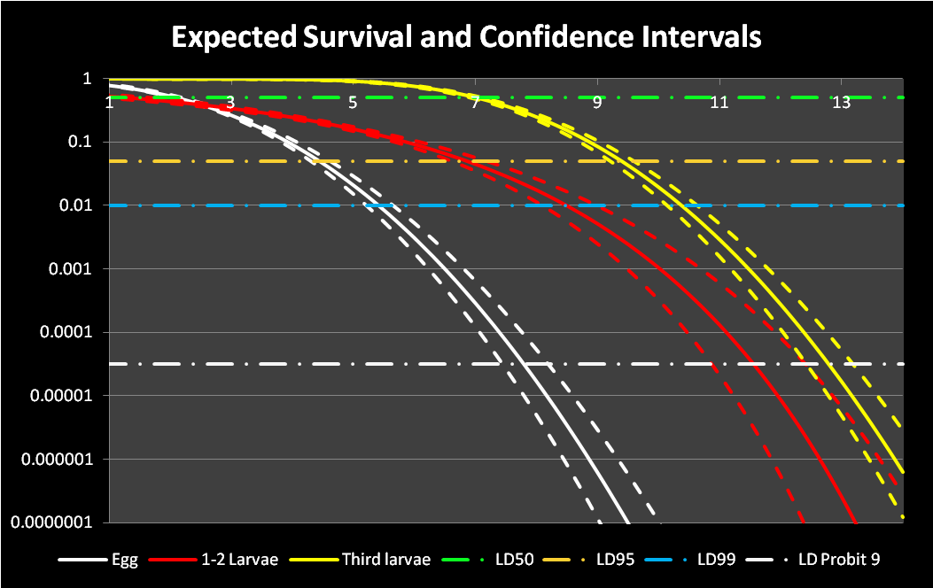

Slide 17
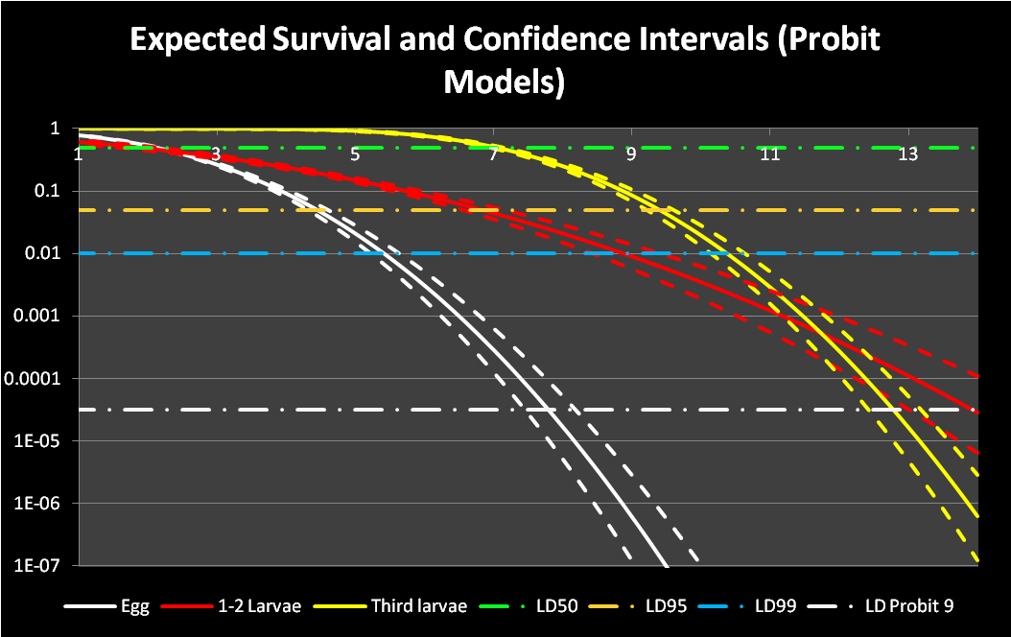

Slide 18
Logit model
Logit is another form of transforming binomial data into linearity and is very similar to probit. In general, if response vs. dose data are not normally distributed, Finney suggests using the logit over the probit transformation (Finney, 1952).

Slide 19
Odds
Indicates how likely it is a success to occur in respect to not happen:

Slide 20
Odds Ratio
If the CI is under 1, there is less probability of success in (x+1) respect to x
If the CI contains 1, there is no diference in the probability of success in (x+1) respect to x
If the CI is above 1, there is more probability of success in (x+1) with respect to x

Slide 21
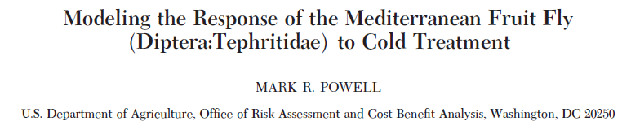
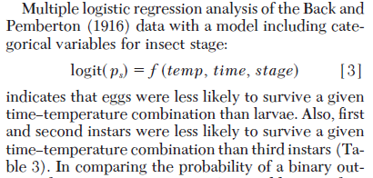
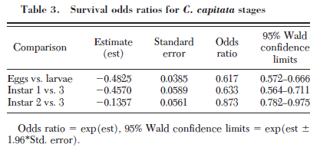

Slide 22
Multiple Logistic Model
If define “o” for eggs and “1” for larvae (first and second stage).

Slide 23
Odds Ratio
This can also be used for varieties!!!

