Slide 1
2013 IPPC Expert Consultation on Cold Treatment
Need of harmonized cold treatment scheme for fruit fly in fresh fruits
December 2-6, 2013
Buenos Aires, Argentina
JEON, YS and PARK, HS
Dept. of Plant Quarantine, Animal and Plant Quarantine Agency/ MAFRA
Republic of Korea

Slide 2
I. Introduction
Official definition under the IPPC
Treatment(s) are…
for the control of regulated pests on regulated articles, primarily those moving in international trade.
[ISPM 28: Phytosanitary treatments for regulated pests]
Need of international standards
- To suggest further experiments needed in future for harmonized
scheme of cold treatment for pest species
- To develop ISPM on minimum effective requirement of temperature
and duration for each pest species with available data

Slide 3
I. Introduction
All plants and plant products could be imported
except for the prohibited articles
- Prohibited articles are…
• Host plants and plant products from the origin of the
prohibited pest (prohibited area) including those
in transit through the prohibited area
* Prohibited pests: Fruit fly, Codling moth, PCN, Fire blight, etc.
Lift a ban after PRA/IRA on the prohibited articles
- Prohibited articles from the relevant countries cannot be
imported without PRA/IRA

Slide 4
Ⅱ. Approved cold treatment condition
PRA/IRA including Pest Risk Management on pests of concern
- Pest Risk Managements are…
• Hot water treatment: Mango, Papaya…
• Fumigation (Methyl bromide): Cherry, Mangosteen
• KD treatment: Pinus spp.
• Cold treatment: Orange, Lemon, Grapefruit, Grape…
Lift a ban after PRA/IRA
- Total : 24 countries, 27 items, 46 cases
- Cold treatment : 11 countries, 9 items, 19 cases

Slide 5
Ⅱ. Approved cold treatment condition
Introduction to cold treatment in Korea
- What kind of pests can be applied?
* Prohibited pests: Fruit fly
Examples for Fruit importation
- Items: Citrus spp. (orange, lemon, grapefruit)
- Countries: Argentina, USA(Florida), Spain, South Africa,
Taiwan, Israel, Australia, Egypt
Why harmonization?
- Items (Countries): Orange (8 countries)
- Cold treatments: 15 conditions

Slide 6
Ⅱ. Approved cold treatment condition
Market access in Korea
Market access with cold treatment
Spain: Orange
Italy: Kiwi
France: Kiwi
Israel: Sweetie, Orange, Grapefruit
Taiwan: Pongkang orange, Litchi
USA(Florida):
Orange, Grapefruit, Tangerine
NORTH
AMERICA
EUROPE
ASIA
11 countries
9 items
AFRICA
South Africa: Orange, Lemon, Grapefruit
Egypt: Orange
SOUTH
AMERICA
OCEANIA
Argentina: Orange
Peru: Grape
Australia: Orange, Lemon

Slide 7
Ⅱ. Approved cold treatment condition
Condition on Citrus spp.
Country | Since | Item | Core temp. | Duration | Target pests
USA | 2000 | Orange Grapefruit Tangerine | 0.6℃ 0.8℃ 1.1℃ 1.4℃ 1.7℃ | 14 days 16 days 17 days 19 days 20 days | Anastrepha suspensa
Australia | 2000 | Orange | 1±0.5℃ 2±0.5℃ 3±0.5℃ | 16 days 18 days 20 days | Bactrocera aquilonis B. halfordiae B. jarvisi B. neohumevalis B. trivitis B. tryoni Ceratitis capitata
 |  | Lemon | 1±0.5℃ 2±0.5℃ 3±0.5℃ | 14 days 16 days 18 days
Taiwan | 1995 | Pongkang orange | 1.0℃ | 14 days | Bactrocera dorsalis B. cucurbitae B. tsuneonsis B. caudatus B. latifrons B. Tau

Slide 8
Ⅱ. Approved cold treatment condition
Condition on Citrus spp. (continued)
Country | Since | Item | Temperature | Duration | Target pests
Spain | 2004 | Orange | 2℃ | 16 days | Ceratitis capitata
Egypt | 2007 | Orange | 1.7℃ | 16 days | Bactrocera zonata Ceratitis capitata
Argentina | 2010 | Orange | 2±0.5℃ | 21 days | Anastrepha fraterculus A. obliqua A. serpentina Ceratitis capitata
Israel | 1999 2011 | Orange Sweetie Grapefruit | 1.5℃ 2.2℃ | 16 days 18 days | Cryptophlebia leucotreta(FCM) Ceratitis capitata
South Africa | 1999 2012 2012 | Orange Lemon Grapefruit | -0.6±0.6℃ | 24 days | Ceratitis capitata C. quinaria C. rosa

Slide 9
Ⅱ. Approved cold treatment condition
Condition on other fresh fruits
Country | Since | Item | Core temp. | Duration | Target pests
Taiwan | 1997 | Litchi | 2℃ | 42 hrs | Bactrocera dorsalis
Peru | 2011 | Grape | 1.1℃ 1.6℃ | 15 days 17 days | Anastrepha fraterculus A. obliqua Ceratitis capitata
Italy | 2012 | Kiwi | 1.1℃ 1.6℃ 2.2℃ | 14 days 16 days 18 days | Ceratitis capitata
France | 2013 | Kiwi | 1.1℃ 1.6℃ 2.2℃ | 14 days 16 days 18 days | Ceratitis capitata

Slide 10
Ⅱ. Approved cold treatment condition
Conditions on fresh orange from 6 countries
Country | Since | Item | Core temp. | Duration | Target pests
Australia | 2000 | Orange | 1±0.5℃ 2±0.5℃ 3±0.5℃ | 16 days 18 days 20 days | Ceratitis capitata Bactrocera aquilonis B. halfordiae B. jarvisi B. neohumevalis B. trivitis B. tryoni
Spain | 2004 | Orange | 2℃ | 16 days | Ceratitis capitata
Egypt | 2007 | Orange | 1.7℃ | 16 days | Ceratitis capitata Bactrocera zonata
Argentina | 2010 | Orange | 2±0.5℃ | 21 days | Ceratitis capitata Anastrepha fraterculus A. obliqua A. serpentina
Israel | 1999 | Orange | 1.5℃ 2.2℃ | 16 days 18 days | Ceratitis capitata Cryptophlebia leucotreta(FCM)
South Africa | 1999 | Orange | -0.6±0.6℃ | 24 days | Ceratitis capitata C. qinaria C. rosa

Slide 11
Ⅲ. Need of harmonization
Cold treatment scheme for fruit fly in fresh fruits
Present
Too many conditions
- The required temperatures are various from -0.6℃ to 3℃
- The required durations are various from 16days to 24days
Future ?
Subject to consideration
- Target pests
- Items
- Production area
- Others

Slide 12
Ⅲ. Need of harmonization
Proposed harmonized cold treatment on fresh fruits
How?
Region | Item | Core temp. | Duration | Target pests
? | ? | Applicable core temperature range | Duration per core temperature range | Ceratitis capitata, etc.

Slide 13
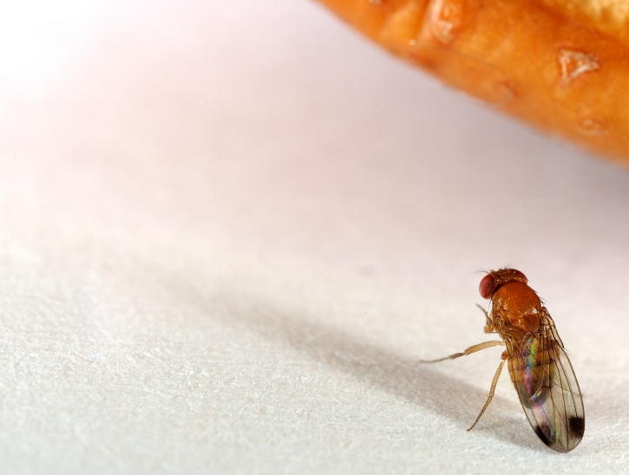
¡ Muchas gracias !

