Slide 1
26th Technical Consultation among regional Plant Protection Organizations 2014
Antigua (Guatemala) 10-14 November 2014
Mekki Chouibani
www.neppo.org

Slide 2
NEPPO
Established in 2009
11 countries members (One on going process of adhesion: Oman)
Algeria, Egypt, Jordan, Libya, Malta, Morocco, Pakistan, Syria, Sudan, Tunisia
Adhesion of Iraq (December 6th, 2013)

Slide 3
Activities
Contribution to the organization of the IPPC Regional workshop for the Near east and North Africa held in Agadir, Morocco 28 October – 1st November 2013
Participated in the Meeting of the Commission on Phytosanitary Measures Standards Committee, 18-22 November 2013 and in 4-9 May 2014 in Rome (Italy).
Participation in the Moroccan Plant Protection Association Congress held in Rabat (Morocco) December 3, 2013 .
“IPPC and International trade”

Slide 4
Activities (2)
Participated in Global Forum for Food and Agriculture. Berlin (Germany) , January 17, 2014 ,
“Impact of invasive species, harmful to plants, on food security and appropriate measures for crisis managements and to secure sustainability of plants production”
Participated in the 9th session of CPM, April 2013
Participation of the IPPC regional workshop. Cairo, Egypt. 26-31 October 2014

Slide 5
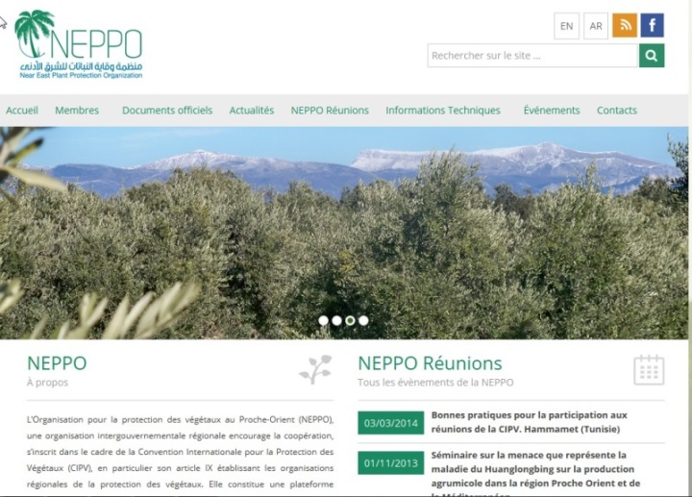
Exchange information
Creation of NEPPO website to facilitate exchange of information
(FAO-Subregional Office Tunis)

Slide 6
Capacity building Huanglongbing Citrus Disease
Agadir, Morocco, November 1, 2013.
Awareness' meeting for the Near East NPPO,
In collaboration with FAO, COSAVE and OIRSA
Share experiences of COSAVE and OIRSA Region, Saudi Arabia, Iran and Spain

Slide 7
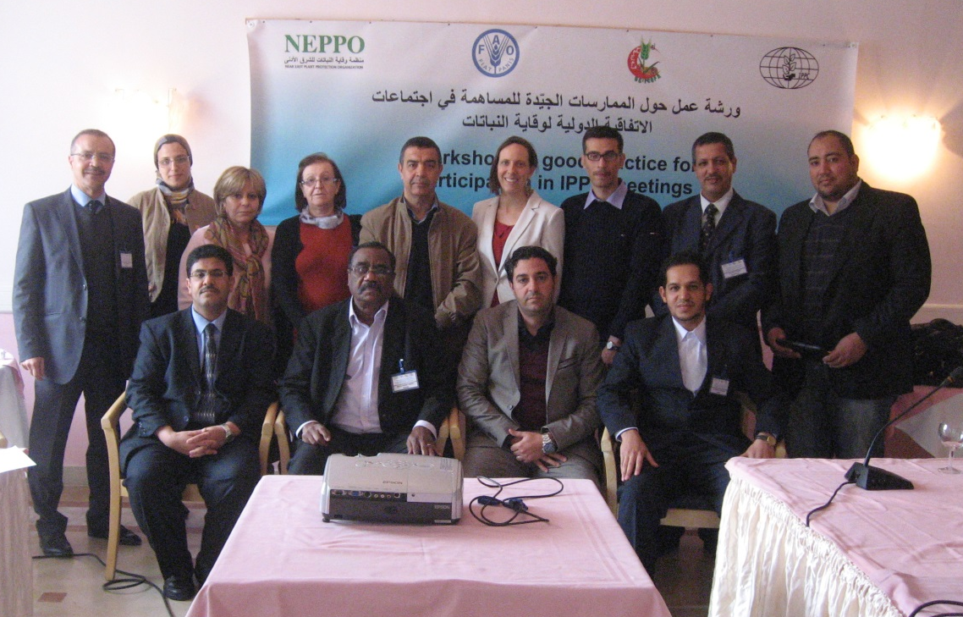
Good practice for participation in IPPC meetings
Hammamet, Tunisia, on March 3-5, 2014
Collaboration with IPPC Secretariat
Enhance skills of NPPOs
Examination of some relevant items of the 9th CPM Agenda,

Slide 8
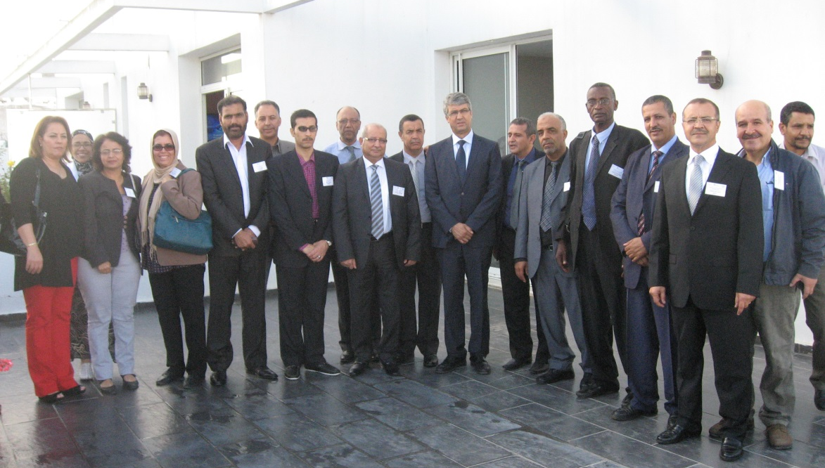
Pest surveillance and all related ISPMs
Workshop in Rabat, Morocco. September 22-24, 2014
Discussion of ISPM 6 and 4, 8, 17 and 26
Discussion of two surveillance programs prepared by participant on Red palm weevil and on Huanglongbing disease(with associated vectors)

Slide 9
Emerging pests of concern for the NEPPO region
Red Palm Weevil : Rhynchophorus ferrugineus : Big concern and potential highly negative environment and socioeconomical impact. Detected on ornamental palm trees in Morocco (Tangier, North) and Tunisia (Carthage), Not yet detected in Algeria,
Fruit flies: Bactrocera zonata and B, invadens, North Africa is surrounded by the both B. zonata in Lybia and B,invadens in Sénégal (Maybe in Mauritania).

Slide 10
Emerging pests of concern for the NEPPO region (Continued)
Huanglonging Citrus Disease (HLB). The Mediterranean and most Near East (Except Saudia Arabia and Yemen) area are free from HLB and its vectors (Except Iran). Important threat to Citrus Industry.
Tuta absoluta in some extent in the Middle East countries
Bayoud: Fusarium oxysposrum fsp albedenis, Big concern mainly in the Gulf

