Slide 1
Some Current Pest Concerns
For TC26 in 2014

Slide 2
Submitted for approval to the Council 2014: Pests recommended for regulation

Slide 3
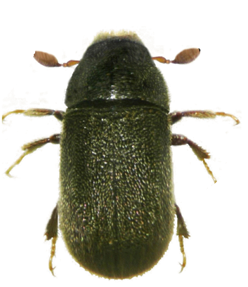
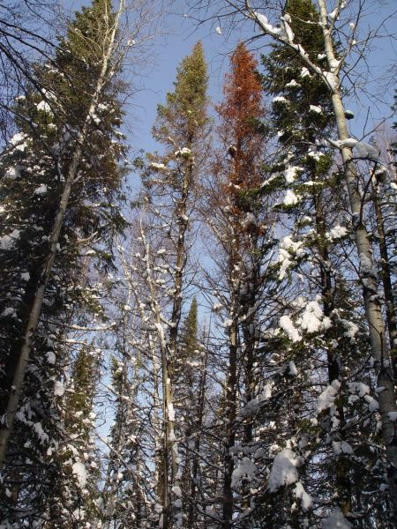
Polygraphus proximus
Coleoptera: Scolytinae (bark beetle)
Host plants: mainly Abies species but also Pinus, Picea, Larix and Tsuga species (new species attacked while spreading)
EPPO region: Russia (native in Far East, introduced in Siberia and Moscow region)
Asia (native): China, Japan, Korea Republic & Korea Democratic Peoples’ Republic
Endangered area where hosts occur
Impact potentially major

Slide 4
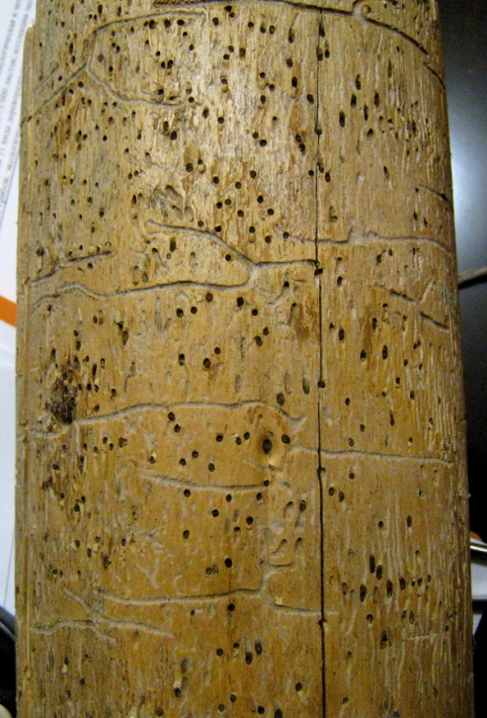
Measures recommended for:
Wood with bark
Particle wood, waste wood and bark
Plants for planting of host plants
Wood Packaging

Slide 5
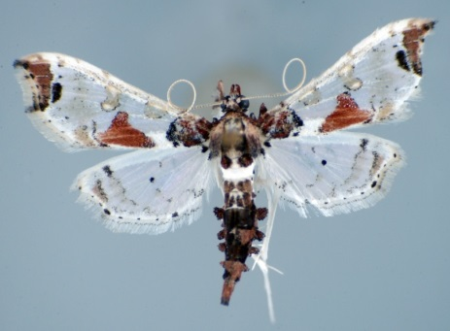
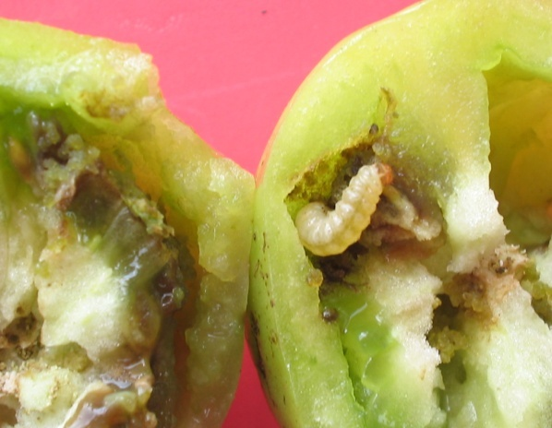
Neoleucinodes elegantalis: tomato fruit borer
Lepidoptera: Crambidae
Fruit borer (not leaf miner).
Host plants: Solanaceous plants (e.g. tomato, Capsicum, eggplant) and weeds. Host range may differ in different countries
Present in South America and Central America (but not a pest everywhere! doubtful records?)
Endangered area: southern part of the region and glasshouse crops
Potential impact: moderate (on fruit production, exports)
Measures recommended for fruits and plants for planting of host plants
All photos in the presentation by A. Diaz-Montilla

Slide 6
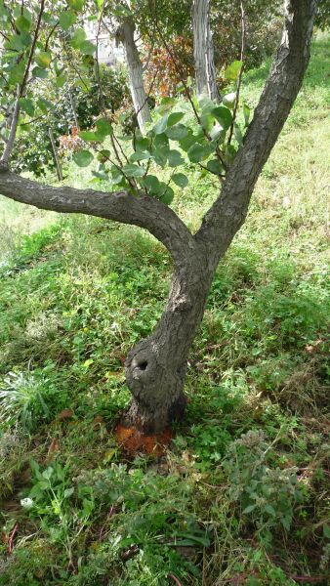
Aromia bungii
Coleoptera: Cerambycidae
Wood borer.
Known hosts: Prunus spp. (e.g. apricot, cherry, plum, peach)
Doubftul hosts: Diospyros spp., Citrus, Populus…
Native from China, North Korea, South Korea, Mongolia, Vietnam.
Introduced: Japan (2013); EPPO region (under eradication in Italy and Germany)
Endangered area: Most EPPO region
Impact: Major (low uncertainty)

Slide 7
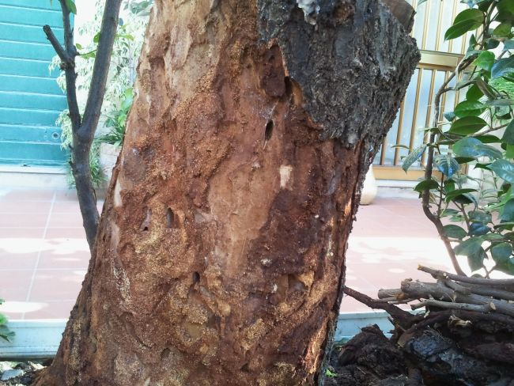
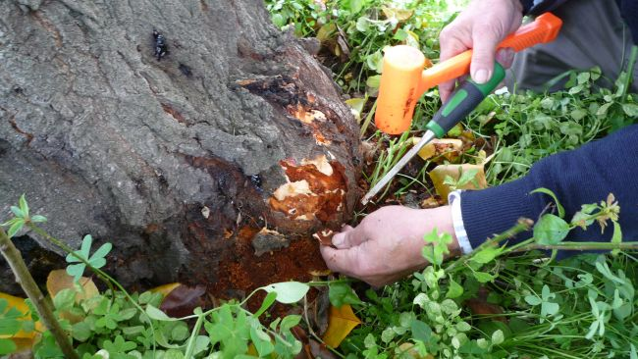
Measures recommended for
Host plants for planting
Wood (round or sawn) of host species
Hardwood particle wood and waste wood
Wood Packaging
Wooden furniture and objects made of wood:

Slide 8
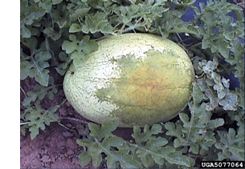
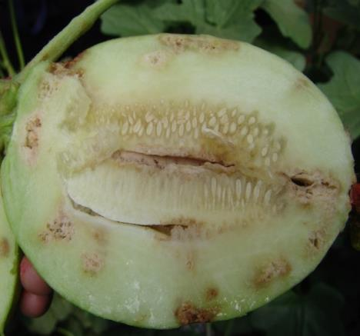
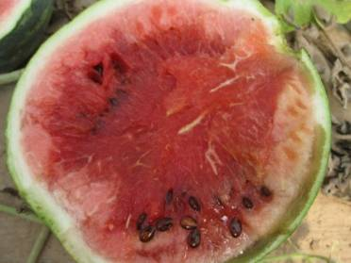
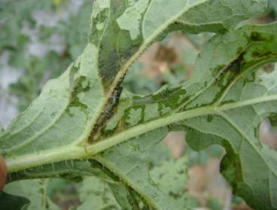
Acidovorax citrulli
Bacterial fruit blotch
Hosts cucurbits:
-watermelon (Citrullus lanatus)
-cantaloupe and honeydew melon (Cucumis melo): the most susceptible hosts.
-Cucumber (Cucumis sativus), pumpkin (Cucurbita moschata) and squash (Cucurbita pepo)
David B. Langston, Univ.of Georgia (US)

Slide 9
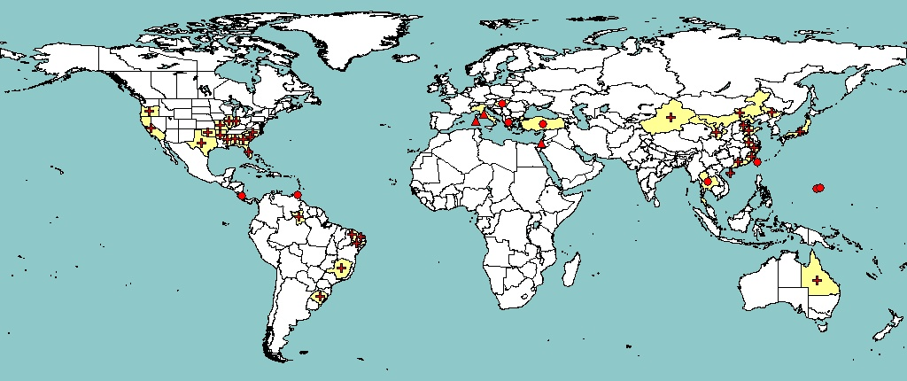
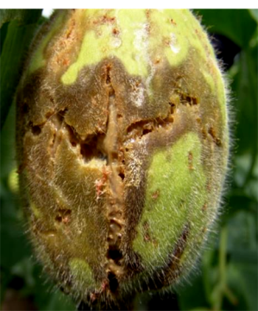
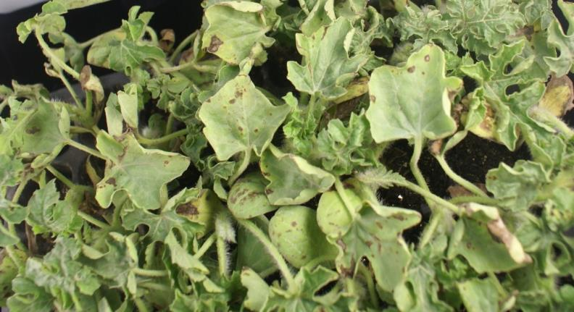
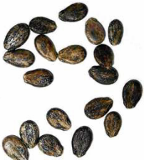
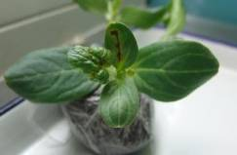
Distribution, North America, Asia
PRA on Acidovorax citrulli (Prima Phacie project
Review by core members)
Outbreaks in EPPO letter to NPPOs: pest declared eradicated
Endangered area watermelon growing area of the EU but Uncertainties on conditions for the disease to express (but risk if humid summer)
Economic impact Potentially major.
Measures recommended for seeds and seedlings

Slide 10
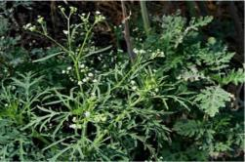
Parthenium hysterophorus
Annual plant native to the subtropics of North and South America. Weed of crops and pastures in several countries in Africa, in India, in Australia, etc.
In EPPO only recorded in Israel.
Endangered area whole Mediterranean basin as well as the surroundings of the Black sea and eastern Asia.
Impacts on crops and pastures moderate to high, depending on the production techniques.
In addition: major impacts on human and animal health through allergies and dermatitis (worse than A artemisifolia)
Measures recommended for
Used machinery
Growing medium adherent to plants for planting
Grain
Travelers
Climate suitability for Parthenium hysterophorus in the EPPO region modelled using CLIMEX

Slide 11
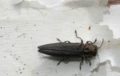
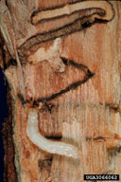
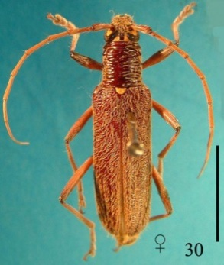
Agrilus anxius
Revised risk management options
Coleoptera: Buprestidae
Wood borer of birch (Betula spp.)
Present in North America (Canada, USA)
European and Asian birch species more susceptible than American species
Added on EPPO A1 list in 2011. Measures strengthened to be in line with those recommended for A. planipennis.
Oemona hirta
Coleoptera: Cerambycidae (Wood borer)
Highly polyphagous 200 plant species, mostly trees,
Only occurs in New-Zealand
Added to EPPO A1 list in 2013, measures for wood, wood chips and wood waste added (in line with Aromia bungii)

Slide 12
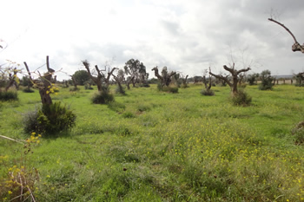
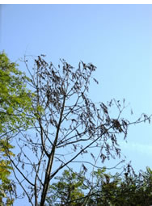
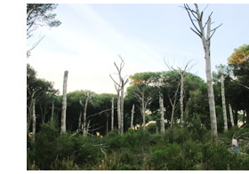
Also of concern
Xylella fastidiosa
on EPPO A1 list since 1981
reported from Italy in Oct 2013
wide host range
pathway of introduction not known
Thousand Cankers Disease of Walnut
Geosmithia morbida / Pityophthorus juglandis
2013 reported from Italy
PRA Expert Working Group in August
Heterobasidion irregulare
Coastal areas near Rome
From southern USA?
Slow spread
EPPO Alert List since 2013
PRA Expert Working Group in December

Slide 13
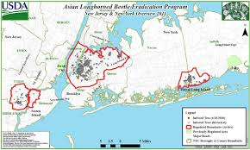
Main concern remains “Pest X”!
Standard on “Generic Elements for Contingency Plans”
Council Colloquium on Contingency Planning 2013
EPPO Inspectors Workshop – Kew, November 2014
Focus on generic elements – pest specific detail later
Encourage learning from others’ experience
Potential database of eradication expertise?

