Slide 1
International Regional Organization for Plant and Animal Health
26th Technical Consultation among
Regional Plant Protection Organizations
Antigua Guatemala, November 10th-14th, 2014

Slide 2
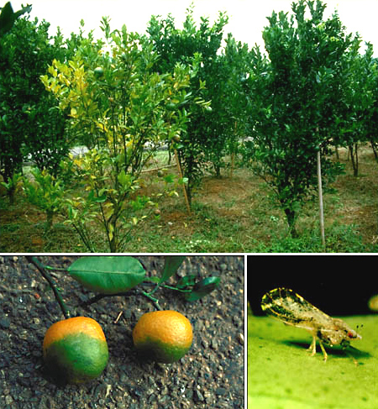
EMERGING PESTS OF CONCERN FOR OIRSA REGION
Candidatus Liberibacter asiaticus’ (HLB – citrus greening). Detected in the Dominican Republic in 2008; Belize, 2008; Mexico, 2009. OIRSA developed a Regional Phytosanitary Campaign for surveillance and control.

Slide 3
Coffee Leaf Rust Phytosanitary Program
Hemileia vastratix Berk & Br.
Epidemic phytosanitary event from Mexico down to Panama.
Significant looses in Coffee industry.
OIRSA -in coordination with IICA, CATIE, and PROMECAFE- developed a Regional Phytosanitary Program.
Coffee Leaf Rust early warning system developed.

Slide 4
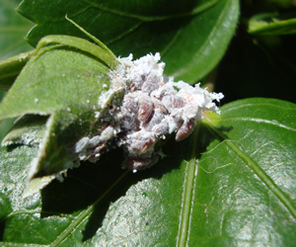
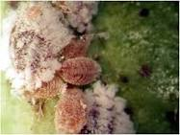
Maconellicoccus hirsutus
Spread in the OIRSA Region, currently present in Belize, Honduras, El Salvador and Costa Rica.
Restrictive to trade.
Biological control strategy:
Criptolaemus montrouzieri.
Anagyrus kamali.

Slide 5
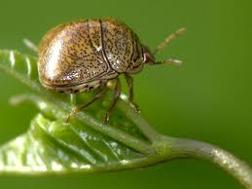
Pests pressing to gain entry to the Region
Megacopta cribraria (Fabricius 1798) (Heteroptera: Plataspidae), Kudzu bug. Distributed in Southeast Asia. Georgia (USA) in 2008, and extended to adjacent States.
Numerous interceptions in the region; live and dead insects, in many points of entry and different means of transportation.
The concern is that it may become a pest attacking legumes in Central America.

Slide 6
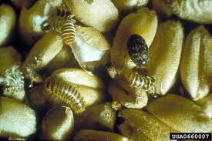
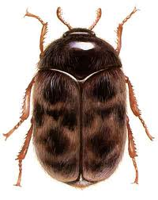
Trogoderma granarium Everts 1898, Khapra beetle
Intercepted not only dead but alive in conveyances in many points of entry to the OIRSA region.

Slide 7
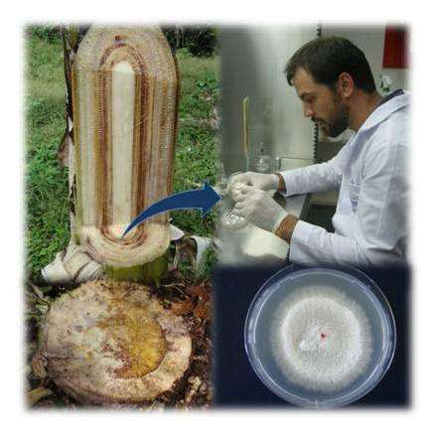
Pests considered as serious threats for the Region
Fusarium oxysporum f.sp. cubense Race 4 Tropical (FOC R4T).
Not present in America.
Cavendish, the most important variety of banana for export, is susceptible. It will have serious impact in Honduras, Costa Rica and Panama.
Phytosanitary Contingency Plan for FOC R4T
New outbreaks reported in Mozambique and Jordania.

Slide 8
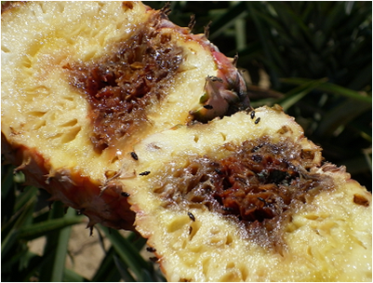
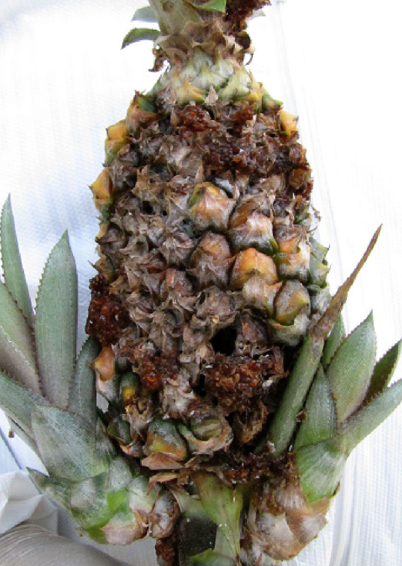
Fusarium guttiforme
Present in Brazil
Threatening the pineapple industry of Central America: Costa Rica, Honduras, Mexico and Panama.
At present there is no phytosanitary control .

Slide 9
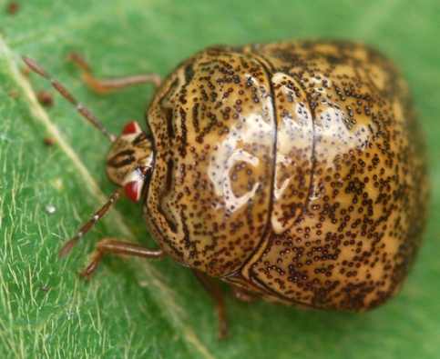
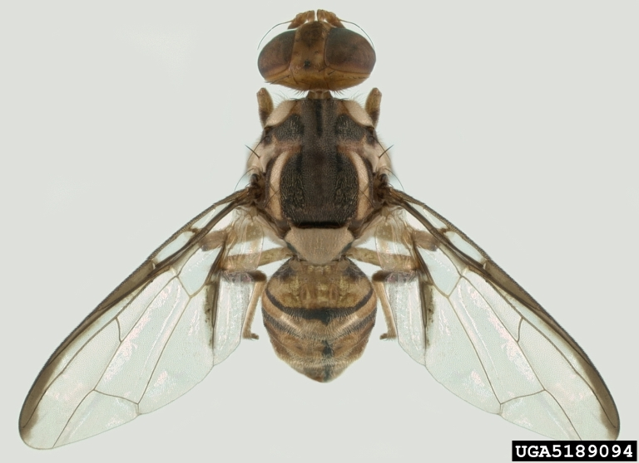
THANKS !!

